Slide 1

Canadian Bioinformatics Workshops
www.bioinformatics.ca

Slide 2

Module #: Title of Module
2

Slide 3
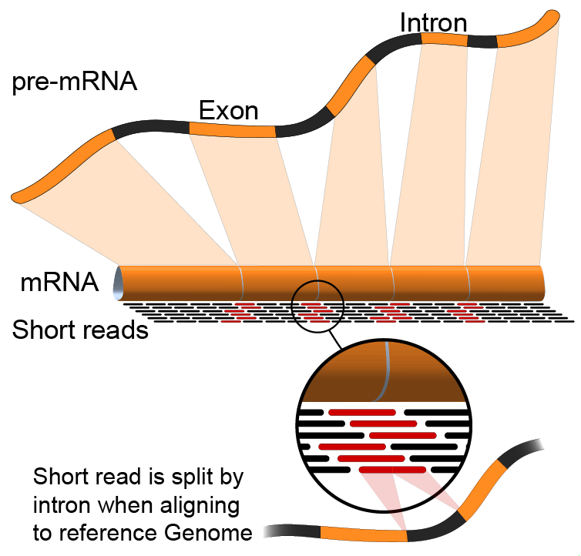
Module 3
Expression and Differential Expression (lecture)
Malachi Griffith & Obi Griffith
Informatics for RNA-seq Analysis
June 8-9, 2015

Slide 4
Learning objectives of the course
Module 0: Introduction to cloud computing
Module 1: Introduction to RNA sequencing
Module 2: RNA-seq alignment and visualization
Module 3: Expression and Differential Expression
Module 4: Isoform discovery and alternative expression
Tutorials
  Provide a working example of an RNA-seq analysis pipeline
  Run in a ‘reasonable’ amount of time with modest computer resources
  Self contained, self explanatory, portable

Slide 5
Learning Objectives of Module
Expression estimation for known genes and transcripts
‘FPKM’ expression estimates vs. ‘raw’ counts
Differential expression methods
Downstream interpretation of expression and differential estimates
  multiple testing, clustering, heatmaps, classification, pathway analysis, etc.

Slide 6
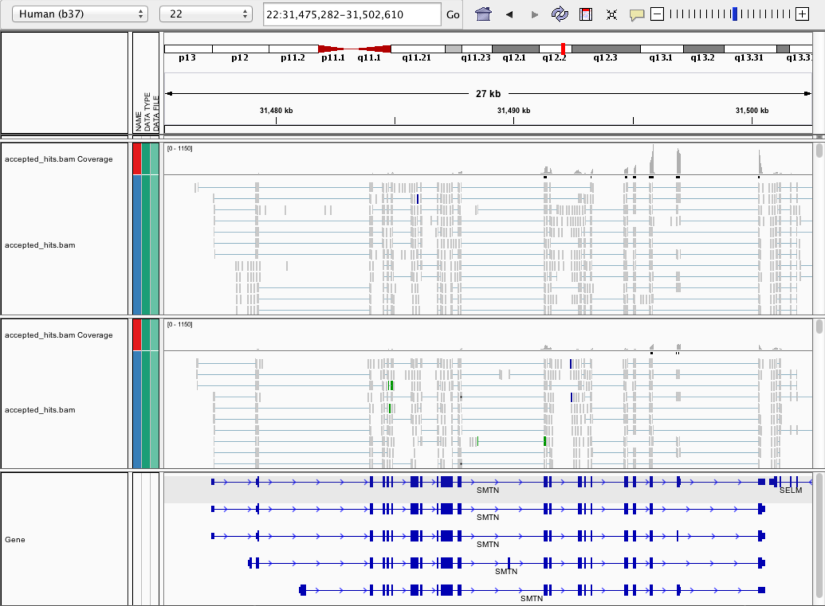
Expression estimation for known genes and transcripts
3’ bias
Down-regulated

Slide 7
What is FPKM (RPKM)
RPKM: Reads Per Kilobase of transcript per Million mapped reads.
FPKM: Fragments Per Kilobase of transcript per Million mapped reads.
In RNA-Seq, the relative expression of a transcript is proportional to the number of cDNA fragments that originate from it. However:
  The number of fragments is also biased towards larger genes
  The total number of fragments is related to total library depth
FPKM (or RPKM) attempt to normalize for gene size and library depth
RPKM (or FPKM) = (10^9 * C) / (N * L)
  C = number of mappable reads/fragments for a gene/transcript/exon/etc
  N = total number of mappable reads/fragments in the library
  L = number of base pairs in the gene/transcript/exon/etc
http://www.biostars.org/p/11378/
http://www.biostars.org/p/68126/

Slide 8
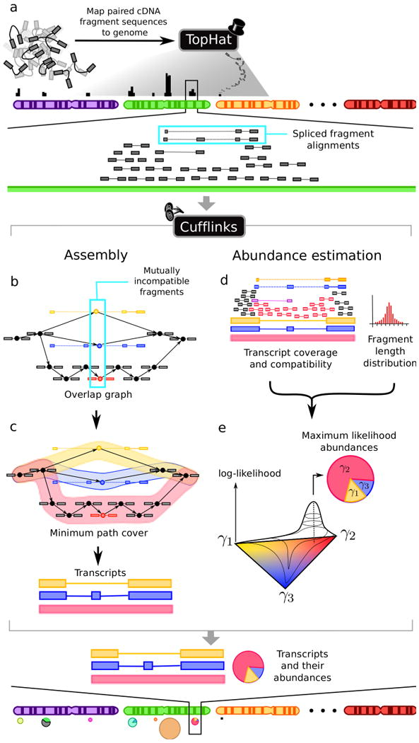
How does cufflinks work?
Overlapping 'bundles' of fragment alignments are assembled, fragments are connected in an overlap graph, transcript isoforms are inferred from the minimum paths required to cover the graph
Abundance of each isoform is estimated with a maximum likelihood probabilistic model
  makes use of information such as fragment length distribution
  http://cole-trapnell-lab.github.io/cufflinks/papers/

Slide 9
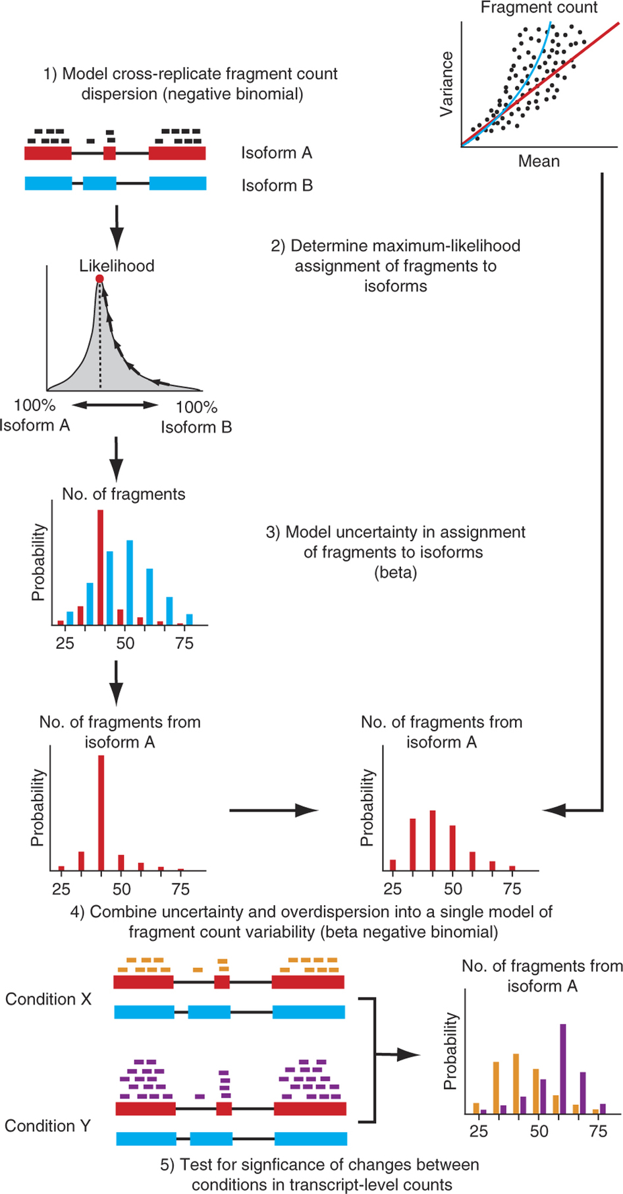
How does cuffdiff work?
The variability in fragment count for each gene across replicates is modeled.
The fragment count for each isoform is estimated in each replicate (as before), along with a measure of uncertainty in this estimate arising from ambiguously mapped reads
  transcripts with more shared exons and few uniquely assigned fragments will have greater uncertainty
The algorithm combines estimates of uncertainty and cross-replicate variability under a beta negative binomial model of fragment count variability to estimate count variances for each transcript in each library
These variance estimates are used during statistical testing to report significantly differentially expressed genes and transcripts.

Slide 10
Why is cuffmerge necessary?
Cuffmerge
  Allows merge of several Cufflinks assemblies together
    Necessary because even with replicates cufflinks will not necessarily assemble the same numbers and structures of transcripts
  Filters a number of transfrags that are probably artifacts.
  Optional: provide reference GTF to merge novel isoforms and known isoforms and maximize overall assembly quality.
  Make an assembly GTF file suitable for use with Cuffdiff
    Compare apples to apples

Slide 11
What do we get from cummeRbund?
Automatically generates many of the commonly used data visualizations
Distribution plots
Overall correlations plots
MA plots
Volcano plots
Clustering, PCA and MDS plots to assess global relationships between conditions
Heatmaps
Gene/transcript-level plots showing transcript structures and expression levels

Slide 12
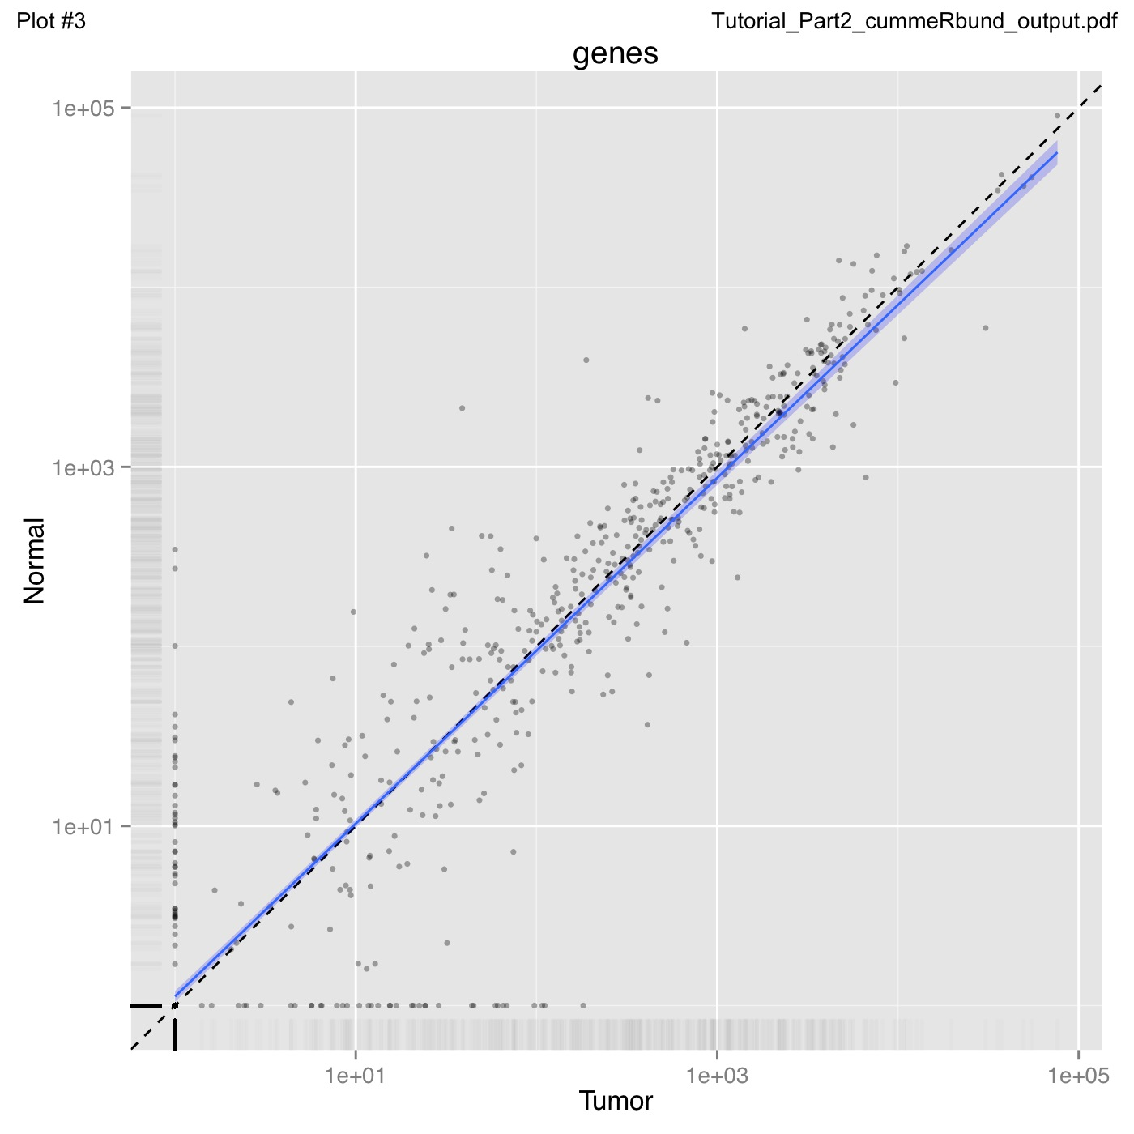
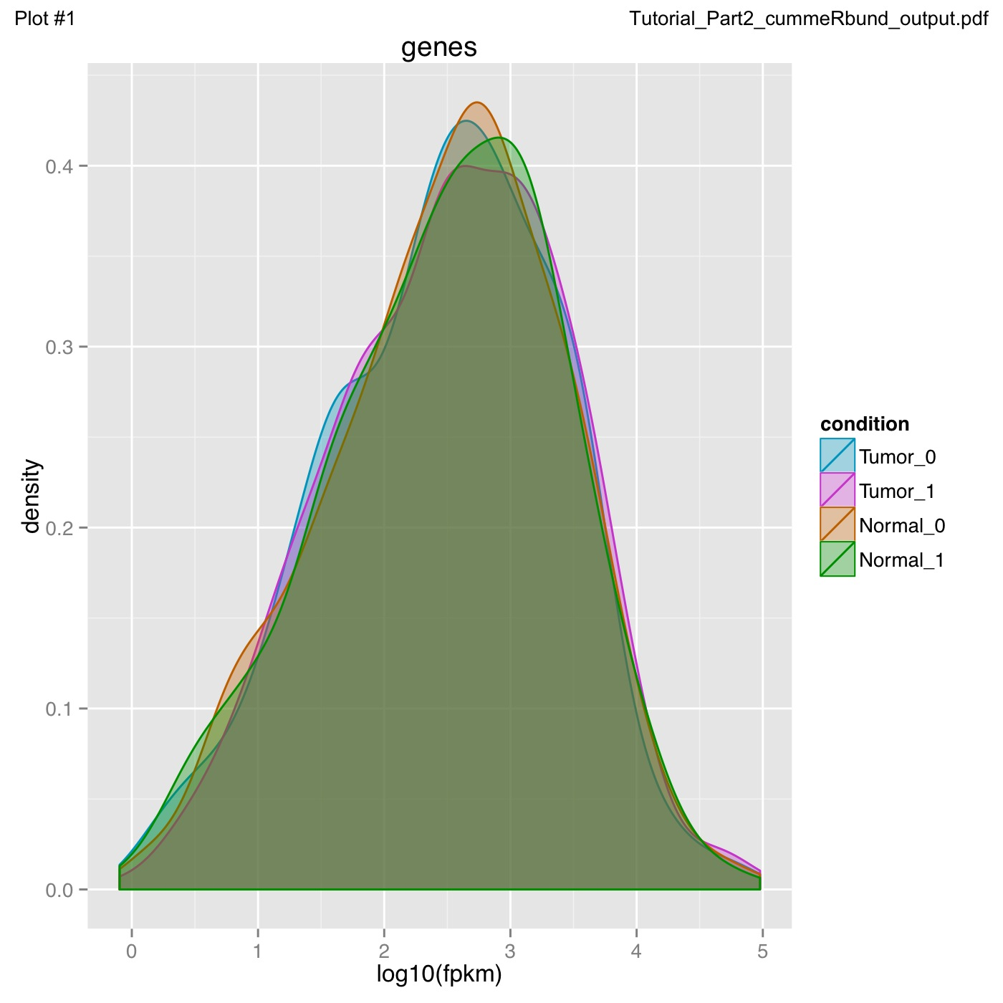
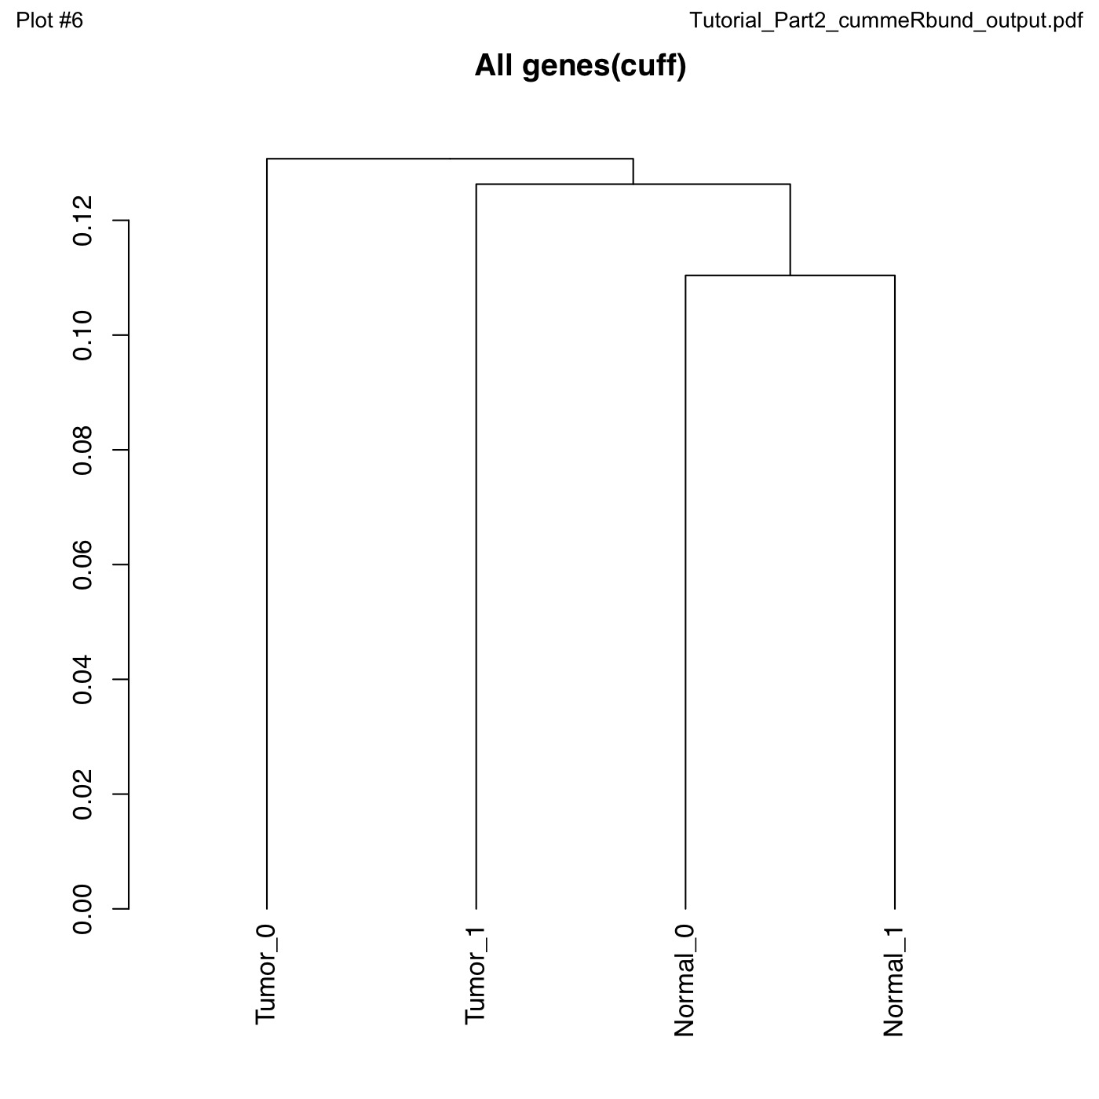
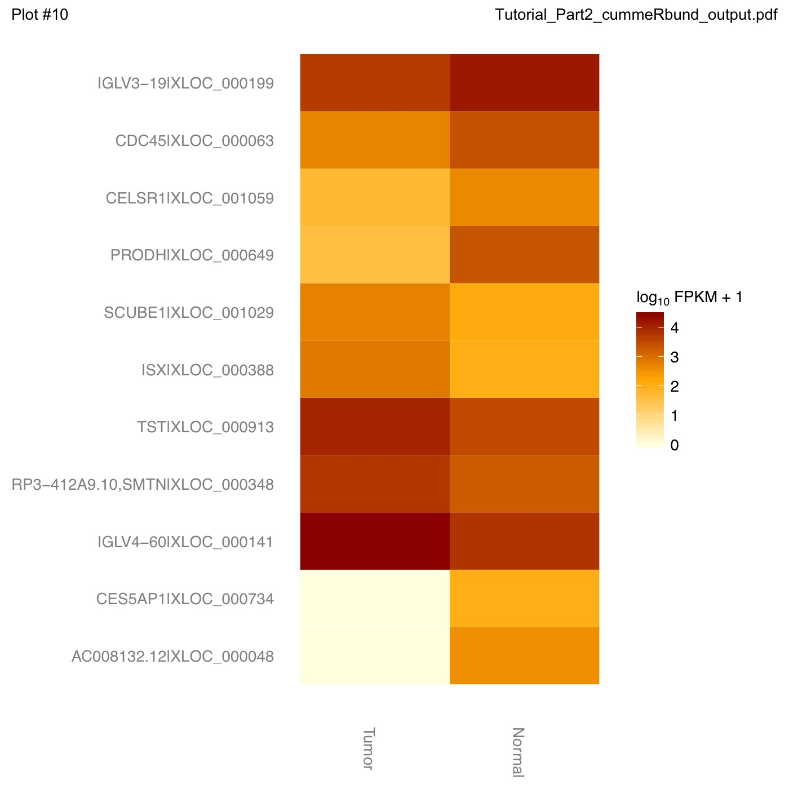
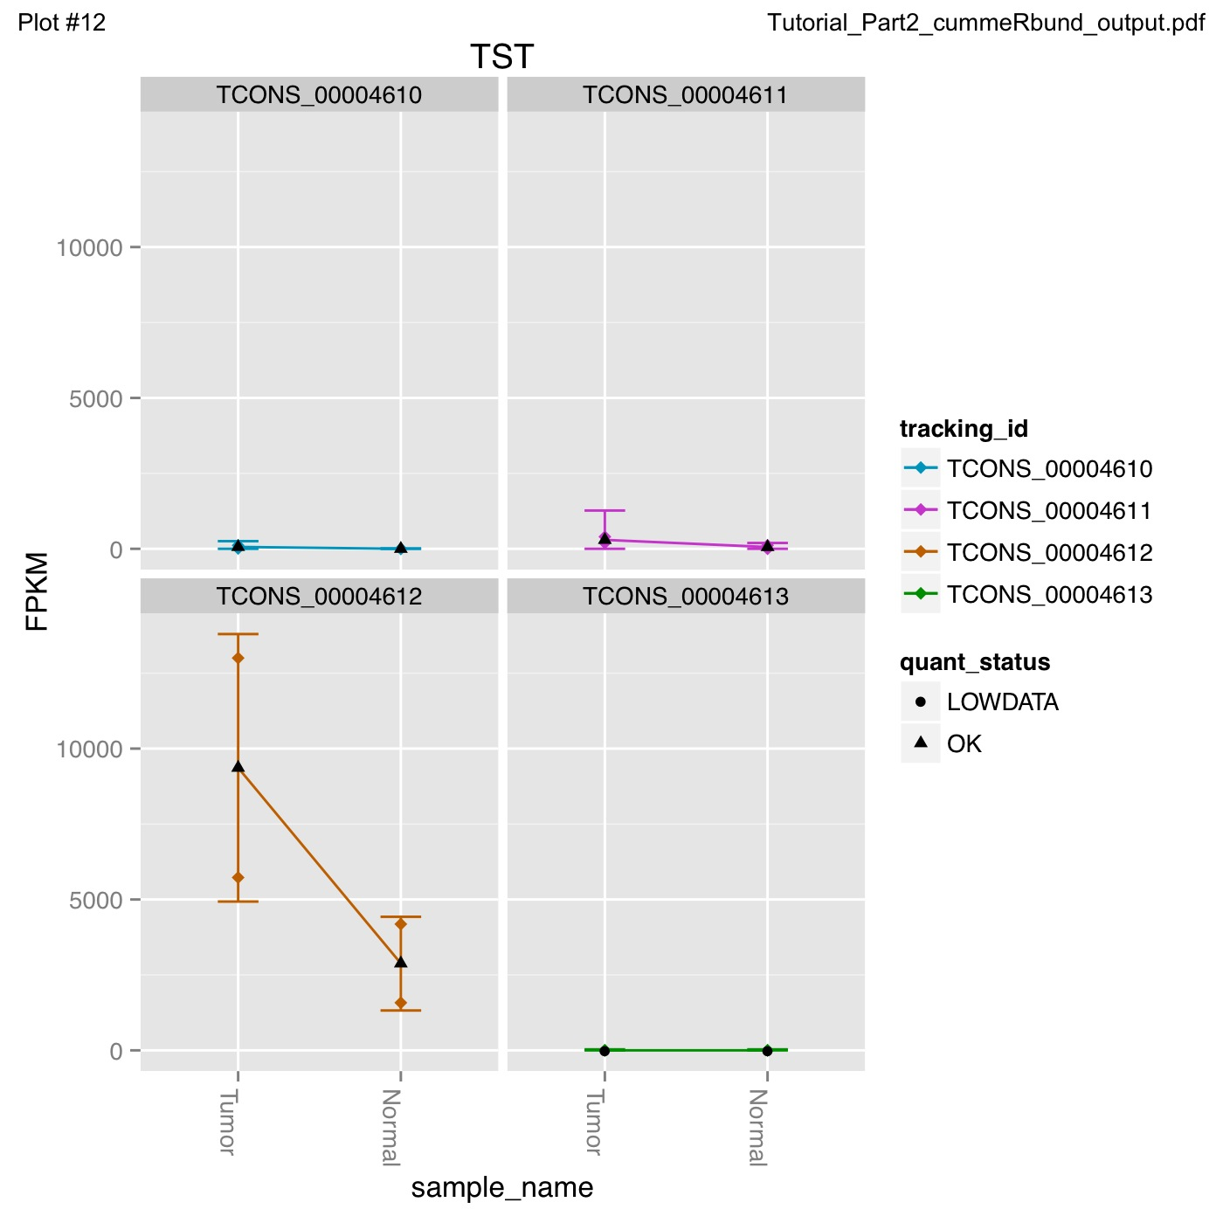
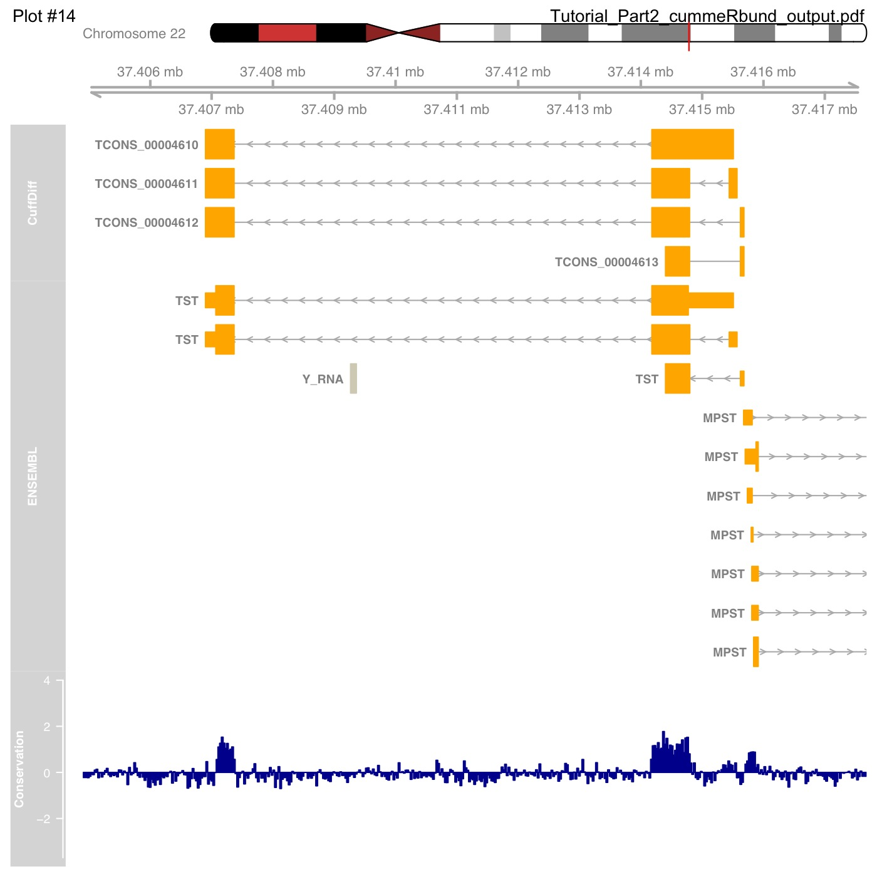
What do we get from cummeRbund?

Slide 13
Alternatives to FPKM
Raw read counts as an alternate for differential expression analysis
  Instead of calculating FPKM, simply assign reads/fragments to a defined set of genes/transcripts and determine “raw counts”
    Transcript structures could still be defined by something like cufflinks
HTSeq (htseq-count)
  http://www-huber.embl.de/users/anders/HTSeq/doc/count.html
  htseq-count --mode intersection-strict --stranded no --minaqual 1 --type exon --idattr transcript_id accepted_hits.sam chr22.gff > transcript_read_counts_table.tsv
  Important caveat of ‘transcript’ analysis by htseq-count:
    http://seqanswers.com/forums/showthread.php?t=18068

Slide 14
‘FPKM’ expression estimates vs. ‘raw’ counts
Which should I use?
FPKM
  When you want to leverage benefits of tuxedo suite
  Good for visualization (e.g., heatmaps)
  Calculating fold changes, etc.
Counts
  More robust statistical methods for differential expression
  Accommodates more sophisticated experimental designs with appropriate statistical tests

Slide 15
Alternative differential expression methods
Raw count approaches
  DESeq - http://www-huber.embl.de/users/anders/DESeq/
  edgeR - http://www.bioconductor.org/packages/release/bioc/html/edgeR.html
  Others…

Slide 16
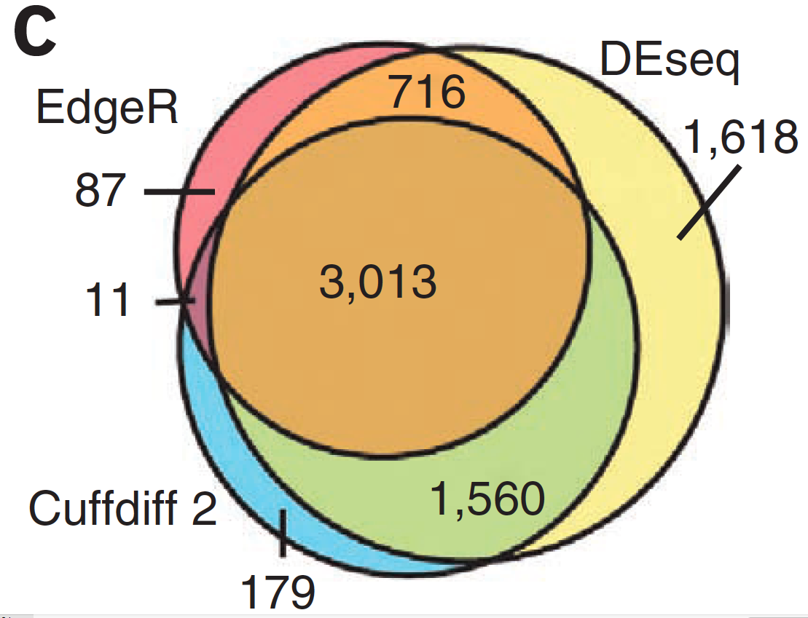
Multiple approaches advisable

Slide 17
Lessons learned from microarray days
Hansen et al. “Sequencing Technology Does Not Eliminate Biological Variability.” Nature Biotechnology 29, no. 7 (2011): 572–573.
Power analysis for RNA-seq experiments
  http://euler.bc.edu/marthlab/scotty/scotty.php
RNA-seq need for biological replicates
  http://www.biostars.org/p/1161/
RNA-seq study design
  http://www.biostars.org/p/68885/

Slide 18
Multiple testing correction
As more attributes are compared, it becomes more likely that the treatment and control groups will appear to differ on at least one attribute by random chance alone.
Well known from array studies
  10,000s genes/transcripts
  100,000s exons
  With RNA-seq, more of a problem than ever
  All the complexity of the transcriptome
  Almost infinite number of potential features
    Genes, transcripts, exons, juntions, retained introns, microRNAs, lncRNAs, etc, etc
Bioconductor multtest
  http://www.bioconductor.org/packages/release/bioc/html/multtest.html

Slide 19
Downstream interpretation of expression analysis
Topic for an entire course
Expression estimates and differential expression lists from cufflinks/cuffdiff (or alternative) can be fed into many analysis pipelines
See supplemental R tutorial for how to format cufflinks data and start manipulating in R
Clustering/Heatmaps
  Provided by cummeRbund
  For more customized analysis various R packages exist:
    hclust, heatmap.2, plotrix, ggplot2, etc.
Classification
  For RNA-seq data we still rarely have sufficient sample size and clinical details but this is changing
    Weka is a good learning tool
    RandomForests R package (biostar tutorial being developed)
Pathway analysis
  IPA
  Cytoscape
  Many R/BioConductor packages: http://www.bioconductor.org/help/search/index.html?q=pathway

Slide 20
Introduction to tutorial
(Module 3)

Slide 21
Bowtie/Tophat/Cufflinks/Cuffdiff
RNA-seq Pipeline
Sequencing
Read alignment
Transcript compilation
Gene identification
Differential expression
RNA-seq reads (2 x 100 bp)
Bowtie/TopHat alignment (genome)
Cufflinks
Cufflinks (cuffmerge)
Cuffdiff
(A:B comparison)
Raw sequence data
(.fastq files)
Reference genome
(.fa file)
Gene annotation
(.gtf file)
CummRbund
Inputs
Visualization
Module 3

Slide 22
We are on a Coffee Break & Networking Session

