Slide 1

Canadian Bioinformatics Workshops
www.bioinformatics.ca

Slide 2
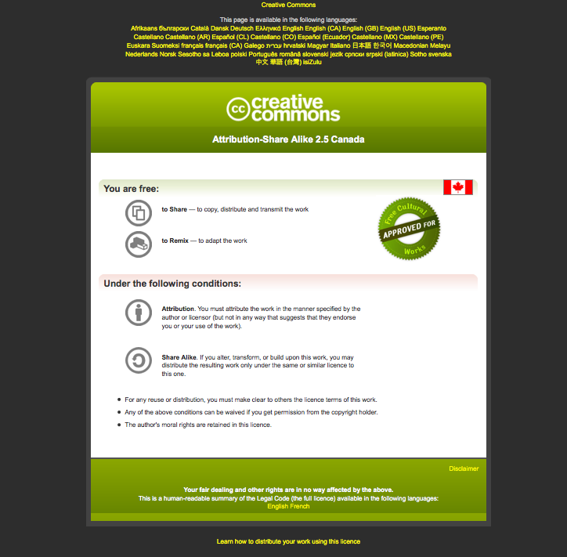
Module #: Title of Module
2

Slide 3
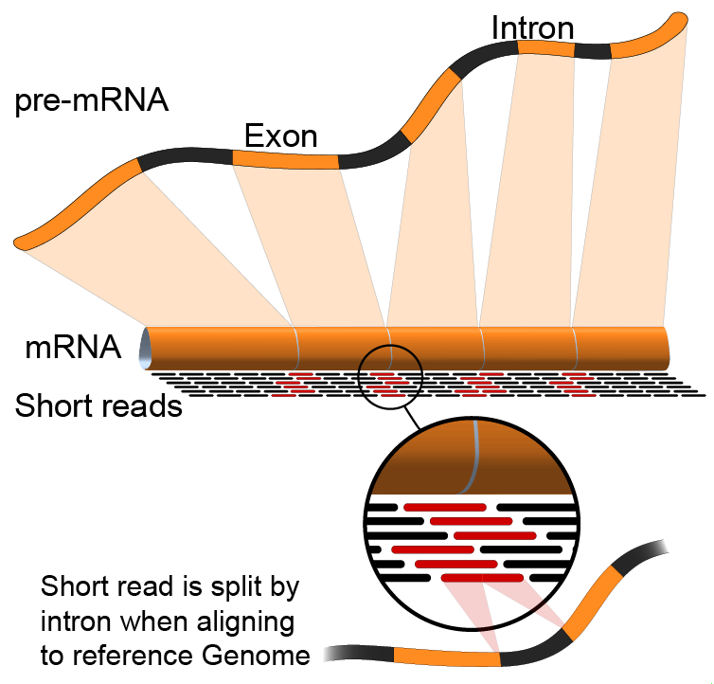

Introduction to Genome Analysis Platforms
Malachi Griffith, Obi Griffith, Jason Walker
Informatics for RNA-seq analysis
June 16 - 17, 2016

Slide 4
What is a genome analysis ‘platform’?
Means different things to different people…
  Lost of jargon and buzzwords
Hardware
  e.g. ‘Dell Genomic Data Analysis Platform’
Pipelines
Cloud computing
  ‘Private clouds’
  ‘Public clouds’ - Amazon AWS, Google Cloud, digital ocean, etc.
Virtualization and virtual machines
  VirtualBox (vagrant), OpenStack, VMWare
Workflow management systems
Software development kits (SDKs)
Application programming interfaces (APIs)
Distributed storage and processing (e.g. ‘Hadoop’)
Job schedulers. e.g. pbs, lsf, sge, openlava,

Slide 5
List of existing genome analysis platforms
https://docs.google.com/spreadsheets/d/1o8iYwYUy0V7IECmu21Und3XALwQihioj23WGv-w0itk/pubhtml
Genome Modeling System (GMS), Galaxy, bcbio-nextgen, Omics Pipe, Illumina BaseSpace, BINA Genomic Analysis System, SeqWare, DNA Nexus Platform, gkno, NGSANE, Appistry's Ayrris, GATK's Queue, Curoverse's Arvados, CGA's Firehose, Seven Bridges Genomics, MIT STAR, GenomOncology, ga4gh, IBM's PowerGene Orchestrator, etc.

Slide 6
What is a job scheduler?
A job scheduler is a computer application for controlling unattended background program execution (commonly called batch processing).
For example, in genomics data processing, a researcher might use a job scheduler to submit 100 tophat alignment jobs to a cluster of computers at their institute’s data center
Notes:
http://en.wikipedia.org/wiki/Job_scheduler

Slide 7
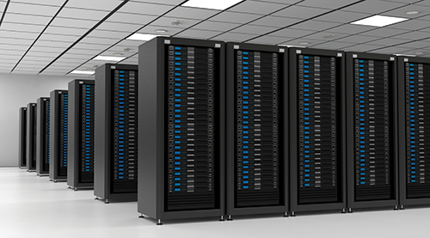
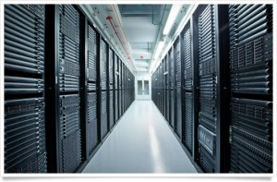
What is cloud computing?
The practice of using a network of remote servers hosted on the Internet to store, manage, and process data, rather than a local server or a personal computer.
For example, instead of using a local server or buying 25 computers with 8 CPU’s each, 70Gg of RAM, etc. for the RNA-seq course we rented these computers on the Amazon ‘Cloud’. All analysis for the course actually happened at a massive data center in Northern Virginia
Notes:
http://en.wikipedia.org/wiki/Cloud_computing

Slide 8
What is a virtual machine?
A virtual machine (VM) is an operating system OS or application environment that is installed on software which imitates dedicated hardware. The end user has the same experience on a virtual machine as they would have on dedicated hardware.
In the context of genome analysis pipelines a virtual machine may sometimes be used to allow researchers to share and distribute very complex computing environments (may dependencies) that are difficult to set up.
Notes:
http://en.wikipedia.org/wiki/Virtual_machine

Slide 9
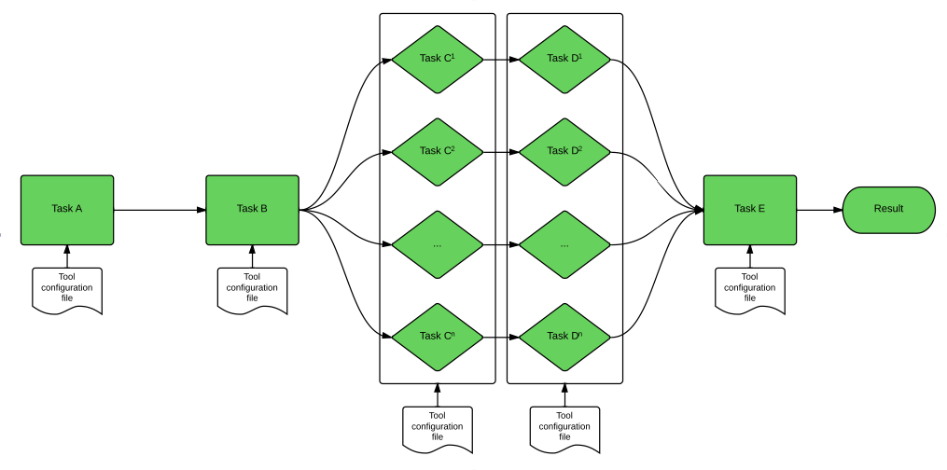
What is a workflow management system?
A workflow management system (WfMS) is a software system for the execution of a defined sequence of tasks, arranged as a workflow.
For example, the RNA-seq analysis has many steps with interconnected dependencies
  TopHat alignment of several lanes of data needs to happens before they can all be merged into a final BAM file, and merging needs to happen before indexing of the BAM, and so on.
  Some steps can happen in parallel, other in series. Workflow systems help handle these dependencies
Notes:
http://en.wikipedia.org/wiki/Workflow_management_system

Slide 10
What is a software development kit (SDK)?
A software development kit (SDK) is a set of software development tools that facilitates the creation of applications for a certain software framework
E.g. DNA Nexus Platforms provides software development kit with support for several programming languages to help you build pipelines efficiently in their system
Notes:
http://en.wikipedia.org/wiki/Software_development_kit

Slide 11
What is an application programming interface (API)
An API is a set of routines, protocols, and tools for building software applications. An API expresses a software component in terms of its operations, inputs, outputs, and underlying types. An API defines functionalities that are independent of their respective implementations, which allows definitions and implementations to vary without compromising each other.
Notes:
http://en.wikipedia.org/wiki/Application_programming_interface

Slide 12
What is distributed storage and processing (e.g. ‘Hadoop’)?
Hadoop is an open-source software framework for distributed storage and distributed processing of Big Data on clusters of commodity hardware. Its Hadoop Distributed File System (HDFS) splits files into large blocks and distributes the blocks amongst the nodes in the cluster. For processing the data, the Hadoop Map/Reduce moves code (software) to the nodes that have the required data, and the nodes then process the data in parallel. This approach takes advantage of data locality, in contrast to conventional HPC architecture which usually relies on a parallel file system (compute and data separated, but connected with high-speed networking).
Notes:
http://en.wikipedia.org/wiki/Apache_Hadoop

Slide 13
Examples
Assuming you have some NGS data, how should you analyze it?
Depends where you are on the informatics spectrum. Do you want to:
  Build a completely novel process, a custom pipeline, develop algorithms, write software, etc.
    Maximum flexibility. Performance and scalability are determined by how well you engineer it.
  Build on top of someone else genome analysis platform
    Don’t have to start from scratch but still have a lot of flexibility.
    e.g. GMS, Arvados, DNA Nexus, bcbio-nextgen, Gkno, etc.
  Upload data in web browser, use graphical user interface
    Sacrifices flexibility for ease of use
    Galaxy, Illumina BaseSpace
  Have someone do the analysis for you and give you the results

Slide 14
Companies whose platforms amount to bioinformatics for hire…
Appistry's Ayrris
Seven Bridges Genomics
GenomOncology
IBM's PowerGene Orchestrator
BINA Genomic Analysis System
  Sort of. They provide a pre-configured hardware + software solution, help you install it and connect it to your in house data production
Etc.

Slide 15
Galaxy
http://galaxyproject.org/
Open Source academic project.
Example RNA-seq workflow
  https://usegalaxy.org/u/mwolfien/w/rnaseq-wolfien-pipeline
A web based interface that allows you to run existing workflows or create custom analyses by combining tools in the Galaxy ‘toolshed’

Slide 16
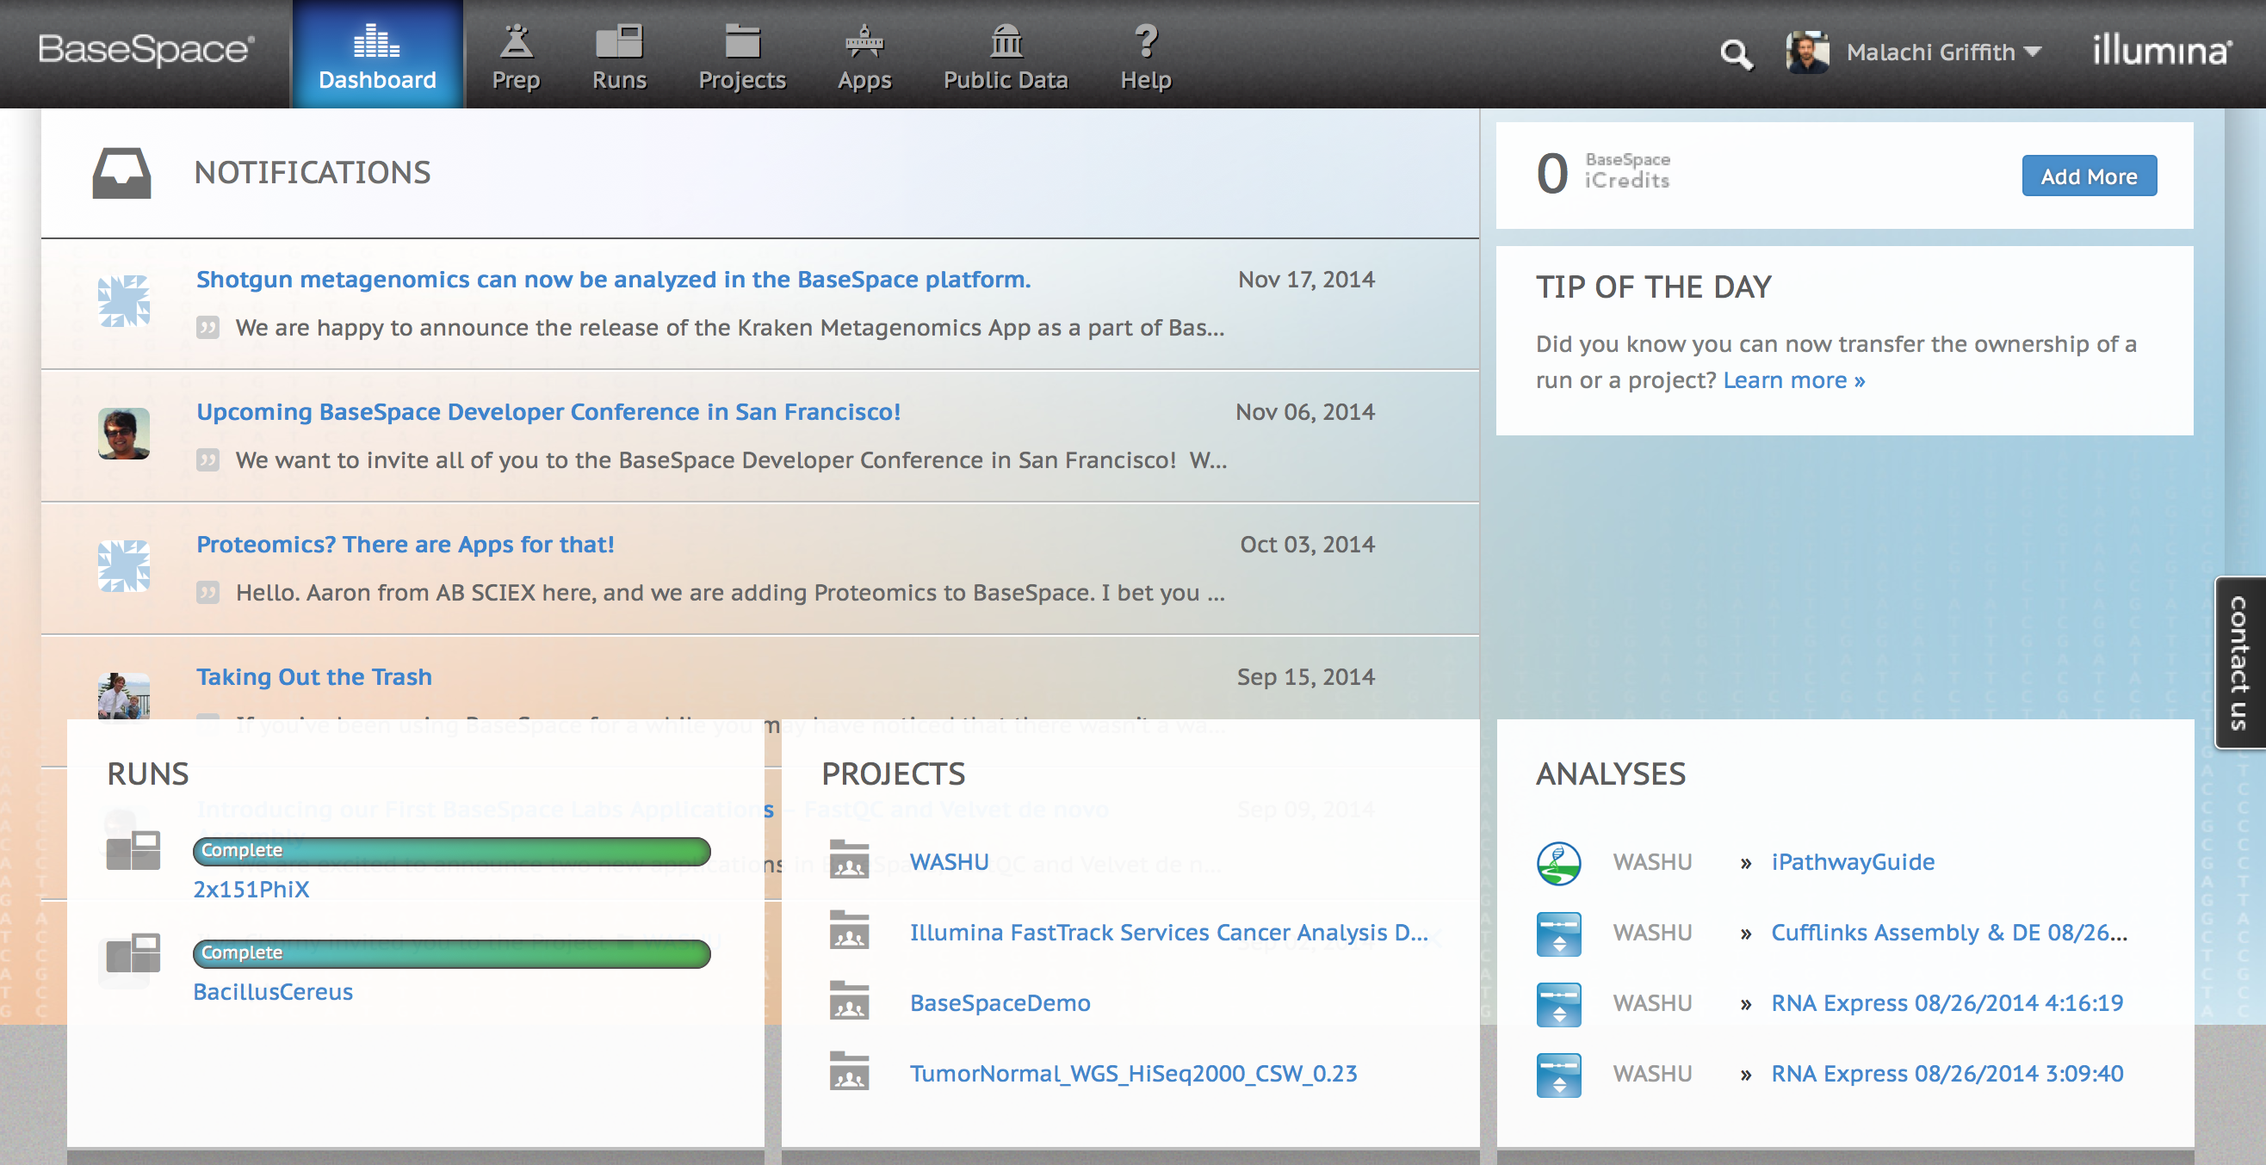
Illumina BaseSpace
Use integrated ‘apps’ and automated pipelines.
Graphical interface
https://basespace.illumina.com

Slide 17
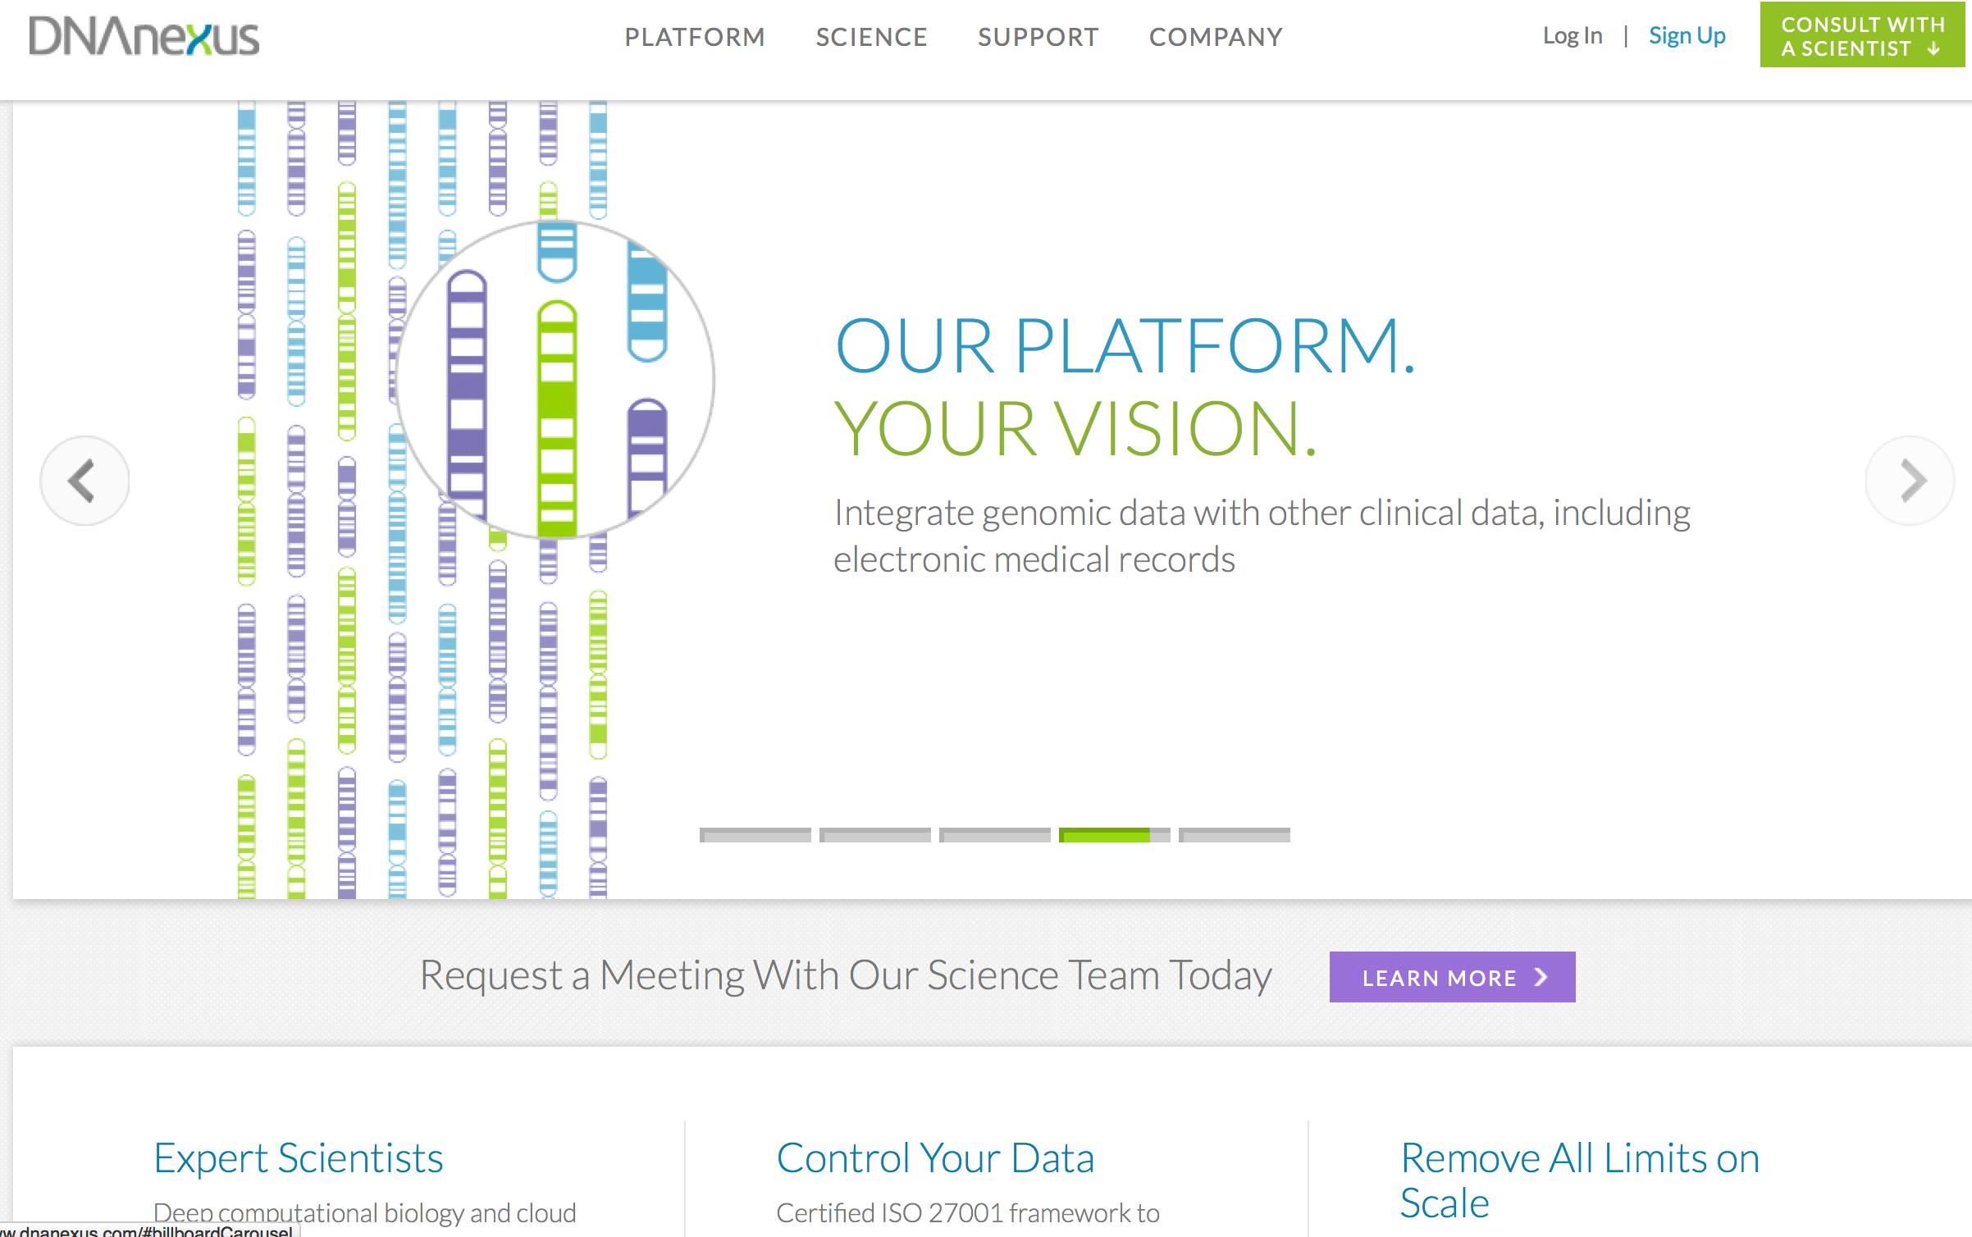
DNA Nexus Platform
Build your own pipeline or use an existing one
DNA Nexus handles cloud deployment, etc. for you
https://www.dnanexus.com/

Slide 18
Other pipeline development platforms to build on top of
Gkno
  http://gkno.me/
Genome Modeling System (GMS)
  https://github.com/genome/gms
Arvados
  https://arvados.org/
Bcbio-nextgen
  https://bcbio-nextgen.readthedocs.org/en/latest/
OmicsPipe
  http://sulab.org/tools/omics-pipe/
NGSANE
  https://github.com/BauerLab/ngsane

Slide 19
The Global Alliance for Genomics Health (ga4gh)
An international coalition, formed to enable the sharing of genomic and clinical data.
Work on data models and APIs for Genomic data.
Not yet entirely clear what is available to be used by end users beyond the ‘beacon’ project:
http://genomicsandhealth.org/
http://ga4gh.org/#/
https://github.com/ga4gh
  http://ga4gh.org/#/beacon

Slide 20
We are on a Coffee Break & Networking Session

