Slide 1

Canadian Bioinformatics Workshops
www.bioinformatics.ca

Slide 2

Module #: Title of Module
2

Slide 3
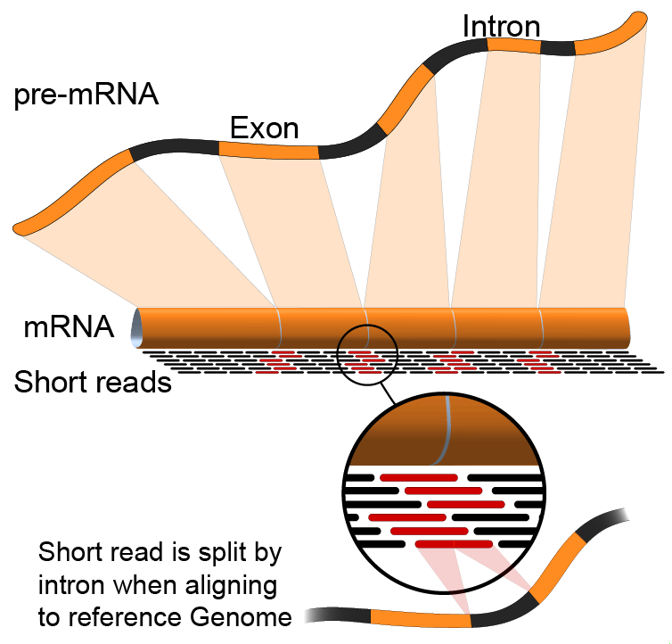
RNA-Seq Module 3
Expression and Differential Expression (tutorial)
Malachi Griffith, Obi Griffith, Fouad Yousif
Informatics for RNA-seq Analysis
June 16 - 17, 2016

Slide 4
Learning Objectives of Tutorial
Generate gene/transcript expression estimates with cufflinks
Perform differential expression analysis with cuffmerge and cuffdiff
Summarize and visualize results
  cummeRbund
  Old school R methods

Slide 5
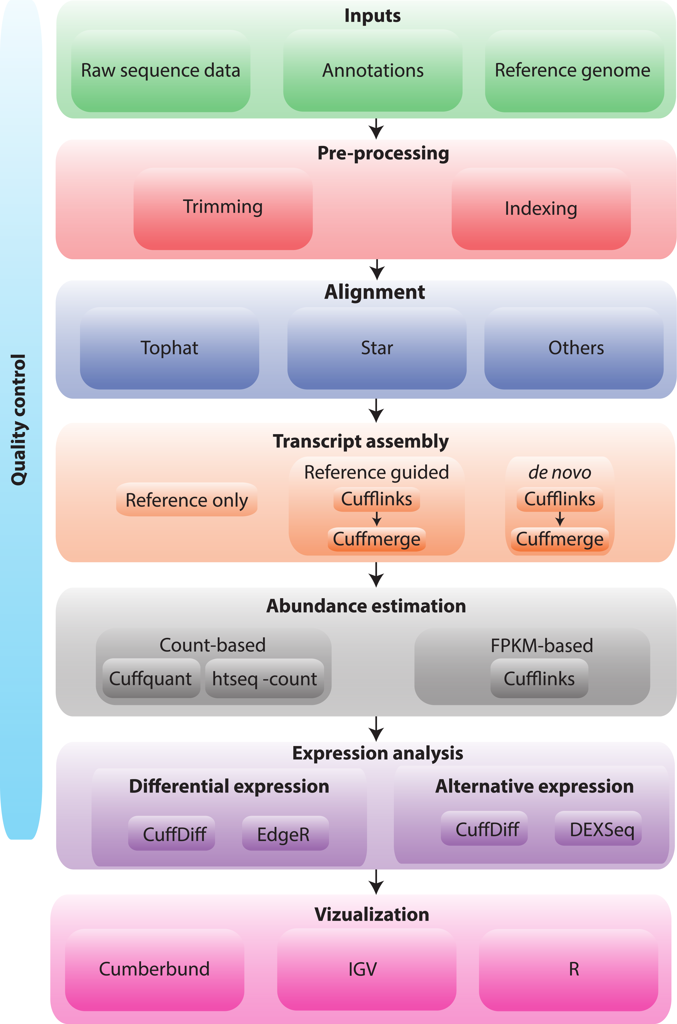
RNA-seq Analysis Flow Chart

Slide 6
4-i. Generate expression estimates
The alignment SAM/BAM files generated in the previous step will now be used by cufflinks to calculate expression estimates
  For all transcripts on the target chromosome
For this step an option, confusingly also called ‘-G’ is used
  Forces cufflinks to calculate expression values for known transcripts
  To discover novel transcripts with Cufflinks you should:
    Not use the '-G' option. De novo transcript assembly and estimation will be performed. (we will try this in Module 4) OR ...
    Use the '-g' option. Known transcripts will be used as a ‘guide’, but novel transcripts will also be predicted.
This step will generate one isoform and one gene expression file for each library
  Expression values are reported as ‘FPKM’, or ‘Fragments Per Kilobase of exon per million fragments Mapped’
  Where each ‘fragment’ corresponds to a read-pair mapped to the genome
Notes:
Consequtive basepairs

Slide 7
4-i. Generate expression estimates (Optional Alternatives)
The Alignment SAM/BAM files generated from STAR can also be used in cufflinks to generate expression estimates – exactly as above
Another alternative we will explore is a count-based method
  We will use a program called htseq-count
    Requires name-sorted SAM file
    We will count at the gene level (transcript-level is also possible)
In the end we will have three expression estimates for each sample
  Tophat/cufflinks
  STAR/cufflinks
  Tophat/Htseq-count
Notes:
Consequtive basepairs

Slide 8
4-ii. Perform differential expression analysis
In this step we will use cuffmerge and cuffdiff to:
  Combine expression estimates from our 6 libraries into more convenient files
  Combine expression estimates across replicates
  Compare UHR vs. HBR and identify significantly differentially expressed genes and isoforms (transcripts)
Note that these commands can get quite complicated when you have replicates
  The positioning of spaces and commas, and grouping of libraries matters!
Comparisons
  Compare UHR vs. HBR using all replicates, for known (reference only mode) transcripts

Slide 9
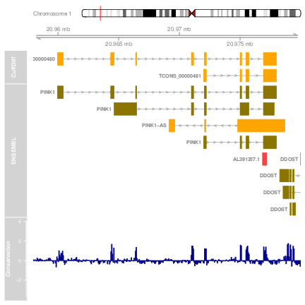
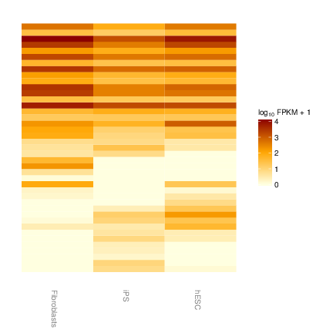
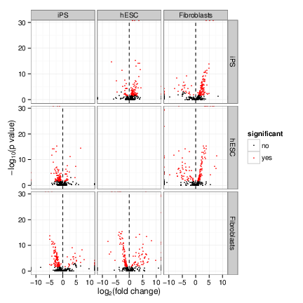
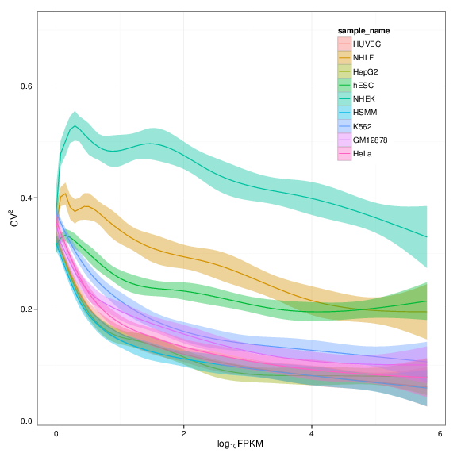
4-iii. Summarize and visualize results
In this step we will run the R package cummeRbund to visualize our expression and differential expression results from Cuffdiff.
  See online tutorial for details
  http://compbio.mit.edu/cummeRbund/
  http://compbio.mit.edu/cummeRbund/manual_2_0.html

Slide 10
Post-process output files (optional)
Cufflinks and Cuffdiff output various file formats
  .fpkm_tracking, transcrips.gtf, and .diff files
In this step, we will explore the content of these files at the linux command line before importing them into R for more advanced summarization, plotting, etc.
  If you are unfamiliar with R, this is an interactive statistical programming interface that can also be used for graphing and file data manipulation (i.e. an alternative to ‘excel’)
  http://cran.r-project.org/

Slide 11
Summarize and visualize results
(optional)
In this step we will use R to summarize and visualize the results of the previous steps
  Explanation of the R commands is provided in the online wiki
Examples of the tasks performed:
  Examine the expression estimates
    How reproducible are the technical replicates?
    How well do the different library construction methods correlate?
    Visualize the differences between/among replicates, library prep methods and tumor versus normal
  Examine the differential expression estimates
    Visualize the expression estimates and highlight those genes that appear to be differentially expressed according to cuffdiff
    Generate a list of the top differentially expressed genes

Slide 12
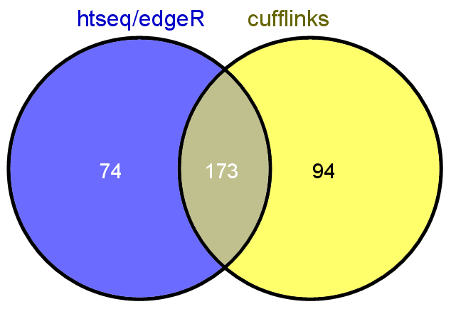
Perform differential expression analysis with edgeR using htseq output (optional)
Make use of raw counts generated by htseq-count
Load into R and process with edgeR package
Compare significantly differentially expressed genes from two methods

Slide 13
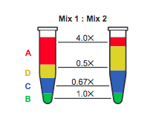
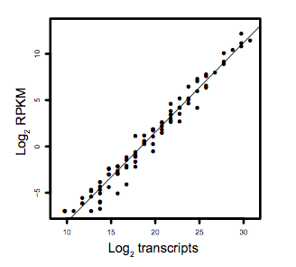
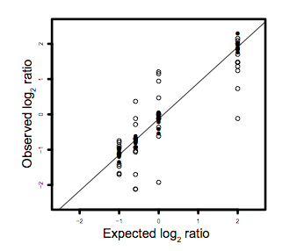
Analysis of ERCC spike-in expression and differential expression (optional)
https://tools.lifetechnologies.com/content/sfs/manuals/cms_086340.pdf
Lower Limit of Detection
Dynamic Range (dose response)
Fold-change response (DE)

Slide 14
We are on a Coffee Break & Networking Session

