Slide 1

Canadian Bioinformatics Workshops
www.bioinformatics.ca

Slide 2
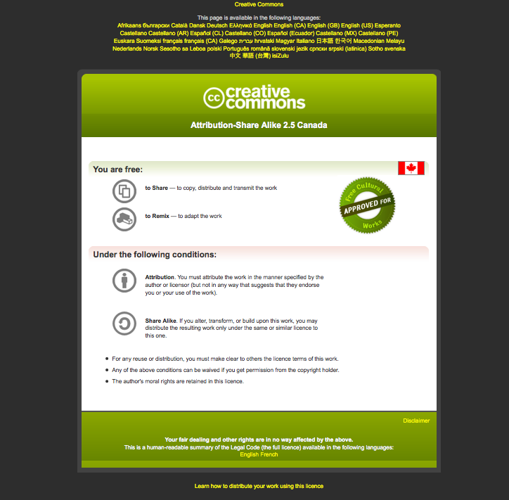
Module #: Title of Module
2

Slide 3
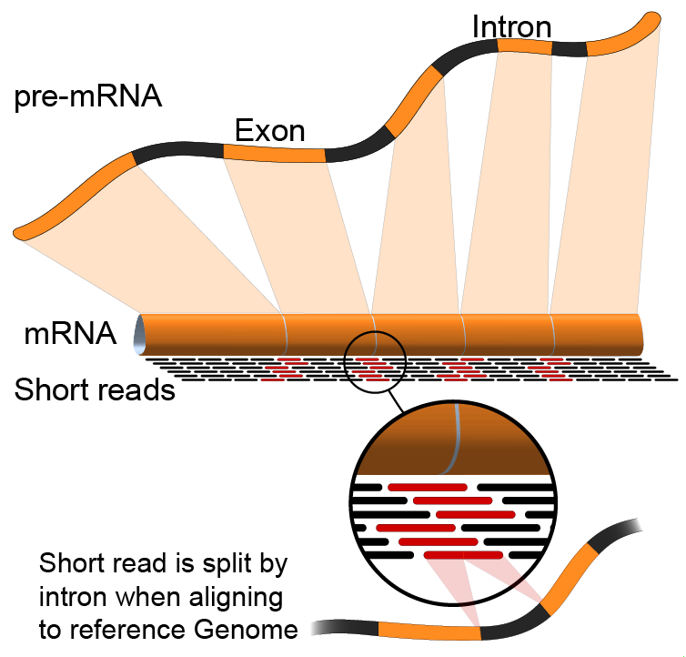
RNA-Seq Module 4
Isoform Discovery and Alternative Expression (lecture)
Malachi Griffith, Obi Griffith, Fouad Yousif
Informatics for RNA-seq Analysis
June 16 - 17, 2016

Slide 4
Learning objectives of the course
Module 0: Introduction to cloud computing
Module 1: Introduction to RNA Sequencing
Module 2: Alignment and Visualization
Module 3: Expression and Differential Expression
Module 4: Isoform Discovery and Alternative Expression
Tutorials
  Provide a working example of an RNA-seq analysis pipeline
  Run in a ‘reasonable’ amount of time with modest computer resources
  Self contained, self explanatory, portable

Slide 5
Learning objectives of module 4
Explore use of Cufflinks in reference annotation based transcript (RABT) assembly mode and ‘de novo’ assembly mode.
  Both modes require a reference genome sequence...

Slide 6
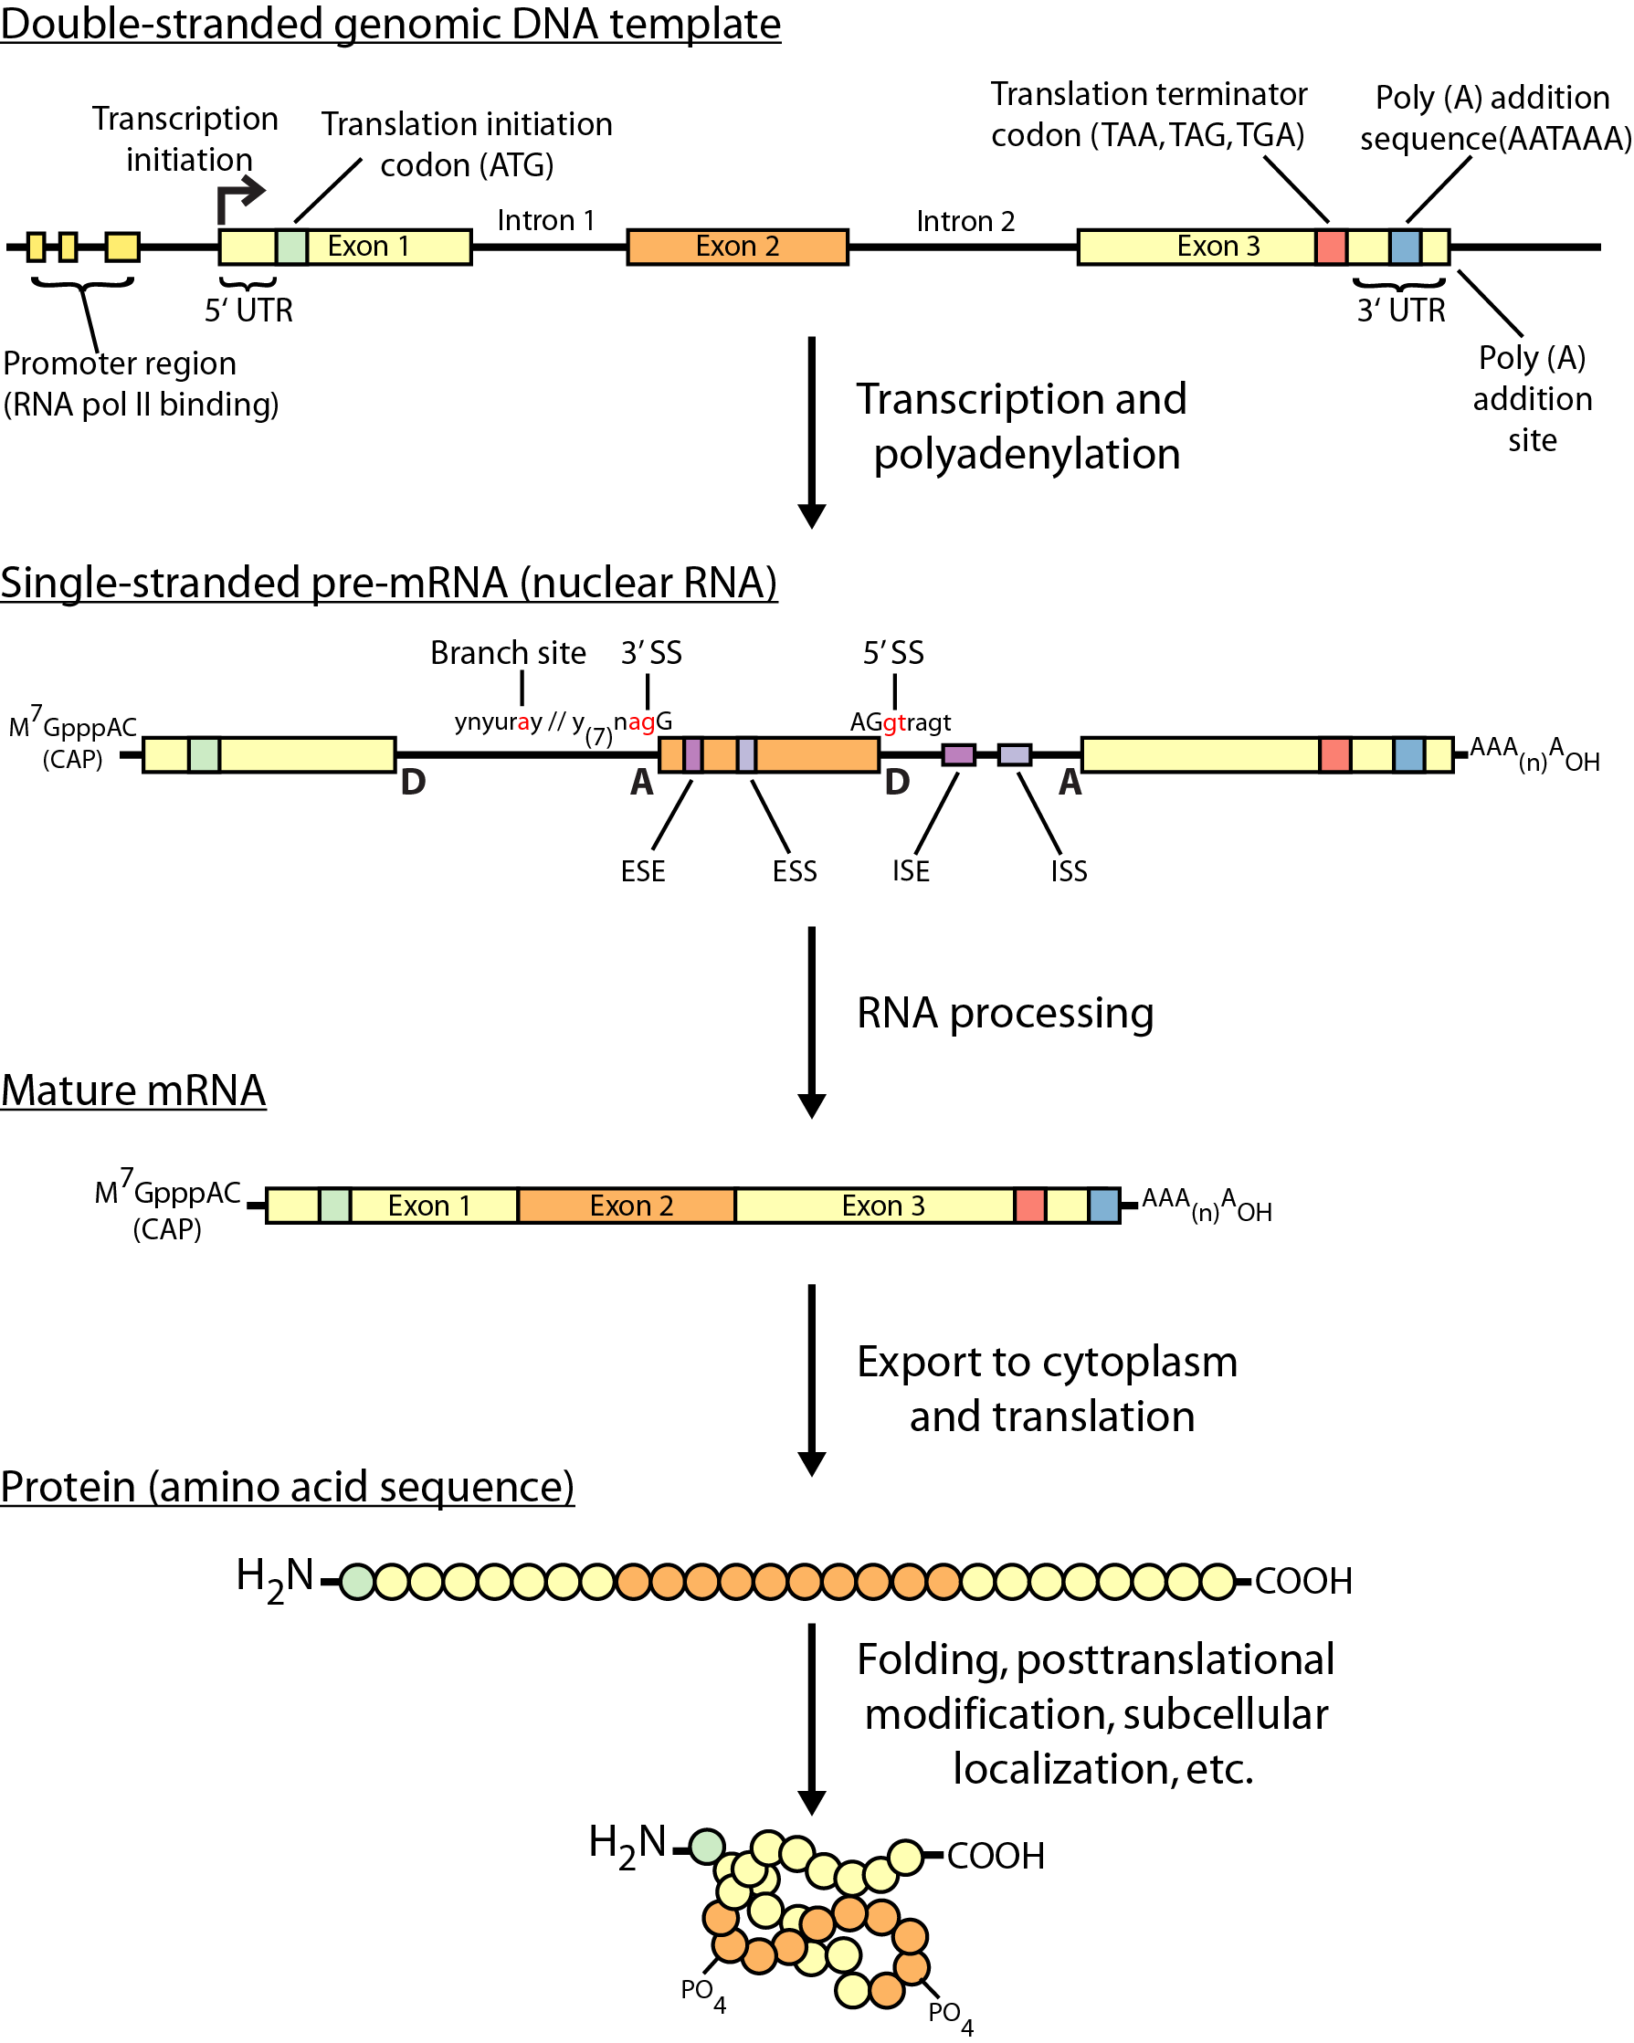
Review of gene expression

Slide 7
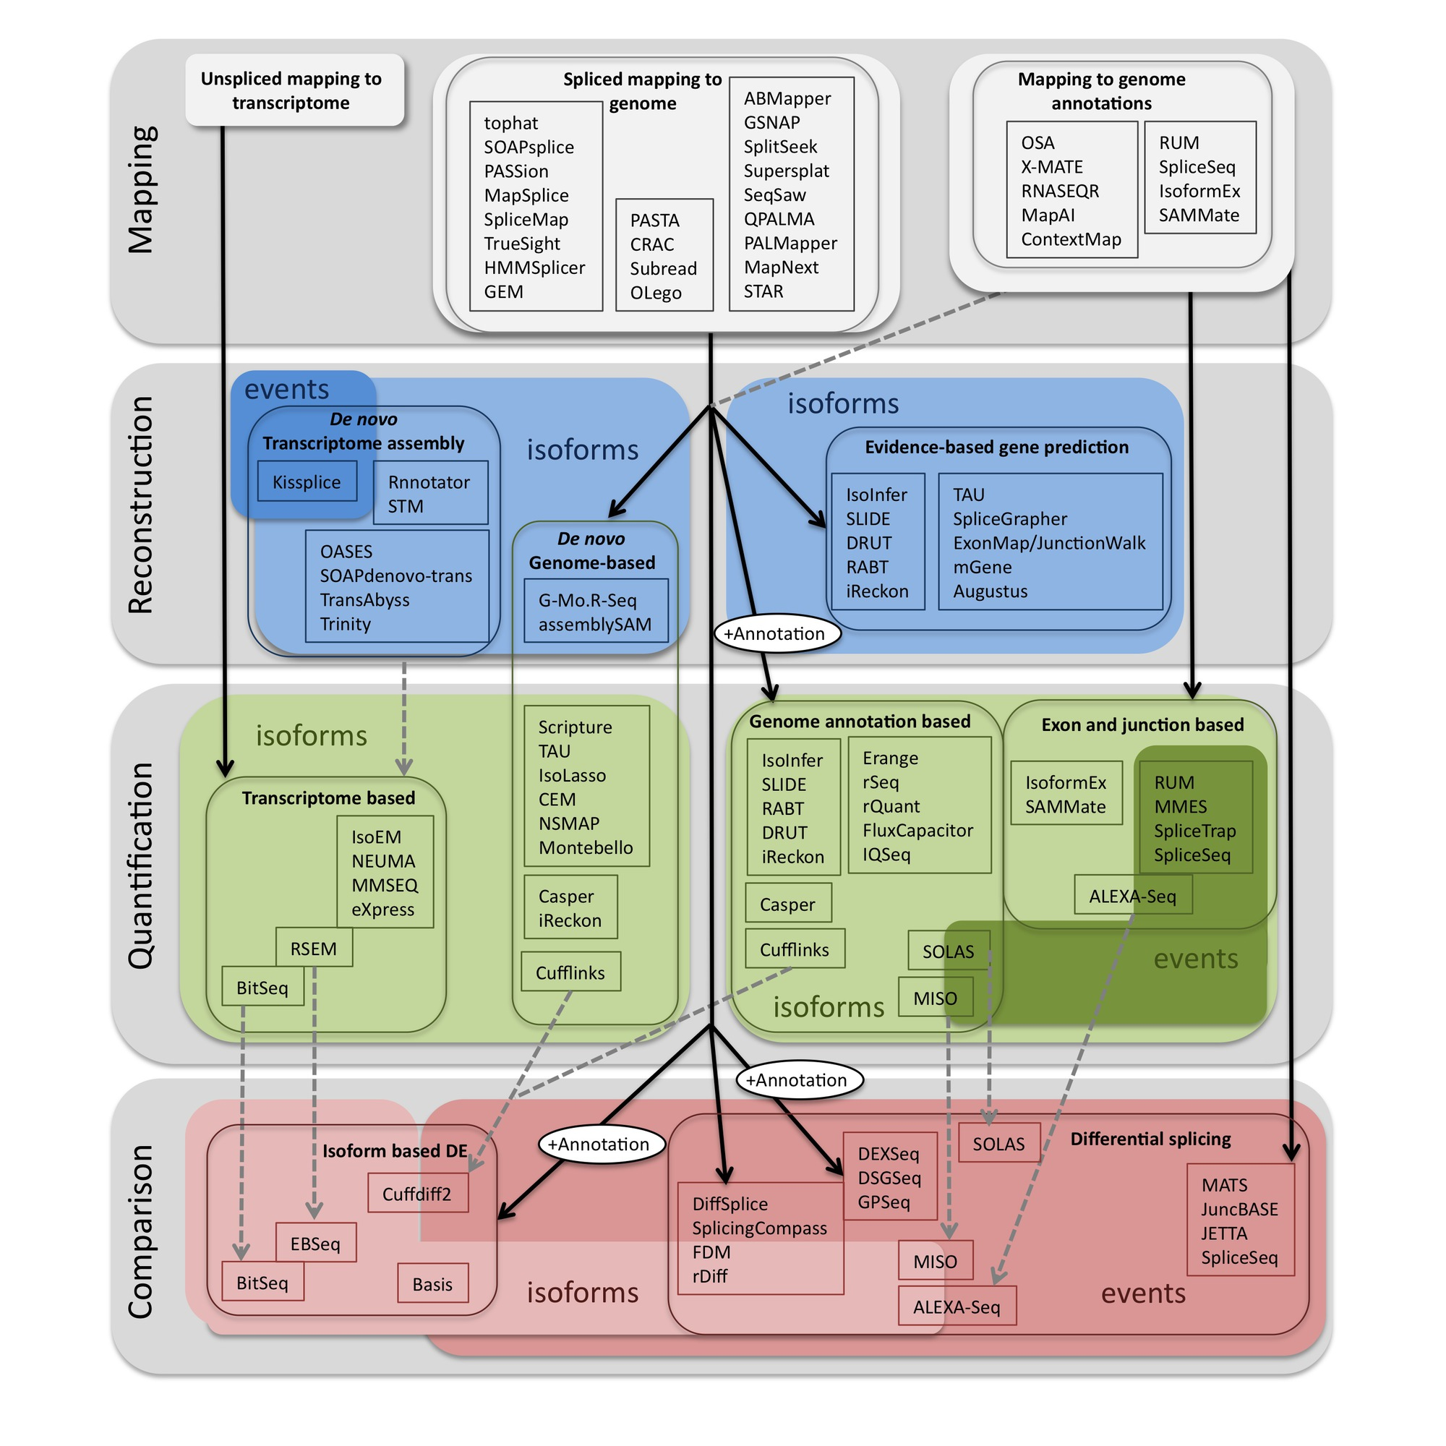
Methods to study splicing by RNA-seq
http://www.rna-seqblog.com/data-analysis/splicing-junction/methods-to-study-splicing-from-rna-seq/
http://arxiv.org/ftp/arxiv/papers/1304/1304.5952.pdf

Slide 8
Useful resources and discussion
Best approach to predict novel and alternative splicing events from RNA-seq data
  http://www.biostars.org/p/68966/
  http://www.biostars.org/p/62728/
Alternative splicing detection
  http://www.biostars.org/p/65617/
  http://www.biostars.org/p/11695/
Identifying genes that express different isoforms in cancer vs normal RNA-seq data
  http://www.biostars.org/p/50365/
Cufflinks / Cuffdiff Output - How are tests different?
  http://www.biostars.org/p/13525/
Visualization of alternative splicing events using RNA-seq data
  http://www.biostars.org/p/8979/

Slide 9
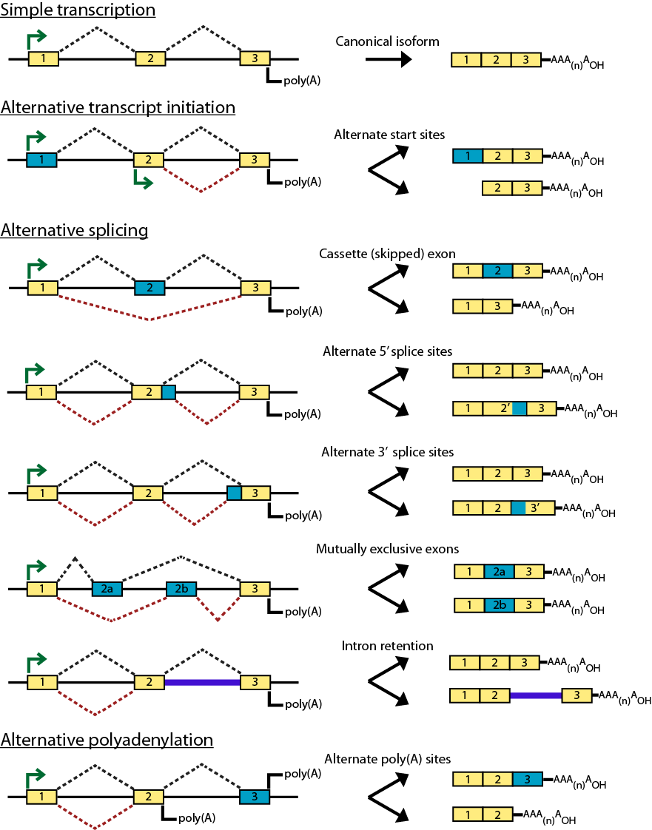
Types of alternative expression - part 1

Slide 10
Types of alternative expression – part 2

Slide 11
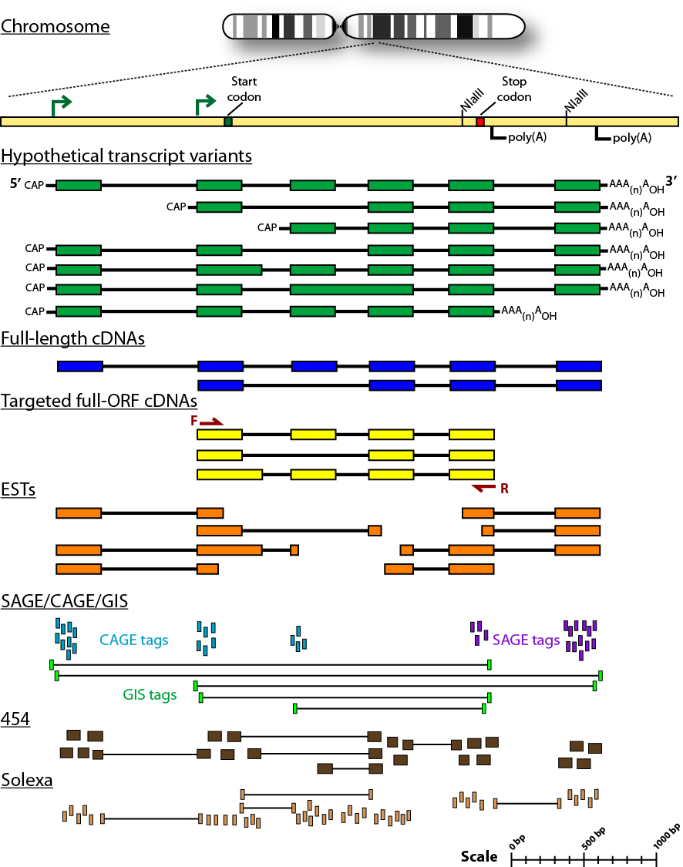
Sequencing methods for studying alternative isoforms

Slide 12
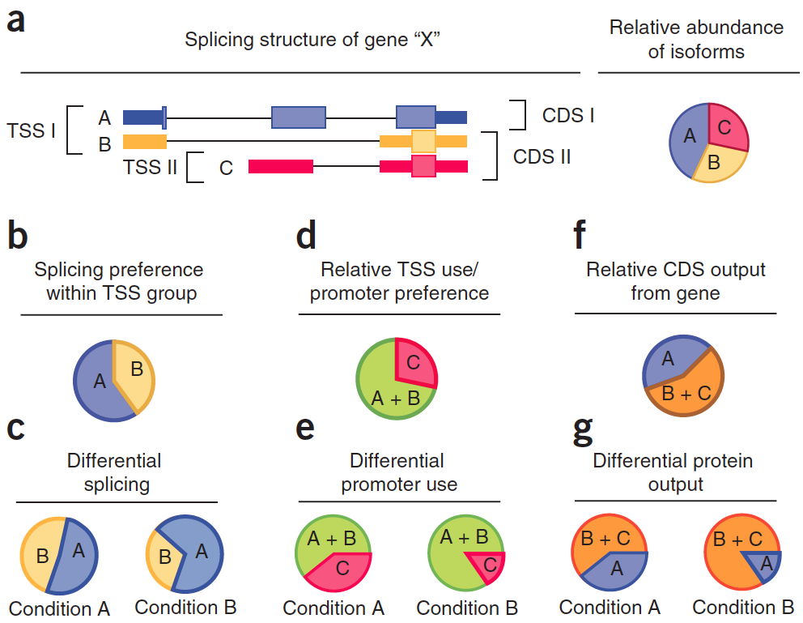
Cufflinks alternative splicing tests

Slide 13
Cufflinks alternative splicing tests
Relevant Cuffdiff output file
splicing.diff
promoters.diff
cds.diff

Slide 14
Introduction to tutorial
(Module 4)

Slide 15
Bowtie/Tophat/Cufflinks/Cuffdiff
RNA-seq Pipeline
Module 4 – Rerun Cufflinks in alternative ‘modes’
Sequencing
Read alignment
Transcript compilation
Gene identification
Alternative expression
RNA-seq reads (2 x 100 bp)
Bowtie/TopHat alignment (genome)
Cufflinks
Cufflinks (cuffmerge)
Cuffdiff
(A:B comparison)
Raw sequence data
(.fastq files)
Reference genome
(.fa file)
Gene annotation
(.gtf file)
CummRbund
Inputs

Slide 16
What if I don’t have a reference genome for my species?
Have you considered sequencing the genome of your species?
If that is not practical or you simply prefer a transcript discovery approach that does not rely on prior knowledge of the genome or transcriptome there are some tools available ...
  Unfortunately de novo transcriptome assembly is beyond the scope of this workshop
  The good news is that the skills you learn here will help you figure out how to install and run those tools yourself

Slide 17
Methods to study splicing by RNA-seq
http://www.rna-seqblog.com/data-analysis/splicing-junction/methods-to-study-splicing-from-rna-seq/
http://arxiv.org/ftp/arxiv/papers/1304/1304.5952.pdf

Slide 18
We are on a Coffee Break & Networking Session

