Slide 1
Canadian Bioinformatics Workshops
www.bioinformatics.ca

Slide 2
Module #: Title of Module
2

Slide 3
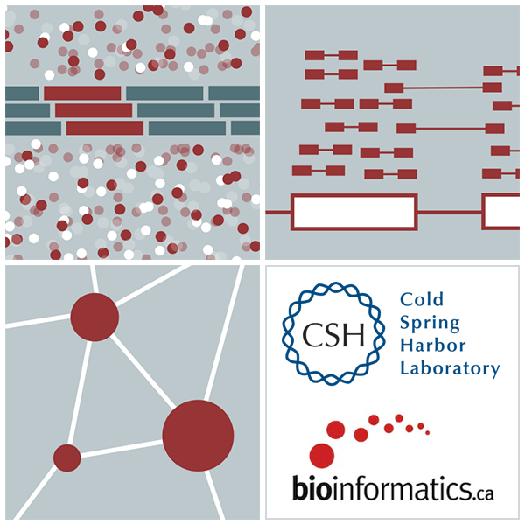
Introduction to cloud computing
Malachi Griffith, Obi Griffith, Fouad Yousif Slides courtesy of Francis Ouellette
Informatics for RNA-seq Analysis July 10-12, 2017

Slide 4
Learning Objectives
Introduction to cloud computing concepts
Introduction to cloud computing providers
Use the Amazon EC2 console to create an instance for each student
Will be used for many hands-on tutorials throughout the course
How to log into your cloud instance

Slide 5
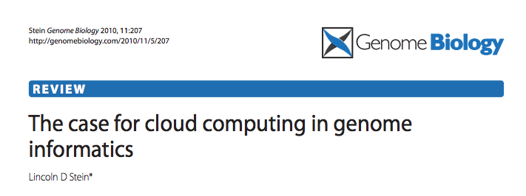
Disk Capacity vs Sequencing Capacity, 1990-2012
Disk Storage
(Mbytes/$)
DNA
Sequencing (bp/$)
1,000,000
1,000,000,000
100,000,000
100,000
10,000,000
10,000
Hard disk storage (MB/$)
Doubling time=14 mo
1,000,000
1,000
100,000
100
10,000
Nextgen sequencing (bp/$)
Doubling time=4 mo0
1,000
10
100
Pre-nextgen sequencing (bp/$)
Doubling time=19 mo
1
10
0
1
1990
1992
1994
1996
1998
2000
2003
2004
2006
2008
2010
2012

Slide 6
About DNA and computers
We'll hit the $1000 genome during 2015-?, then need to think about the $100 genome.
The doubling time of sequencing has been ~5-6 months.
The doubling time of storage and network bandwidth is ~12 months.
The doubling time of CPU speed is ~18 months.
The cost of sequencing a base pair will eventually equal the cost of storing a base pair

Slide 7
What is the general biomedical scientist to do?
Lots of data
Poor IT infrastructure in many labs
Where do they go?
Write more grants?
Get bigger hardware?

Slide 8
Cloud computing providers
Amazon AWS
https://aws.amazon.com/
Google cloud
https://cloud.google.com/
Digital ocean
https://www.digitalocean.com/
Others I have not tried:
Microsoft Azure (https://azure.microsoft.com/en-us/)
Rackspace cloud (http://www.rackspace.com/cloud)

Slide 9
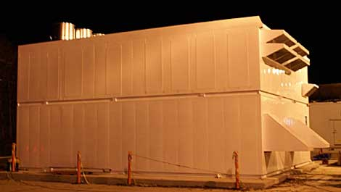
Amazon Web Services (AWS)
Infinite storage (scalable): S3 (simple storage service)
Compute per hour: EC2 (elastic cloud computing)
Ready when you are High Performance Computing
Multiple football fields of HPC throughout the world
HPC are expanded at one container at a time:

Slide 10
Some of the challenges of cloud computing:
Not cheap!
Getting files to and from there
Not the best solution for everybody
Standardization
PHI: personal health information & security concerns
In the USA: HIPAA act, PSQIA act, HITECH act, Patriot act, CLIA and CAP programs, etc.
http://www.biostars.org/p/70204/

Slide 11
Some of the advantages of cloud computing:
We received a grant from Amazon, so supported by ‘AWS in Education grant award’.
There are better ways of transferring large files, and now AWS makes it free to upload files.
A number of datasets exist on AWS (e.g. 1000 genome data).
Many useful bioinformatics AMI’s (Amazon Machine Images) exist on AWS: e.g. cloudbiolinux & CloudMan (Galaxy) – now one for this course!
Many flavors of cloud available, not just AWS

Slide 12
In this workshop:
Some tools (data) are
on your computer
on the web
on the cloud.
You will become efficient at traversing these various spaces, and finding resources you need, and using what is best for you.
There are different ways of using the cloud:
Command line (like your own very powerful Unix box)
With a web-browser (e.g. Galaxy): not in this workshop

Slide 13
Things we have set up:
Loaded data files to an ftp server
We brought up an Ubuntu (Linux) instance, and loaded a whole bunch of software for NGS analysis.
Saved this as an Amazon Machine Instance (AMI)
We will clone this and create separate instances for everybody in the class.
We’ve simplified the security: you basically all have the same login and file access, and opened ports. In your own world you would be more secure.

Slide 14
Amazon AWS documentation
https://github.com/griffithlab/rnaseq_tutorial/wiki/Intro-to-AWS-Cloud-Computing
http://aws.amazon.com/console/

Slide 15
Logging into Amazon AWS

Slide 16
Login to AWS console
https://364840684323.signin.aws.amazon.com/console

Slide 17
Select "EC2" service
Make sure you are in Oregon region

Slide 18
Launch a new Instance

Slide 19
Choose an AMI – Find the CSHL SEQTEC 2016 AMI in the Community AMIs
Search for: cshl_seqtec_2016_v3 (US West - Oregon)

Slide 20
Choose “m4.2xlarge” instance type, then "Next: Configure Instance Details".

Slide 21
Select "Protect against accidental termination", then "Next: Add Storage".

Slide 22
You should see "snap-xxxxxxx" (32GB) and "snap-xxxxxxx" (80GB) as the two storage volumes selected. Then, "Next: Tag Instance"

Slide 23
Create a tag like “Name=ObiGriffith” [use your own name]. Then hit "Next: Configure Security Group".
Important: Don’t forget to name your instance!
(FirstnameLastname)

Slide 24
Select an Existing Security Group, choose "SSH_HTTP". Then hit "Review and Launch".

Slide 25
Review the details of your instance, note the warnings, then hit Launch

Slide 26
Choose an existing key pair: "CSHL_2016" and then Launch.

Slide 27
View Instances to see your new instance spinning up!

Slide 28
Find YOUR instance, select it, and then hit connect for instructions on how to connect

Slide 29
Take note of your Public DNS and the instructions on changing permissions for the key file (Note, we will login as ubuntu NOT root)

Slide 30
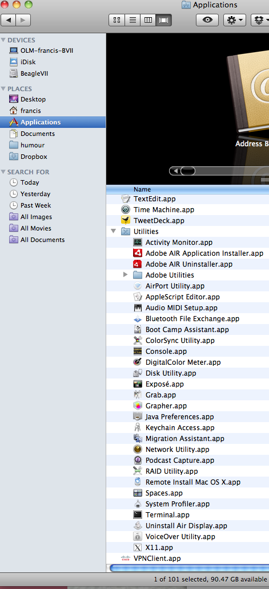
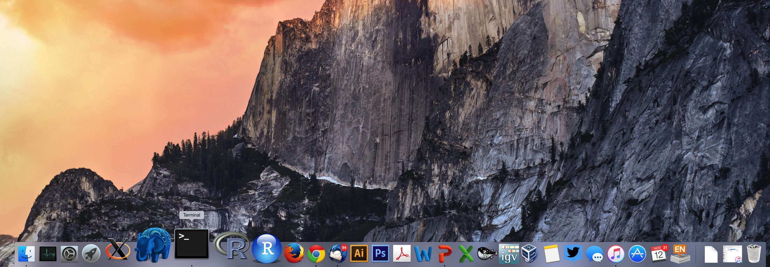
Opening a ‘terminal session’ on a Mac
In a Finder window
‘Applications’ -> ‘Utilities’ -> ‘Terminal’
Or on your dock

Slide 31
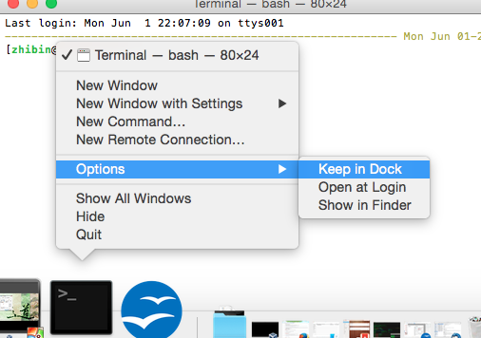
Add the terminal App to your dock

Slide 32
Creating a working directory on your Mac called ‘cshl’
mkdir cshl
cd cshl

Slide 33
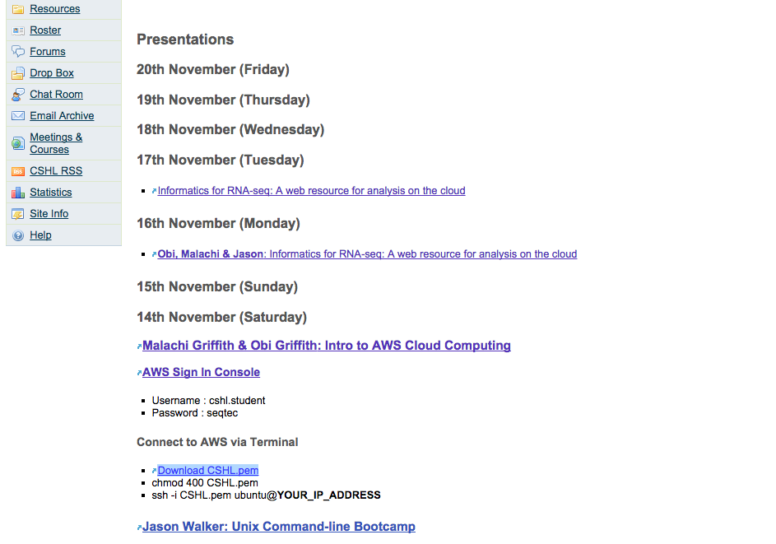
Obtain your AWS ‘key’ file from course wiki
Go to course wiki, “Presentations” page
On Mac: Control+
Save Link As
Save key file to your new ‘cshl’ directory

Slide 34
Viewing the ‘key’ file once downloaded

Slide 35
Changing file permissions of your ‘key’ file (Mac/Linux)
ls -l (long listing)
drwx------+ 67 ogriffit staff 2278 22 May 21:25 ../
-rw-r--r--@ 1 ogriffit staff 1696 22 May 21:31 CSHL.pem
rwx : owner
rwx : group
rwx: world
r read (4)
w write (2)
x execute (1)
Which ever way you add these 3 numbers, you know which integers
were used (6 is always 4+2, 5 is 4+1, 4 is by itself, 0 is none of them etc …)
So, when you have:
chmod 400 <file name>
It is “r” for the the file owner only

Slide 36
Logging into your instance
Mac/Linux
cd cshl/
chmod 400 CSHL.pem
ssh -i CSHL.pem ubuntu@[YOUR PUBLIC DNS]

Slide 37
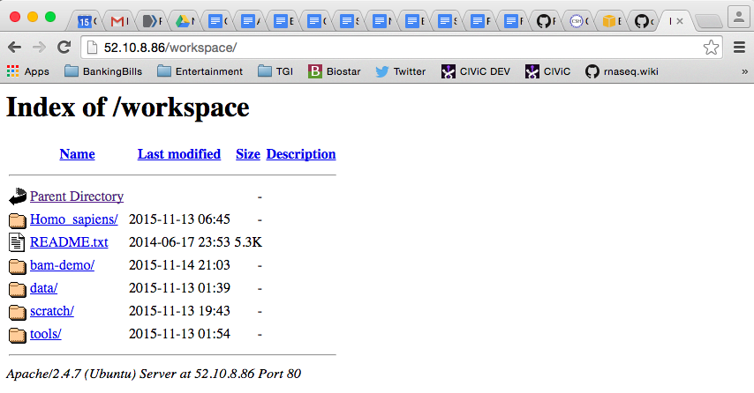
Copying files from AWS to your computer (using a web browser)
http://[YOUR PUBLIC DNS]/

Slide 38
Logging out of your instance
Mac/Linux – simply type exit
exit
Note, this disconnects the terminal session (ssh connection) to your cloud instance. But, your cloud instance is still running! See next slide for how to stop your instance.

Slide 39
When you are done for the day you can “Stop” your instance – Don’t Terminate!
Go to AWS EC2 Dashboard, select “Instances” tab, then find your instance. Right-click and chose ‘Instance State’ -> ‘Stop’

Slide 40
Next morning, you can “Start” your instance again
Go to AWS EC2 Dashboard, select “Instances” tab, then find your instance. Right-click and chose ‘Instance State’ -> ‘Start’

Slide 41
When you restart your instance you will need to find your new Public DNS or IP address. Select your instance and “Connect” or look in Description tab. Then go back to instructions for “Logging into your instance”

Slide 42
So, at this point:
Your Mac desktop is ready for the workshop
If it is not, you know where to get the information you need
You know how to login to AWS
The next step is to login to your linux machine on AWS and learn the basics of a linux command line

Slide 43
We are on a Coffee Break & Networking Session

