Slide 1
Canadian Bioinformatics Workshops
www.bioinformatics.ca

Slide 2
Module #: Title of Module
2

Slide 3
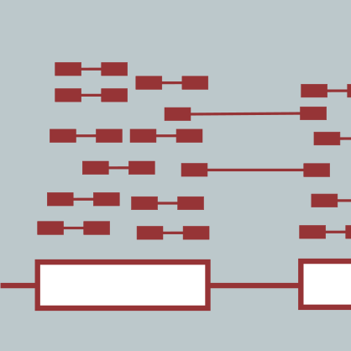
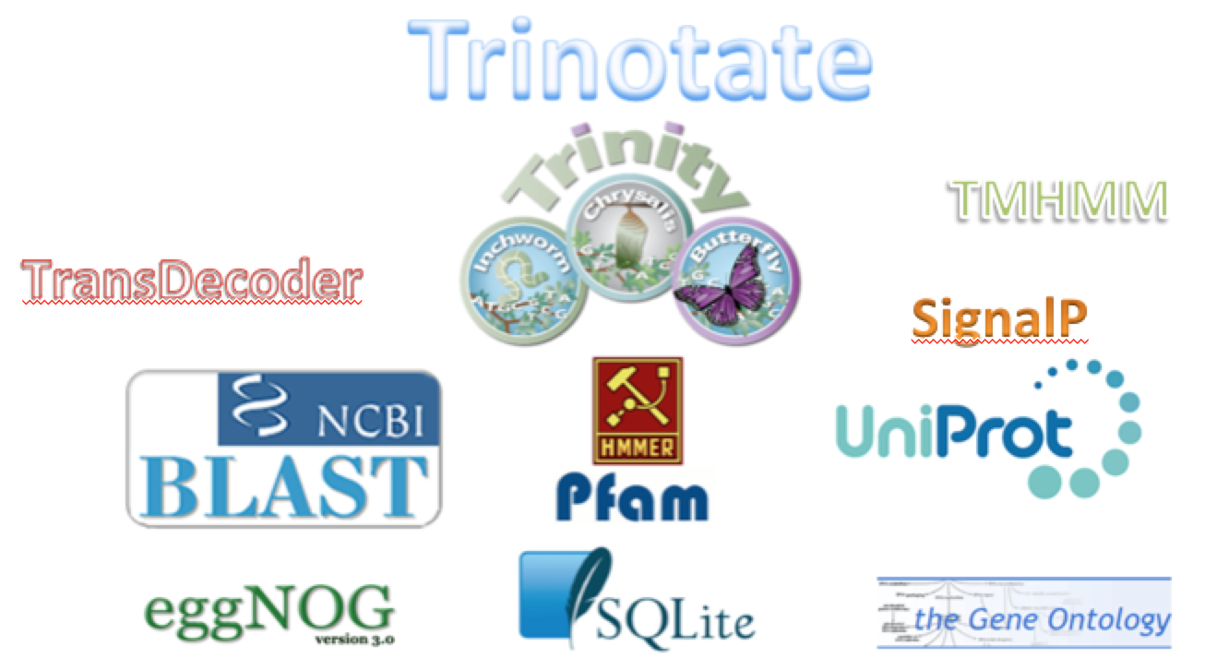
Functional Annotation and Analysis of Transcripts
Brian Haas
Informatics for RNA-Seq Analysis
July 10-12, 2017

Slide 4
Learning Objectives of Module
Explore methods to glean biological function from transcript sequences.
Differentiate between homology-based and sequence composition-based functional inference.

Slide 5
Transcript Functional Annotation
GGAGCTGGAGGCCCCCAGGCAACTACACCGTCCACGTACCCAGAGGGGCTGGGCCCTCCC
ACCAGAGACCACGCCCTGGTGTGCCTTAGGGGCCCTGGTTTGTTAGTCTCTGAGTGTGCA
GTTGCTGCACATGGGGCCCTGGCGCTTGCTGCACCAACTTCCTGTTGGGCCCGTGGTCCT
TGGAGGCATGCAGTTCAGCAGACAGTGACTCAGCCATCCACCCAACATGCGGAACGTGTC
TCTTCTGCAGGTCCCGGTCCACAGCAGGATTCCCCCTCTGTGAAAAGGCACGCTGATCTG
TCTGGATAAGTGTGGCCGGCCCCATGTATCCGGAATCAACCACGGGGTCCCCAGCTCGAC
TCTCCCTGCGGCAGACAGGCTCCCCCGGGATGATCTACAGTACTCGTTATGGGAGTCCCA
AAAGACAGCTCCAGTTTTACAGGAATCTGGGCAAATCTGGCCTTCGGGTCTCCTGCCTGG
GGCTTGGAACATGGGTGACCTTCGGGGGCCAGATCACGGATGAGATGGCAGAGCACCTAA
TGACCTTGGCCTACGATAATGGCATCAACCTGTTCGATACGGCGGAGGTCTACGCTGCTG
GAAAAGCTGAAGTGGTATTAGGGAACATCATTAAGAAGAAGGGATGGAGACGGTCCAGCC
TTGTCATCACCACCAAGATCTTCTGGGGTGGAAAAGCGGAGACTGAGAGAGGCCTTTCCA
GGAAGCACATAATTGAAGGACTGAAAGCGTCCCTGGAGCGGCTGCAGCTGGAGTACGTGG
ATGTGGTTTTTGCCAACCGCCCAGACCCCAACACGCCCATGGAAGAGACCGTGCGGGCCA
TGACCCATGTCATCAACCAGGGGATGGCCATGTACTGGGGCACATCACGCTGGAGCTCCA
TGGAGATCATGGAGGCCTACTCGGTGGCTCGGCAGTTCAACCTGATCCCGCCCATCTGCG
AGCAAGCGGAATATCACATGTTCCAGAGGGAGAAGGTGGAGGTCCAGCTGCCAGAGCTGT
TCCACAAGATAGGAGTAGGTGCCATGACCTGGTCCCCTCTGGCGTGCGGCATCGTCTCAG
GGAAGTATGACAGCGGGATCCCACCCTACTCCAGAGCCTCCCTGAAGGGCTACCAGTGGT
TGAAGGACAAGATCCTGAGTGAGGAGGGTCGCCGCCAGCAGGCCAAGCTGAAGGAACTGC
AGGCCATTGCCGAACGCCTGGGCTGCACCCTACCCCAGCTGGCCATAGCCTGGTGCCTGA
GGAATGAGGGTGTCAGCTCCGTGCTTCTGGGTGCTTCCAATGCAGAACAACTTATGGAGA
ACATTGGAGCAATACAGGTCCTTCCAAAATTGTCGTCTTCCATCGTCCACGAGATCGACA
GCATTCTGGGCAATAAACCCTACAGCAAAAAGGACTATAGATCCTAAGTCTACTCCCCAC
CCCTCGTGCCCCACCCGGACAGTTCCCGGTTCCCTCCTCGTCTCTGTTCGCTCGCTTCTG
CTGTTCCAAAGCCAAATGCAGAGTGTGGTTCACATCCAAAGGGAAATCACTATGCCCAGA
CGTGACAGGGAATCGACCTCCAAAGTCACCGCCAGATGCCGCCTGCCGCTTCTTCACTGG
ATACTGTCCGACAACGGATGCCAGGGGATGGCATCAGTTAGGGGGACATCCAGAGGCTCC
CGCCCAAGCCCACCACCTCTGCTTATCCTTCAAGAAGAAACACTTGCCCCCAGCCATGGC
CCTTCACGGAAATTCTAGAAGCCATGGCCGGGTGGAGGTCTCATCCTTAGAGCAGGAGGG
Can we gather hints of biological function from sequence?
Module
bioinformatics.ca
Notes:
From RNA-Seq data, we were able to reconstruct transcripts, and from the expression data, we might have clues as to what transcripts are likely to be important to certain processes such as different tissue types, environmental conditions, or responding to some experimental perturbation.
---
It would be useful to know what biological functions these transcripts represent.
For example do the transcripts code for proteins and can we glean what the function of those proteins might be based on properties of the sequence?

Slide 6
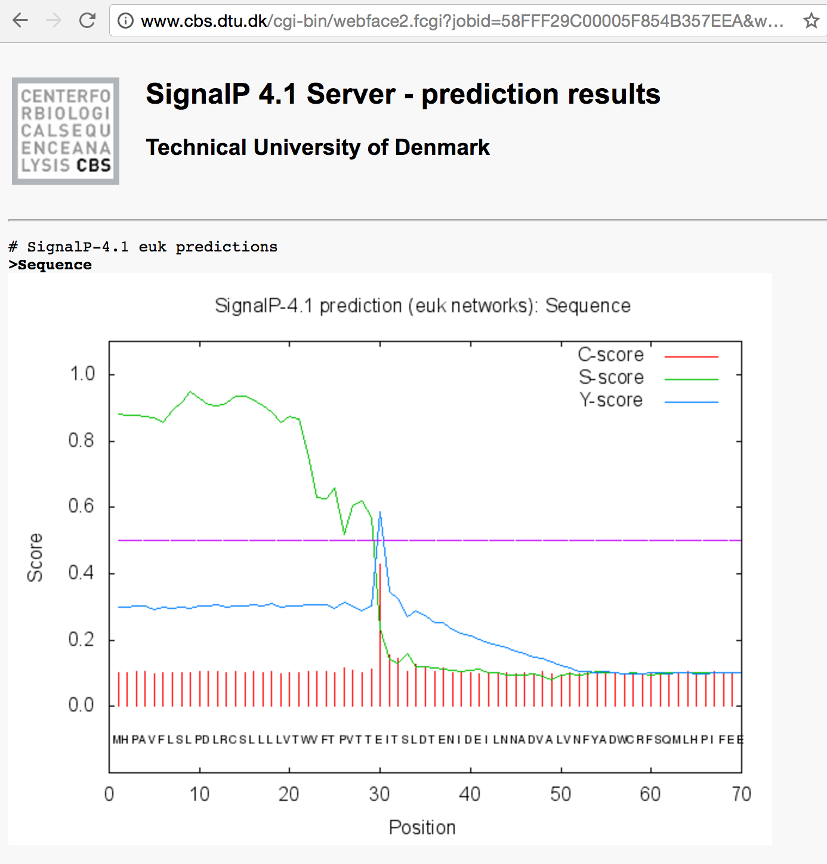
Methods used to predict function from sequence
Sequence homology
Searching protein database for sequence similarity
Query
Database Match
Sequence composition
Predict functions of sequence using machine learning methods for pattern recognition.
Neural Networks
Hidden Markov Models
Module
bioinformatics.ca
Notes:
There are several methods available for predicting biological function from sequence data,
---
including sequence homology based methods, involving searching databases of previously identified sequences and looking for patterns of sequence conservation that might indicate evolutionary relationships and possibly related biological functions.
---
There are also prediction methods that use machine learning methods such as neural networks and hidden markov models to identify sequence patterns that would hint at biological functions, and we’ll see some examples of those methods that we routinely use here.

Slide 7
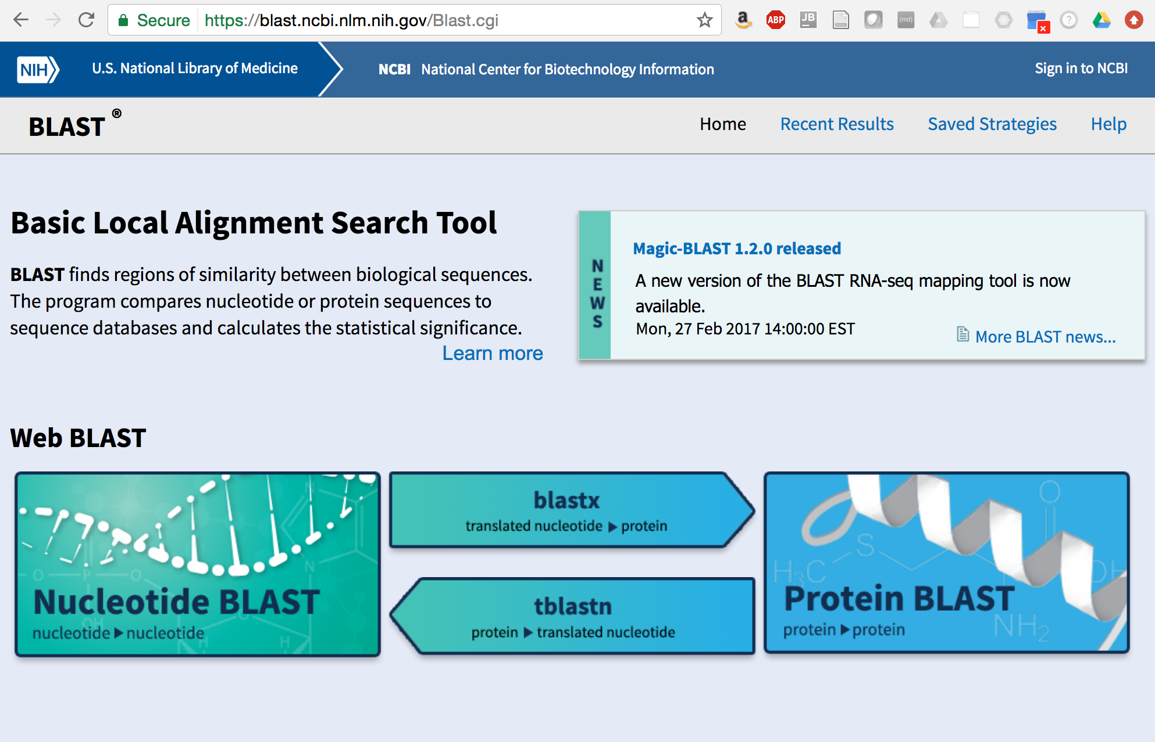
Use BLAST to search for sequence similarity to known proteins
Module
bioinformatics.ca
Notes:
An effective way to identify sequences that are similar to other known sequences is to search a sequence database using BLAST.
----
The blastx method searches translations of your transcript sequence in all 6 possible reading frames against a protein database and will report all significant sequence matches.
If you find a highly significant match to a protein of known function, this could provide excellent clues towards possible shared functions.

Slide 8
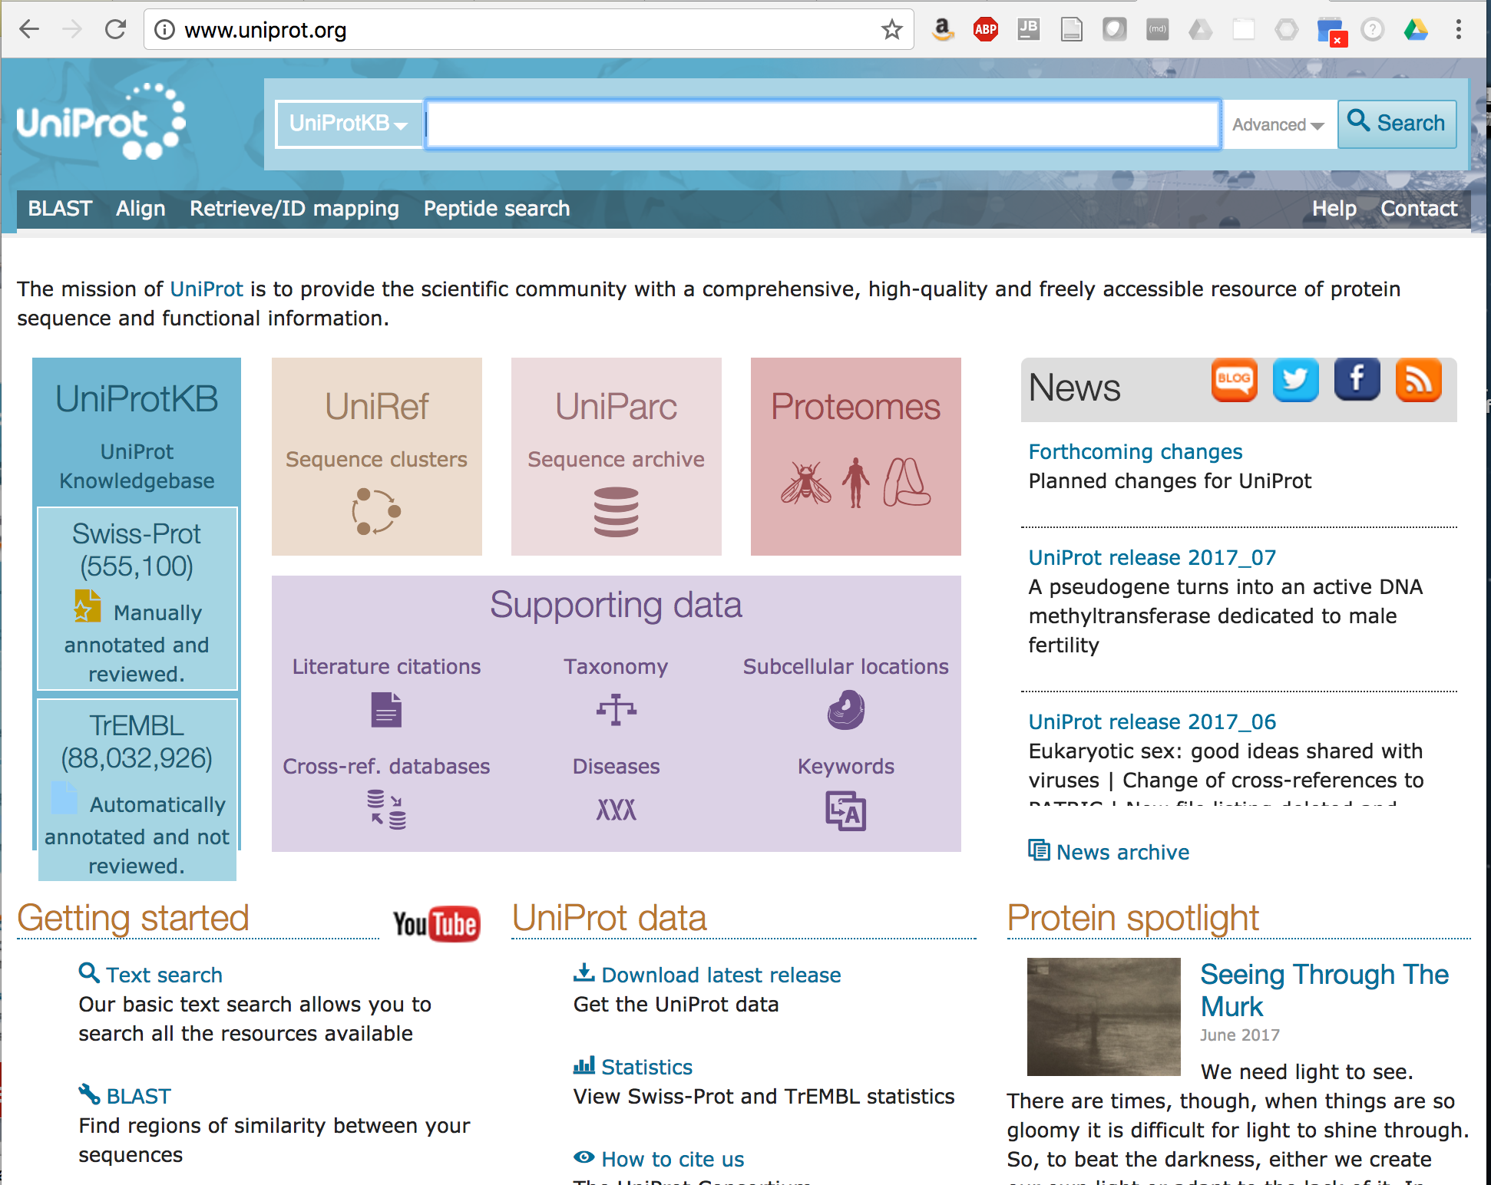
The Swiss-Prot database is a valuable source of proteins with known functions
(as of July, 2017)
Module
bioinformatics.ca
Notes:
One of the most valuable protein databases to search using BLAST is the Swiss-Prot database.
---
Swiss-Prot is part of the larger European UniProt Knowledgebase, which is a comprehensive database of all known protein sequences. At the time of this recording, the Uniprot Knowledgebase has over 85 million protein sequences. Annotations for the vast majority of these sequences are generated automatically have not been manually reviewed.
The Swiss-Prot subset of the knowledgebase contains over half a million entries with high quality functional annotations that are in many cases based on experimental support, derived from published studies, and these functional annotations have been assigned and manually reviewed by expert bioinformaticians.

Slide 9
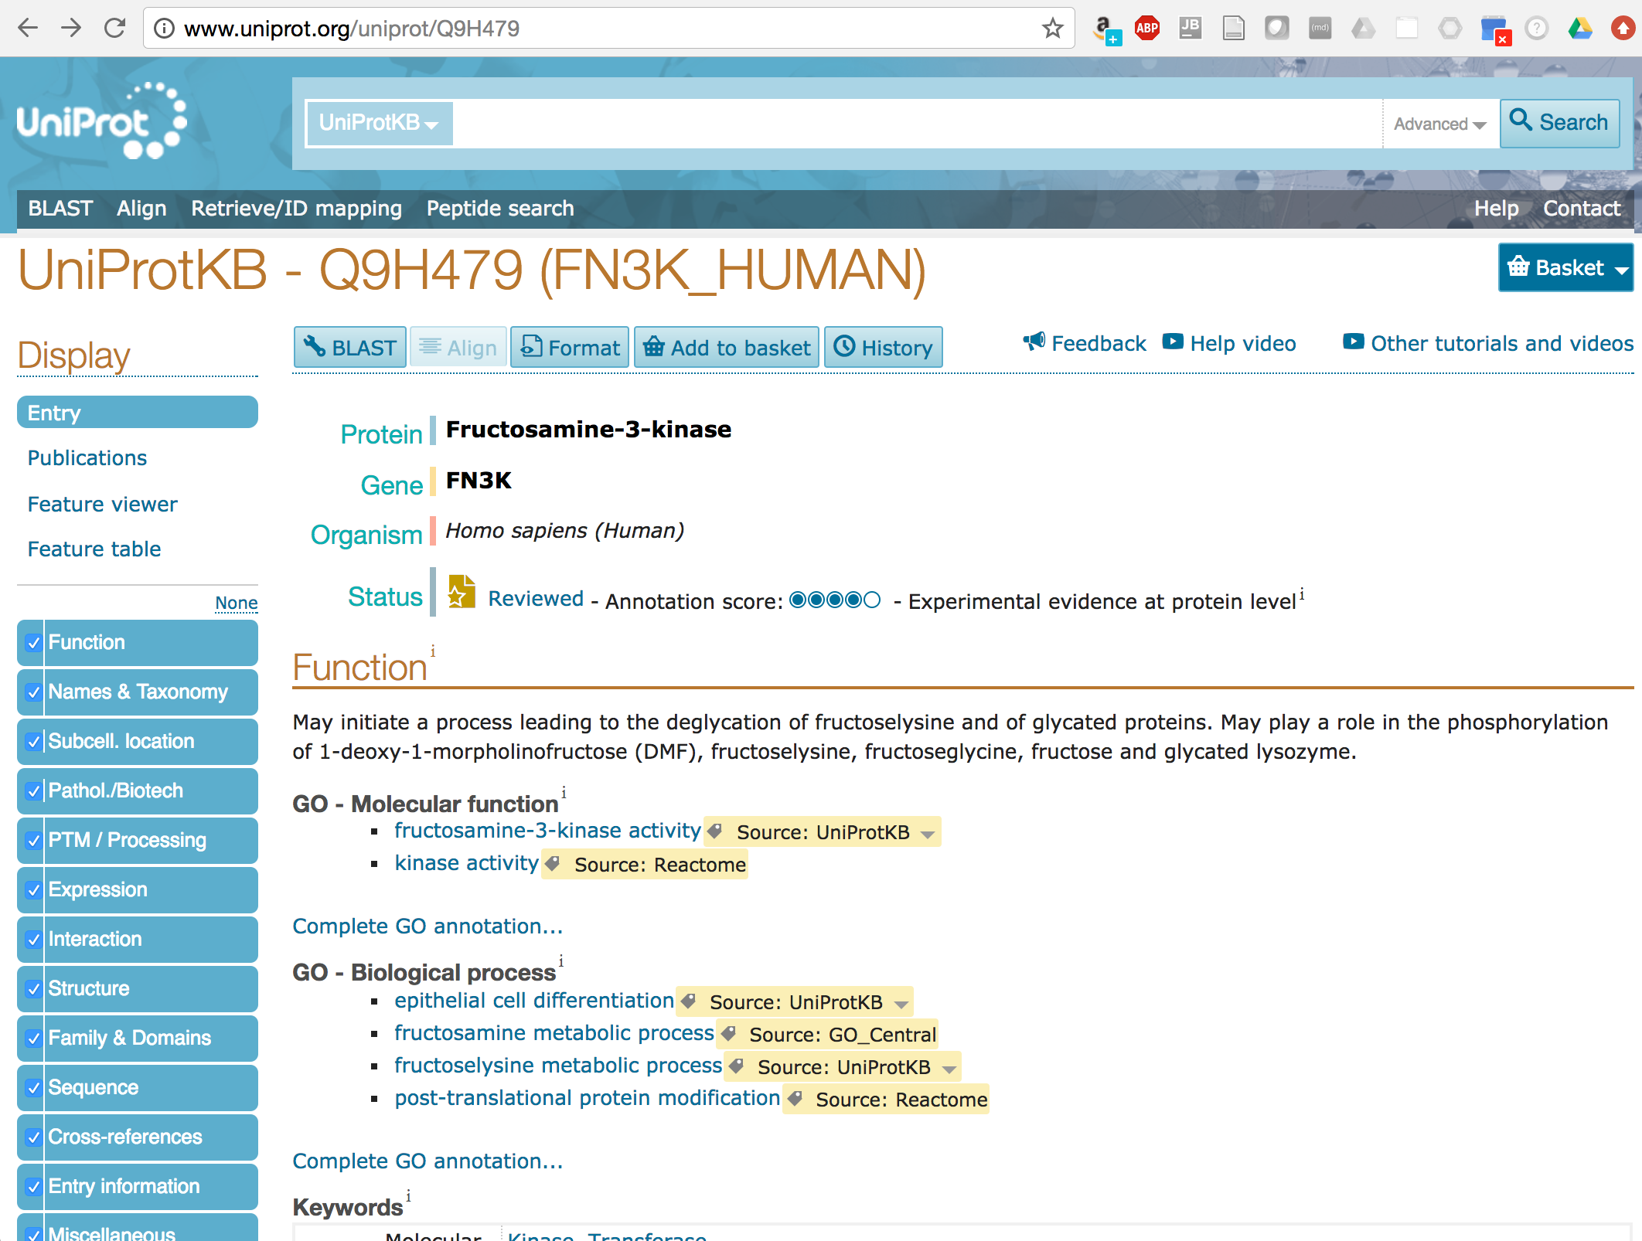
Example of a Swiss-Prot Record
Gene Ontology (GO):
Structured vocabulary for defining molecular functions, biological processes, and cellular components.
Module
bioinformatics.ca
Notes:
Here’s an example of a record within swissprot, showing a report for a Fructosamine-3-kinase protein.
---
The report contains rich information about the function of this protein, written in free-form text, which is very useful to investigators wanting to read about what’s known about the function of this protein.
---
In addition, many of these records include assignments of proteins to Gene Ontology terms. Gene Ontology provides a structured vocabulary for defining molecular functions, biological processes, and cellular components.
If we click on one of the assigned terms, such as the molecular function ‘fructosamine-3-kinase activity’…

Slide 10
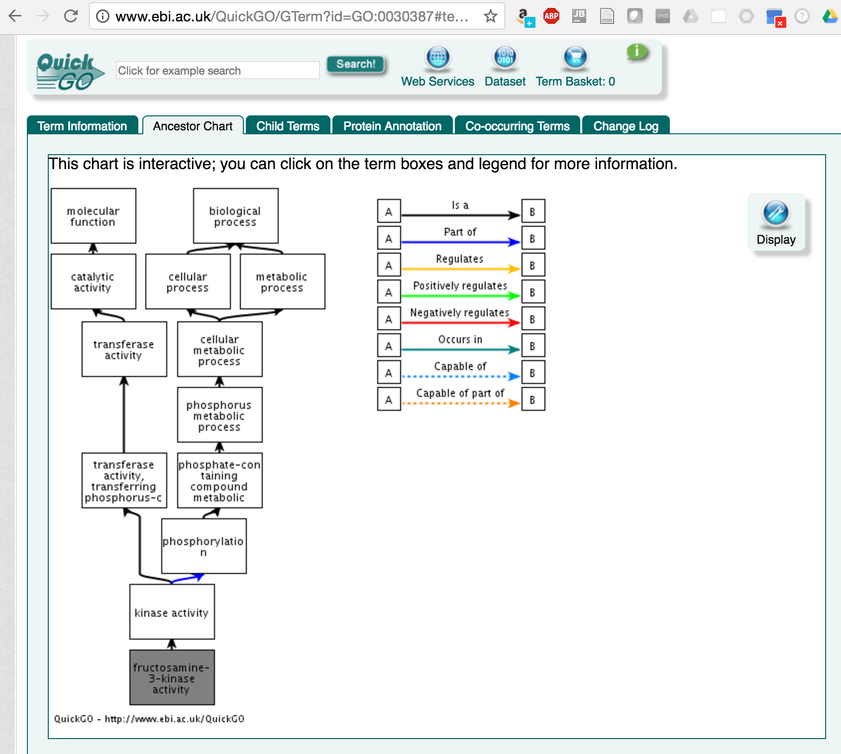
Gene Ontology: a structured relational vocabulary for describing biological functions
Gene Ontology terms are organized into a directed acyclic graph. Terms are organized from general (top) to more specific (bottom).
The GO structure enables computations such as exploring function enrichment among sets of transcripts.
Module
bioinformatics.ca
Notes:
we can view the entire structure of the Gene Ontology centered at that GO term.
---
Gene Ontology terms are organized into a directed graph structure, with individual terms assigned at nodes in the graph, and parental nodes representing more generalized functional descriptions and children terms representing more specific functions.
In this example, our assignment of ‘fructosamine-3-kinase activity’ has a more general parent term of ‘kinase activity’, and the assignment terms become more general as we further traverse the graph up to the root terms representing molecular function or biological process.
If we have a highly significant match of our transcript sequence to this protein, we might infer that it is evolutionarily related and may have the same function, and we might transitively assign these GO terms to our transcript of interest.
---
Having a comprehensive annotation of GO terms for our transcriptome will allow us to perform other downstream computations to examine which functions are represented by the expression data in our samples of interest. We can further examine sets of transcripts that are found to be differentially expressed among different conditions to see if they’re enriched for certain biological functions.

Slide 11
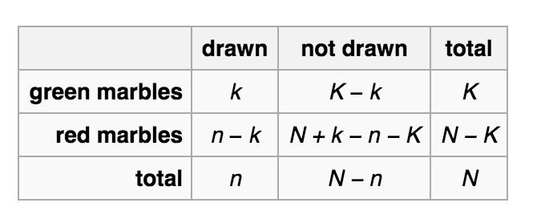
Gene ontology functional enrichment
 | (+) Differentially Expressed | (-) Not Differentially Expressed | Totals
+ Gene Ontology | 50 | 200 | 250
- Gene Ontology | 1950 | 17800 | 19750
Totals | 2000 | 18000 | 20000
Module
bioinformatics.ca
Notes:
Fisher’s exact test: The test is useful for categorical data that result from classifying objects in two different ways; it is used to examine the significance of the association (contingency) between the two kinds of classification.

Slide 12
No significant sequence similarity… What else?
GGAGCTGGAGGCCCCCAGGCAACTACACCGTCCACGTACCCAGAGGGGCTGGGCCCTCCC
ACCAGAGACCACGCCCTGGTGTGCCTTAGGGGCCCTGGTTTGTTAGTCTCTGAGTGTGCA
GTTGCTGCACATGGGGCCCTGGCGCTTGCTGCACCAACTTCCTGTTGGGCCCGTGGTCCT
TGGAGGCATGCAGTTCAGCAGACAGTGACTCAGCCATCCACCCAACATGCGGAACGTGTC
TCTTCTGCAGGTCCCGGTCCACAGCAGGATTCCCCCTCTGTGAAAAGGCACGCTGATCTG
TCTGGATAAGTGTGGCCGGCCCCATGTATCCGGAATCAACCACGGGGTCCCCAGCTCGAC
TCTCCCTGCGGCAGACAGGCTCCCCCGGGATGATCTACAGTACTCGTTATGGGAGTCCCA
AAAGACAGCTCCAGTTTTACAGGAATCTGGGCAAATCTGGCCTTCGGGTCTCCTGCCTGG
GGCTTGGAACATGGGTGACCTTCGGGGGCCAGATCACGGATGAGATGGCAGAGCACCTAA
TGACCTTGGCCTACGATAATGGCATCAACCTGTTCGATACGGCGGAGGTCTACGCTGCTG
GAAAAGCTGAAGTGGTATTAGGGAACATCATTAAGAAGAAGGGATGGAGACGGTCCAGCC
TTGTCATCACCACCAAGATCTTCTGGGGTGGAAAAGCGGAGACTGAGAGAGGCCTTTCCA
GGAAGCACATAATTGAAGGACTGAAAGCGTCCCTGGAGCGGCTGCAGCTGGAGTACGTGG
ATGTGGTTTTTGCCAACCGCCCAGACCCCAACACGCCCATGGAAGAGACCGTGCGGGCCA
TGACCCATGTCATCAACCAGGGGATGGCCATGTACTGGGGCACATCACGCTGGAGCTCCA
TGGAGATCATGGAGGCCTACTCGGTGGCTCGGCAGTTCAACCTGATCCCGCCCATCTGCG
AGCAAGCGGAATATCACATGTTCCAGAGGGAGAAGGTGGAGGTCCAGCTGCCAGAGCTGT
TCCACAAGATAGGAGTAGGTGCCATGACCTGGTCCCCTCTGGCGTGCGGCATCGTCTCAG
GGAAGTATGACAGCGGGATCCCACCCTACTCCAGAGCCTCCCTGAAGGGCTACCAGTGGT
TGAAGGACAAGATCCTGAGTGAGGAGGGTCGCCGCCAGCAGGCCAAGCTGAAGGAACTGC
AGGCCATTGCCGAACGCCTGGGCTGCACCCTACCCCAGCTGGCCATAGCCTGGTGCCTGA
GGAATGAGGGTGTCAGCTCCGTGCTTCTGGGTGCTTCCAATGCAGAACAACTTATGGAGA
ACATTGGAGCAATACAGGTCCTTCCAAAATTGTCGTCTTCCATCGTCCACGAGATCGACA
GCATTCTGGGCAATAAACCCTACAGCAAAAAGGACTATAGATCCTAAGTCTACTCCCCAC
CCCTCGTGCCCCACCCGGACAGTTCCCGGTTCCCTCCTCGTCTCTGTTCGCTCGCTTCTG
CTGTTCCAAAGCCAAATGCAGAGTGTGGTTCACATCCAAAGGGAAATCACTATGCCCAGA
CGTGACAGGGAATCGACCTCCAAAGTCACCGCCAGATGCCGCCTGCCGCTTCTTCACTGG
ATACTGTCCGACAACGGATGCCAGGGGATGGCATCAGTTAGGGGGACATCCAGAGGCTCC
CGCCCAAGCCCACCACCTCTGCTTATCCTTCAAGAAGAAACACTTGCCCCCAGCCATGGC
CCTTCACGGAAATTCTAGAAGCCATGGCCGGGTGGAGGTCTCATCCTTAGAGCAGGAGGG
Module
bioinformatics.ca
Notes:
It’s often the case that we don’t find sequence similarity to proteins of known function. What else can we do to potentially glean some hints into what the function might be?

Slide 13
Is there an ORF for a potential Coding Region?
GGAGCTGGAGGCCCCCAGGCAACTACACCGTCCACGTACCCAGAGGGGCTGGGCCCTCCC
ACCAGAGACCACGCCCTGGTGTGCCTTAGGGGCCCTGGTTTGTTAGTCTCTGAGTGTGCA
GTTGCTGCACATGGGGCCCTGGCGCTTGCTGCACCAACTTCCTGTTGGGCCCGTGGTCCT
TGGAGGCATGCAGTTCAGCAGACAGTGACTCAGCCATCCACCCAACATGCGGAACGTGTC
TCTTCTGCAGGTCCCGGTCCACAGCAGGATTCCCCCTCTGTGAAAAGGCACGCTGATCTG
TCTGGATAAGTGTGGCCGGCCCCATGTATCCGGAATCAACCACGGGGTCCCCAGCTCGAC
TCTCCCTGCGGCAGACAGGCTCCCCCGGGATGATCTACAGTACTCGTTATGGGAGTCCCA
AAAGACAGCTCCAGTTTTACAGGAATCTGGGCAAATCTGGCCTTCGGGTCTCCTGCCTGG
GGCTTGGAACATGGGTGACCTTCGGGGGCCAGATCACGGATGAGATGGCAGAGCACCTAA
TGACCTTGGCCTACGATAATGGCATCAACCTGTTCGATACGGCGGAGGTCTACGCTGCTG
GAAAAGCTGAAGTGGTATTAGGGAACATCATTAAGAAGAAGGGATGGAGACGGTCCAGCC
TTGTCATCACCACCAAGATCTTCTGGGGTGGAAAAGCGGAGACTGAGAGAGGCCTTTCCA
GGAAGCACATAATTGAAGGACTGAAAGCGTCCCTGGAGCGGCTGCAGCTGGAGTACGTGG
ATGTGGTTTTTGCCAACCGCCCAGACCCCAACACGCCCATGGAAGAGACCGTGCGGGCCA
TGACCCATGTCATCAACCAGGGGATGGCCATGTACTGGGGCACATCACGCTGGAGCTCCA
TGGAGATCATGGAGGCCTACTCGGTGGCTCGGCAGTTCAACCTGATCCCGCCCATCTGCG
AGCAAGCGGAATATCACATGTTCCAGAGGGAGAAGGTGGAGGTCCAGCTGCCAGAGCTGT
TCCACAAGATAGGAGTAGGTGCCATGACCTGGTCCCCTCTGGCGTGCGGCATCGTCTCAG
GGAAGTATGACAGCGGGATCCCACCCTACTCCAGAGCCTCCCTGAAGGGCTACCAGTGGT
TGAAGGACAAGATCCTGAGTGAGGAGGGTCGCCGCCAGCAGGCCAAGCTGAAGGAACTGC
AGGCCATTGCCGAACGCCTGGGCTGCACCCTACCCCAGCTGGCCATAGCCTGGTGCCTGA
GGAATGAGGGTGTCAGCTCCGTGCTTCTGGGTGCTTCCAATGCAGAACAACTTATGGAGA
ACATTGGAGCAATACAGGTCCTTCCAAAATTGTCGTCTTCCATCGTCCACGAGATCGACA
GCATTCTGGGCAATAAACCCTACAGCAAAAAGGACTATAGATCCTAAGTCTACTCCCCAC
CCCTCGTGCCCCACCCGGACAGTTCCCGGTTCCCTCCTCGTCTCTGTTCGCTCGCTTCTG
CTGTTCCAAAGCCAAATGCAGAGTGTGGTTCACATCCAAAGGGAAATCACTATGCCCAGA
CGTGACAGGGAATCGACCTCCAAAGTCACCGCCAGATGCCGCCTGCCGCTTCTTCACTGG
ATACTGTCCGACAACGGATGCCAGGGGATGGCATCAGTTAGGGGGACATCCAGAGGCTCC
CGCCCAAGCCCACCACCTCTGCTTATCCTTCAAGAAGAAACACTTGCCCCCAGCCATGGC
CCTTCACGGAAATTCTAGAAGCCATGGCCGGGTGGAGGTCTCATCCTTAGAGCAGGAGGG
Module
bioinformatics.ca
Notes:
We might ask whether it looks like the transcript might encode a protein sequence.

Slide 14
Is there an ORF for a potential Coding Region?
GGAGCTGGAGGCCCCCAGGCAACTACACCGTCCACGTACCCAGAGGGGCTGGGCCCTCCC
ACCAGAGACCACGCCCTGGTGTGCCTTAGGGGCCCTGGTTTGTTAGTCTCTGAGTGTGCA
GTTGCTGCACATGGGGCCCTGGCGCTTGCTGCACCAACTTCCTGTTGGGCCCGTGGTCCT
TGGAGGCATGCAGTTCAGCAGACAGTGACTCAGCCATCCACCCAACATGCGGAACGTGTC
TCTTCTGCAGGTCCCGGTCCACAGCAGGATTCCCCCTCTGTGAAAAGGCACGCTGATCTG
TCTGGATAAGTGTGGCCGGCCCCATGTATCCGGAATCAACCACGGGGTCCCCAGCTCGAC
TCTCCCTGCGGCAGACAGGCTCCCCCGGGATGATCTACAGTACTCGTTATGGGAGTCCCA
AAAGACAGCTCCAGTTTTACAGGAATCTGGGCAAATCTGGCCTTCGGGTCTCCTGCCTGG
GGCTTGGAACATGGGTGACCTTCGGGGGCCAGATCACGGATGAGATGGCAGAGCACCTAA
TGACCTTGGCCTACGATAATGGCATCAACCTGTTCGATACGGCGGAGGTCTACGCTGCTG
GAAAAGCTGAAGTGGTATTAGGGAACATCATTAAGAAGAAGGGATGGAGACGGTCCAGCC
TTGTCATCACCACCAAGATCTTCTGGGGTGGAAAAGCGGAGACTGAGAGAGGCCTTTCCA
GGAAGCACATAATTGAAGGACTGAAAGCGTCCCTGGAGCGGCTGCAGCTGGAGTACGTGG
ATGTGGTTTTTGCCAACCGCCCAGACCCCAACACGCCCATGGAAGAGACCGTGCGGGCCA
TGACCCATGTCATCAACCAGGGGATGGCCATGTACTGGGGCACATCACGCTGGAGCTCCA
TGGAGATCATGGAGGCCTACTCGGTGGCTCGGCAGTTCAACCTGATCCCGCCCATCTGCG
AGCAAGCGGAATATCACATGTTCCAGAGGGAGAAGGTGGAGGTCCAGCTGCCAGAGCTGT
TCCACAAGATAGGAGTAGGTGCCATGACCTGGTCCCCTCTGGCGTGCGGCATCGTCTCAG
GGAAGTATGACAGCGGGATCCCACCCTACTCCAGAGCCTCCCTGAAGGGCTACCAGTGGT
TGAAGGACAAGATCCTGAGTGAGGAGGGTCGCCGCCAGCAGGCCAAGCTGAAGGAACTGC
AGGCCATTGCCGAACGCCTGGGCTGCACCCTACCCCAGCTGGCCATAGCCTGGTGCCTGA
GGAATGAGGGTGTCAGCTCCGTGCTTCTGGGTGCTTCCAATGCAGAACAACTTATGGAGA
ACATTGGAGCAATACAGGTCCTTCCAAAATTGTCGTCTTCCATCGTCCACGAGATCGACA
GCATTCTGGGCAATAAACCCTACAGCAAAAAGGACTATAGATCCTAAGTCTACTCCCCAC
CCCTCGTGCCCCACCCGGACAGTTCCCGGTTCCCTCCTCGTCTCTGTTCGCTCGCTTCTG
CTGTTCCAAAGCCAAATGCAGAGTGTGGTTCACATCCAAAGGGAAATCACTATGCCCAGA
CGTGACAGGGAATCGACCTCCAAAGTCACCGCCAGATGCCGCCTGCCGCTTCTTCACTGG
ATACTGTCCGACAACGGATGCCAGGGGATGGCATCAGTTAGGGGGACATCCAGAGGCTCC
CGCCCAAGCCCACCACCTCTGCTTATCCTTCAAGAAGAAACACTTGCCCCCAGCCATGGC
CCTTCACGGAAATTCTAGAAGCCATGGCCGGGTGGAGGTCTCATCCTTAGAGCAGGAGGG
Module
bioinformatics.ca
Notes:
We can look at the transcript sequence and find open reading frames, simply requiring a start codon and a downstream stop codon with some minimal length that could, in theory, be translated into a protein sequence.

Slide 15
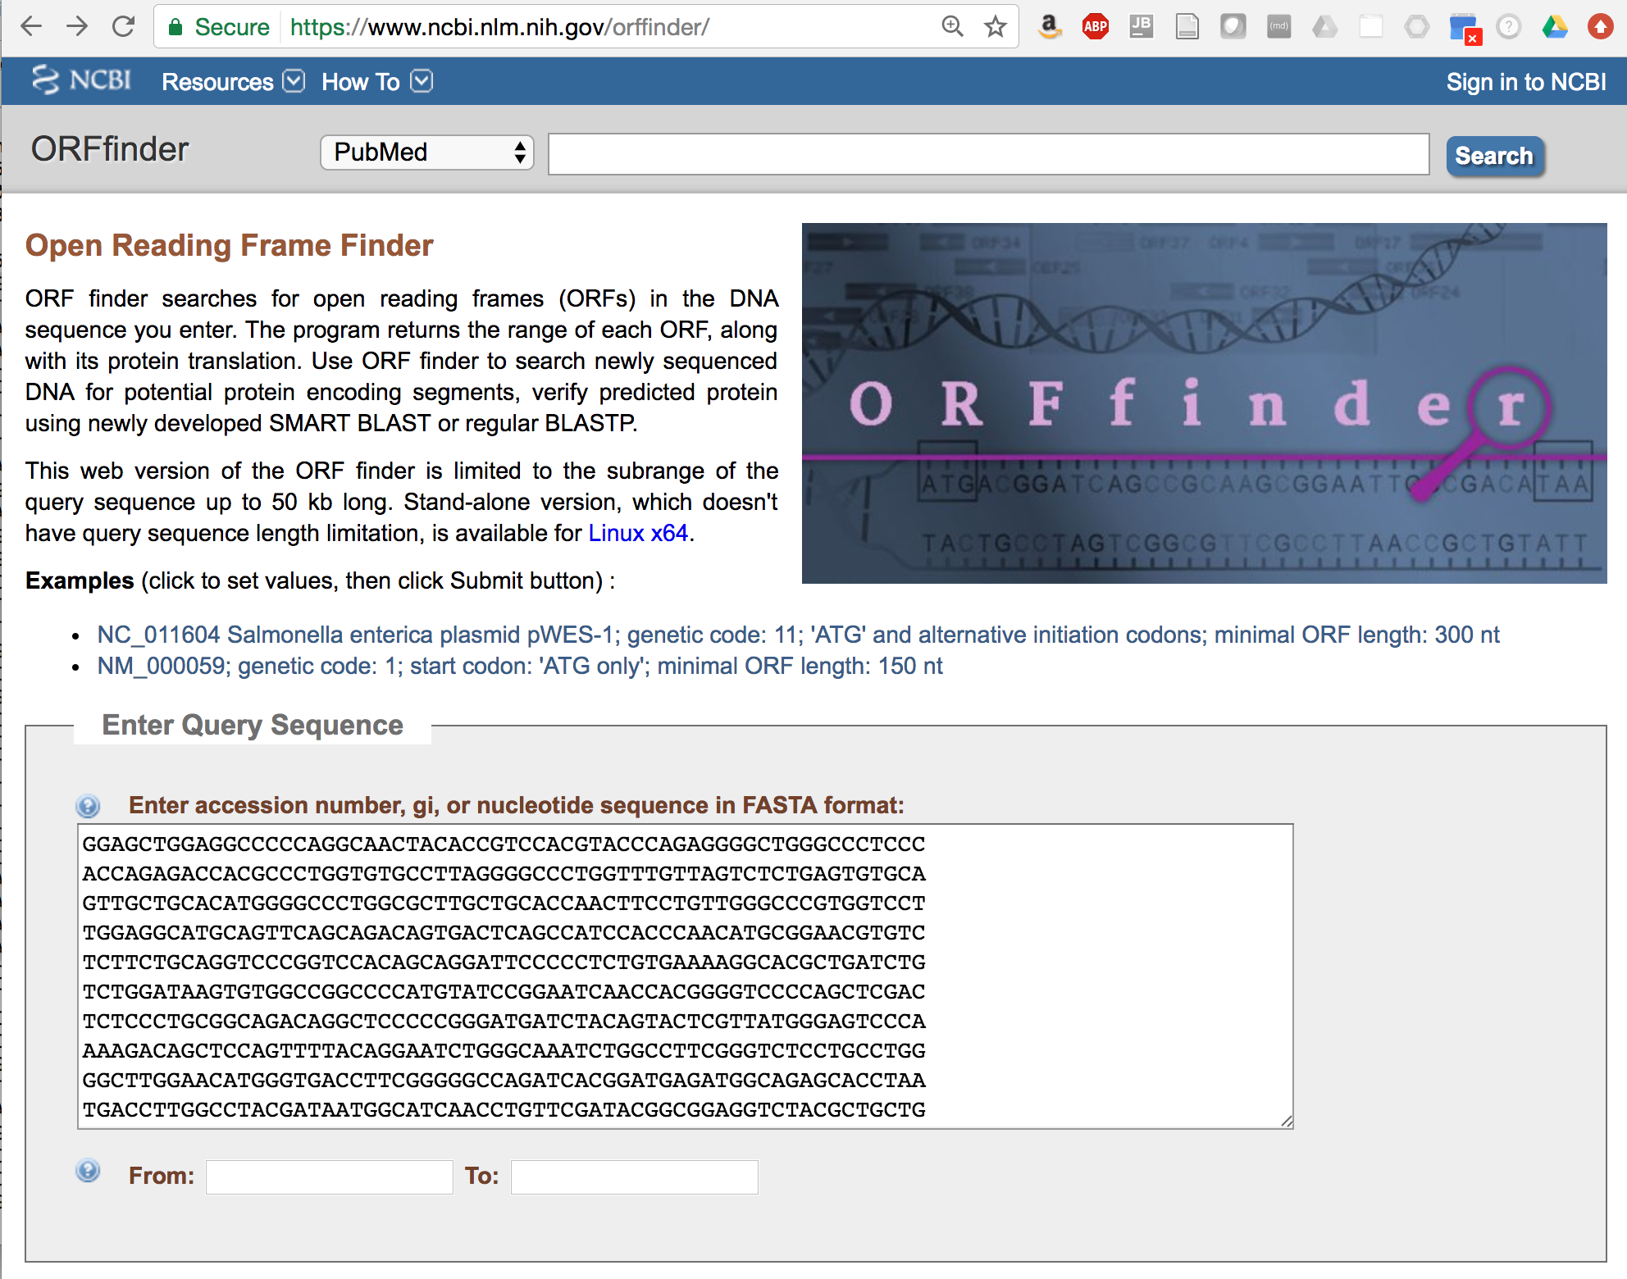
Find all ORFs using ORFfinder
Module
bioinformatics.ca
Notes:
A useful tool for exploring potential open reading frames is ORFfinder, available at NCBI.
Here, we can paste in our transcript sequence

Slide 16
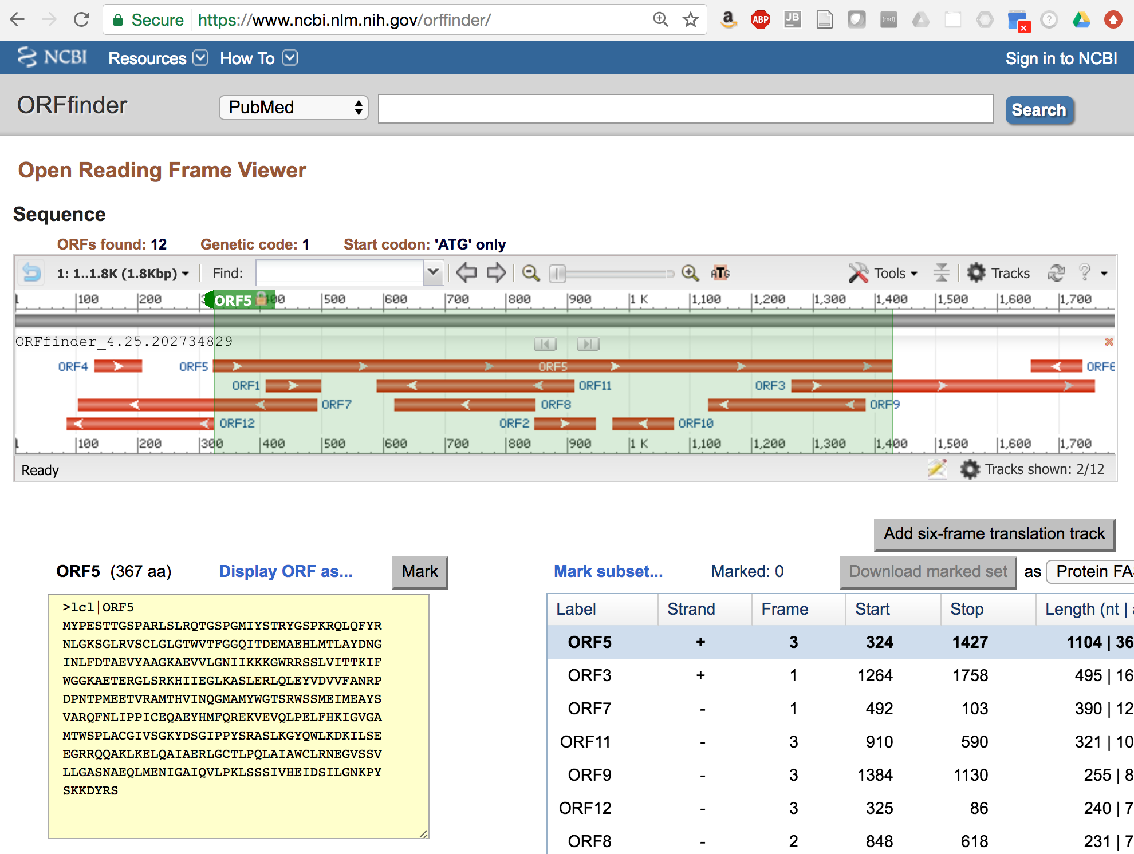
ORFfinder finds all open reading frames and provides translations
ORFs can appear in random sequence – so further analysis is required
Predict coding vs. non-coding ORFs: http://TransDecoder.github.io
Module
bioinformatics.ca
Notes:
And it will report all possible ORFs identified in each of the 6 possible reading frames that meet the minimum ORF length criteria specified.
In this example, we have 12 ORFs found, with one of them being fairly long and the range of this longest ORF is highlighted in the display.
Note, for the transcript to be protein-coding, we should find an ORF, as we know an ORF is required for translation of the corresponding polypeptide, but not all ORFs that we find are true protein-coding regions.
---
ORFs can appear in random sequences. The longer the ORF, generally the less likely it would appear in random sequence and the more likely it is a true protein coding ORF, but this is also highly dependent on the composition of the nucleotide sequence, particularly the GC content.
We can study these ORFs in more detail to see if they have characteristics that would further suggest that they are coding, such as considering codon usage bias and other sequence features.
---
We developed a tool called TransDecoder which does just this, examining each of the ORFs and examining the nucleotide composition of the sequence to predict whether it is a likely coding sequence.

Slide 17
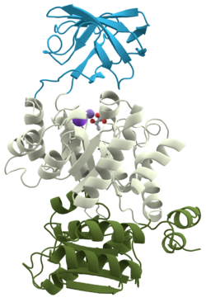
Can we recognize functional domains in putative coding regions?
Hints at substrate binding or catalytic activity
DNA, RNA, calcium, phoshate, etc.
Glycoslase, methylase, kinase, nuclease, lipase, protease, etc.
Module
bioinformatics.ca
Notes:
We can further examine the predicted proteins to see if they contain sequence patterns that are consistent with certain types of functional domains that tend to show up in modular proteins and could provide hints at substrates bound by the protein or a catalytic activity.
https://upload.wikimedia.org/wikipedia/commons/thumb/7/7a/Pyruvate_kinase_protein_domains.png/250px-Pyruvate_kinase_protein_domains.png

Slide 18
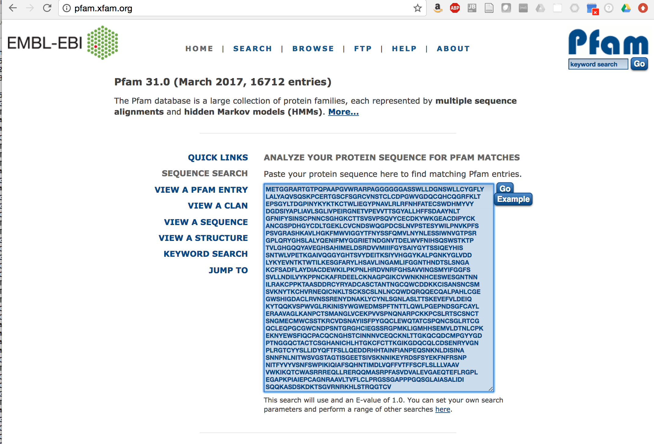
Search the Pfam library of HMMs to identify potential functional domains
Module
bioinformatics.ca
Notes:
A useful way to search for functional domains is by searching your protein sequence through Pfam.
Pfam provides a collection of hidden markov models representing patterns of conservation across diverse sequences that represent functional domains.
At the Pfam website, you can submit a protein sequence derived from one of your ORFs …
ATRNL1 : https://en.wikipedia.org/wiki/Protein_domain

Slide 19
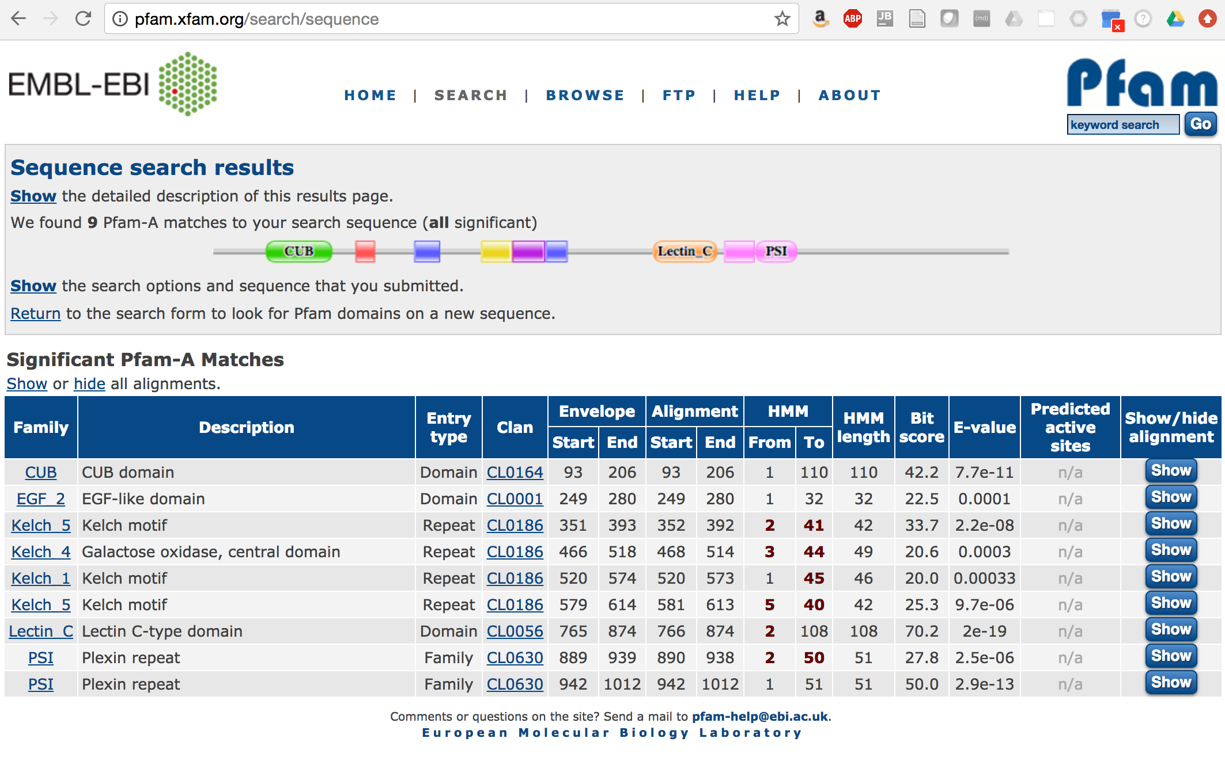
Example Pfam report illustrating modular domain architecture
Module
bioinformatics.ca
Notes:
And it will report all the domains identified in the library that were found to occur with as significant score in your inputted protein sequence.
There’ll be a report indicating the motif type and a graphic at the top of the report showing the position of all the different domains that were found.
Based on the domain found or a combination of domains found, you may be able to infer biological functions encoded by your protein sequence.

Slide 20
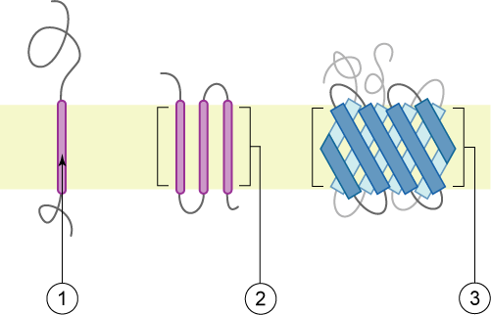
Transmembrane Proteins
Membrane
Polytopic transmembrane α-helical protein
Polytopic transmembrane β-sheet protein
Single transmembrane α-helix (bitopic membrane protein)
From: https://en.wikipedia.org/wiki/Transmembrane_protein
bioinformatics.ca
Module
Notes:
Another analysis we can perform is to see if the protein sequence has characteristics of a transmembrane protein.
Transmembrane proteins contain one or more hydrophobic sequence regions that span across the membrane from the inside to the outside of the cell, and there are computational methods that we can apply to explore whether our protein sequence contains features that are consistent with these properties of transmembrane proteins.

Slide 21
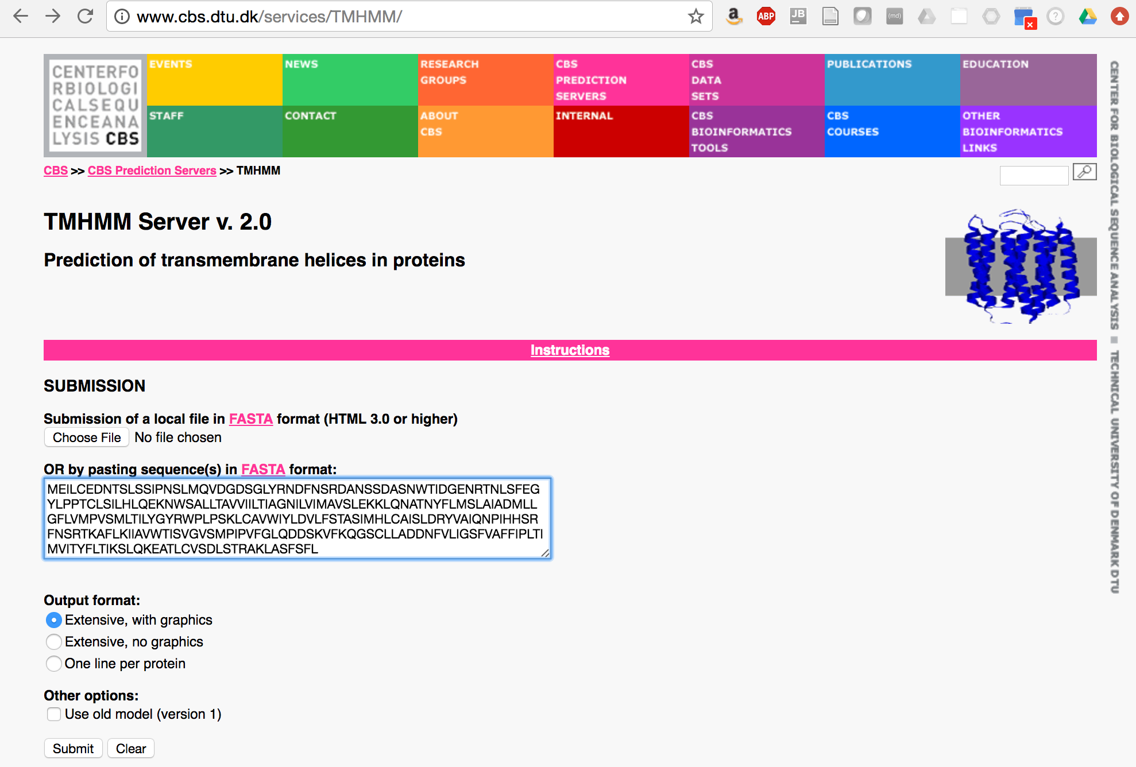
Using TMHMM to identify putative transmembrane proteins
Module
bioinformatics.ca
Notes:
A tool called TMHMM made available by the Technical University of Denmark. TMHMM uses a Hidden Markov Model to predict transmembrane spanning regions within proteins and the topology of the membrane spanning regions with respect to the inside and outside of the cell.
On their website, you can submit your protein sequence….

Slide 22
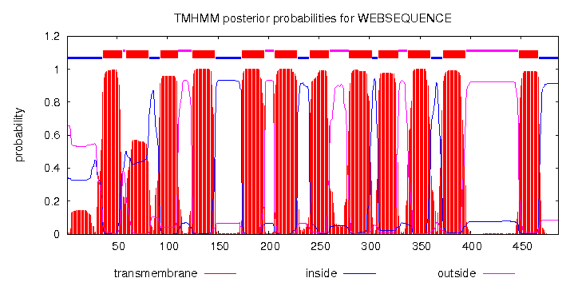
Trans-membrane Domains via TmHMM
Topology=i36-55o59-81i93-110o125-147i174-196o206-228i241-260o280-302i309-328o338-360i373-395o448-467i
http://www.cbs.dtu.dk/services/TMHMM/
Module
bioinformatics.ca
Notes:
And in the case you have a predicted transmembrane protein, it will return a graphic showing the position of the predicted transmembrane along with the overall topology including the intervening protein segments that are predicted to be inside or outside of the cell. The graph provides the posterior probability of residues existing in each of the different states of the model, and there’s a graphic at top that provides a summary of the final prediction illustrating the predicted membrane topology.

Slide 23
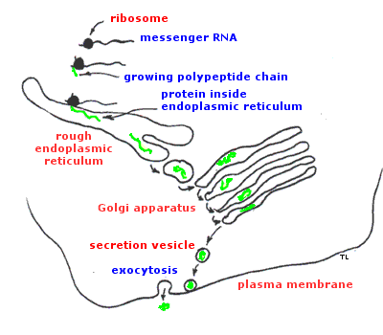
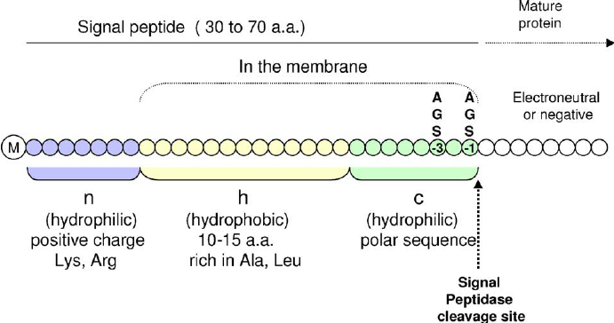
Predicting Secreted Proteins
(from: Vaccine 23(15):1770-8)
(from: https://courses.washington.edu/conj/cell/secretion.htm)
Module
bioinformatics.ca
Notes:
Another class of biological functions that can be predicted from sequence are secretion signals.
In eukaryotes, secreted proteins are translated by the ribosome and inserted into the endoplasmic reticulum where they are eventually packaged into secretory vessicles and released outside the cell.
---
These proteins are targeted to the endoplasmic reticulum by a short 30 to 70 residue N-terminal peptide sequence which has certain sequence features including a hydrophobic core and a cleavage site where that signal peptide is eventually recognized and cleaved as it enters the endoplasmic reticulum.
Secreted proteins in bacteria also have similar N-terminal signal peptides that can be recognized, but, of course, the secretion systems works differently.
Pics from: https://courses.washington.edu/conj/cell/secretion.htm
And
https://www.researchgate.net/figure/7999886_fig3_Fig-3-Typical-tripartite-structure-of-the-N-terminal-signal-peptide-of-preproteins

Slide 24
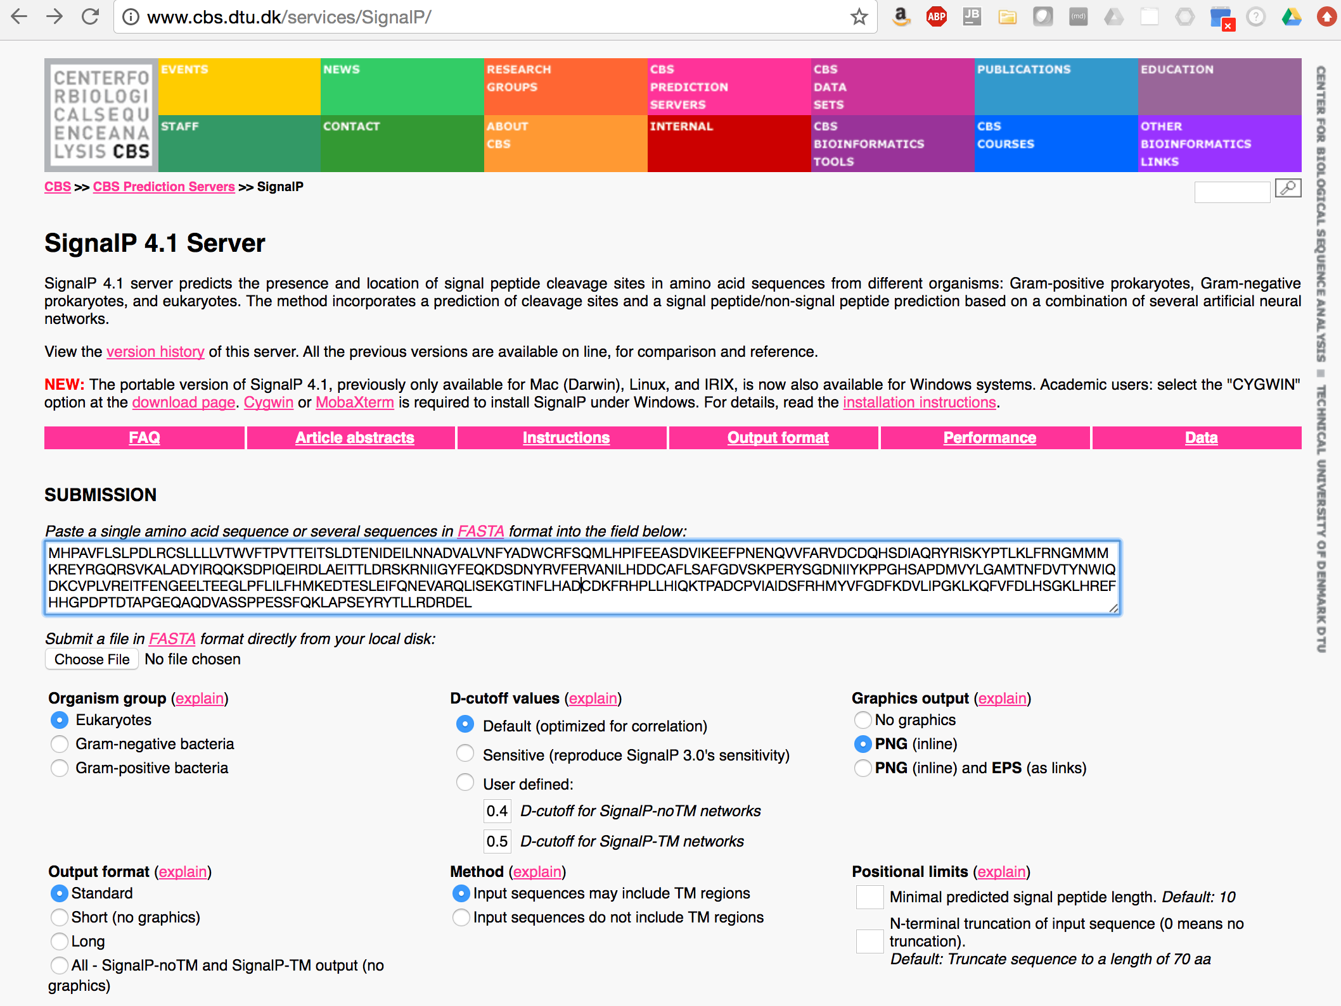
SignalP: Prediction of N-terminal signal peptides
(predict secreted proteins)
Module
bioinformatics.ca
Notes:
The Technical University of Denmark has another useful tool called SignalP that can be used to predict secreted proteins by analyzing the N-terminal region of your protein sequence. This system uses a Neural Network to predict signal peptides.

Slide 25
Example SignalP predicted signal peptide
Signal peptide score
Combined score
Cleavage site score
Module
bioinformatics.ca
Notes:
The output includes a graphic that summarizes scores for the signal peptide, including a scoring of residues for the signal peptide sequence and a separate score for the cleavage site itself.
A combined score that takes into account both the signal peptide and cleavage site score is used to make the final determination of the signal peptide prediction.

Slide 26
Transcriptome-scale functional annotation using Trinotate
TMHMM
TransDecoder
SignalP
Module
bioinformatics.ca
Notes:
Using all of these web-based tools is fine for examining a small number of protein sequences, but it’s not something that scales well to studying more than that, and for studying a whole transcriptome, we’ll need to run these analyses for many thousands of sequences.
We developed a tool called Trinotate that automates running these different tools including predicting coding ORFs using TransDecoder, performing blast searches of transcripts and predicted ORFs against Swiss-Prot, extracting Gene Ontology assignments from the corresponding Swiss-Prot records, running Pfam to search for protein domains, TMHMM to identify putative membrane proteins, and signalP to identify putative secreted proteins.
The results are all stored into a database, and a tab-delimited report is generated to allow you to more easily explore the functional annotations across the many thousands of transcripts, and perform other analyses.

Slide 27
There’s no substitute for experimentally validating protein functions
Module
bioinformatics.ca
Notes:
Of course, if you find a transcript that is fundamentally important to your biological investigations, there’s no substitute to experimentally validating or further exploring its potential function.
Pic from: http://www.transformleaders.tv/wp-content/uploads/2012/03/Experiment.jpg

Slide 28
We are on a Coffee Break & Networking Session

