Slide 1
Canadian Bioinformatics Workshops
www.bioinformatics.ca

Slide 2
Module #: Title of Module
2

Slide 3
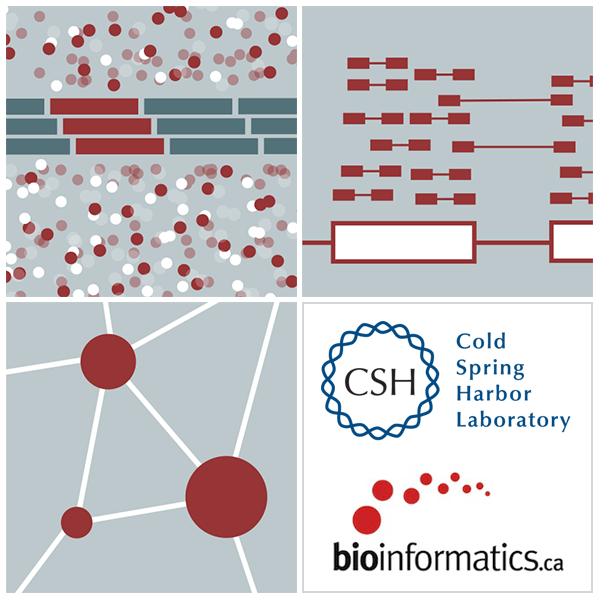
Informatics for RNA-seq Analysis
Malachi Griffith and Obi Griffith May 28-30, 2018

Slide 4
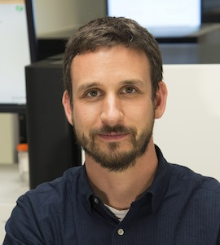
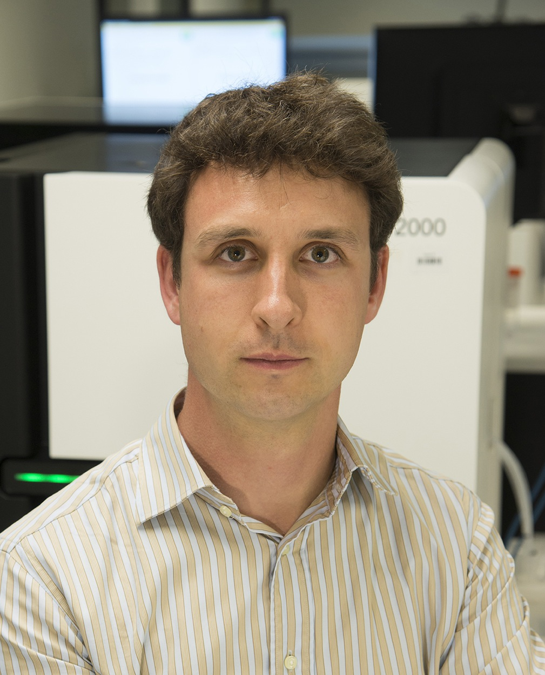
Introductions to MGI/WUSTL instructors
Malachi Griffith Assistant Professor of Medicine Assistant Professor of Genetics
Assistant Director, MGI
Obi Griffith, PhD
Assistant Professor of Medicine Assistant Professor of Genetics
Assistant Director, MGI
McDonnell Genome Institute, Washington University School of Medicine

Slide 5
The McDonnell Genome Institute has pursued the field of genomics since inception: >1000 whole genomes, >5000 exomes, >1000 transcriptomes for dozens of tumor types
Human Genome Project
First to sequence and analyze a tumor whole genome sequence (Ley et al, 2008)
Major contributor to TCGA, PCGP, etc.
Most comprehensively sequenced single patient tumor ever published (Griffith et al, 2015)
Early proof-of-principle for cancer precision medicine (Griffith et al, 2016)
Analysis and tools for first personalized cancer vaccine design in humans (Carreno et al, 2015)
Many other widely used tools
Cancer types
Cases
MGI – 1000+ tumor whole genomes, many more exomes, X10 & NovaSeq will accelerate this!
Notes:
The McDonnell Genome Institute has been a leader in the field of cancer genome analysis from the first tumor genome to be sequenced (an AML case led by Dr. Tim Ley), to major contributions to large consortium efforts such as the Cancer Genome Atlas (TCGA) and Pediatric Cancer Genome Project (PCGP), to the most deeply sequenced individual tumor to date, to proof-of-principle cases for demonstrating the potential sequencing to guide cancer care, to the development of analysis methods and tools for some of the first trials of personalized cancer vaccines, and many other widely used tools. To date we have sequenced more than 1000 cancer whole genomes, more than 5000 whole exomes, and more than 1000 transcriptomes from dozens of tumor types. This represents a substantial fraction of the tumor genomes sequenced world wide.

Slide 6
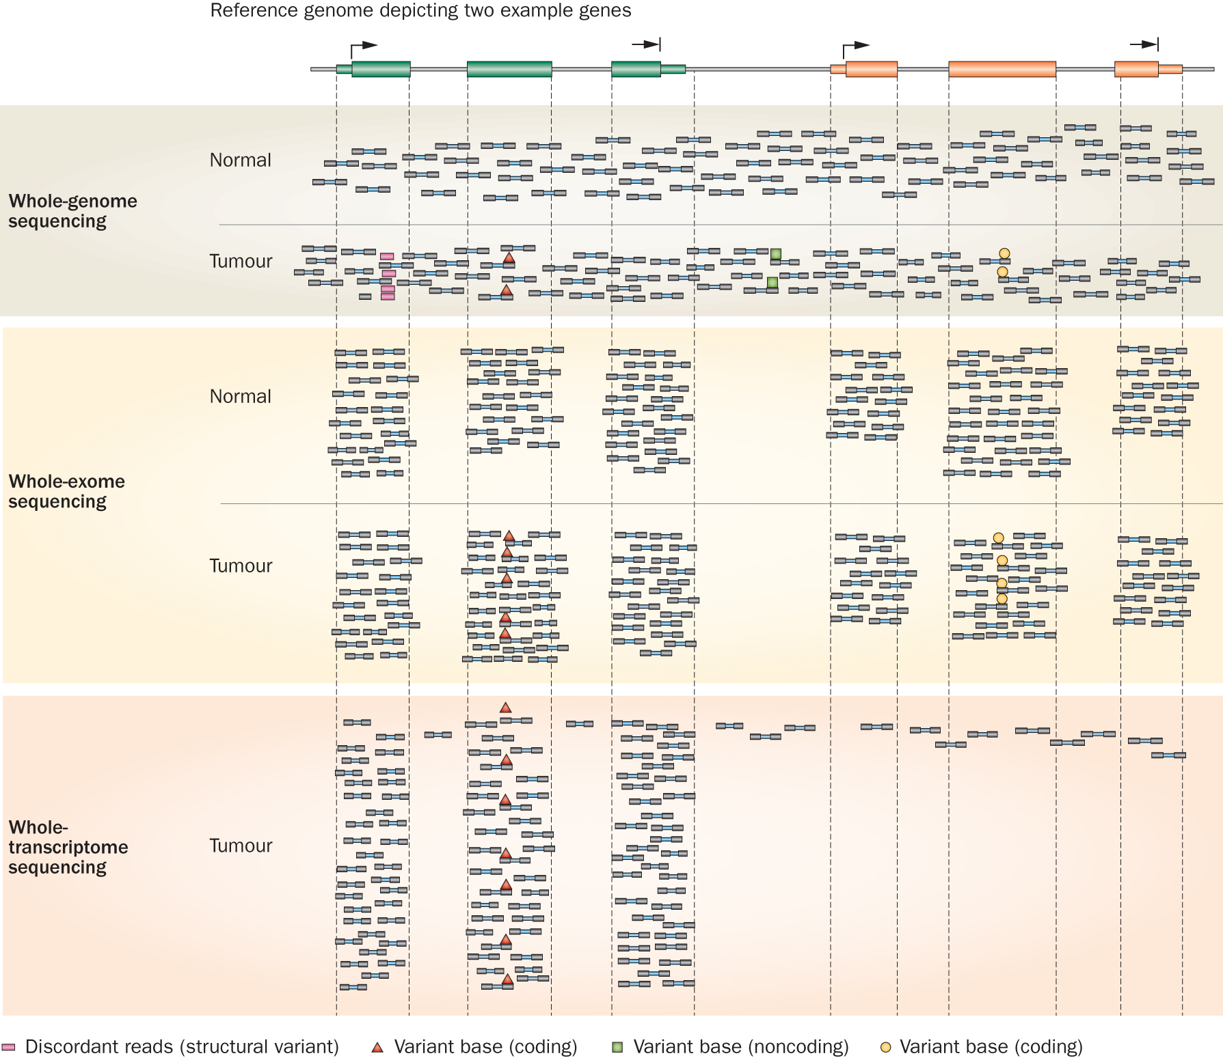
Whole genome, exome, transcriptome and other ‘omic’ sequencing allows us to detect and confirm many different variant types
‘WGS’
‘Exome’
‘RNA-seq’
Notes:
Each of these three data types, whole genome, exome and transcriptome, brings something to the table.
Whole genome gives you broad, even, and relatively unbiased coverage across the genome.
Exome gives you more focused coverage but much greater depth over the exons for a much lower cost than whole genome
RNA-seq gives you a snapshot of the transcriptome.

Slide 7
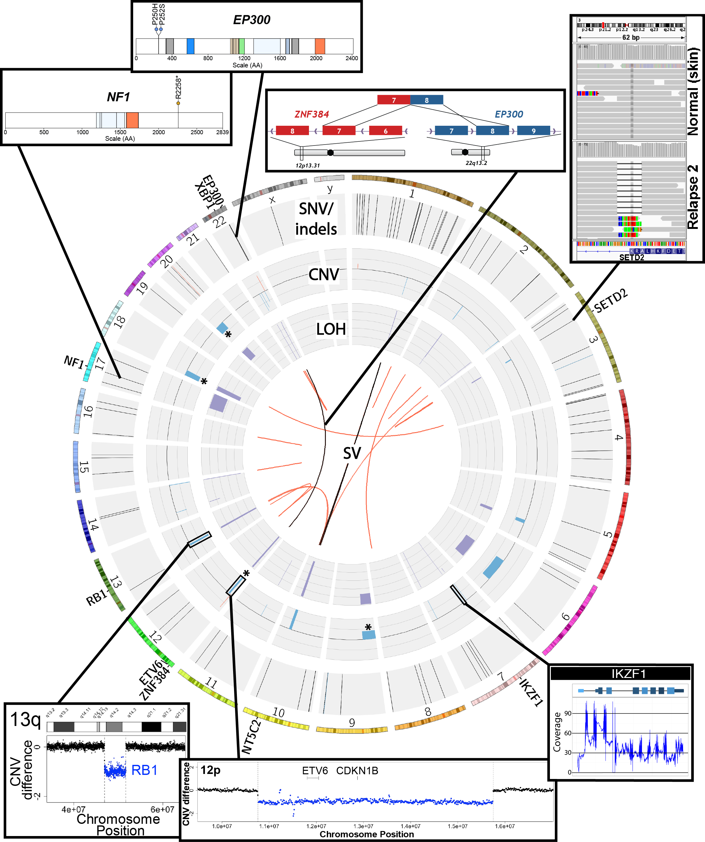
SNVs, Indels, CNVs, SVs, fusions, LOH, expression changes, methylation changes, and more
Notes:
Ultimately, an extremely comprehensive analysis was performed on this relapse tumor.
Many fascinating events were identified
The genome was characterized by a reasonable number of protein coding point mutations including those affecting EP300 and NF1.
While very little amplification was observed several rearrangements and both large and small deletions were apparent. These affected SETD2, XBP1, Ikaros, RB1, ETV6. SETD2 and NF1 were both hit twice.
An interesting EP300-ZNF384 fusion was identified.
At the time it was novel but has since been associated with other ALL patients.
While certainly interesting, none of these genomic events particularly suggested any clinical action.

Slide 8
Comprehensive and integrative analysis methods are needed
Kilannin Krysiak
Notes:
As a proof-of-principle we took a very comprehensive approach. Though we balanced this with the need to complete data generation and a first version of the analysis quickly (41 days from receipt of sample to return of information).
By this time (2nd relapse), the patient had an extensive cytogenetics workup. To this we added exome, whole genome and RNA-seq.
Based on the WGS data we also created a custom NimbleGen capture reagent to cover all SNVs in the patient.
We used these data to identify SNVs and Indels, copy number variants, SVs, expressed variants, fusions, and outlier gene expression events.
The custom capture data was used largely to monitor disease burden in bone marrow samples obtained subsequent to the second relapse (and historical samples that were previously banked).

Slide 9
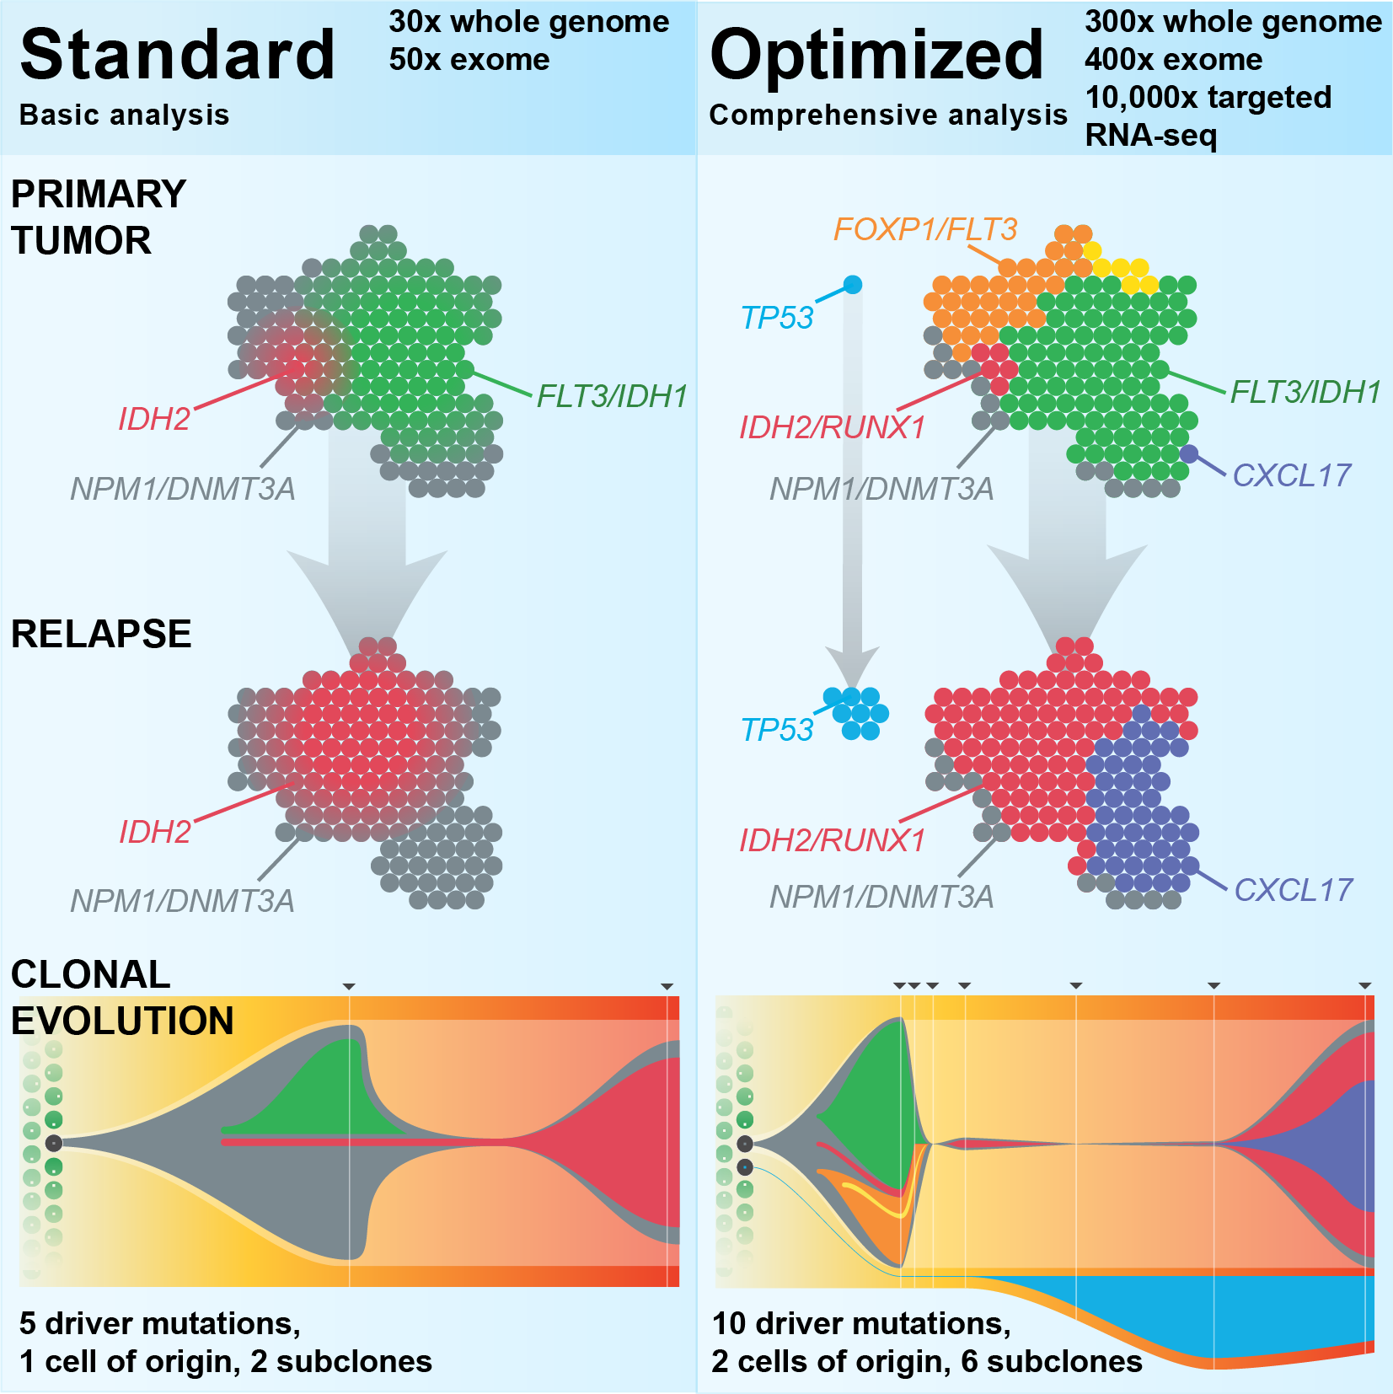
Each study often requires considerable customization
Kilannin Krysiak
Griffith et al. 2015

Slide 10
Personalized medicine requires personalized strategies
Kilannin Krysiak
Griffith et al. 2016

Slide 11
High-throughput sequencing has been largely automated
Good BM, Ainscough BJ, McMichael JF, Su AI, Griffith OL. 2014. Genome Biology. 15(8):438.
Joshua McMichael
Notes:
We have an embarrassment of riches with all of the –omic events now being detected (though there is plenty of room for improvement!).
We are starting to have a handle on doing this routinely and quickly. We can generate the raw data, feed it into automated pipelines that process the data and predict genomic events. Filtering, review and validation thins these lists down to somewhat tractable counts of 10s to 100s of events. Where we are really stuck now is at the interpretation and report generation stage. This is a major bottleneck. The ‘genome analysts’ who have the skill sets to assemble final reports that a clinician might find useful are completely swamped.
One way to address this I already talked about. Education. We can train more of these genomics experts. But we also need to harness informatics strategies to make their job easier and address the bottleneck. With that in mind we are pursuing various data mining, crowd sourcing, natural language processing, etc.

Slide 12
The rest of this workshop will focus on the methods and tools needed to take raw sequence data to interpretation and application – still the bottleneck!
Good BM, Ainscough BJ, McMichael JF, Su AI, Griffith OL. 2014. Genome Biology. 15(8):438.
Joshua McMichael
Notes:
We have an embarrassment of riches with all of the –omic events now being detected (though there is plenty of room for improvement!).
We are starting to have a handle on doing this routinely and quickly. We can generate the raw data, feed it into automated pipelines that process the data and predict genomic events. Filtering, review and validation thins these lists down to somewhat tractable counts of 10s to 100s of events. Where we are really stuck now is at the interpretation and report generation stage. This is a major bottleneck. The ‘genome analysts’ who have the skill sets to assemble final reports that a clinician might find useful are completely swamped.
One way to address this I already talked about. Education. We can train more of these genomics experts. But we also need to harness informatics strategies to make their job easier and address the bottleneck. With that in mind we are pursuing various data mining, crowd sourcing, natural language processing, etc.

Slide 13
The Griffith lab is focused on developing methods to address this bottleneck for precision medicine in cancer
Cancer genome analysis
AML
Optimizing cancer genome analysis
Breast cancer
Immunotherapy (cancer vaccines)
STAT1-/- mouse model
Targeted sequencing of 625 ER+ with long-term follow-up
Liver cancer
Small cell lung cancer
OSCC…
Precision Medicine for Cancer
Genomics Tumor Board
Case Reports and Clinical Trials
Education projects
RNA-seq analysis and cloud computing
CSHL and CBW
Genomic Data Visualization/Interpretation
Tool development

Slide 14
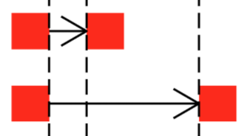
Where tools/resources do not exist we build them
www.dgidb.org
Search genes for known and potentially druggable interactions
https://github.com/griffithlab/pVAC-Seq
Personalize vaccine design
www.docm.info
Filter against highly curated set of mutations known to cause cancer
GenVisR
https://github.com/griffithlab/GenVisR
Create genomic visualizations
www.civicdb.org
Identify highly curated summaries of clinical interpretations for variants in cancer
regtools
https://github.com/griffithlab/regtools
Identify regulatory variants

Slide 15
Encourage best practices for software development
All code deposited in Github
35 repos for different software/projects
Virtually all public and open-source
Test-driven, code review, pull requests, etc
https://github.com/griffithlab
https://github.com/genome

Slide 16
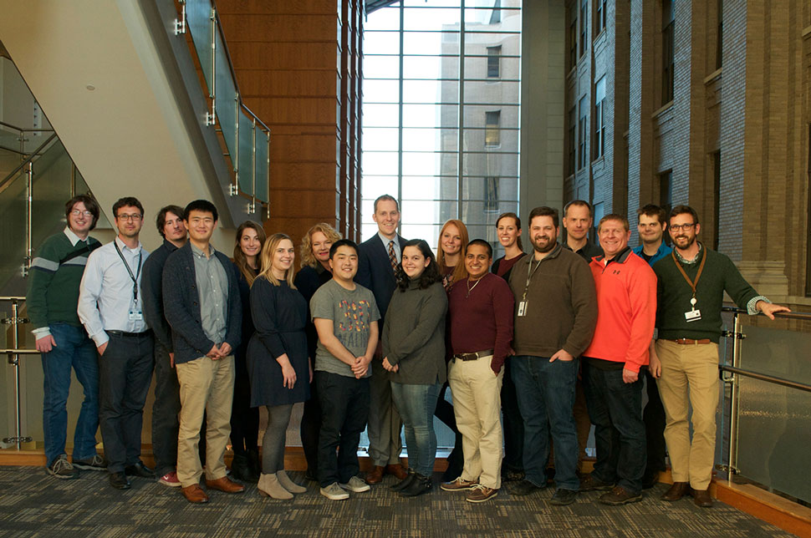
WUSTL – MGI: Group members
Notes:
Not shown: Lynzey Kujan (Intern), Susanna Kiwala,

Slide 17
Informatics background poll
Student poll
Are you doing genomics research?
Do you consider yourself a bioinformatician?
What kind of NGS data are you working with?
WGS?
Exome?
RNAseq?
Epigenome?
Single cell?
Other?
What organism do you work with?
Does it have a reference genome?
Did you bring data?

Slide 18
Student poll continued
Not counting the pre-requisites and materials for this course:
Are you familiar with linux/command line?
Intermediate?
Expert?
Do you sometimes write code?
What language?
Are you familiar with R?
Intermediate?
Expert?
Are you familiar with ggplot?
Intermediate?
Expert?
Do you use git/github?

Slide 19
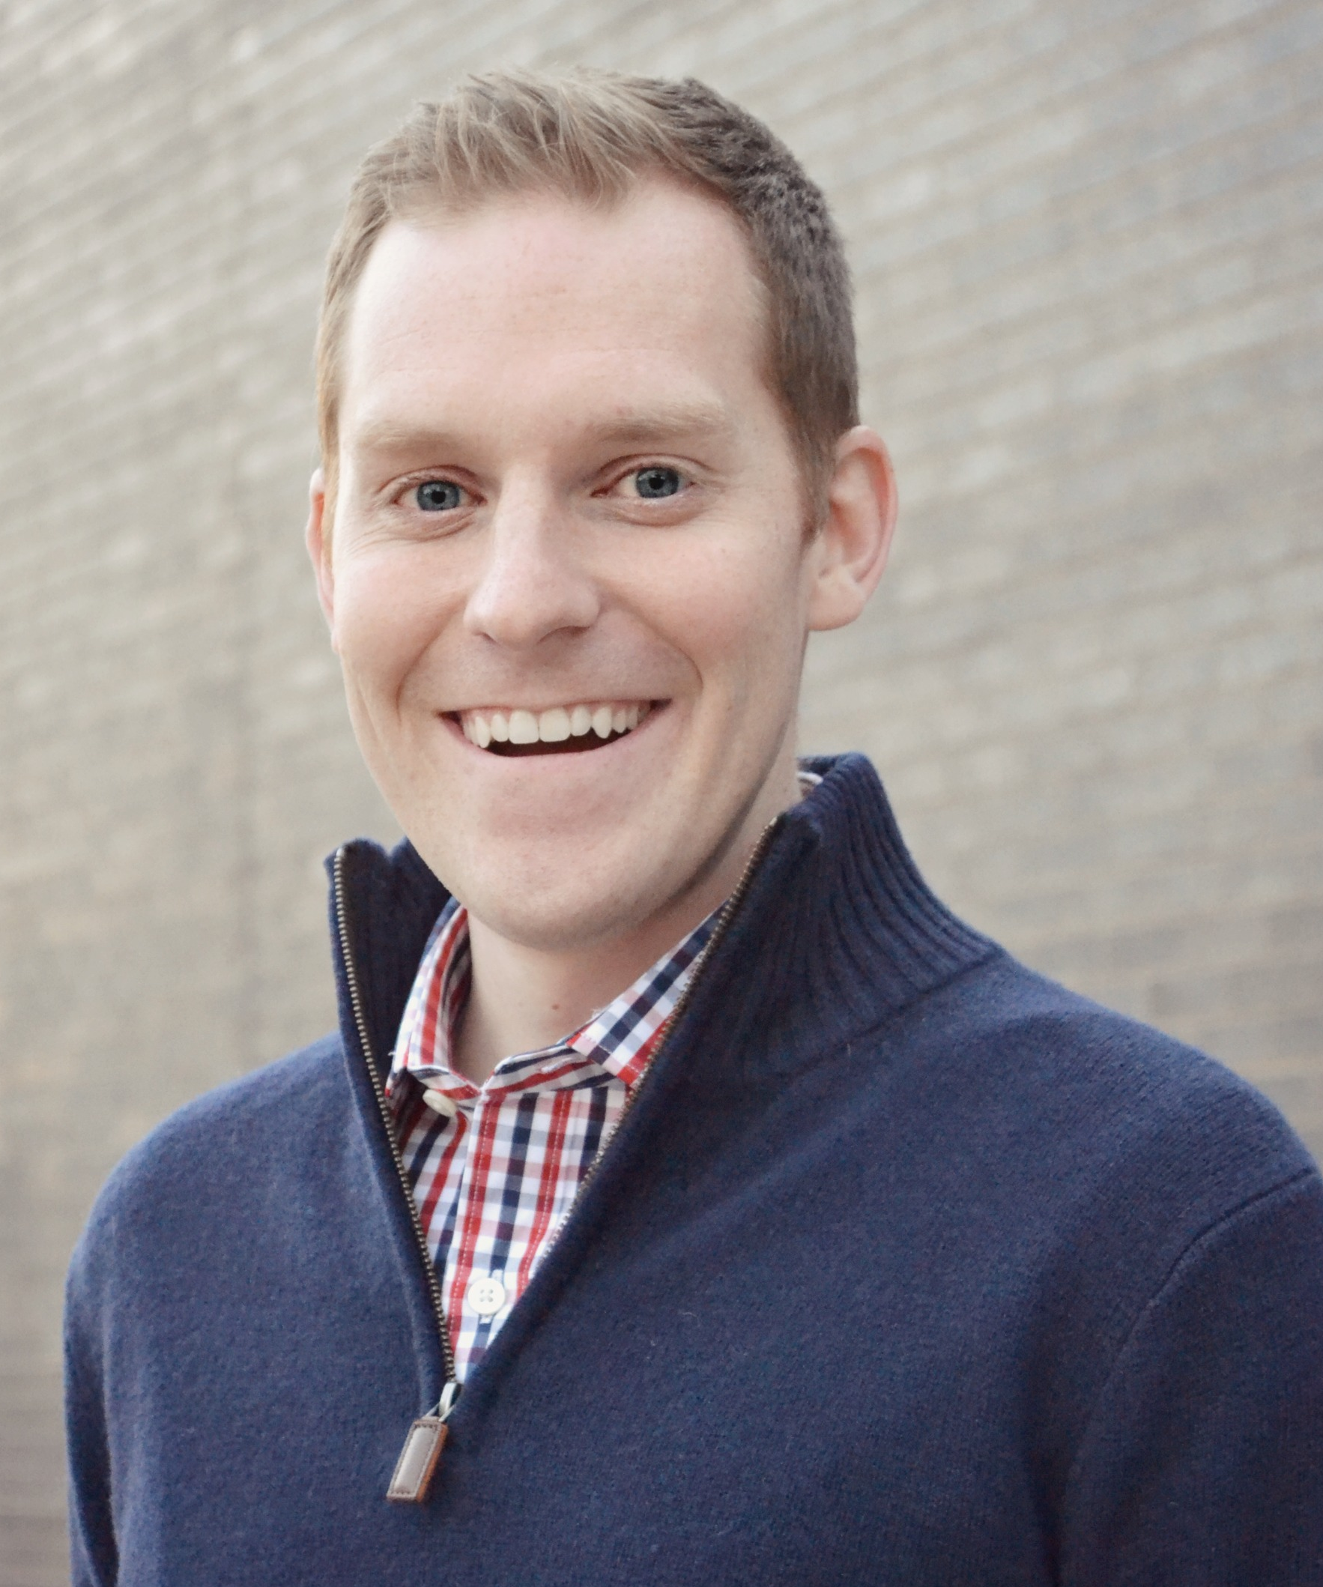
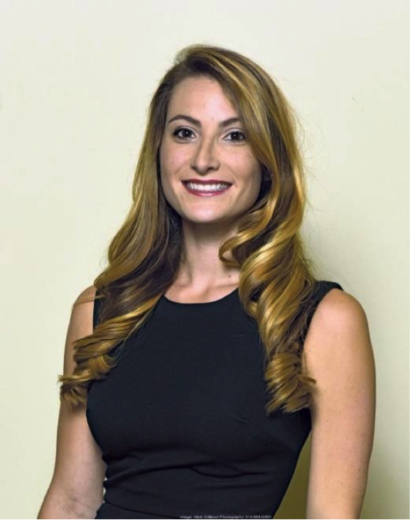
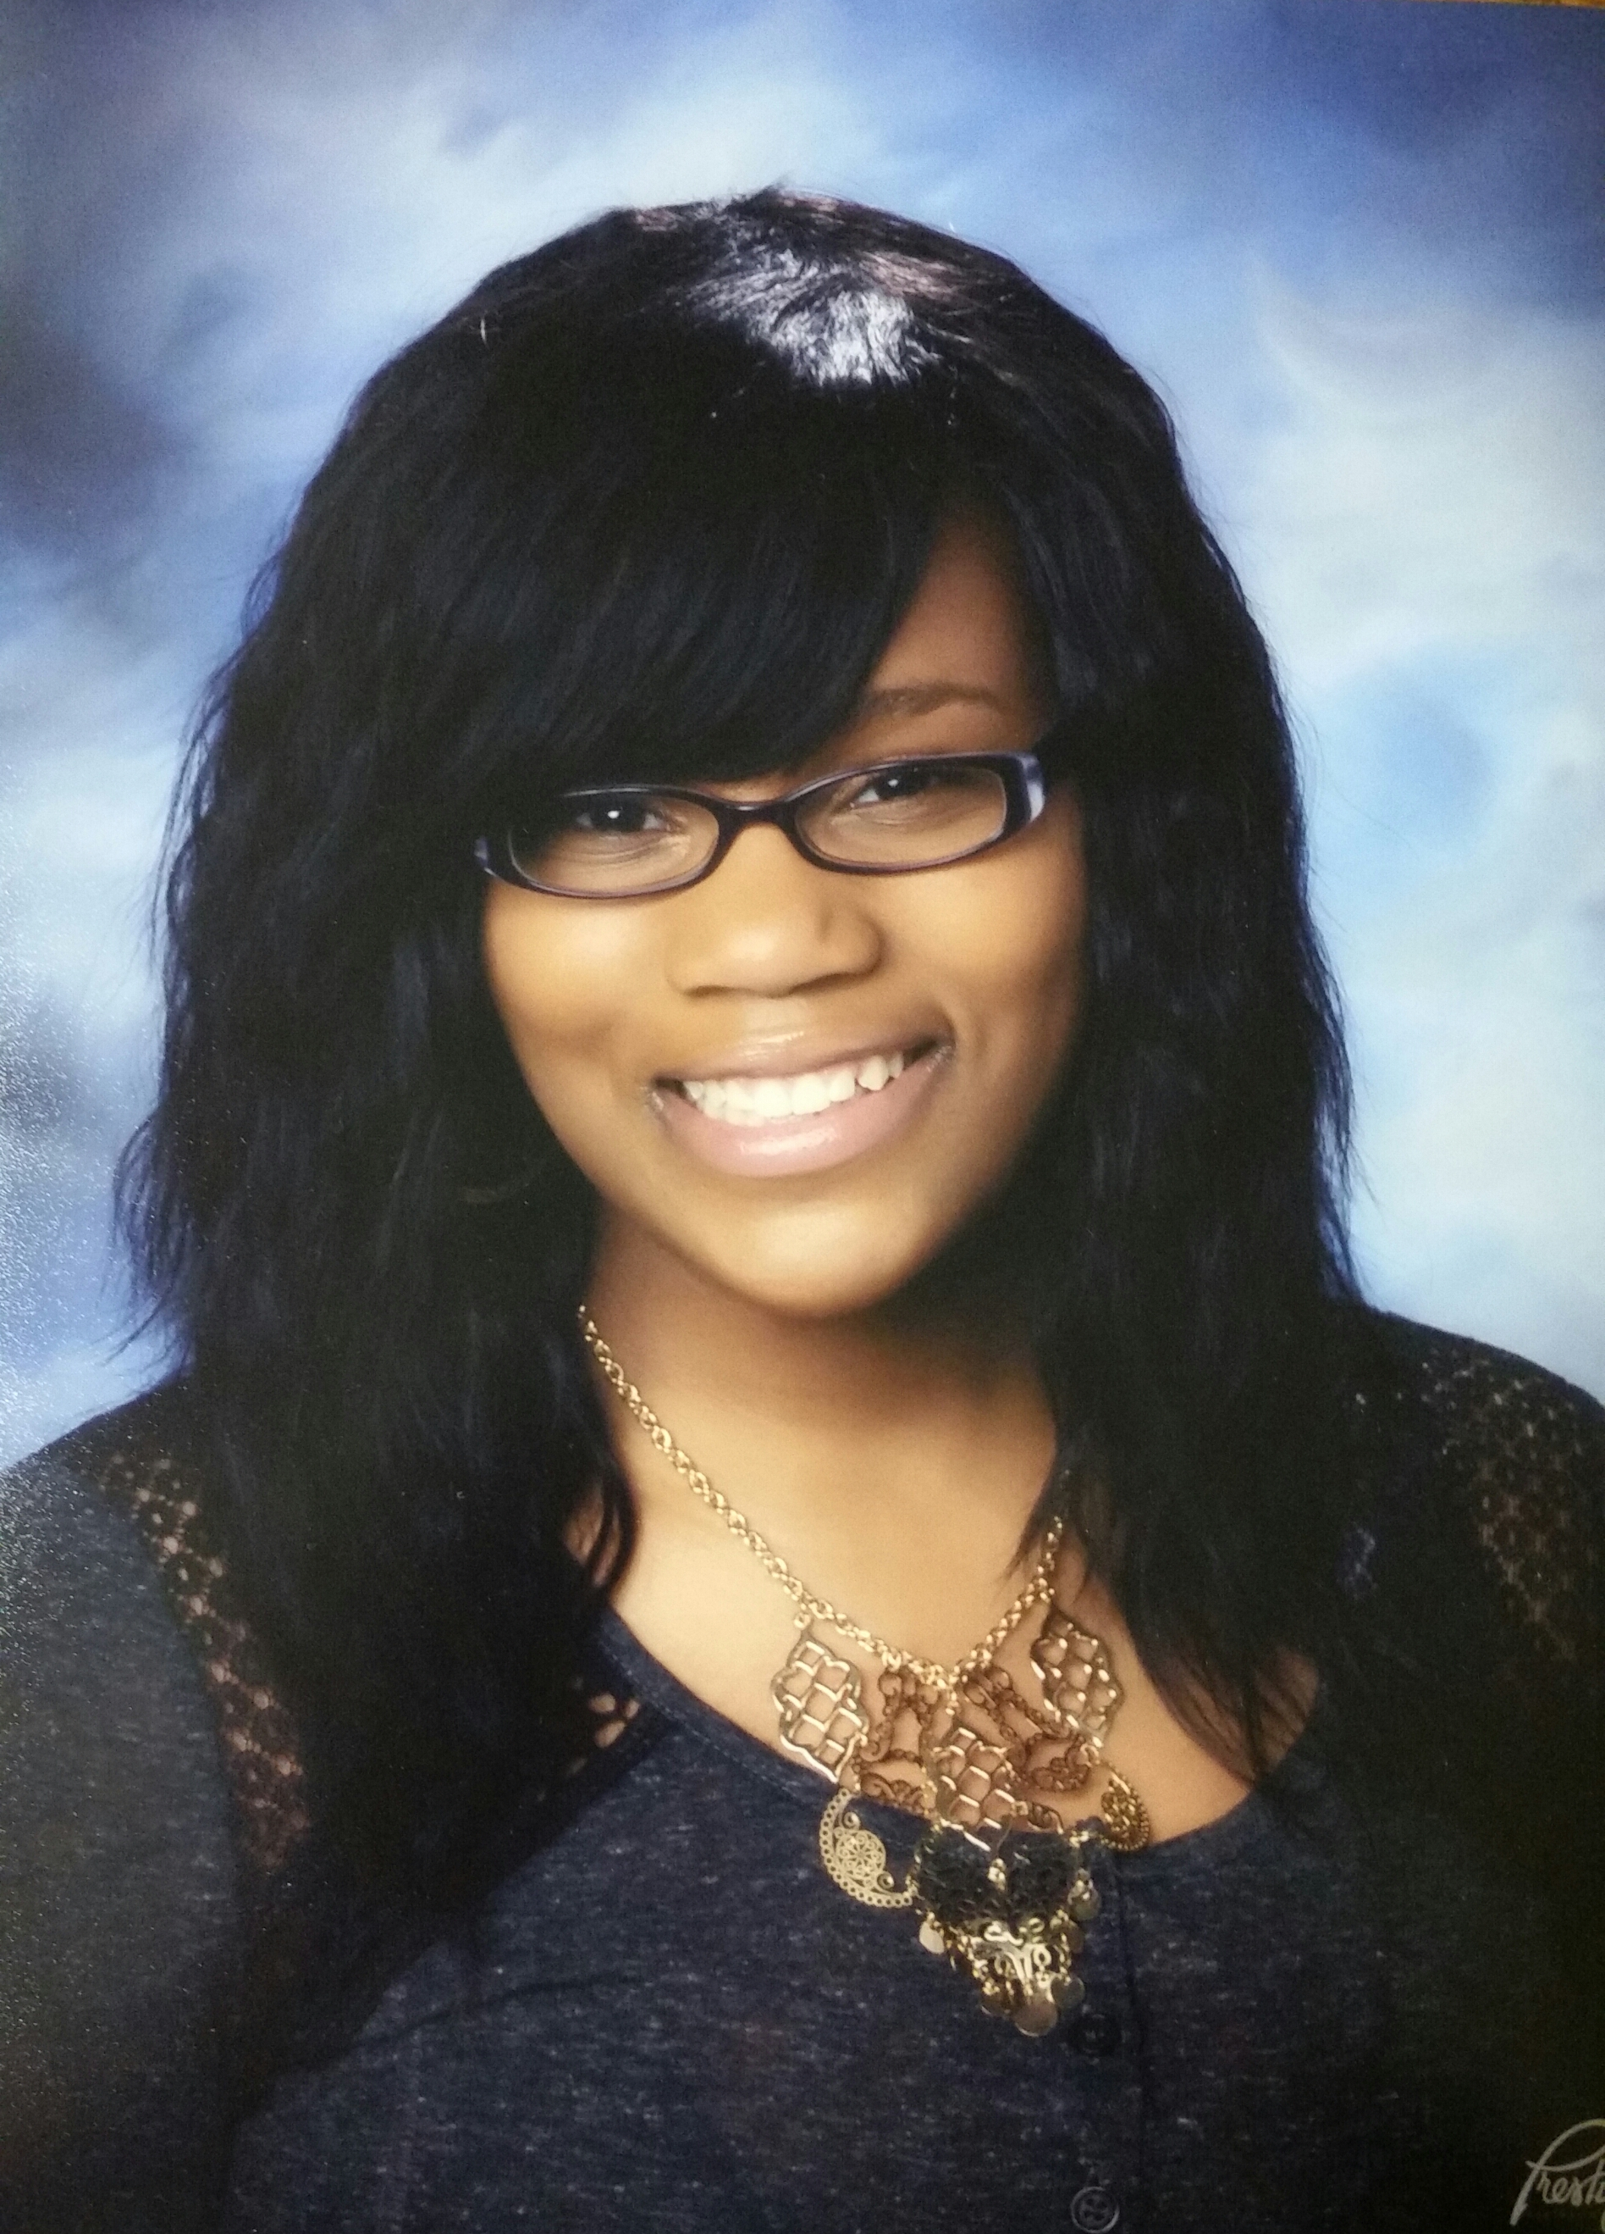
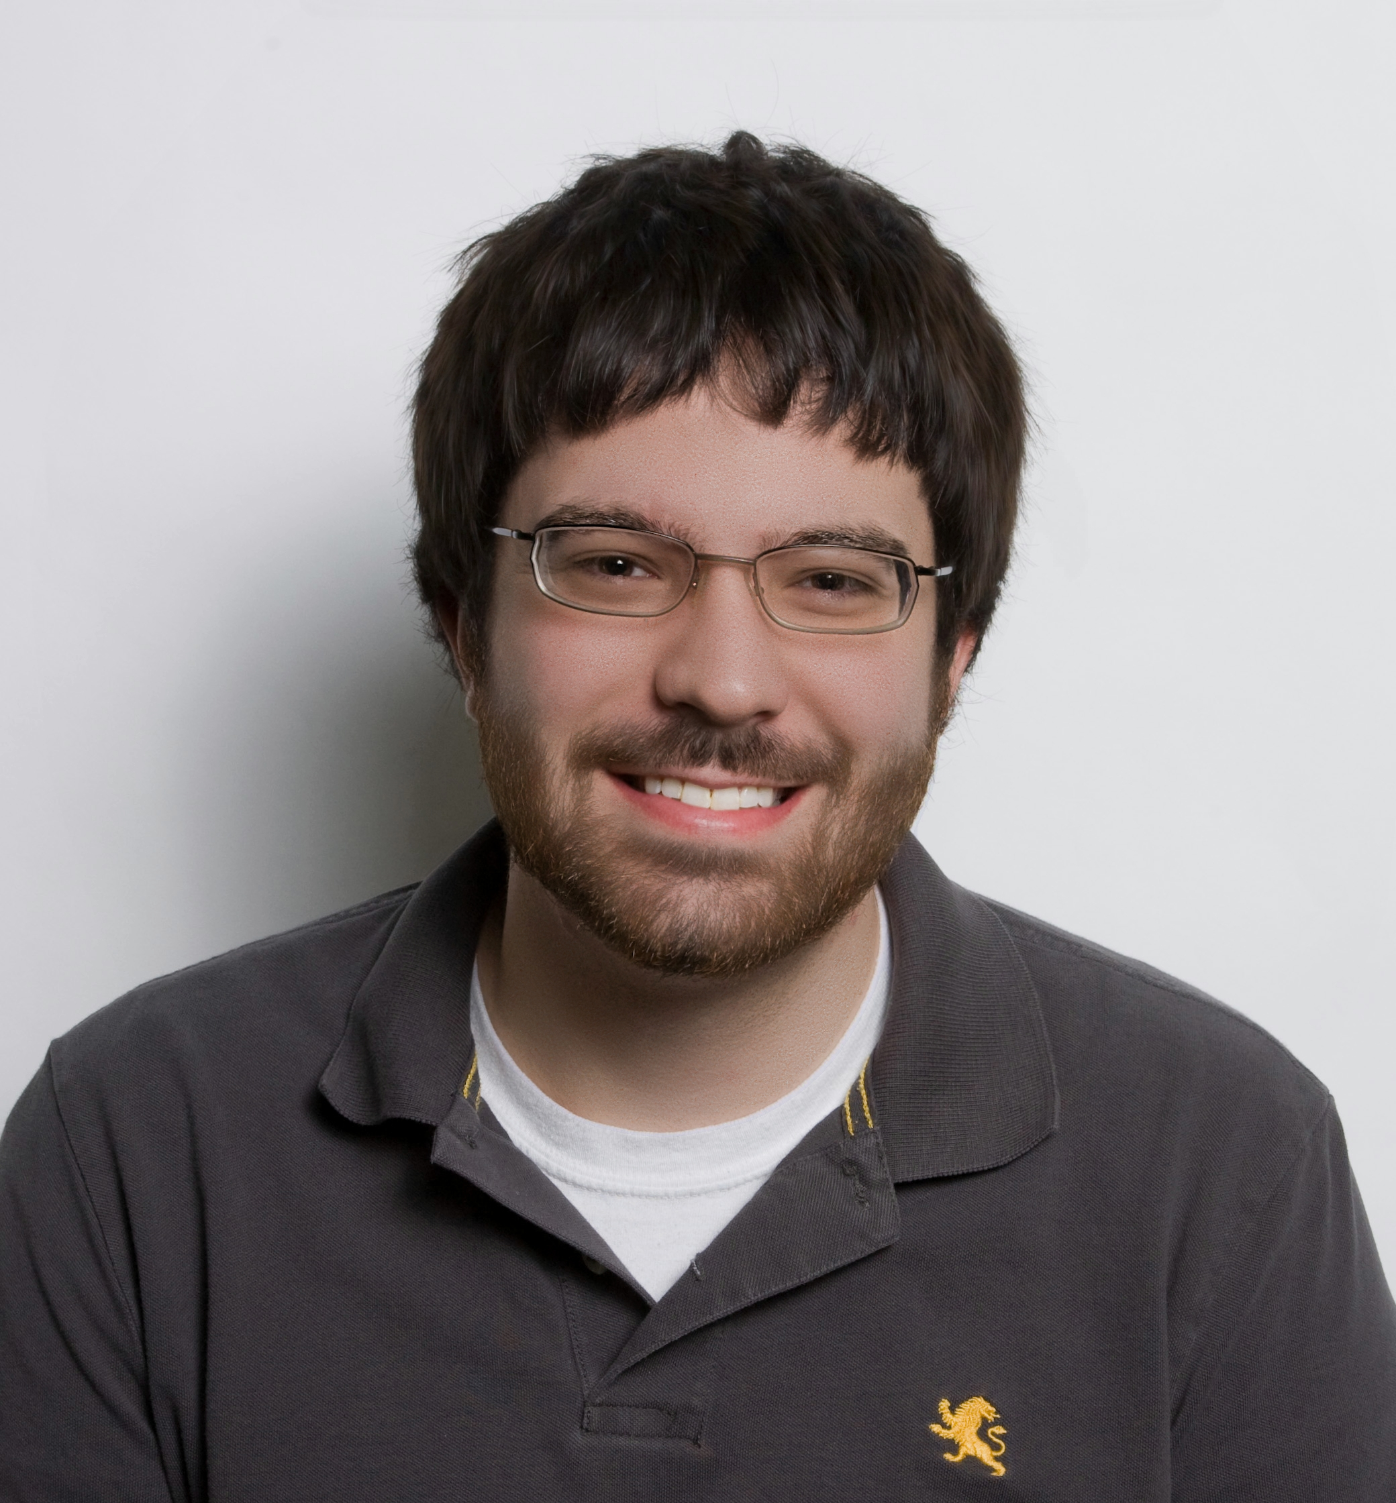
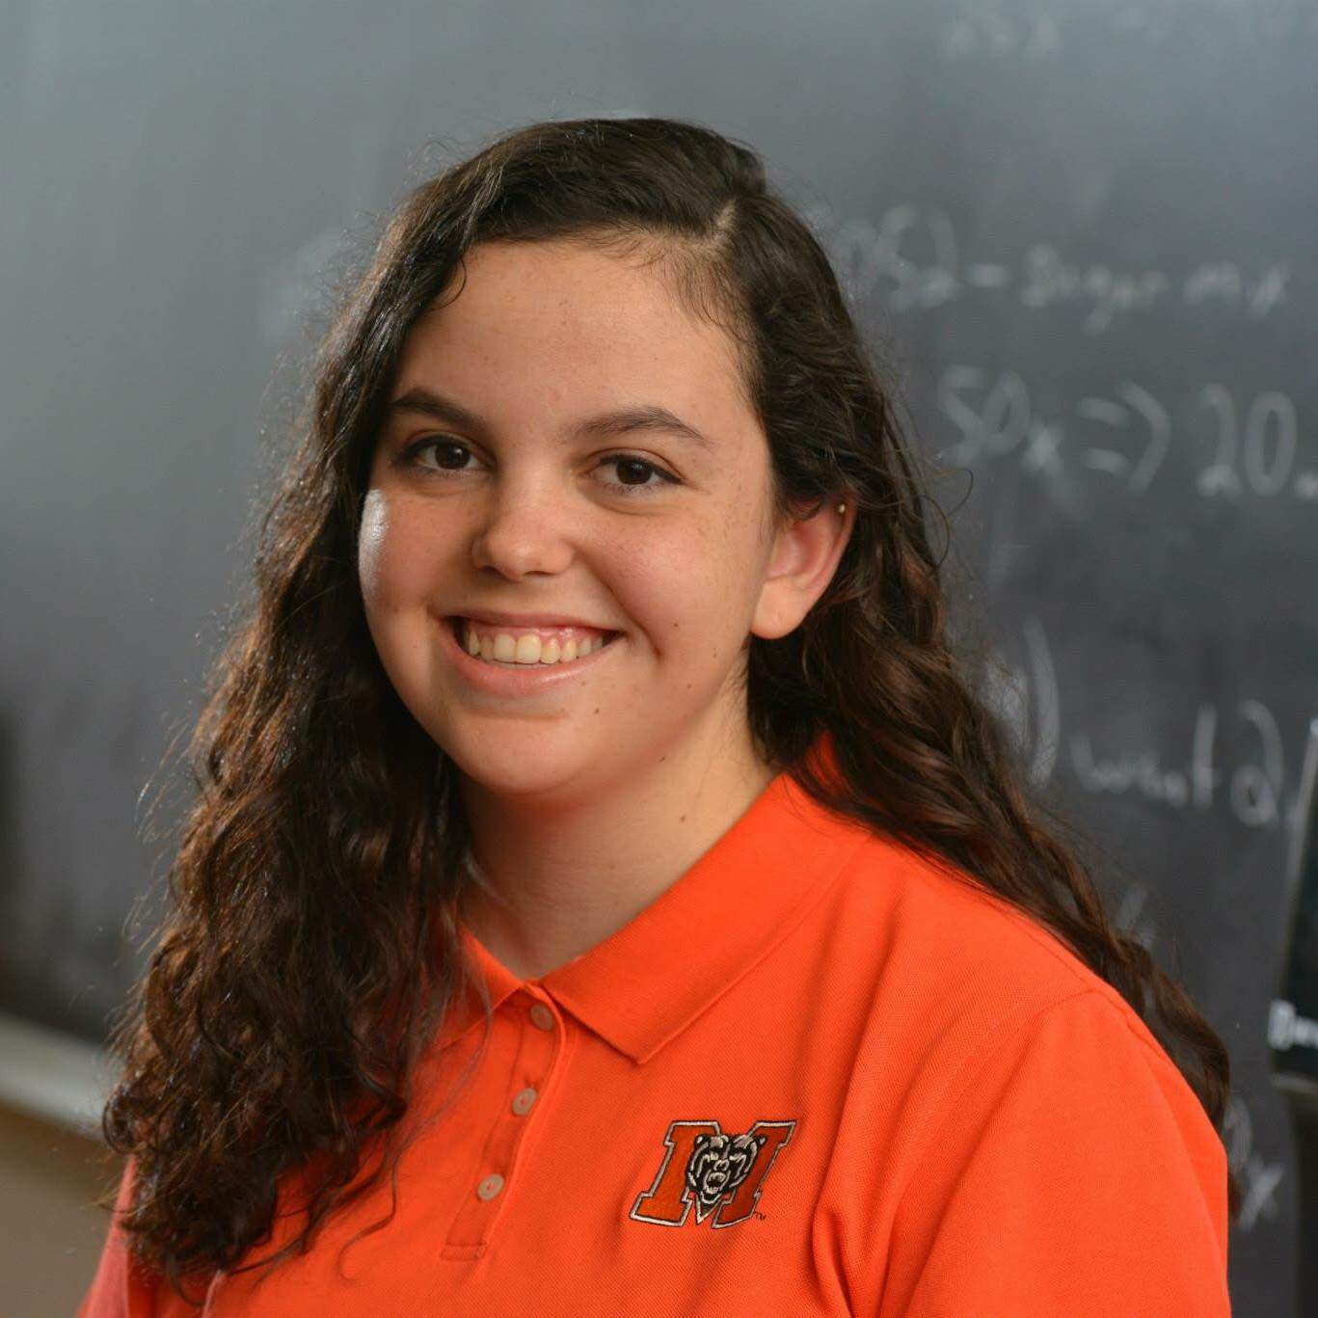
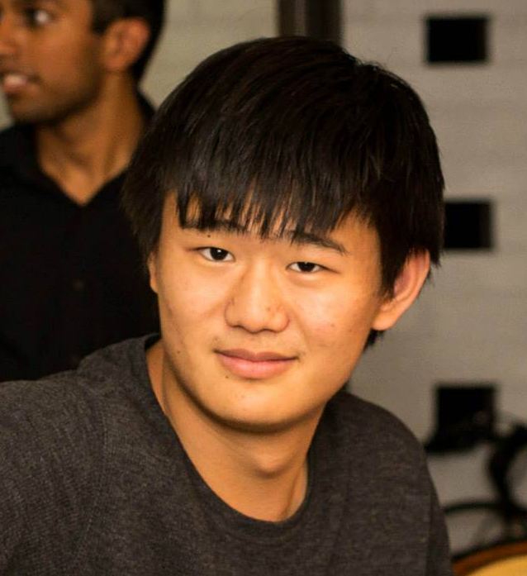
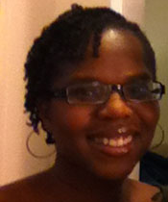
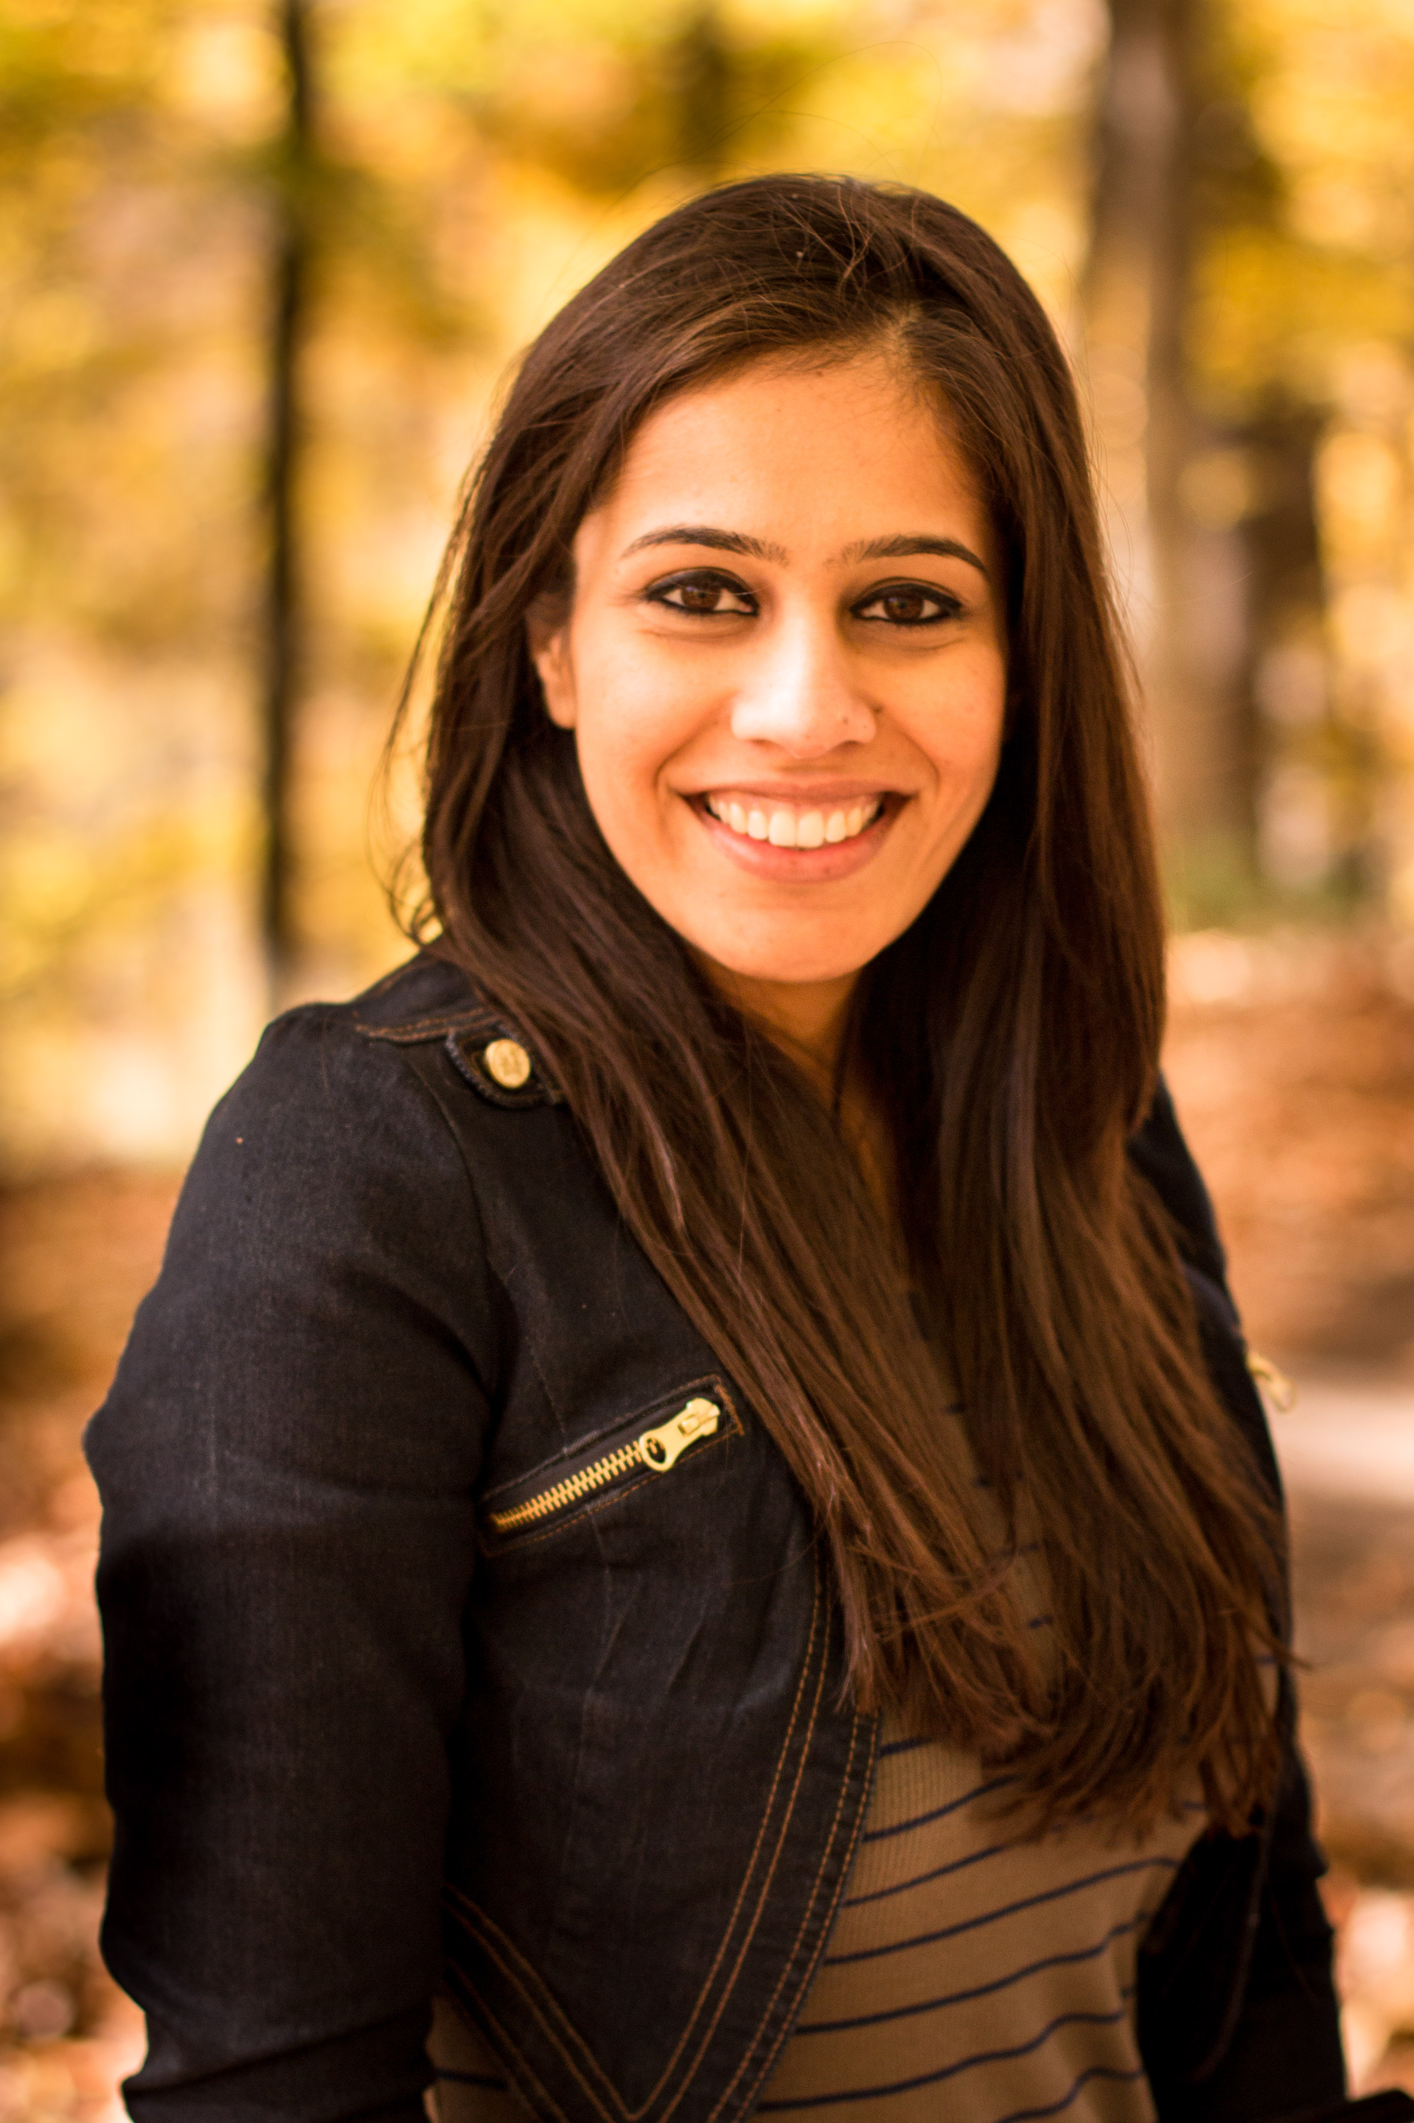
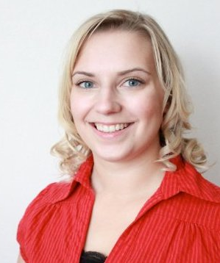
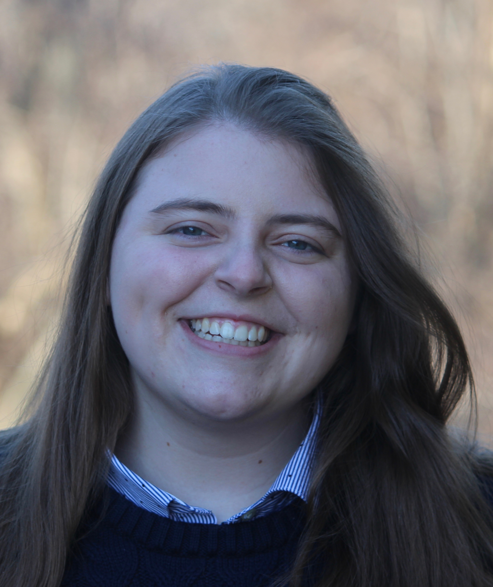
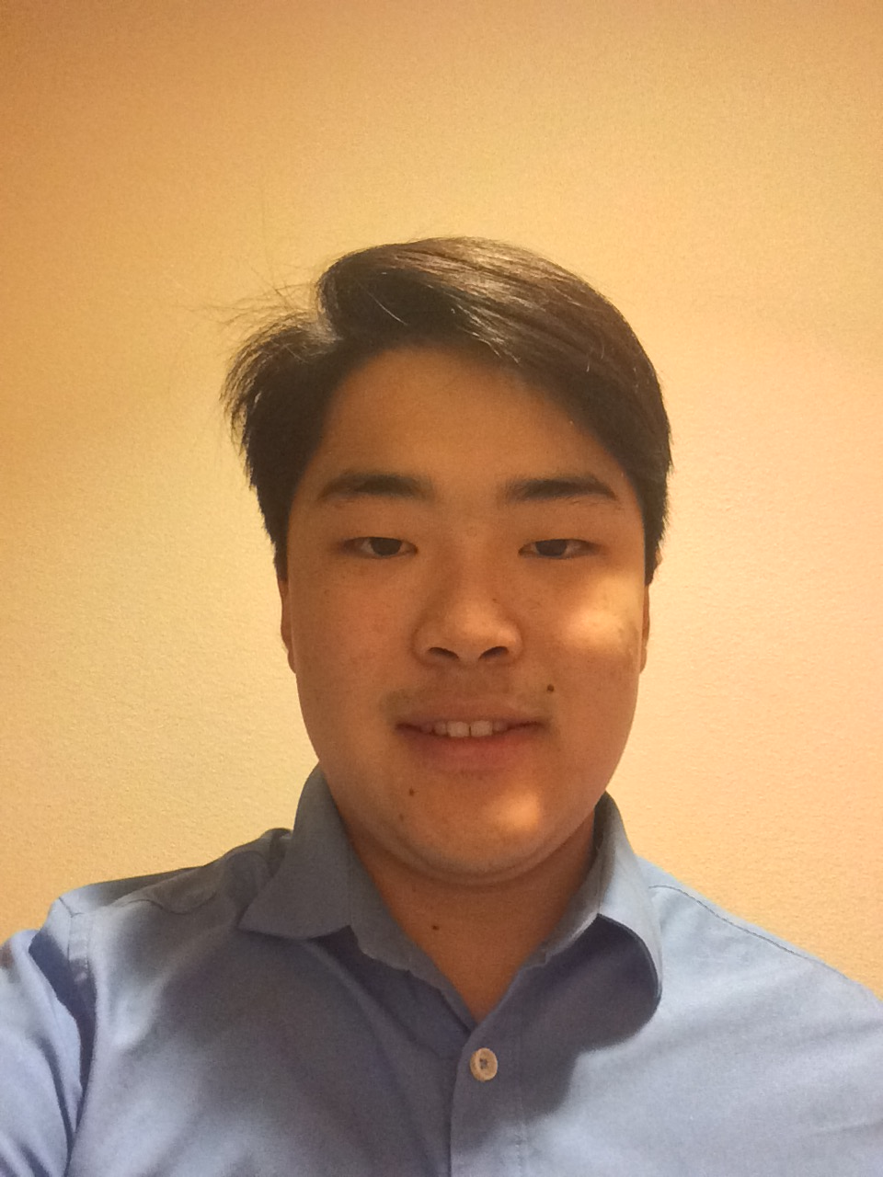
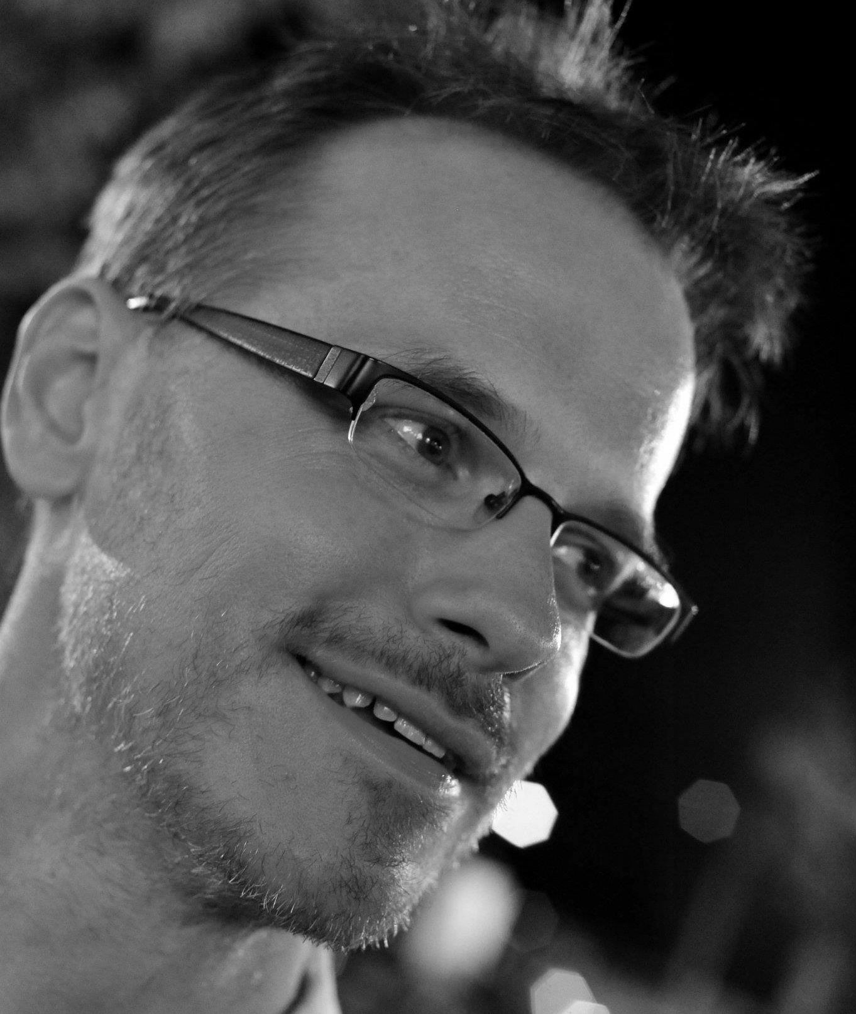
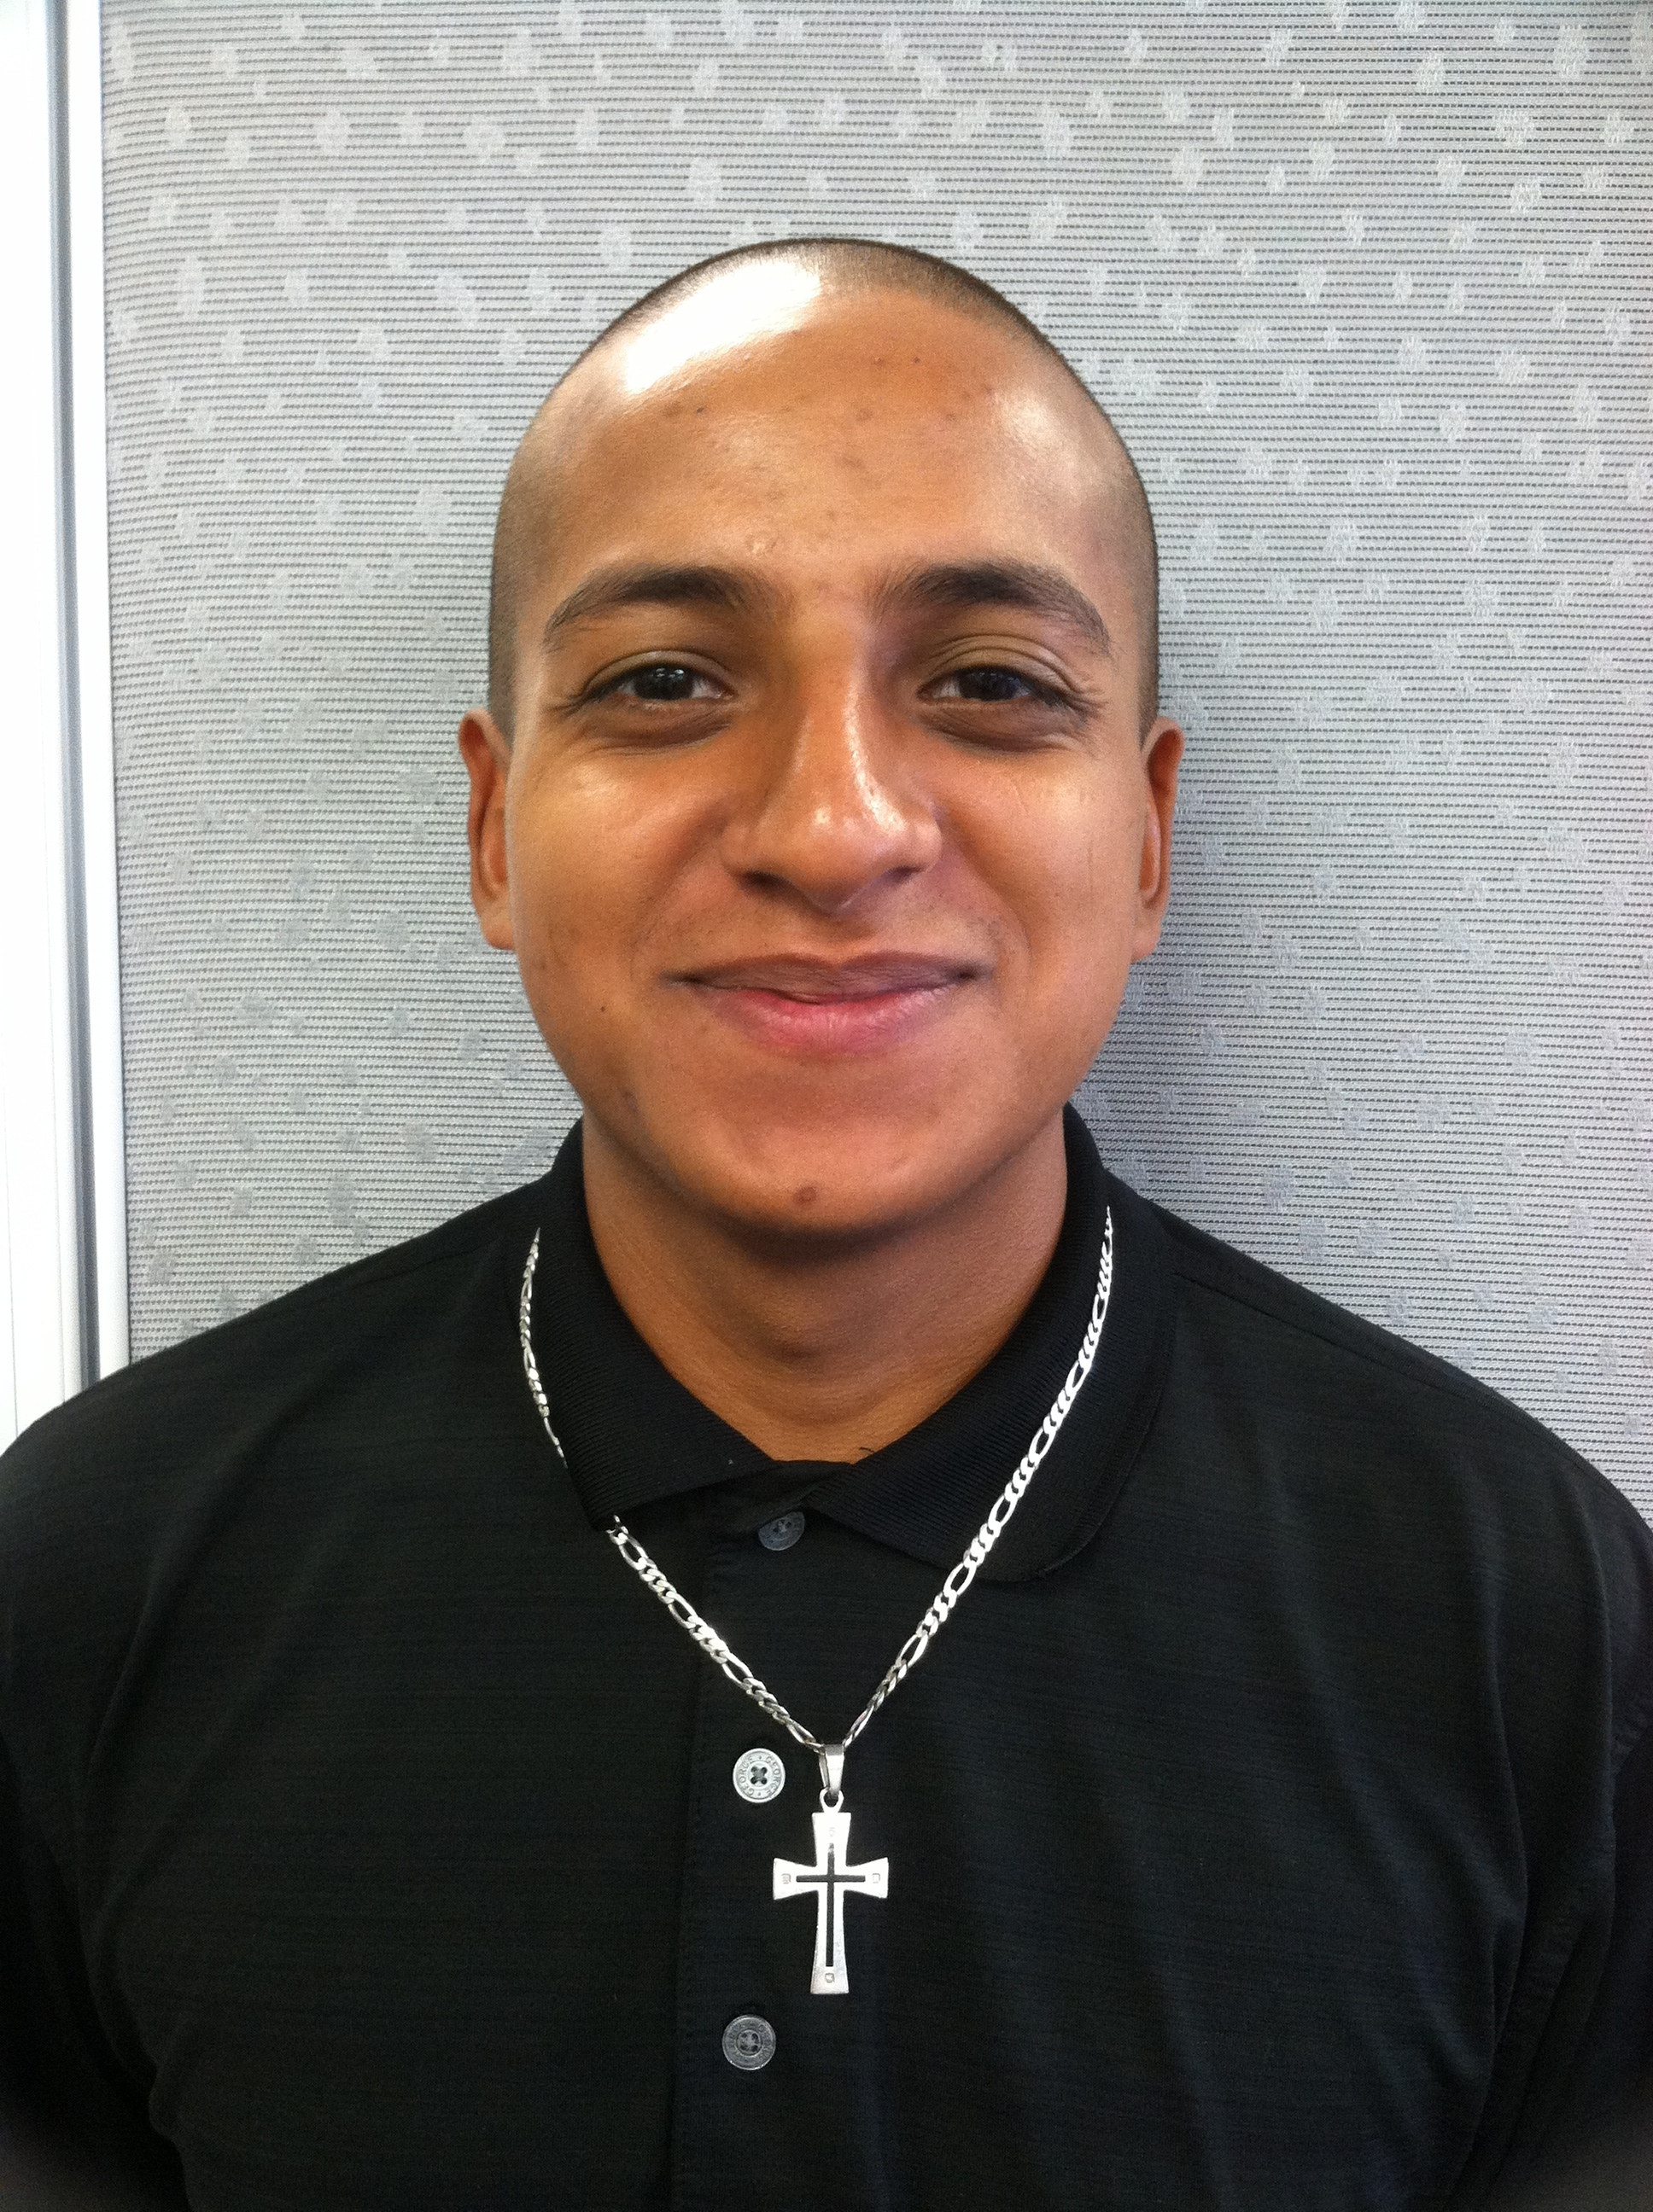
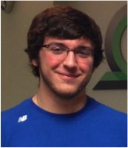
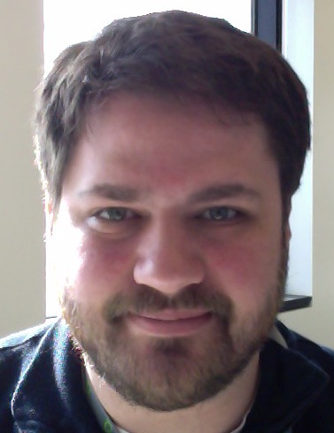
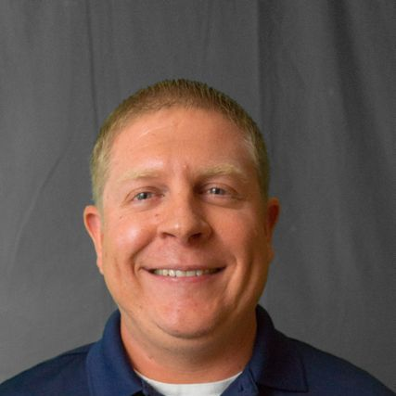
WUSTL – MGI: Group members
Malachi
Griffith
Obi
Griffith
Benjamin
Ainscough
Erica Barnell
Katie
Campbell
Kaitlin Clark
Adam
Coffman
Kelsy Cotto
Arpad Danos
Yang-Yang Feng
Felicia Gomez
Jasreet
Hundal
Susanna Kiwala
Kilanin
Krysiak
Lynzey Kujan
Jason Kunisaki
Josh
McMichael
Cody Ramirez
Zachary
Skidmore
Nick
Spies
Lee
Trani
Alex
Wagner
Jason Walker
Notes:
Not shown: Lynzey Kujan (Intern), Susanna Kiwala,

