Slide 1

Canadian Bioinformatics Workshops
www.bioinformatics.ca
bioinformaticsdotca.github.io

Slide 2
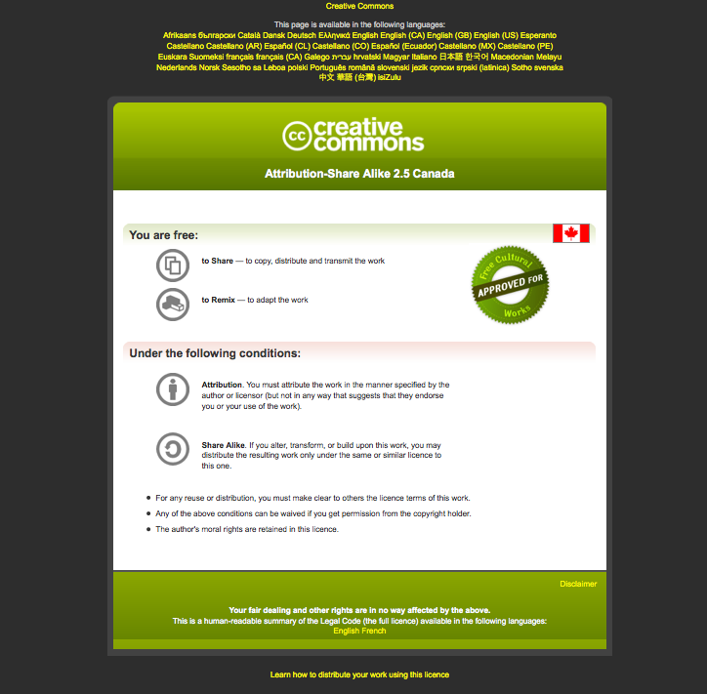

Slide 3
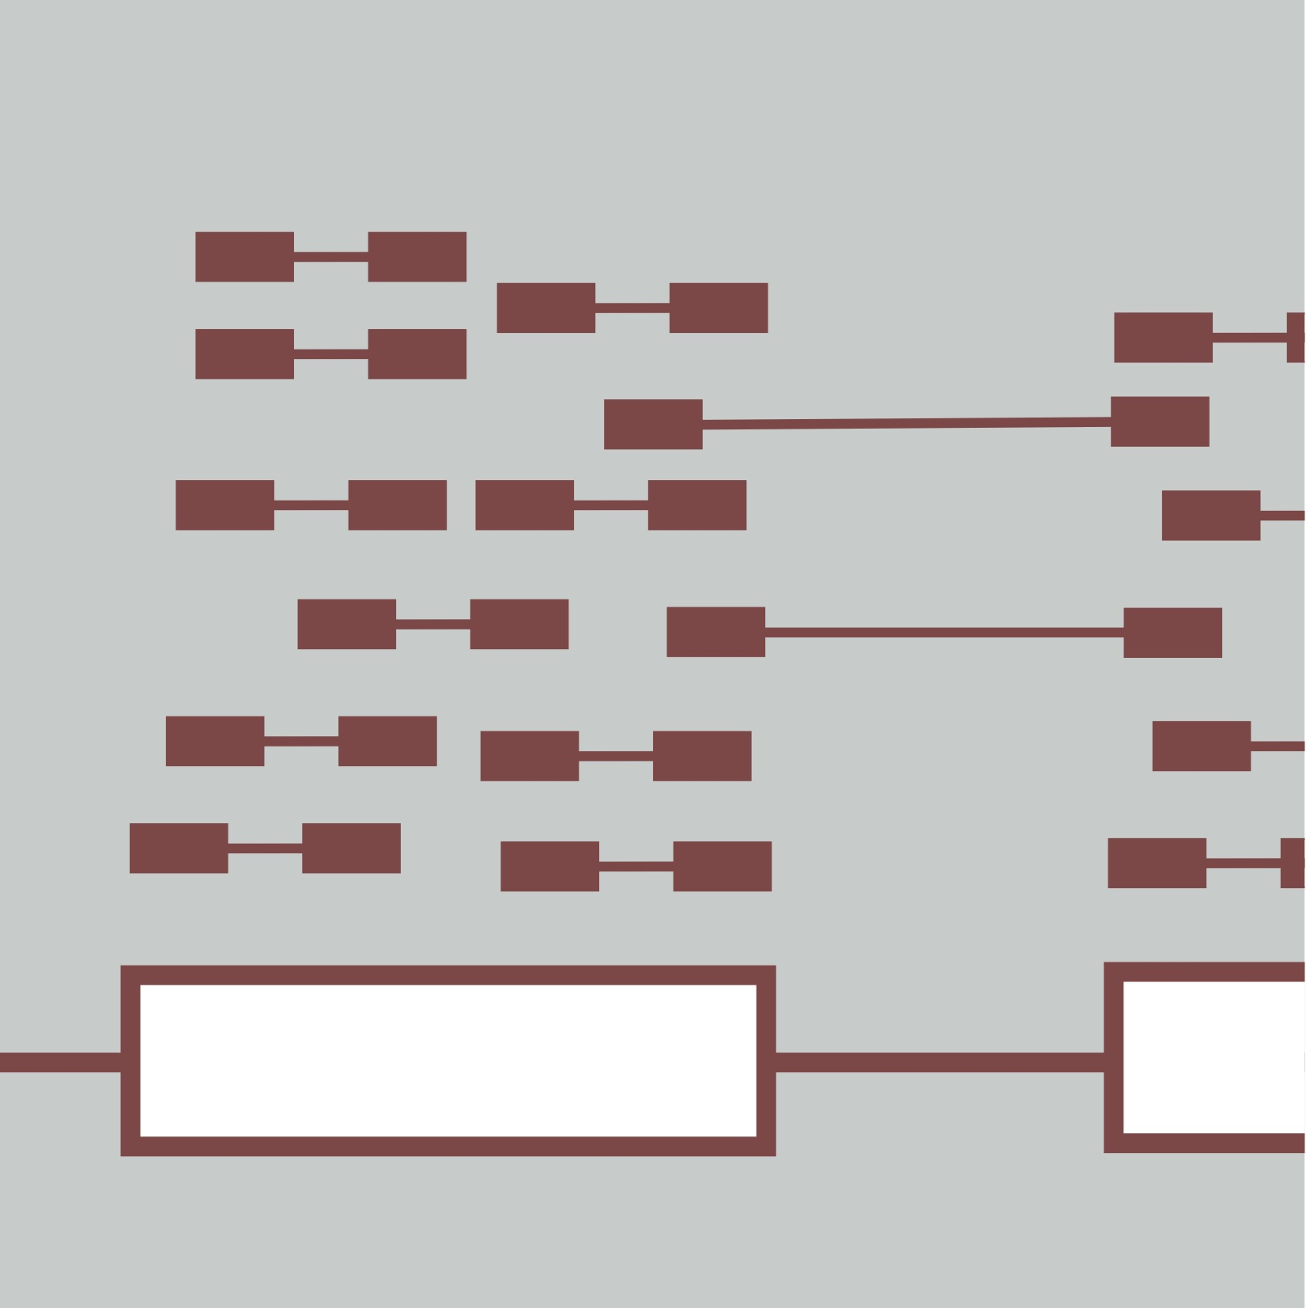

Introduction to Cloud Computing
Kelsy Cotto, Malachi Griffith, Obi Griffith, Megan Richters
Informatics for RNA-seq Analysis
June 11-13, 2019
Workshop icon

Slide 4
Learning objectives of the course
Module 1: Introduction to Cloud Computing
Module 2: Introduction to RNA Sequencing
Module 3: Alignment and Visualization
Module 4: Expression and Differential Expression
Module 5: Alignment Free Expression Estimation
Module 6: Isoform Discovery and Alternative Expression
Module 7: Genome Free De Novo Transcript Assembly
Module 8: Functional Annotation and Analysis of Transcripts
Tutorials
  Provide a working example of an RNA-seq analysis pipeline
  Run in a ‘reasonable’ amount of time with modest computer resources
  Self contained, self explanatory, portable

Slide 5
Learning Objectives
Introduction to cloud computing concepts
Introduction to cloud computing providers
Use the Amazon EC2 console to create an instance for each student
  Will be used for many hands-on tutorials throughout the course
How to log into your cloud instance

Slide 6
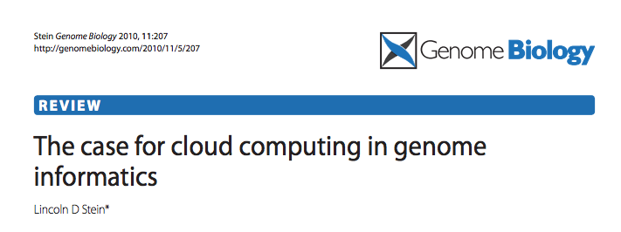
Disk Capacity vs Sequencing Capacity, 1990-2012
Disk Storage
(Mbytes/$)
DNA
Sequencing (bp/$)
1,000,000
1,000,000,000
100,000,000
100,000
10,000,000
10,000
Hard disk storage (MB/$)
Doubling time=14 mo
1,000,000
1,000
100,000
100
10,000
Nextgen sequencing (bp/$)
Doubling time=4 mo0
1,000
10
100
Pre-nextgen sequencing (bp/$)
Doubling time=19 mo
1
10
0
1
1990
1992
1994
1996
1998
2000
2003
2004
2006
2008
2010
2012

Slide 7
About DNA and computers
We hit the $1000 genome* in ~2016
  Need to think about the $100 genome
The doubling time of sequencing has been ~5-6 months.
The doubling time of storage and network bandwidth is ~12 months.
The doubling time of CPU speed is ~18 months.
The cost of sequencing a base pair will eventually equal the cost of storing a base pair

Slide 8
What is the general biomedical scientist to do?
Lots of data
Poor IT infrastructure in many labs
Where do they go?
Write more grants?
Get bigger hardware?

Slide 9
Cloud computing providers
Amazon AWS
  https://aws.amazon.com/
Google cloud
  https://cloud.google.com/
Digital ocean
  https://www.digitalocean.com/
Microsoft Azure
  https://azure.microsoft.com/en-us/
More…

Slide 10
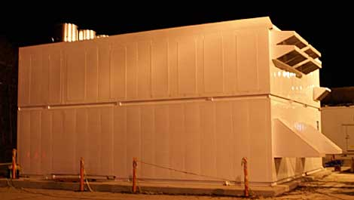

Amazon Web Services (AWS)
Infinite storage (scalable): S3 (simple storage service)
Compute per hour: EC2 (elastic cloud computing)
Ready when you are High Performance Computing
Multiple football fields of HPC throughout the world
HPC are expanded at one container at a time:

Slide 11
Some of the challenges of cloud computing:
Not cheap!
Getting files to and from there
Not the best solution for everybody
Standardization
PHI: personal health information & security concerns
In the USA: HIPAA act, PSQIA act, HITECH act, Patriot act, CLIA and CAP programs, etc.
  http://www.biostars.org/p/70204/

Slide 12
Some of the advantages of cloud computing:
We received a grant from Amazon, so supported by ‘AWS in Education grant award’.
There are better ways of transferring large files, and now AWS makes it free to upload files.
A number of datasets exist on AWS (e.g. 1000 genome data).
Many useful bioinformatics AMI’s (Amazon Machine Images) exist on AWS: e.g. cloudbiolinux & CloudMan (Galaxy) – now one for this course!
Many flavors of cloud available, not just AWS

Slide 13
Key AWS concepts and terminology
AWS - Amazon Web Services. A collection of cloud computing services provided by Amazon.
EC2 - Elastic Compute. An AWS service that allows you to configure and rent computers to meet your compute needs on an as needed basis.
EBS - Elastic Block Storage. A data storage solution that allows you to rent disk storage and associate that storage with your compute resources. EBS volumes are generally backed by SSD devices.

Slide 14
Key AWS concepts and terminology
S3 - Simple storage service. Cheaper than EBS and allows for storage of larger amounts of data with some drawbacks compared to EBS. S3 volumes store data as objects that are accessed by an API or command line interface or other application designed to work with S3. EBS volumes on the other hand can be mounted as if they were a local disk drive associated with the Instance.
SSD - Solid state drive. A particular type of storage hardware that is generally faster and more expensive than traditional hard drives.

Slide 15
Key AWS concepts and terminology
HDD - Hard disk drive. A particular type of storage hardware that is generally cheaper and larger but slower than SSD. HDD drives are traditional hard drives that access data on a spinning magnetic disk.
Ephemeral storage - Also known as Instance Store storage. Data storage associated with an EC2 instance that is local to the host computer. This storage does not persist when the instance is stopped or terminated. In other words, anything you store in this way will be lost if the system is stopped or terminated. Instance store volumes may be backed by SSD or HDD devices.

Slide 16
What is a Region?
An AWS Region is set of compute resources that Amazon maintains (like the Data Center image shown before)
Each Region corresponds to a physical warehouse of compute hardware (computers, storage, networking, etc.).
At the time of writing there are 14 regions: (US East (N.Virginia), US East (Ohio), US West (Oregon), US West (N. California), Canada (Central), EU (Ireland), EU (Frankfurt), EU (London), Asia Pacific (Singapore), Asia Pacific (Sydney), Asia Pacific (Seoul), Asia Pacific (Tokyo), Asia Pacific (Mumbai) and South America (Sao Paulo).
When you are logged into the AWS EC2 console you are always operating in one of these regions.

Slide 17
What is a Region?
Current region shown in the upper right corner of console
It is important to pay attention to what region you are using for several reasons.
  When you create an EC2 instance (EBS volume, etc) in one region you won’t see it in another region.
  The cost to use many AWS resources varies by region.
  The region may influence network performance when you are accessing the instance, especially if you need to transfer large amounts of data in or out.
  Billing is tracked separately for each region
  Generally you should choose a region that is close to you or your users. But cost is also a consideration.

Slide 18
What is difference between the 'Start', 'Stop', 'Reboot', and 'Terminate' (Instance States)?
Start – turn on an EC2 instance that you have previously created
Stop – turn off an EC2 instance that you have previously created
Reboot – restart an EC2 instance
Terminate – permanently stop and destroy an EC2 instance. Any associated EBS volumes may also be destroyed at this time depending on configuration

Slide 19
What is an AMI/snapshot?
AMI (Amazon Machine Image) – a template that specifies how to launch EC2 instances
  Root volume with operating system (OS), pre-installed applications, etc
  Launch permissions the determine who can use the AMI
  Specification of (data) volumes to attach when launched
You can create an AMI for any instance you have created/configured
AMI can be made public for sharing (region-specific)
Creating an AMI involves creating a snapshot of the root and any attached volumes. You will be charged to store this snapshot.

Slide 20
I can not log into my EC2 instance, what might have gone wrong?
Is your instance running?
Are you providing the correct path to your key file?
Is it the correct key file?
Have you set the permissions for your key file correctly?
Did you specify a valid user for your AMI (e.g., ubuntu)?
Did you specify the correct IP address?
Does the Security Group for the instance allow access for your connection protocol (e.g., SSH) and location?

Slide 21
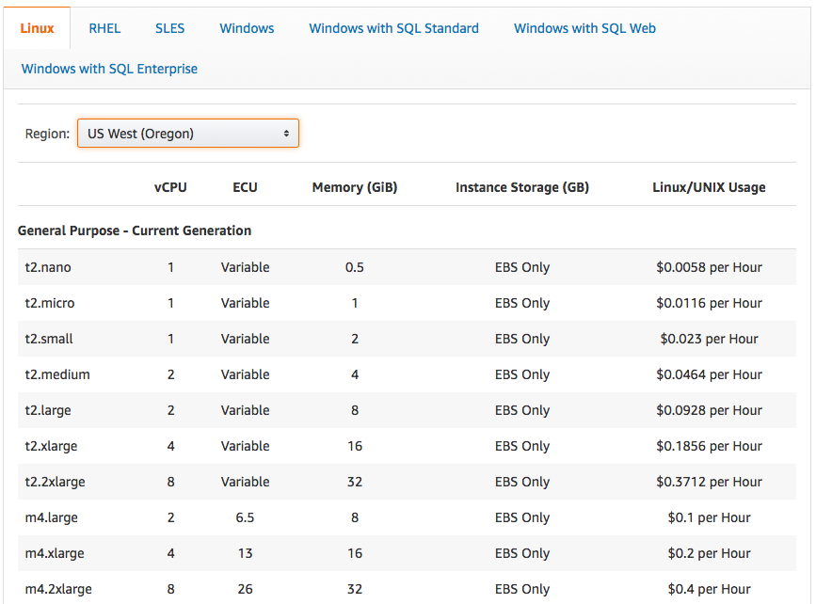
How much does it cost to use AWS EC2 resources?
Data transfer (GB): In: free or $0.01; Out: free, $0.01 or $0.02
EBS storage (GB/Month): $0.10
S3 storage (GB/Month): $0.023 standard, $0.0125 infrequent access, or $0.004 glacier

Slide 22
Why am I still getting a monthly bill?
Generally you get an accounting of usage and cost on a 30 day cycle
  Pricing is per instance-hour (now instance-second!) consumed for each instance type.
  Also charges for storage, transfers, etc
Be aware of regions!
Even when an instance is stopped, storage for root or other EBS volumes persist
Creating AMIs/snapshots requires storage
Explore the billing and cost management tools of AWS to track your spending, set warnings, etc

Slide 23
Amazon AWS documentation
https://github.com/griffithlab/rnaseq_tutorial/wiki/Intro-to-AWS-Cloud-Computing
http://aws.amazon.com/console/

Slide 24
In this workshop:
Some tools (data) are
  on your computer
  on the web
  on the cloud.
You will become efficient at traversing these various spaces, and finding resources you need, and using what is best for you.
There are different ways of using the cloud:
  Command line (like your own very powerful Unix box)
  With a web-browser (e.g. Galaxy): not in this workshop

Slide 25
Things we have set up:
Loaded data files to a web server
We brought up an Ubuntu (Linux) instance, and loaded a whole bunch of software for NGS analysis.
We will clone this and create separate instances for everybody in the class.
We’ve simplified the security: you basically all have the same login and file access, and opened ports. In your own world you would be more secure.

Slide 26
Logging into Amazon AWS

Slide 27
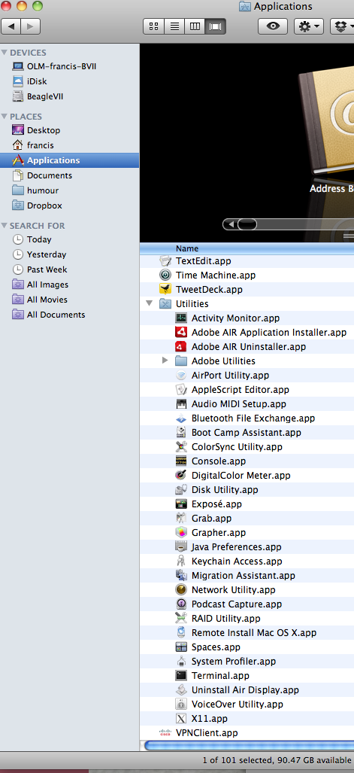
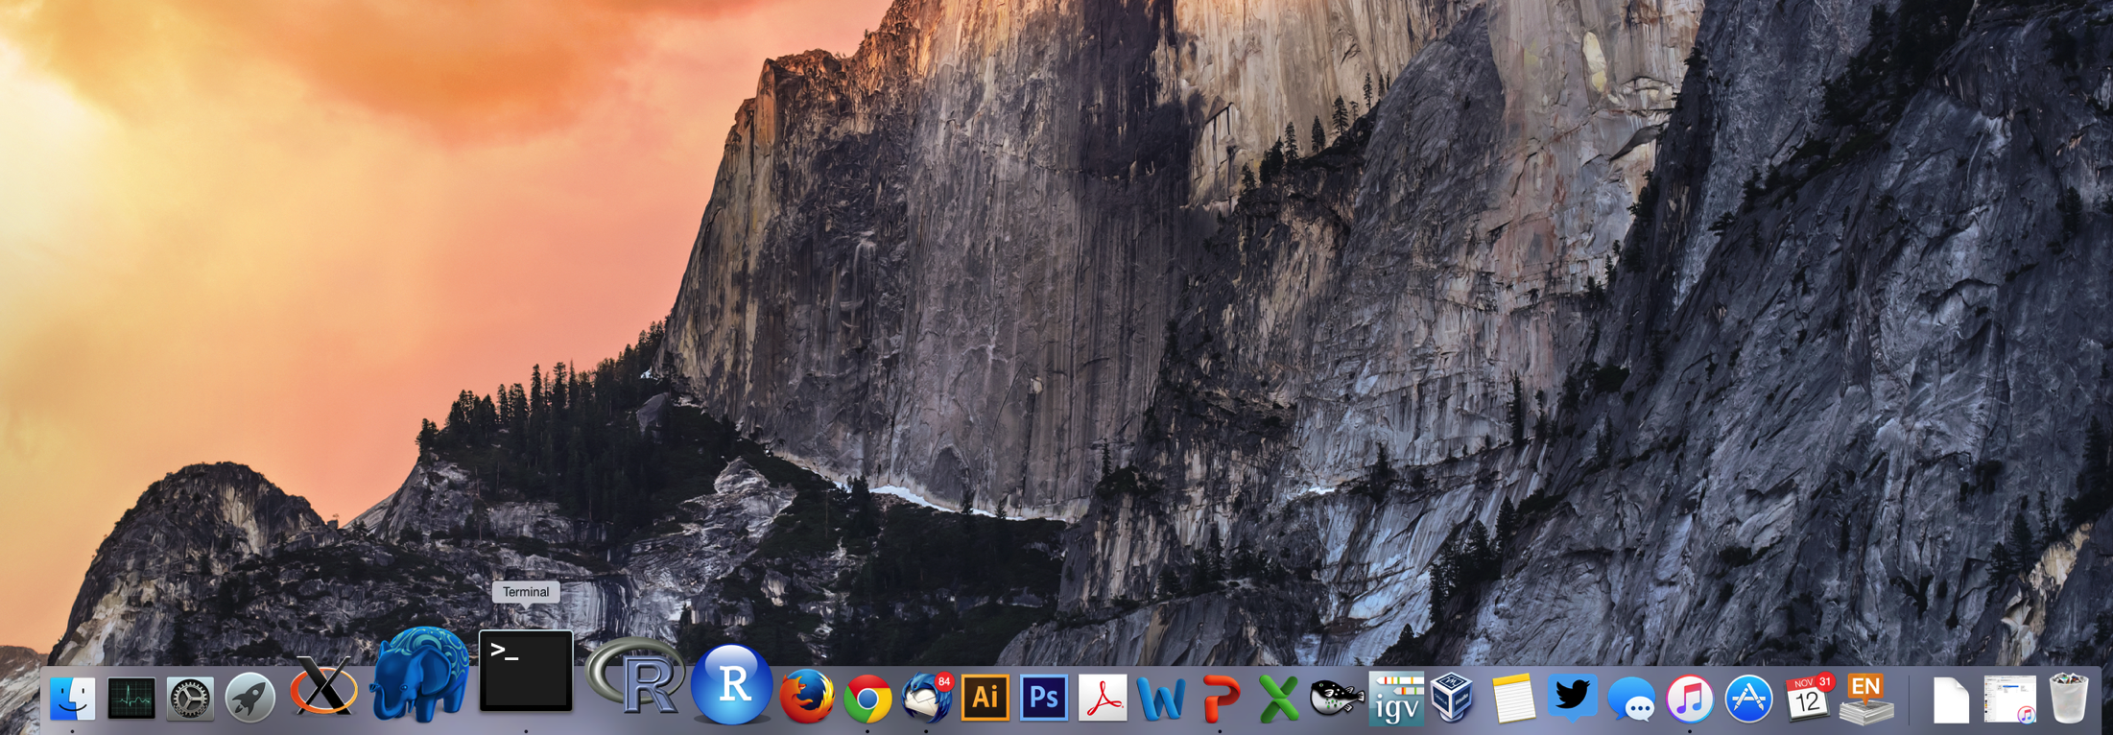
Opening a ‘terminal session’ on a Mac
In a Finder window
‘Applications’ -> ‘Utilities’ -> ‘Terminal’
Or on your dock

Slide 28
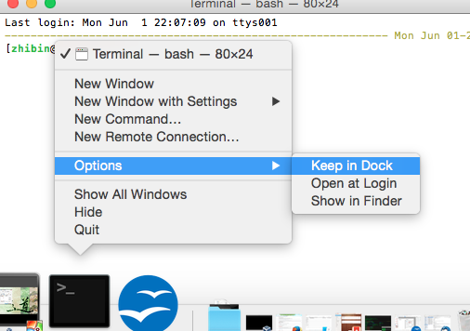
Add the terminal App to your dock

Slide 29
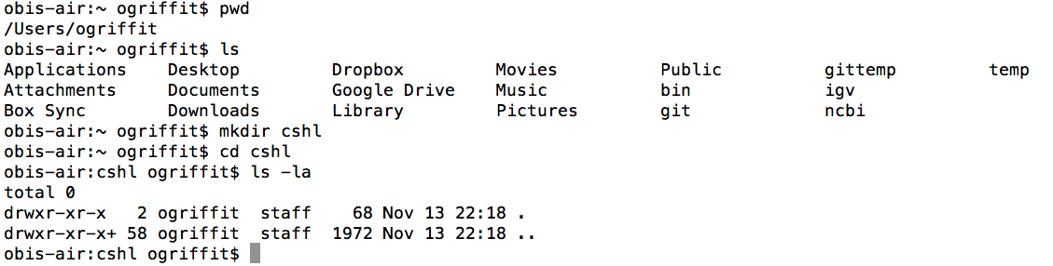
Creating a working directory on your Mac called ‘cbw’
mkdir cbw
cd cbw

Slide 30
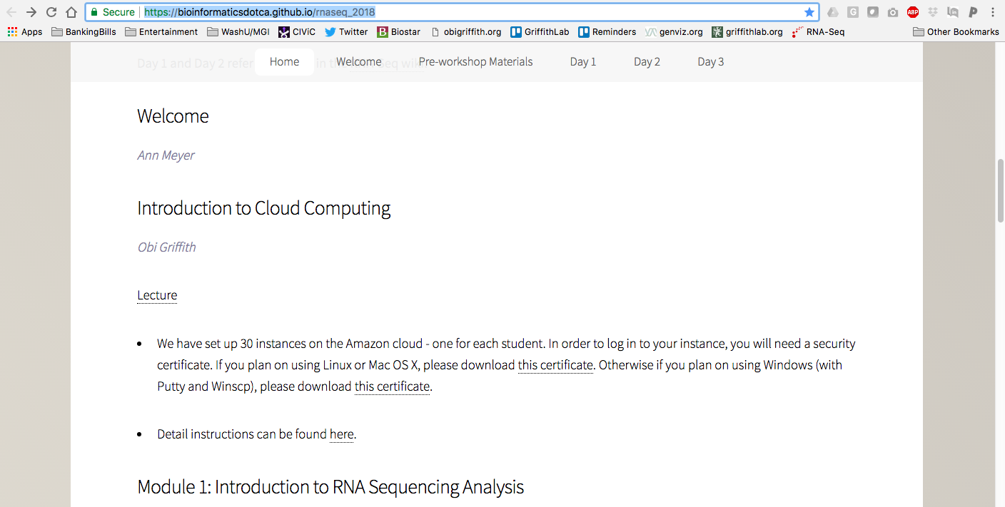
Go to course wiki, “Accessing the cloud” page
Download the certificate
https://bioinformaticsdotca.github.io/RNAseq_2019

Slide 31
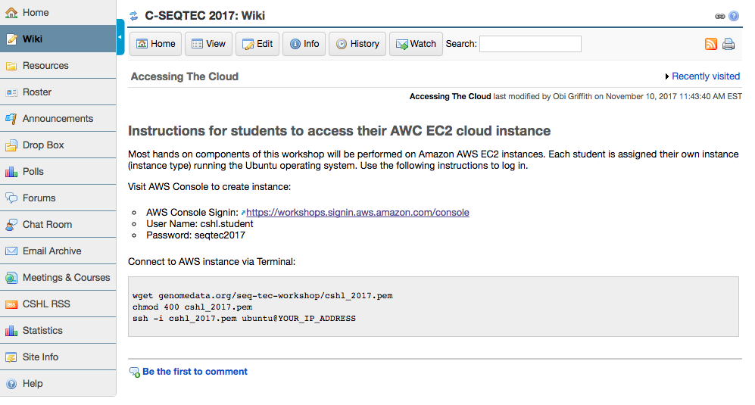
Go to course wiki, “Accessing the cloud” page

Slide 32
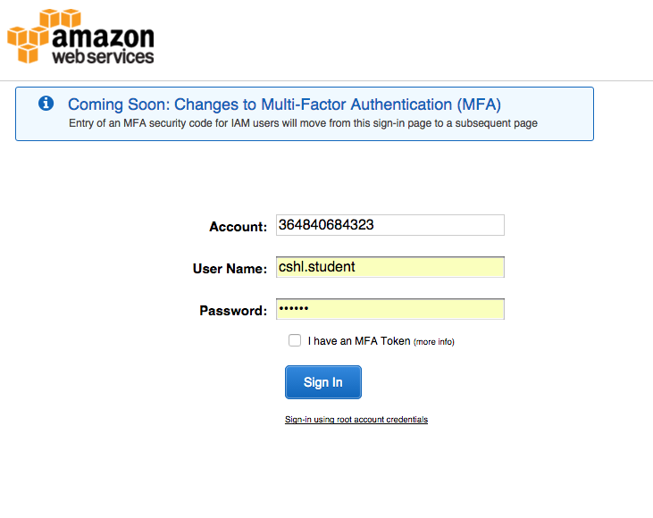
Login to AWS console
https://workshops.signin.aws.amazon.com/console

Slide 33
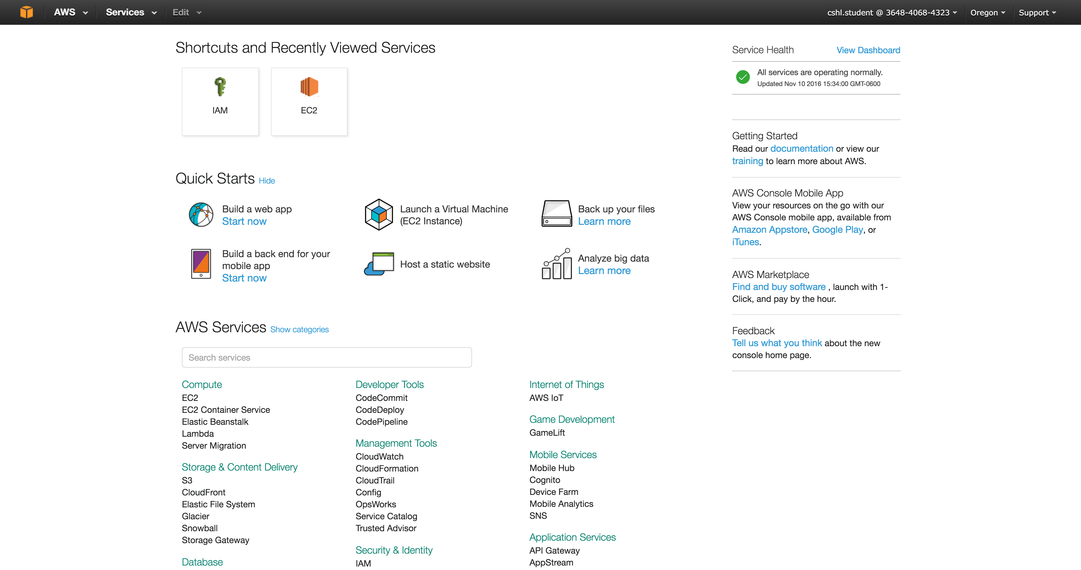
Select "EC2" service
Make sure you are in Oregon region

Slide 34
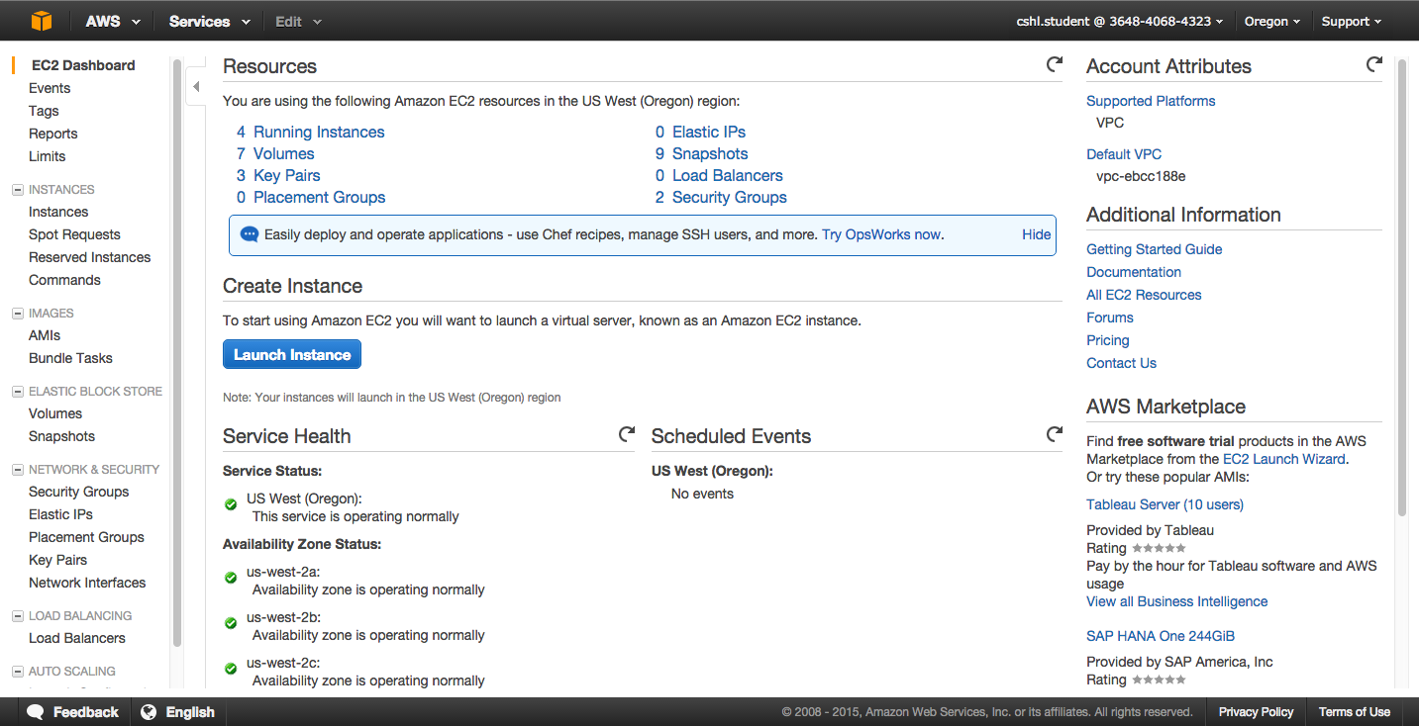
Launch a new Instance

Slide 35
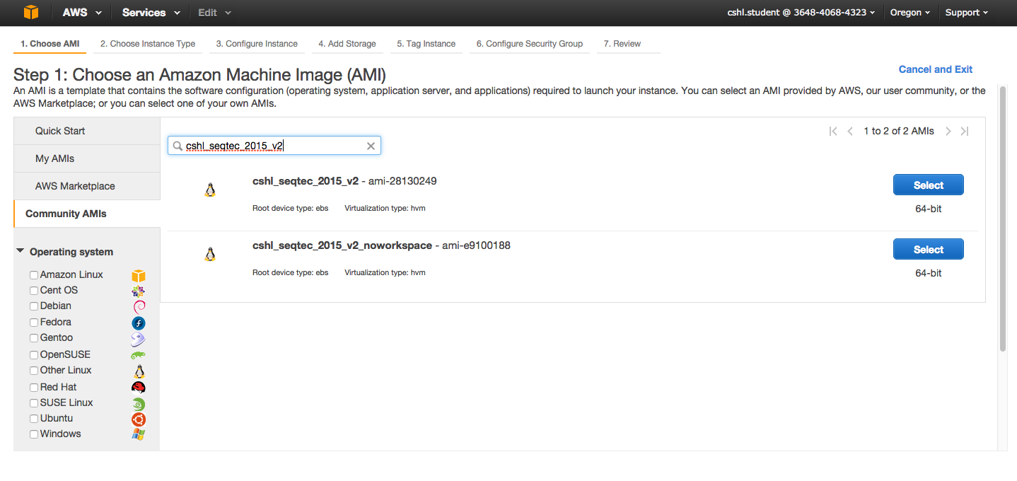
Choose an AMI – Find the CSHL SEQTEC 2017 AMI in the Community AMIs
Search for: “cshl_seqtec_2017_v1” (US West - Oregon)

Slide 36
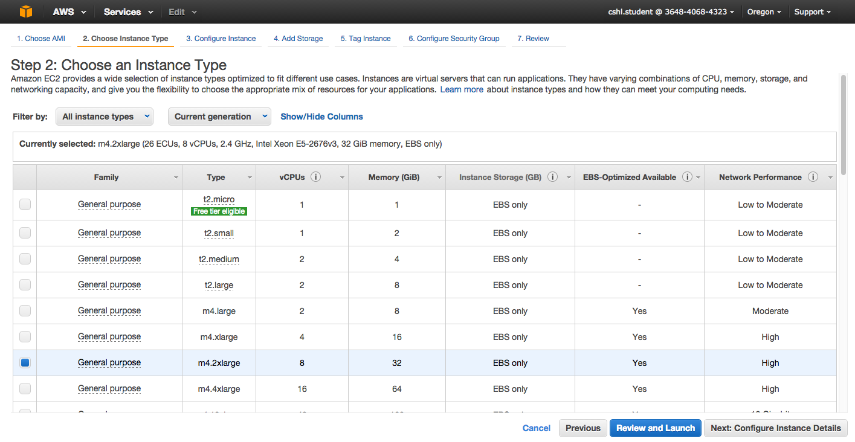
Choose “m4.2xlarge” instance type, then "Next: Configure Instance Details".

Slide 37
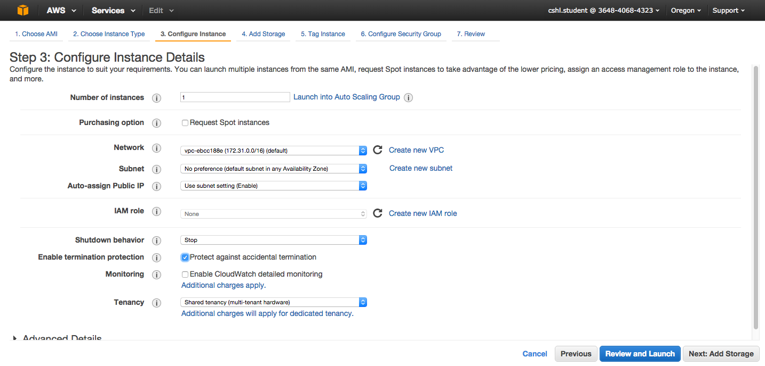
Select "Protect against accidental termination", then "Next: Add Storage".

Slide 38
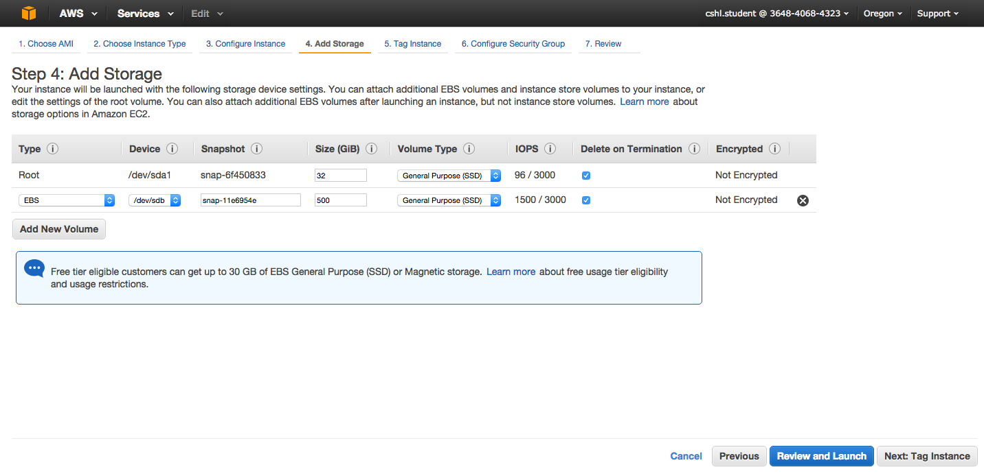
You should see "snap-xxxxxxx" (32GB) and "snap-xxxxxxx" (250GB) as the two storage volumes selected. Then, "Next: Tag Instance"

Slide 39
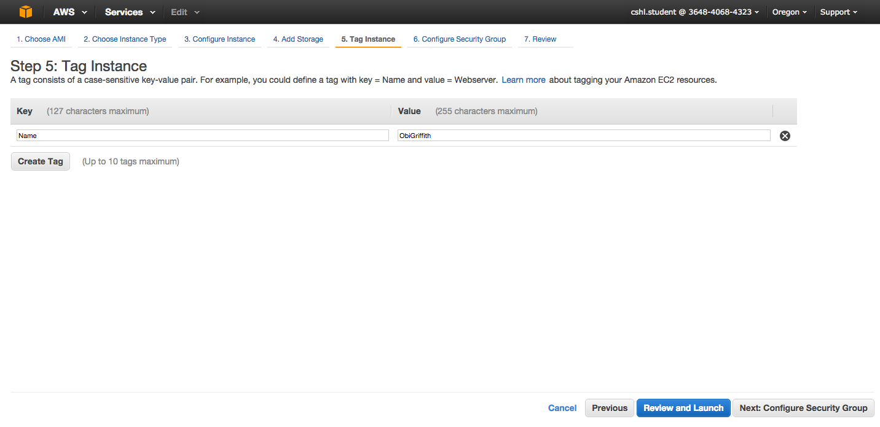
Create a tag like “Name=ObiGriffith” [use your own name]. Then hit "Next: Configure Security Group".
Important: Don’t forget to name your instance!
(FirstnameLastname)

Slide 40
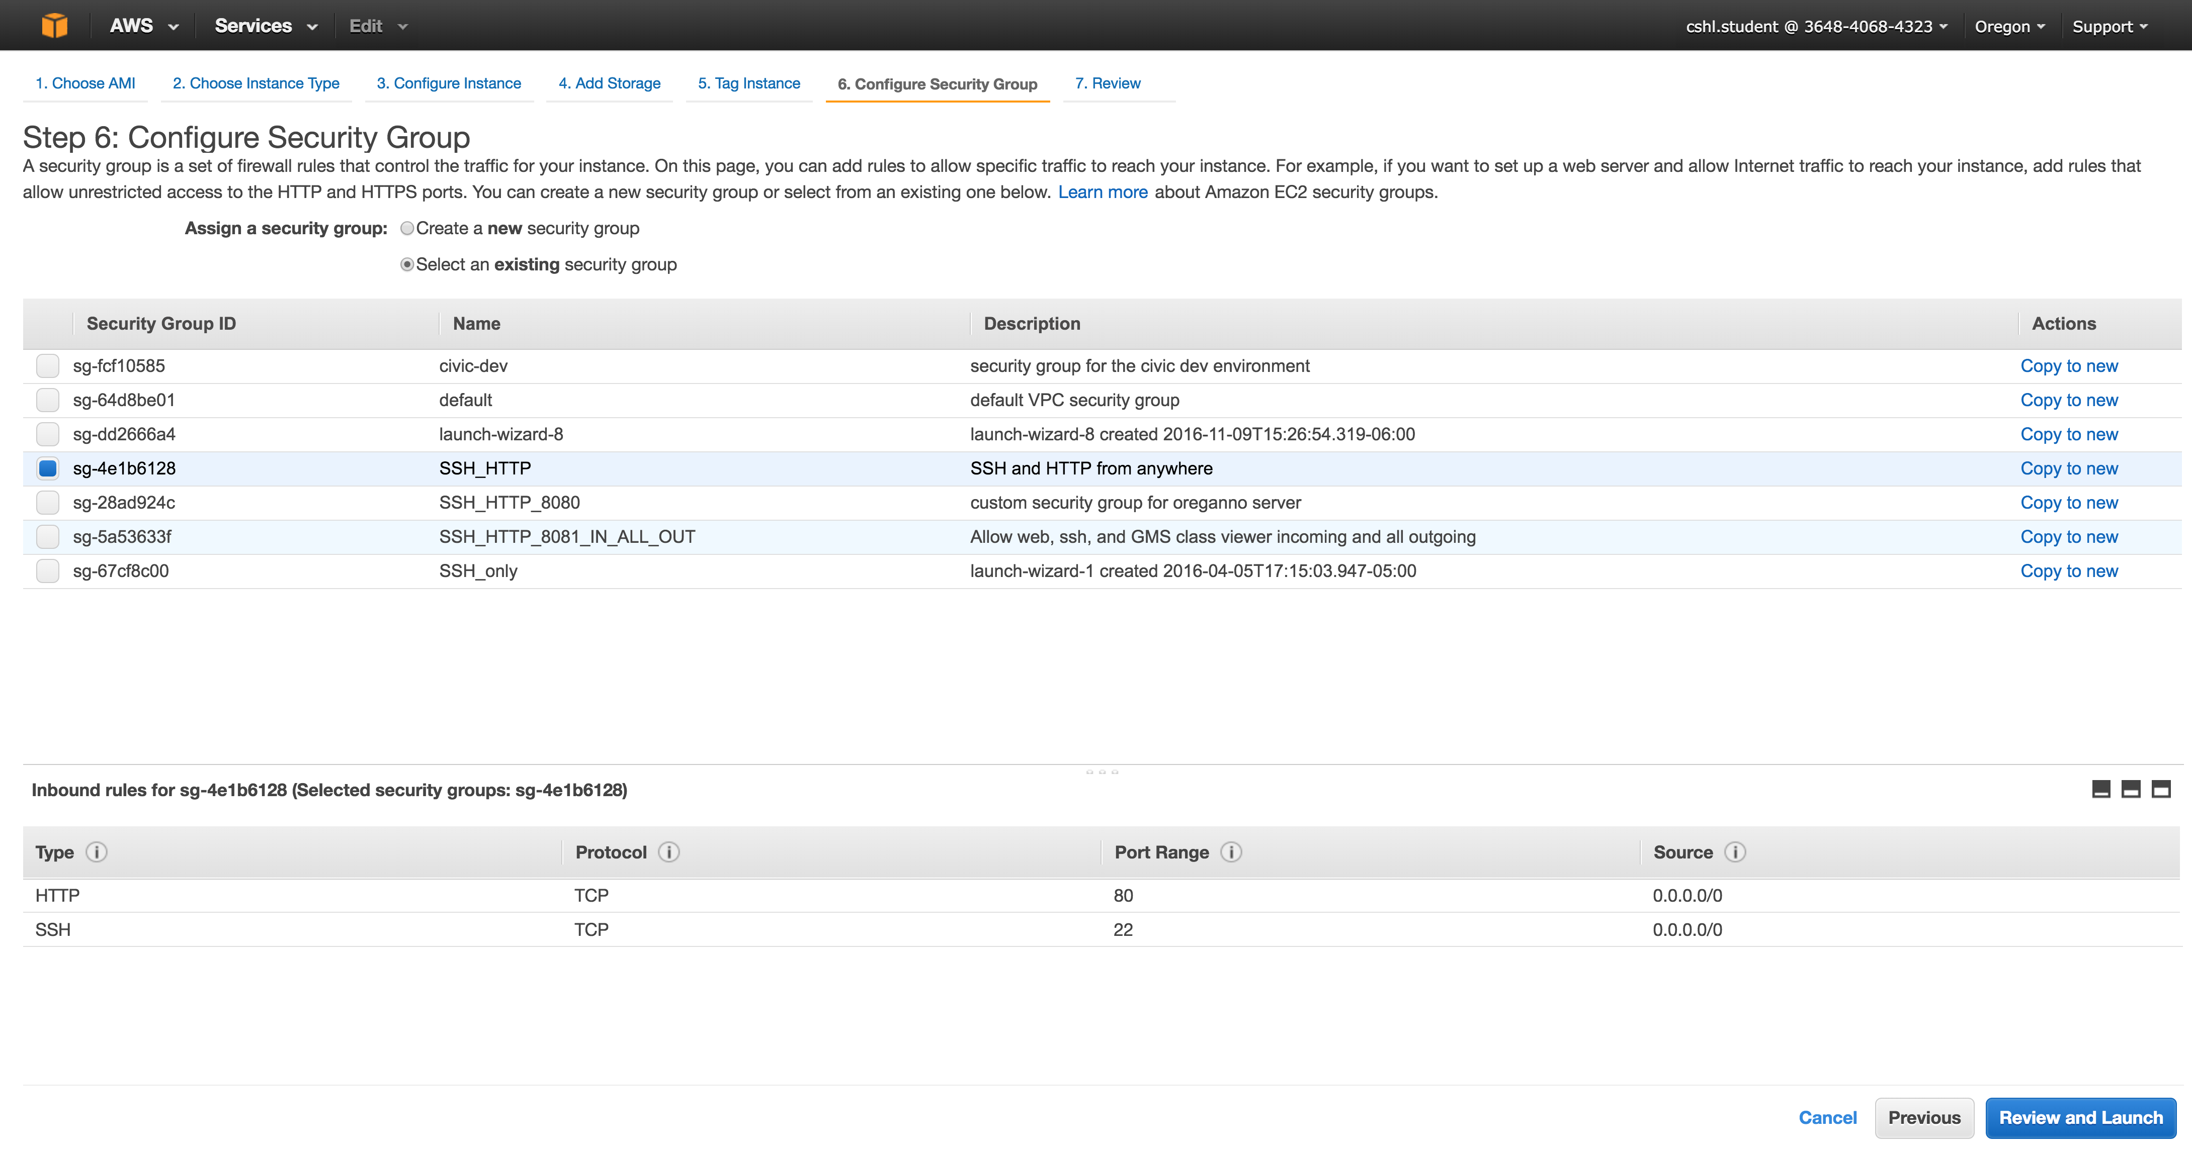
Select an Existing Security Group, choose "SSH_HTTP". Then hit "Review and Launch".

Slide 41
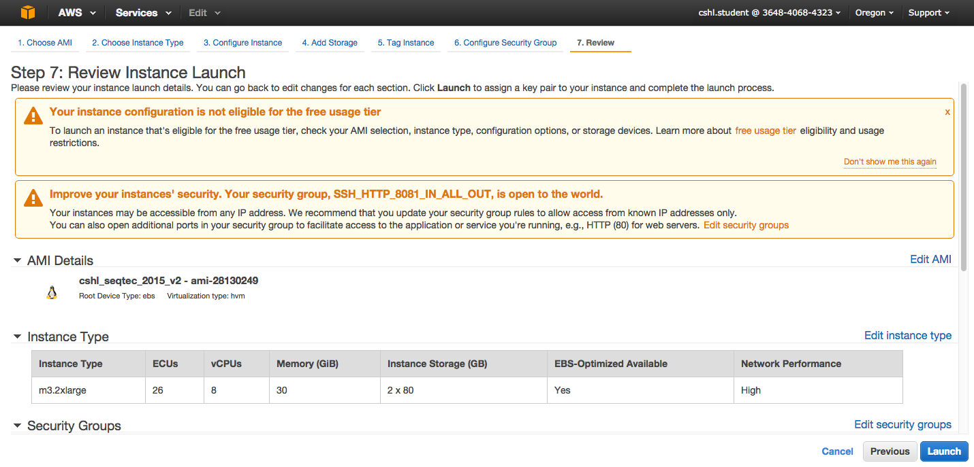
Review the details of your instance, note the warnings, then hit Launch

Slide 42
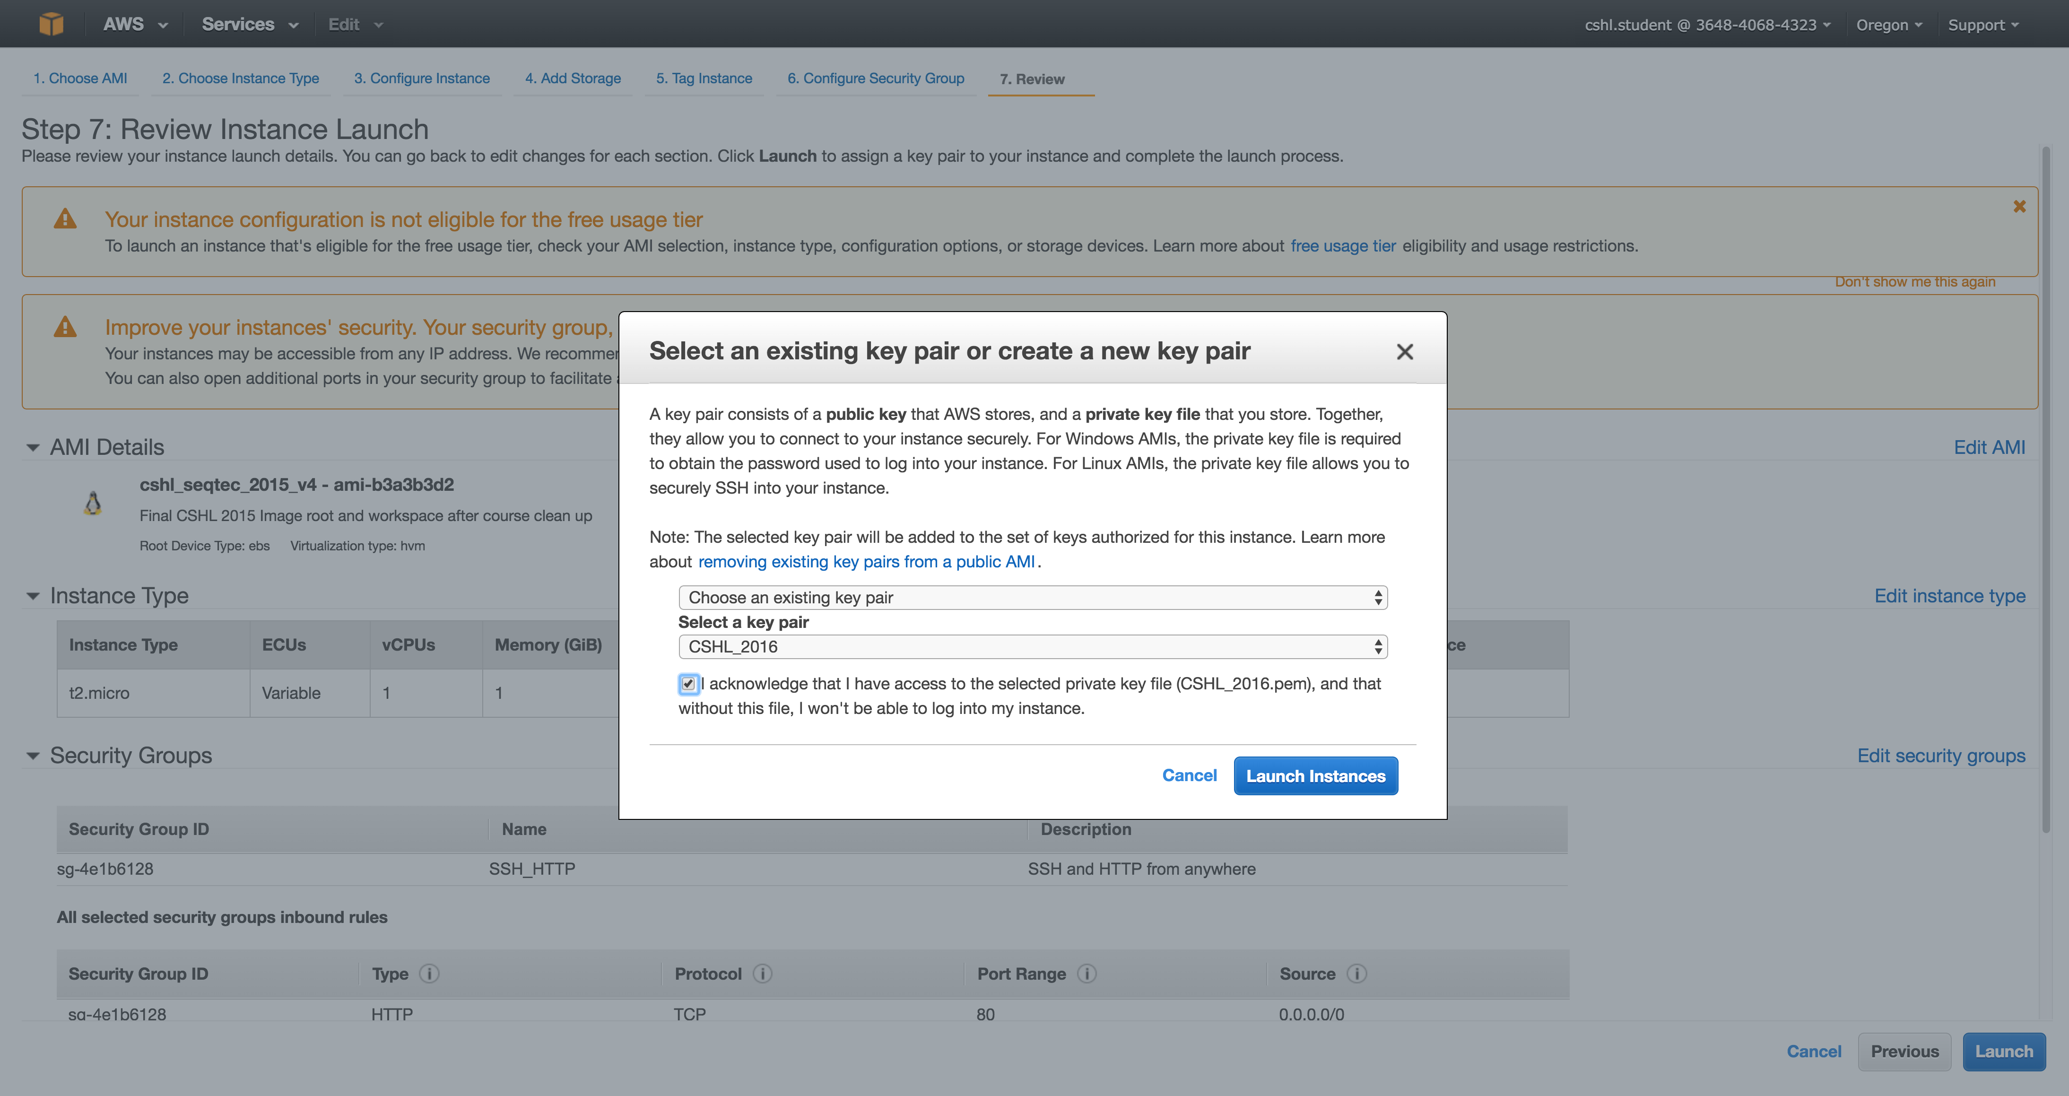
Choose an existing key pair: ”cshl_2017" and then Launch.

Slide 43
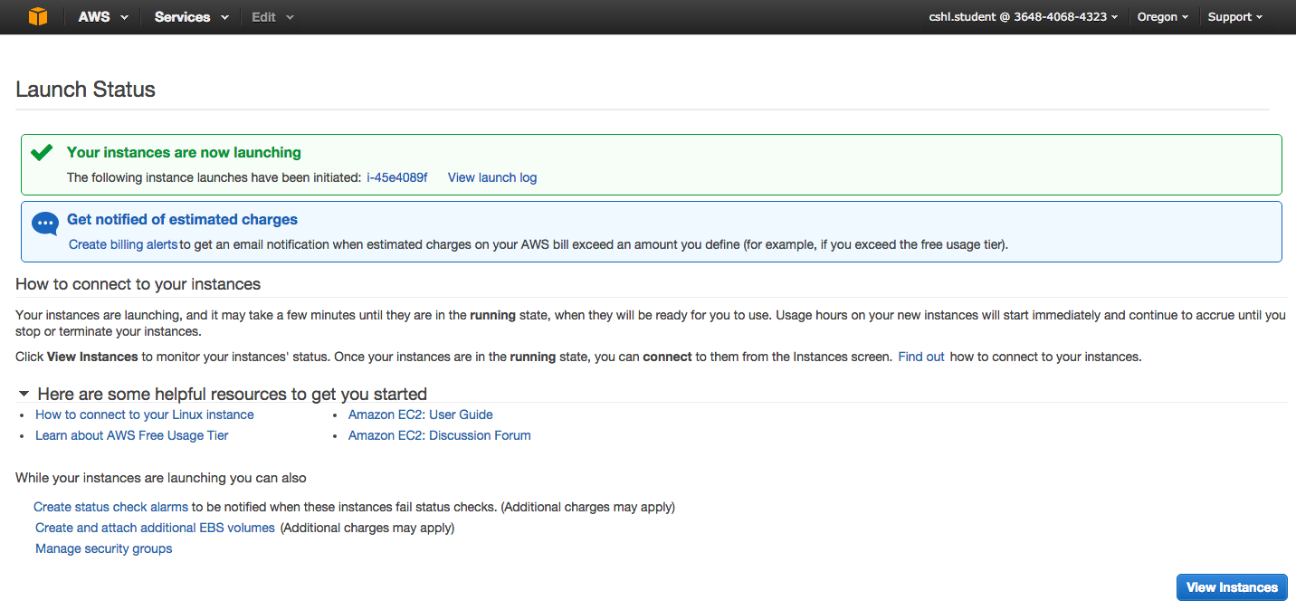
View Instances to see your new instance spinning up!

Slide 44
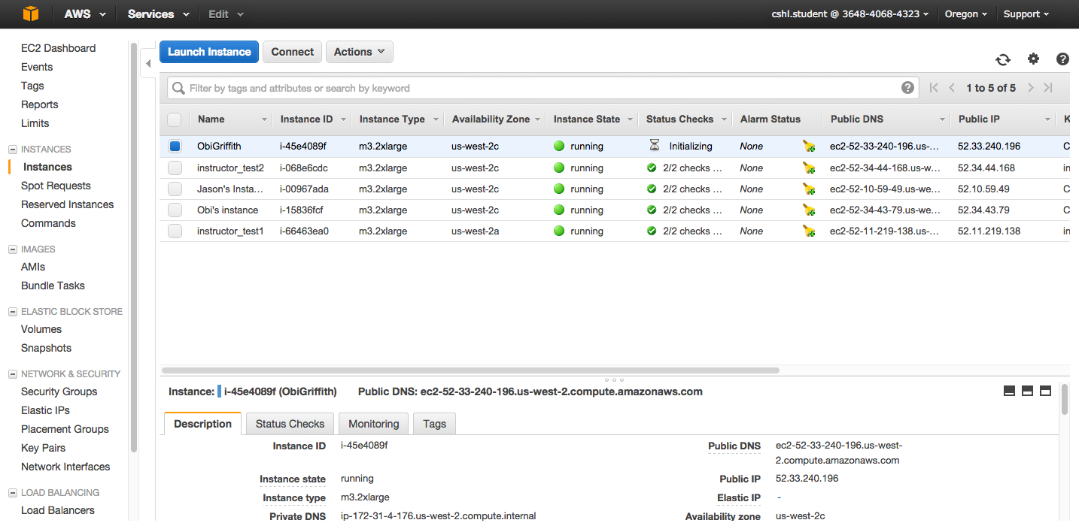
Find YOUR instance, select it, and then hit connect for instructions on how to connect (It may take some time for your instance to be ready)

Slide 45
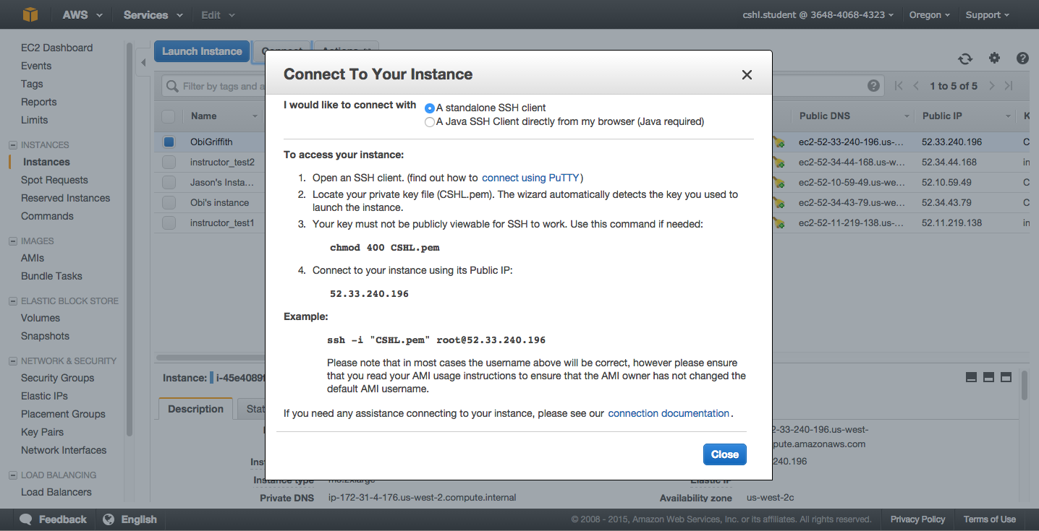
Take note of your Public DNS/IP and the instructions on changing permissions for the key file (Note, we will login as ubuntu NOT root)

Slide 46
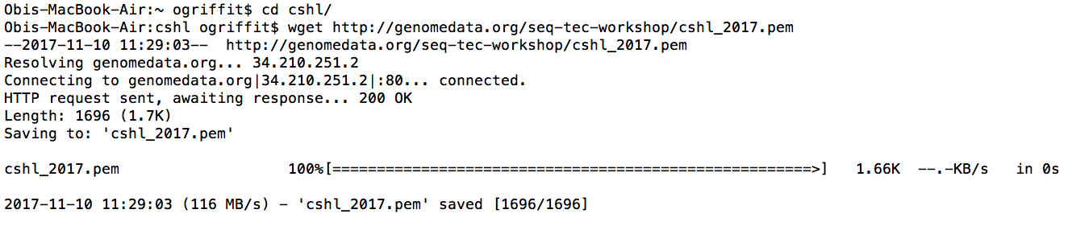
Use ‘wget’ at command line to download pem file
cd ~/cshl
wget genomedata.org/seq-tec-workshop/cshl_2017.pem

Slide 47
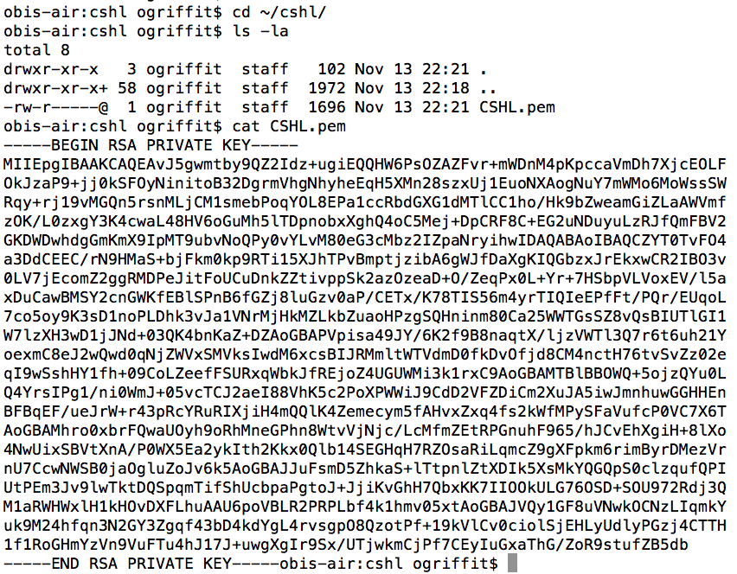
Viewing the ‘key’ file once downloaded
cat CBWNY.pem

Slide 48
Changing file permissions of your ‘key’ file
(Mac/Linux)
ls -l (long listing)
drwx------+ 67 ogriffit staff 2278 22 May 21:25 ../
-rw-r--r--@ 1 ogriffit staff 1696 22 May 21:31 CBWNY.pem
rwx : owner
rwx : group
rwx: world
r read (4)
w write (2)
x execute (1)
Which ever way you add these 3 numbers, you know which integers
were used (6 is always 4+2, 5 is 4+1, 4 is by itself, 0 is none of them etc …)
So, when you have:
chmod 600 <file name>
It is “r” for the the file owner only

Slide 49
Logging into your instance
Mac/Linux
cd ~/cbw
chmod 600 CBWNY.pem
ssh -i CBWNY.pem ubuntu@[YOUR PUBLIC IP]

Slide 50
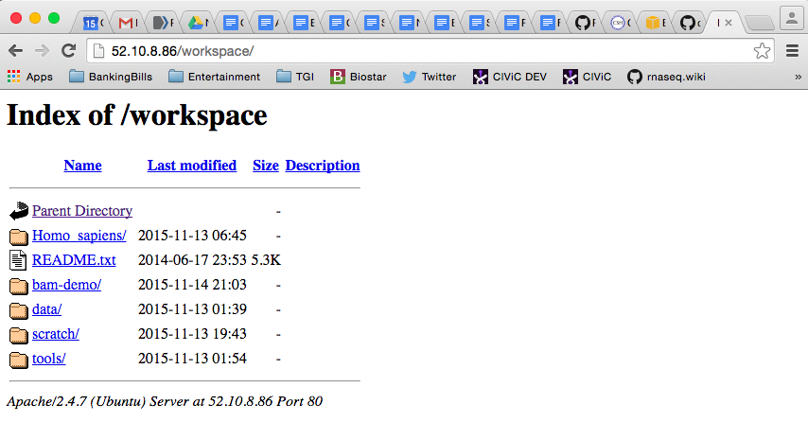
Copying files from AWS to your computer
(using a web browser)
http://[YOUR PUBLIC DNS OR IP]/

Slide 51
Logging out of your instance
Mac/Linux – simply type exit
exit
Note, this disconnects the terminal session (ssh connection) to your cloud instance. But, your cloud instance is still running! See next slide for how to stop your instance.

Slide 52
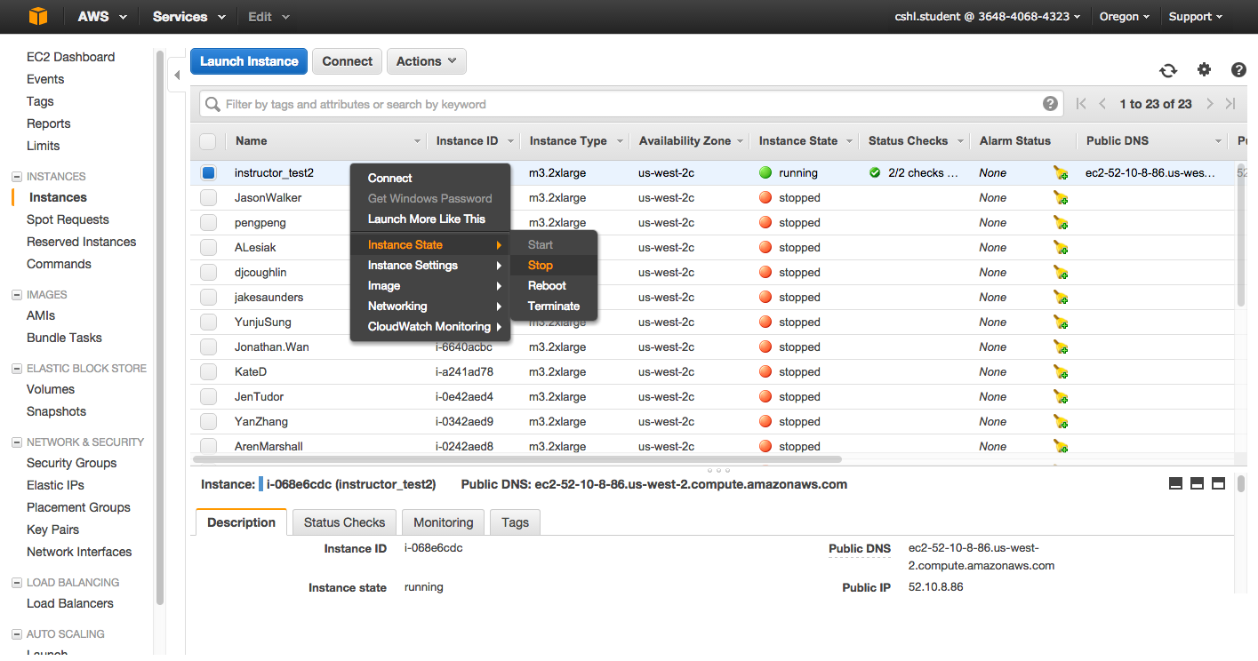
When you are done for the day you can “Stop” your instance – Don’t Terminate!
Go to AWS EC2 Dashboard, select “Instances” tab, then find your instance. Right-click and chose ‘Instance State’ -> ‘Stop’

Slide 53
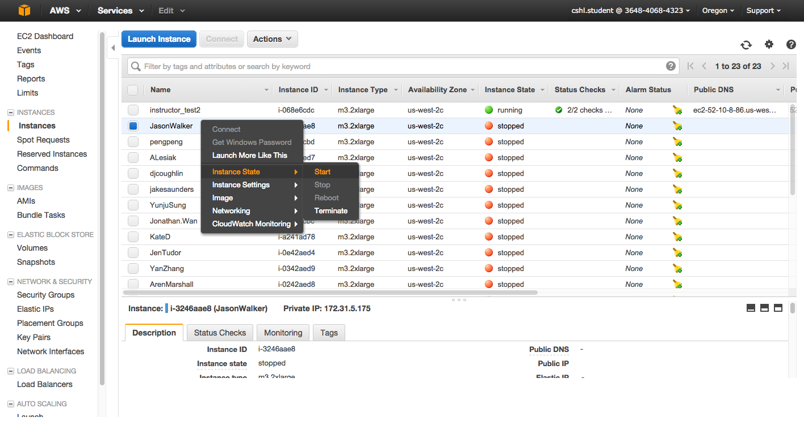
Next morning, you can “Start” your instance again
Go to AWS EC2 Dashboard, select “Instances” tab, then find your instance. Right-click and chose ‘Instance State’ -> ‘Start’

Slide 54
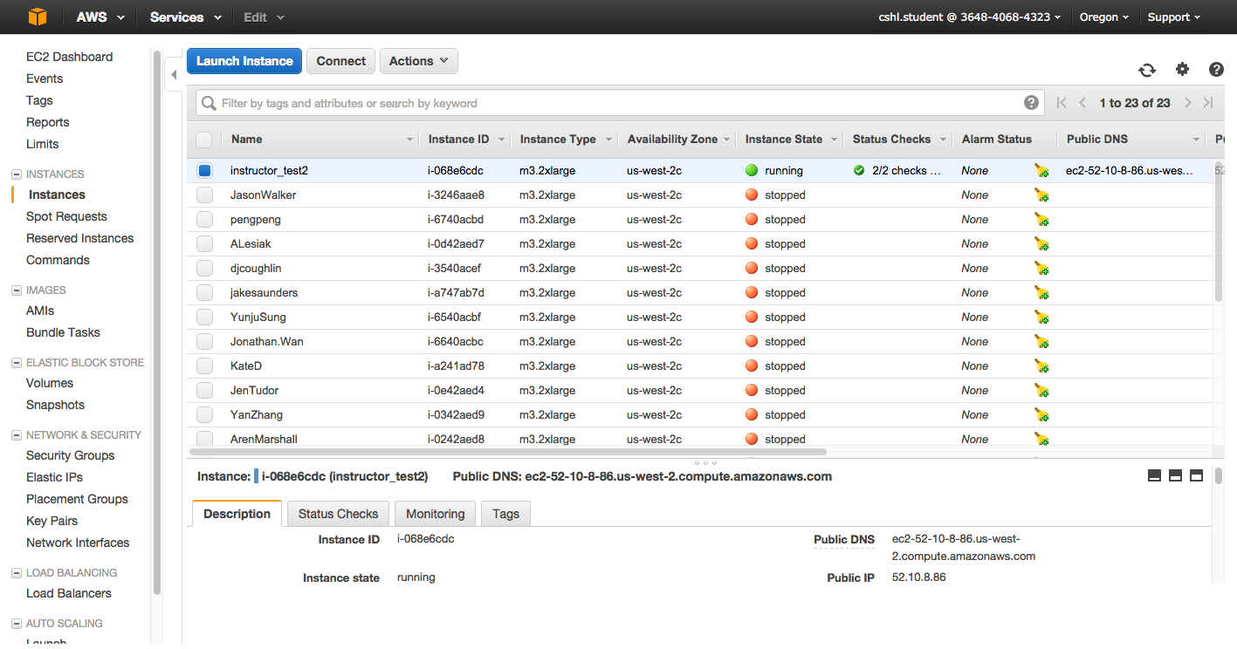
When you restart your instance you will need to find your new Public DNS or IP address. Select your instance and “Connect” or look in Description tab. Then go back to instructions for “Logging into your instance”

Slide 55
So, at this point:
Your Mac desktop is ready for the workshop
If it is not, you know where to get the information you need
You know how to login to AWS
The next step is to login to your linux machine on AWS and learn the basics of a linux command line

Slide 56
We are on a Coffee Break & Networking Session

