Slide 1
Canadian Bioinformatics Workshops
www.bioinformatics.ca
bioinformaticsdotca.github.io
Supported by

Slide 3
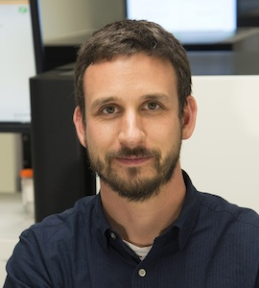
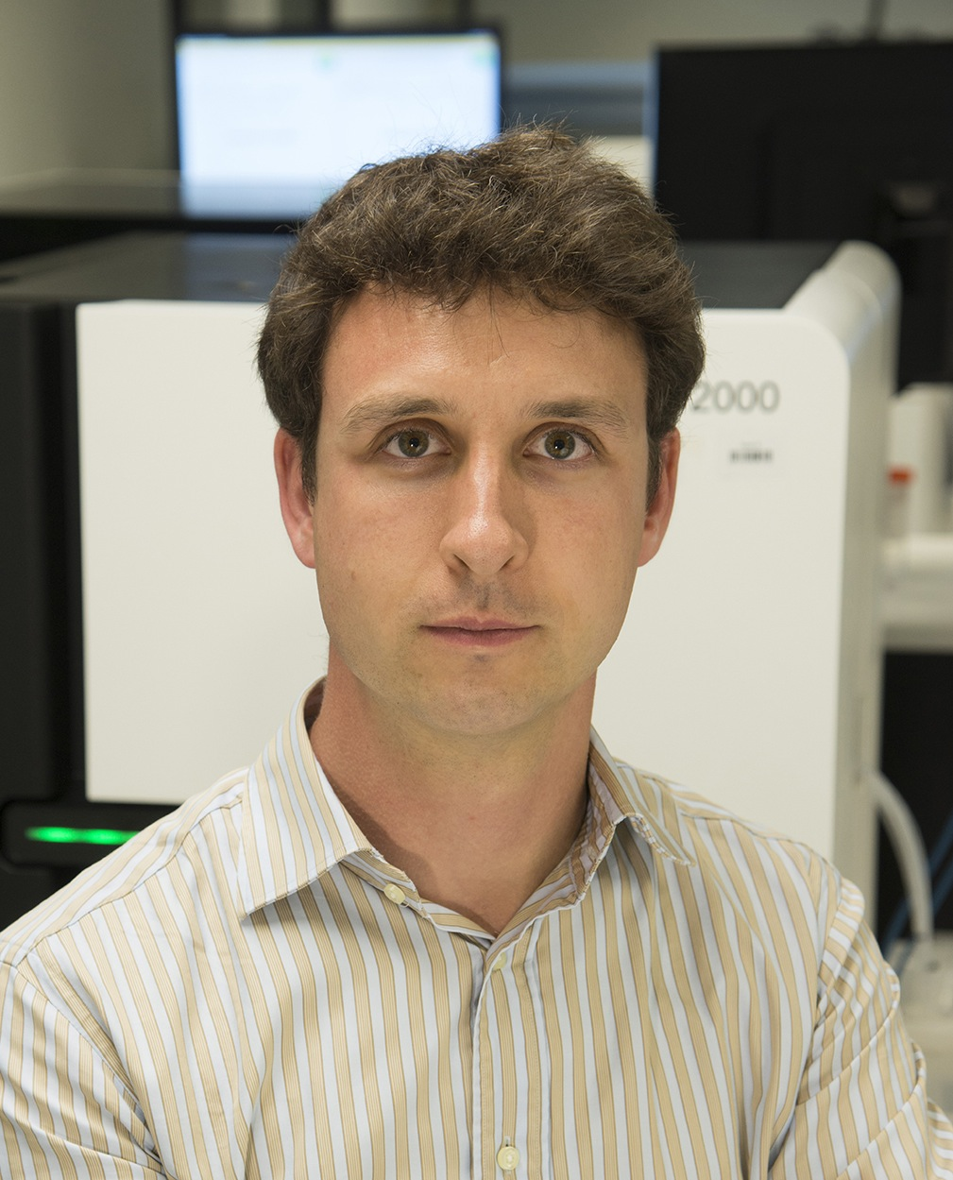
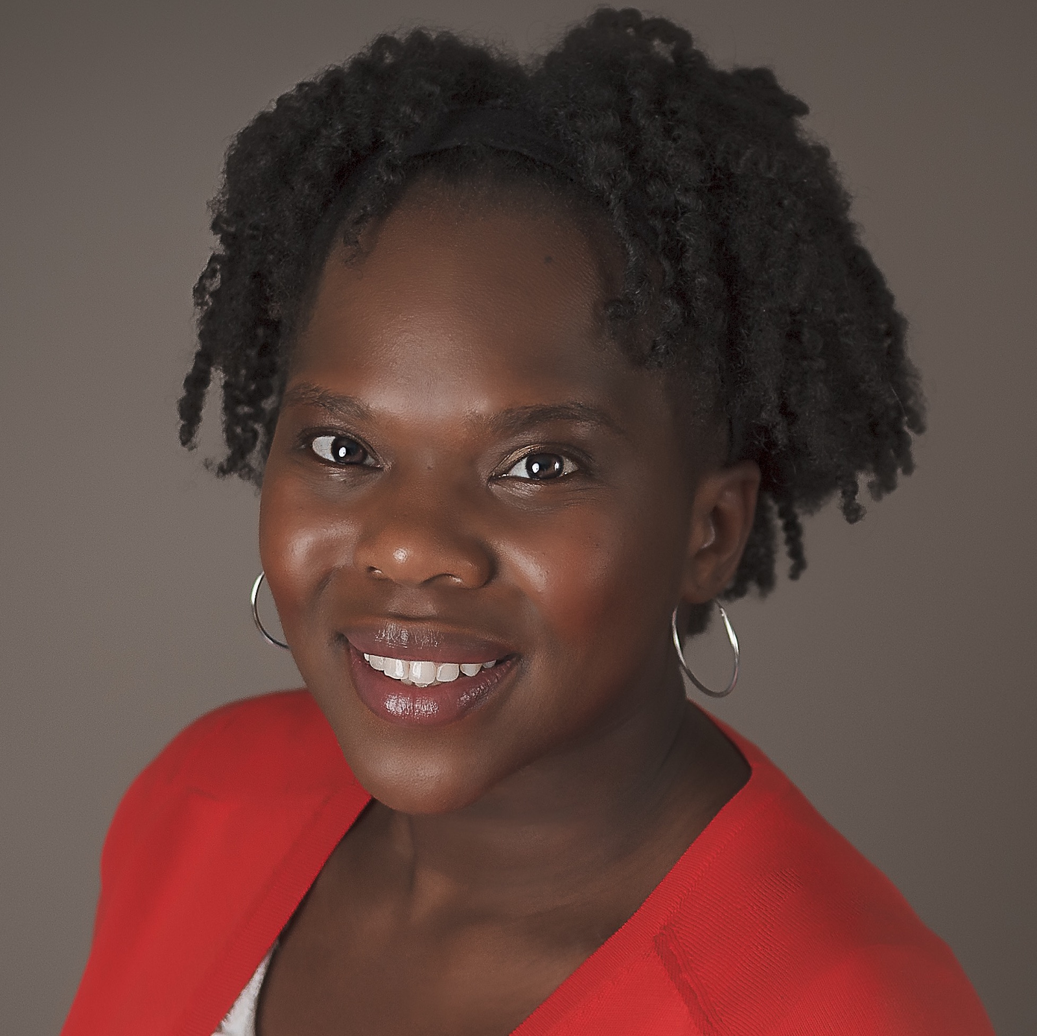
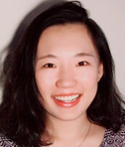
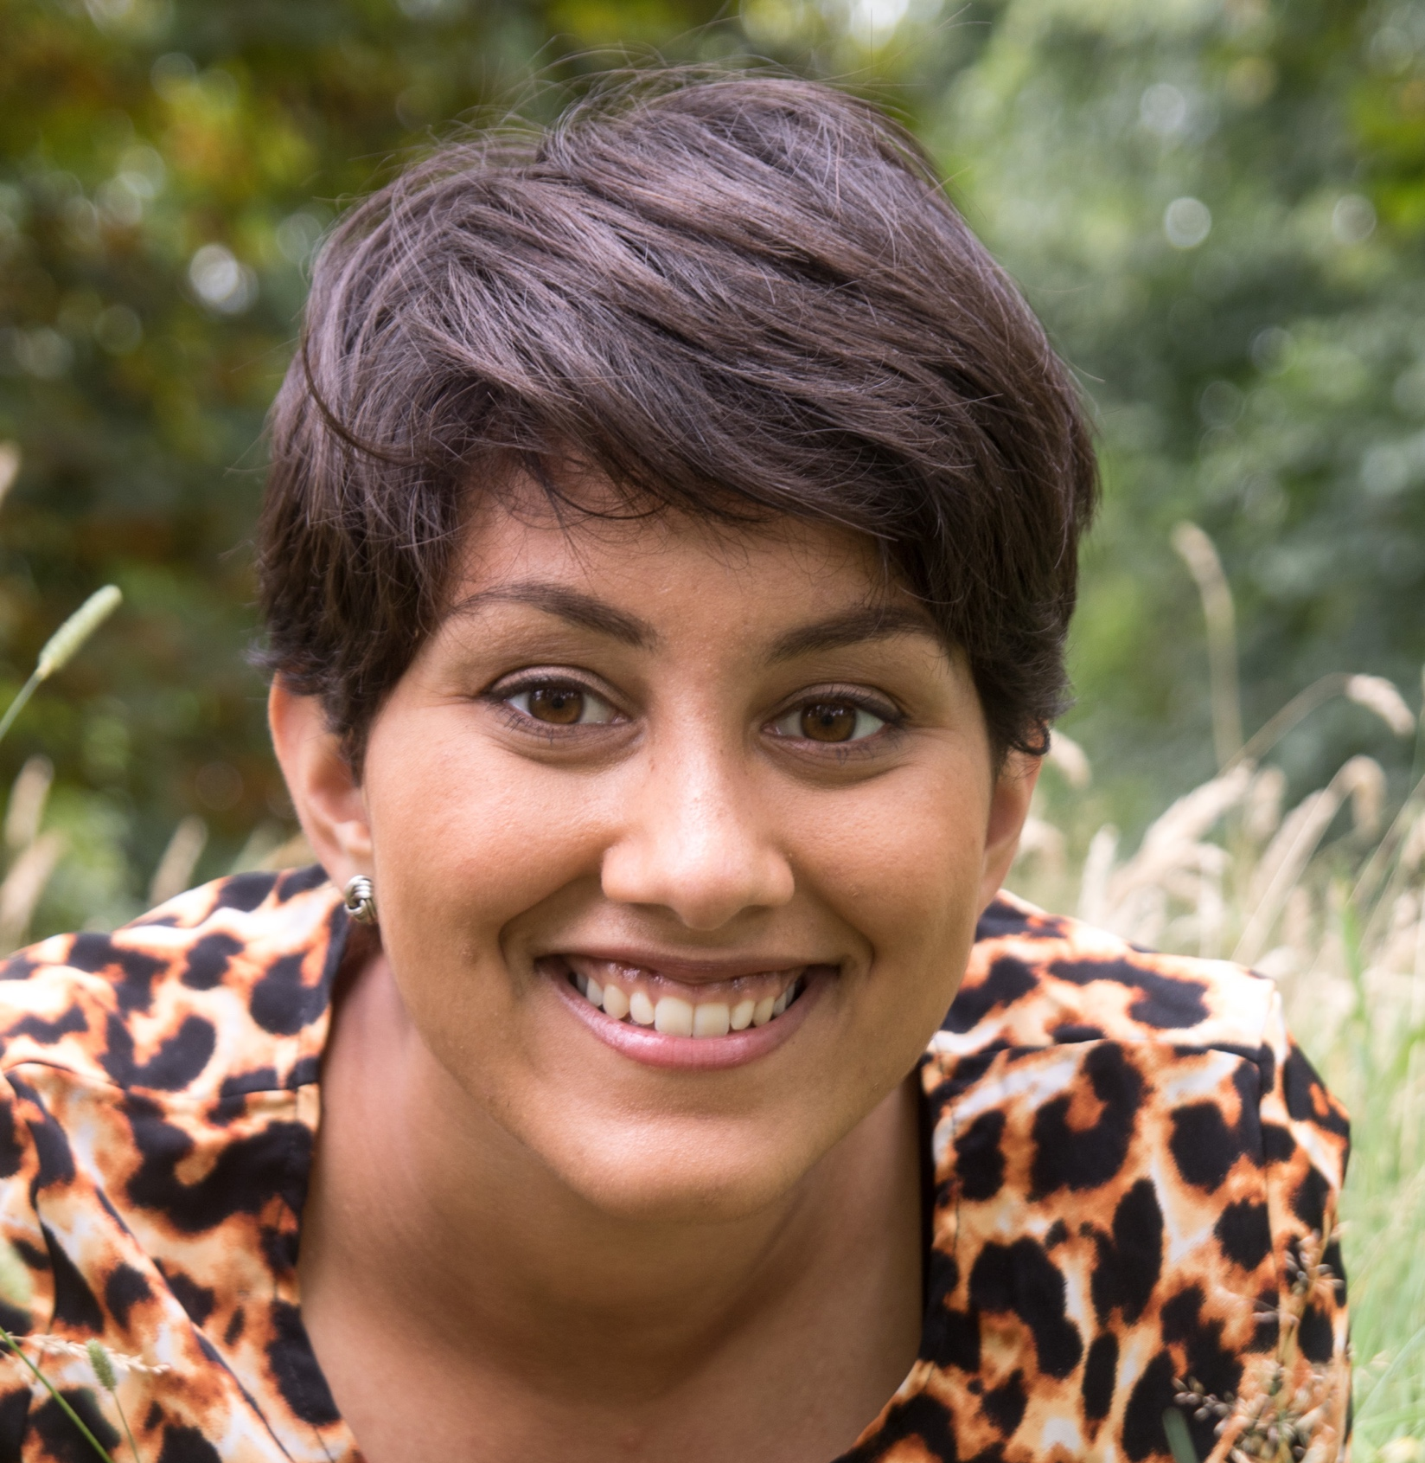
Introductions to Instructors and TAs
Malachi Griffith Associate Professor of Medicine Associate Professor of Genetics
Assistant Director, MGI
Obi Griffith
Associate Professor of Medicine Associate Professor of Genetics
Assistant Director, MGI
Felicia Gomez
Instructor of Medicine
Huiming Xia
PhD candidate
Emma Bell
Postdoctoral research fellow
griffithlab.org
rnabio.org genviz.org pmbio.org

Slide 4
Student poll
Not counting the pre-requisites and materials for this course:
Do you consider yourself a bioinformatician?
Are you familiar with linux/command line?
Intermediate?
Expert?
Do you sometimes write code?
Are you familiar with R?
Intermediate?
Expert?
Do you use git/github?
What organism do you work with?
Who has a dual monitor setup?

Slide 5
We are on a Coffee Break & Networking Session
Workshop Sponsors:

