Slide 1
Canadian Bioinformatics Workshops
www.bioinformatics.ca
bioinformaticsdotca.github.io

Slide 2
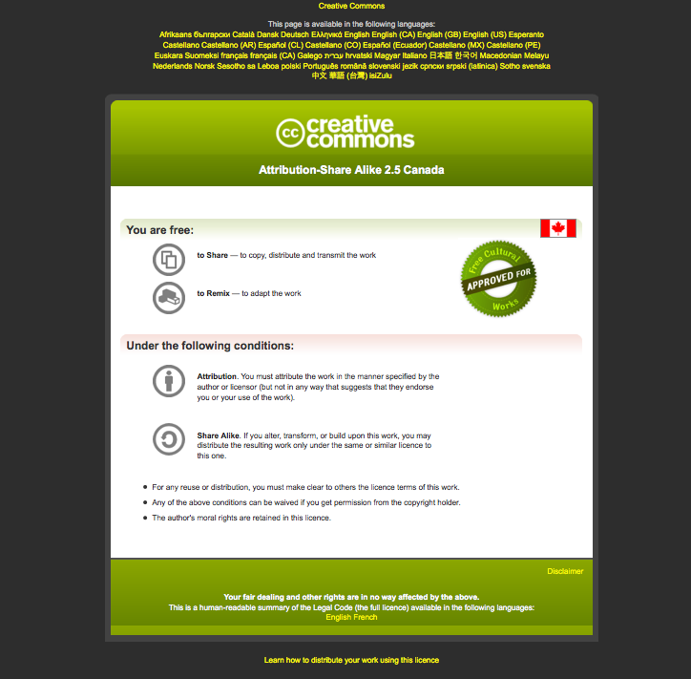

Slide 3
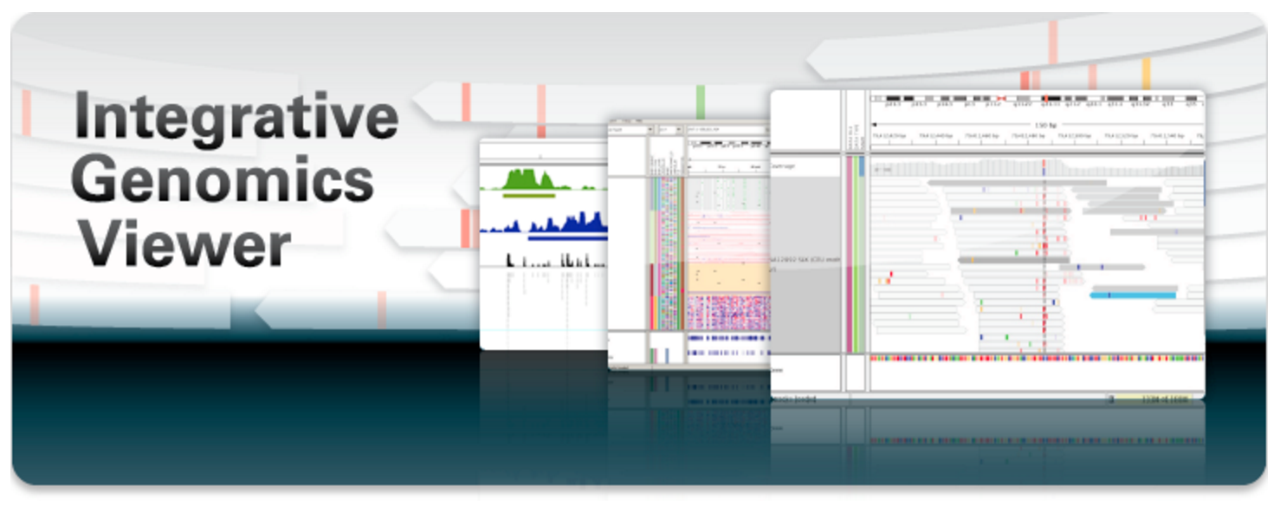

Introduction to IGV
The Integrative Genomics Viewer
Obi Griffith and Malachi Griffith
RNA-seq Analysis 2023. July 17-19, 2023

Slide 4
Visualization Tools in Genomics
there are over 40 different genome browsers, which to use?
depends on
  task at hand
  kind and size of data
  data privacy
Notes:
So what tools can we use to visualize data? Well, it really depends on what your data is and how much of it you have – if you’re looking at inter-chromosomal structural rearrangements in a large cohort of patients, you may want to generate circos plots, if you are looking at mutations you can use a genome browser. Privacy is another important consideration, especially when working with patient-derived data. In that case, you want to make sure for instance, that you can keep your data on your secured computer or cluster, and not upload it online.
That being said, genome browsers are a very good option for a light or thorough investigation in most cases, including those where privacy is a consideration. There are at least 40 different genome browsers out there, built by different teams for different purposes, but most of them solve the core challenge of being able to interactively look at various types of data in the context of a reference genome, whether it be fly, worm, mouse, or human.

Slide 5




HT-seq Genome Browsers
Integrative
Genome
Viewer
UCSC
Genome Browser
Cancer Genome Browser
Trackster
(part of Galaxy)
Savant
Genome
Browser
task at hand : visualizing HT-seq reads, especially good for inspecting variants
kind and size of data : large BAM files, stored locally or remotely
data privacy : run on the desktop, can keep all data private
UCSC Genome Browser has been retro-fitted to display BAM files
Trackster is a genome browser that can perform visual analytics on small windows of the genome, deploy full analysis with Galaxy
Notes:
So if the task at hand is visualizing alignments to the genome, inspecting variants, looking at coverage, and so on, genome browsers will be the right tool. They are able to handle large files stored either locally or remotely, and can keep that data private. IGV is the most highly-used and fully-featured browser, and the one we will spend most time talking about. Other browsers include the UCSC Genome Browser, and the UCSC Cancer Genome Browser, Trackster, which is part of Galaxy and can perform visual analysis on small regions, and the Savant Genome browser, which integrates visualization of variant analysis.

Slide 6
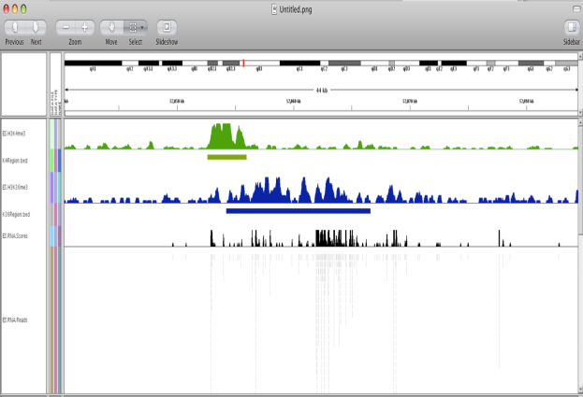
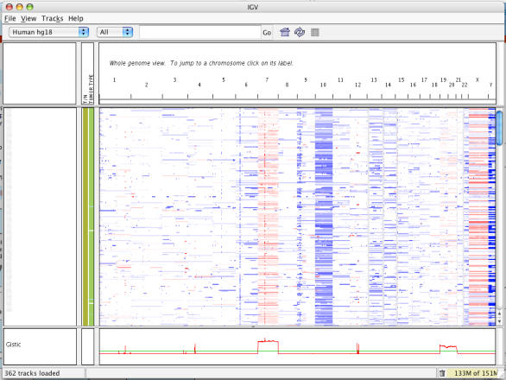
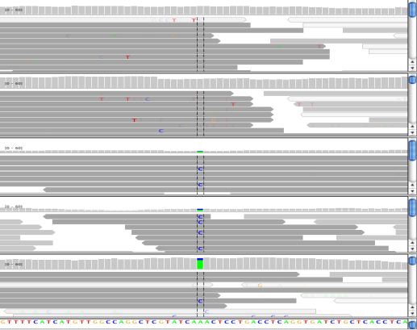
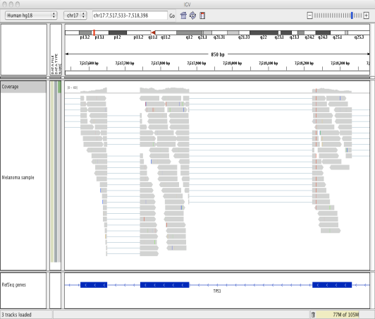
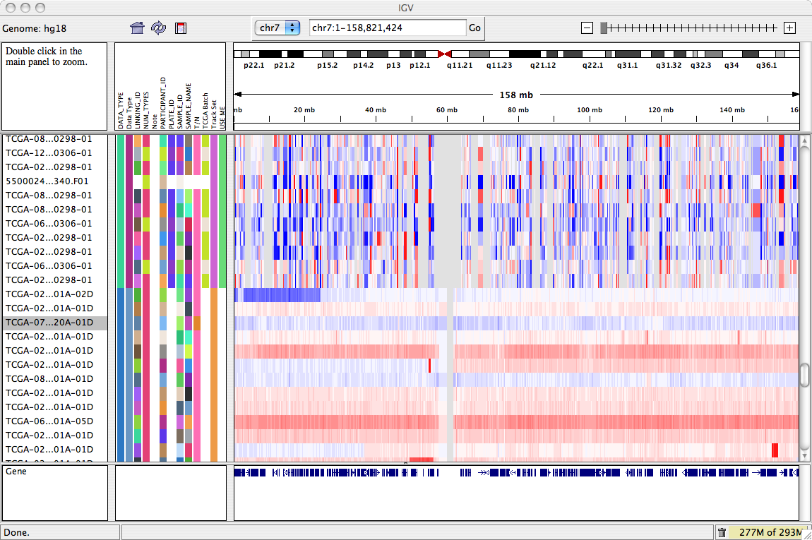
Integrative Genomics Viewer (IGV)
  Desktop application for the interactive
  visual exploration of integrated genomic datasets
Epigenomics
Microarrays
NGS alignments
http://www.broadinstitute.org/igv
RNA-Seq
>85,000 registrations (2014)
mRNA, CNV, Seq
Notes:
Let’s delve into more detail on the Integrative Genimics Viewer (IGV). IGV’s design is focused on the integrative nature of genomic studies, with support for both array-based and next-generation sequencing data, and their integration together with additional clinical or phenotypic data. A user can visualize and explore their own data set, and importantly, can do so in the context of any available public data set, which is extremely powerful.

Slide 7

Features
With IGV you can…
  Explore large genomic datasets with an intuitive, easy-to-use interface.
  Integrate multiple data types with clinical and other sample information.
  View data from multiple sources:
    local, remote, and “cloud-based”.
  Automation of specific tasks using command-line interface
Notes:
The user interface is intuitive and easily learned;
It can integrate multiple data types with clinical data;
It allows visualization of one or multiple locations in the genome at once
And can pull data from local of remote locations.
Finally, it allows automation of certain tasks using “batch jobs”, which can be invoked while an IGV session is in progress – we’ll try this out at the end of the lab in fact. IGV can also be used non-interactively, so, invoked on the commandline with a batch job of tasks to perform. This is quite useful when we want to do a lot of one thing, like saving an image of the read support at every mutation in a list of SNVs.

Slide 8


IGV data sources
Local files
TCGA
GenomeSpace
HTTP server
FTP server
    - View local files without uploading.
    - View remote files without downloading the whole dataset.

Slide 9
Using IGV: the basics
  Launch IGV
  Select a reference genome
  Load data
  Navigate through the data
    WGS data
      SNVs
      structural variations

Slide 10
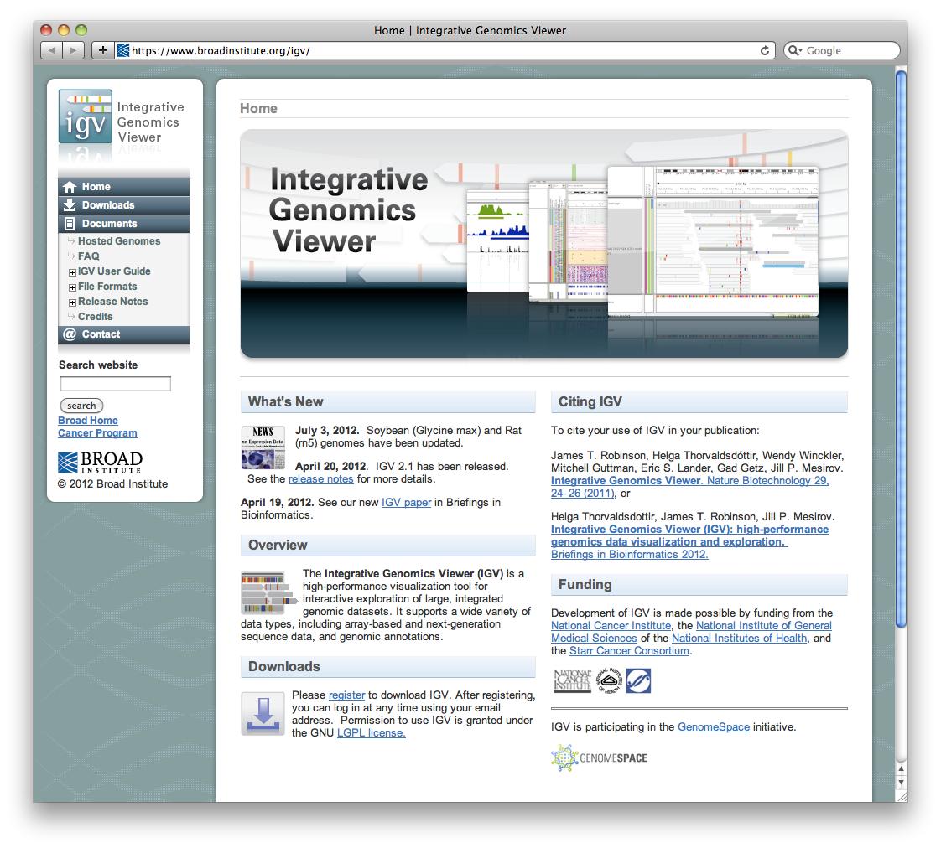
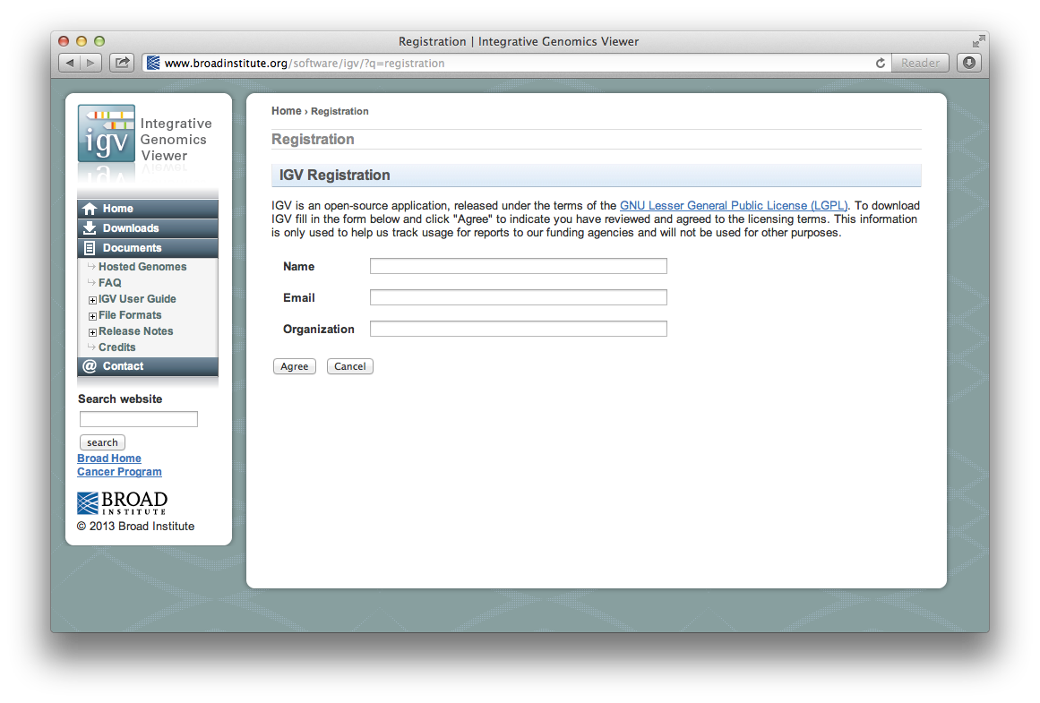
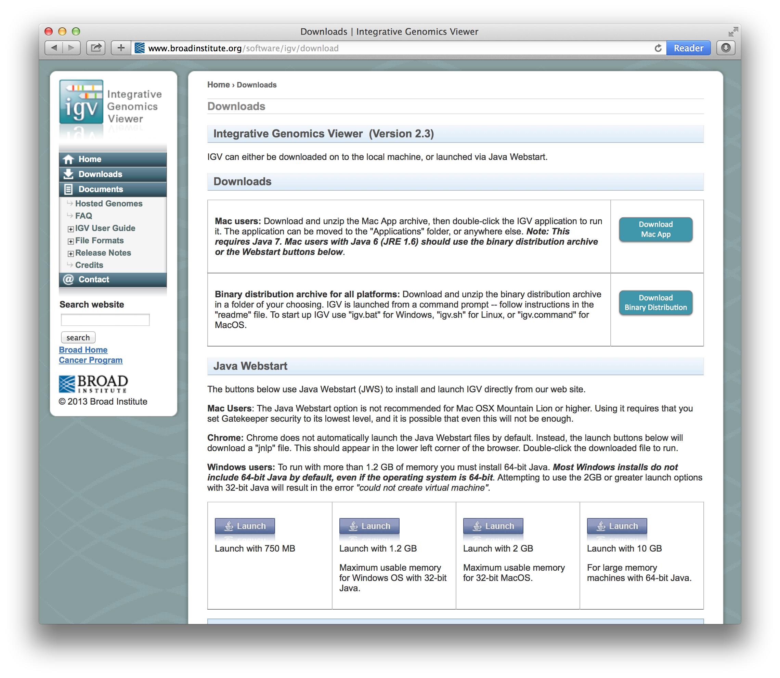

Launch IGV
Notes:
IGV is available on all platforms that support Java. Installation and launching are accomplished by clicking a “Launch” button on the IGV web site, or alternatively, by installing the application locally.

Slide 11
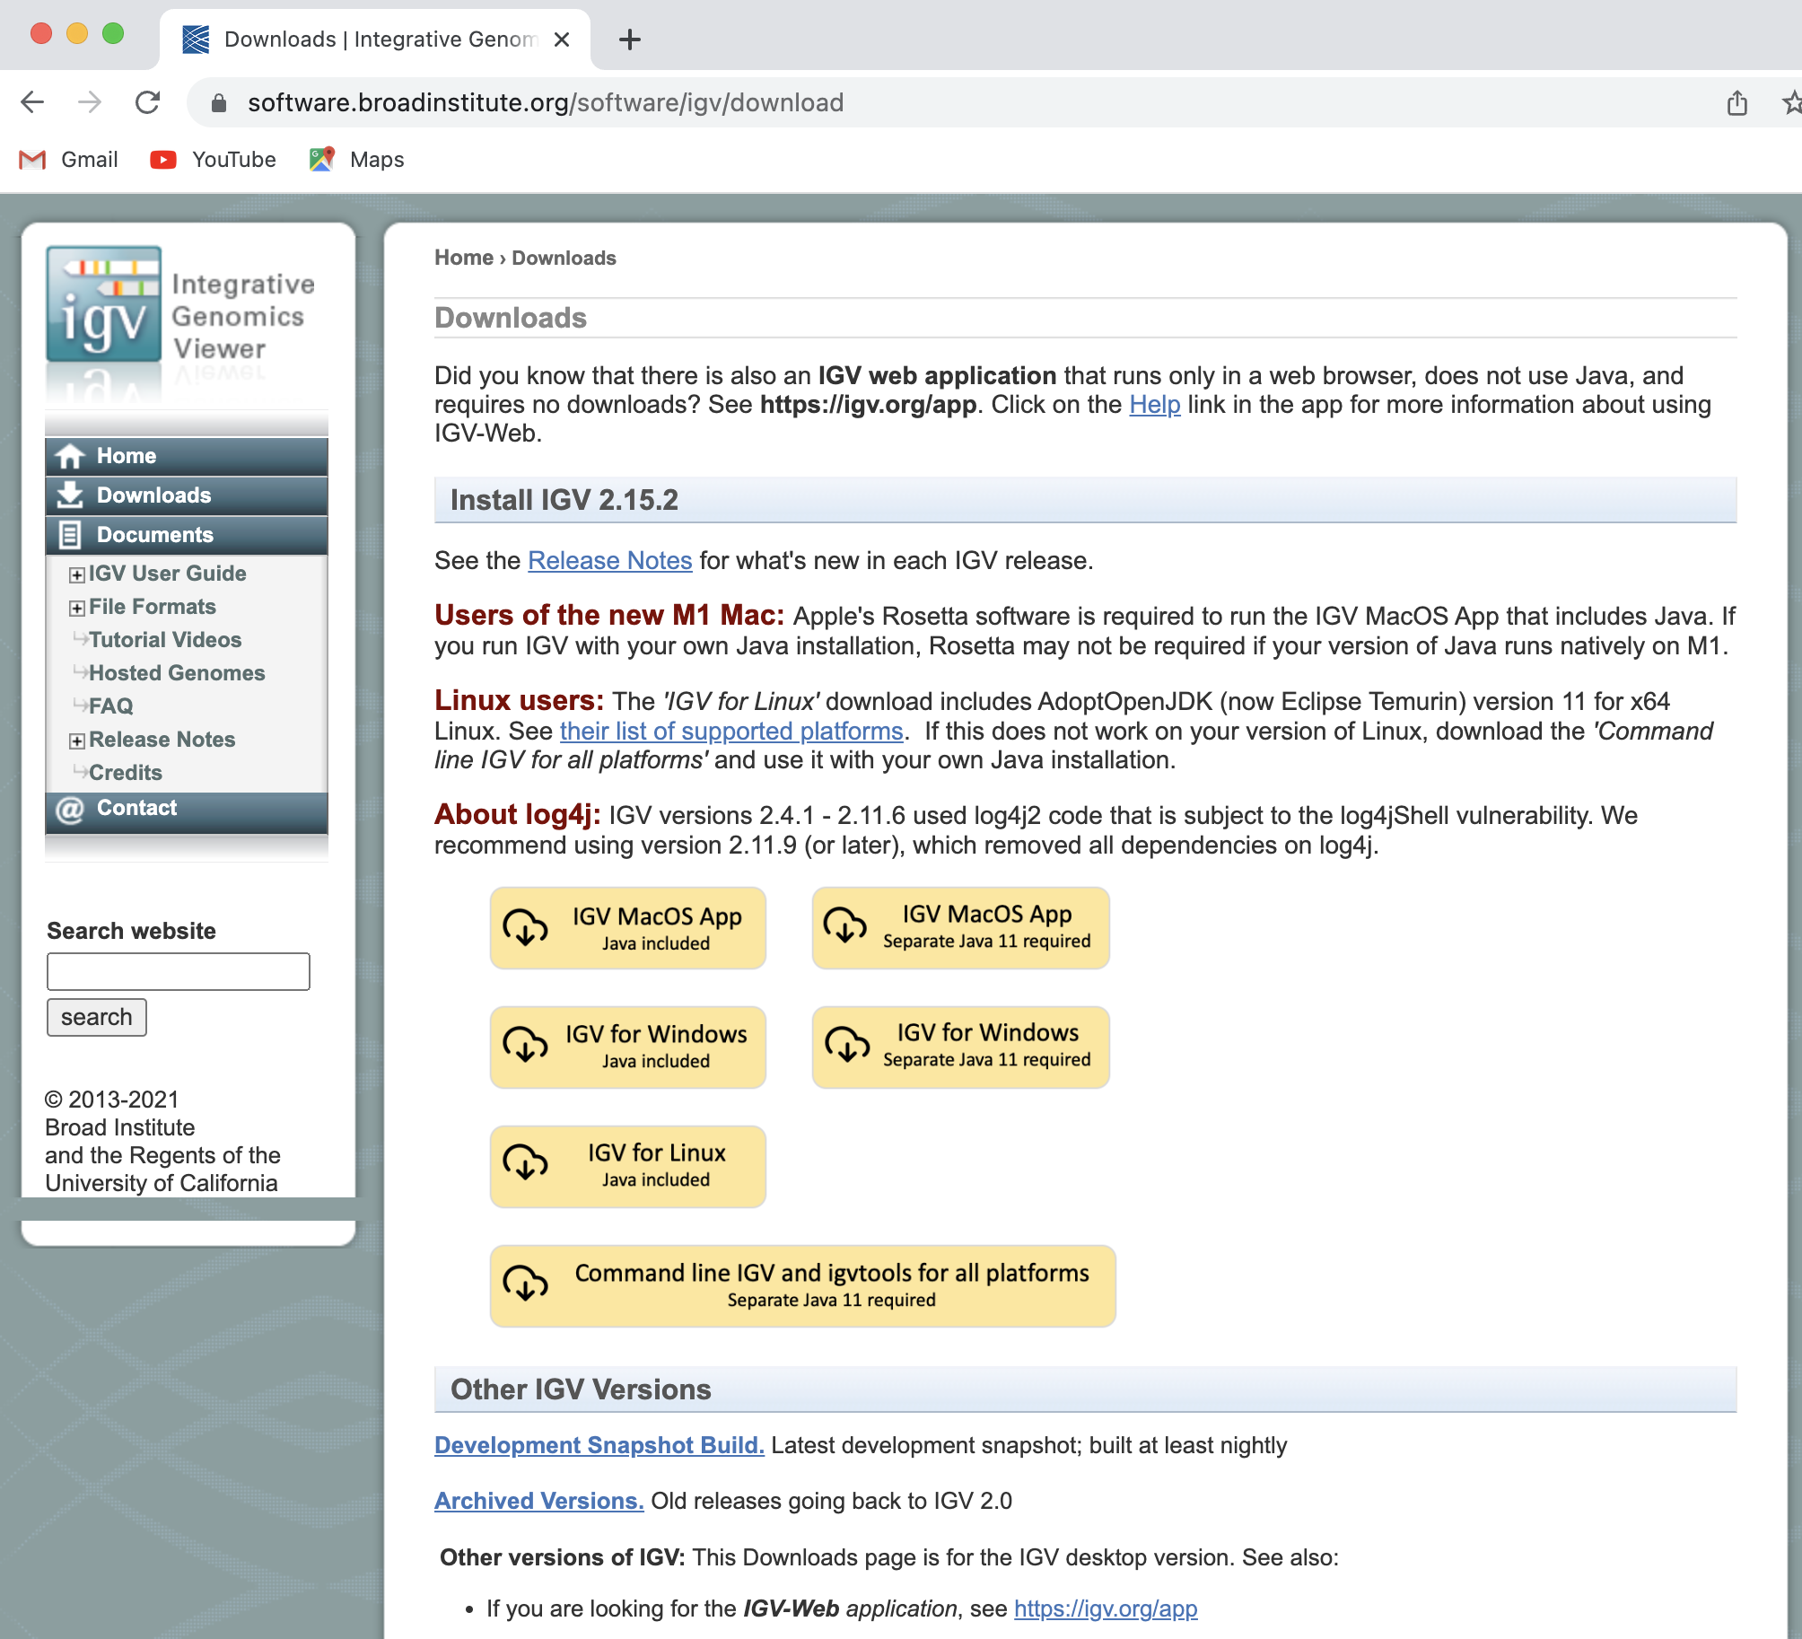
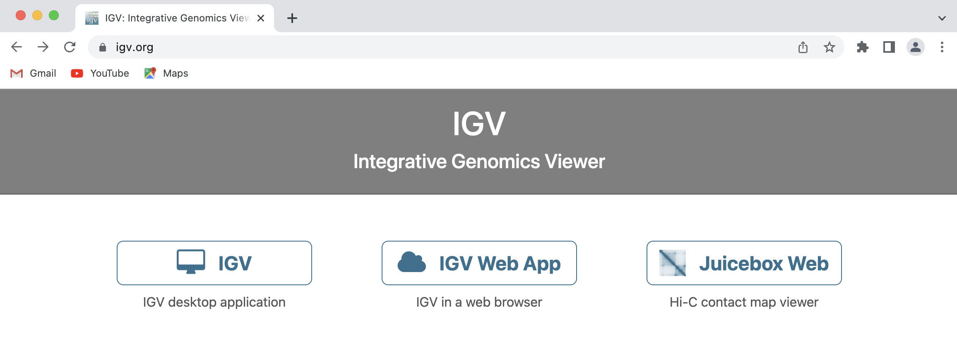
Launch IGV
Notes:
IGV is available on all platforms that support Java. Installation and launching are accomplished by clicking a “Launch” button on the IGV web site, or alternatively, by installing the application locally.

Slide 12
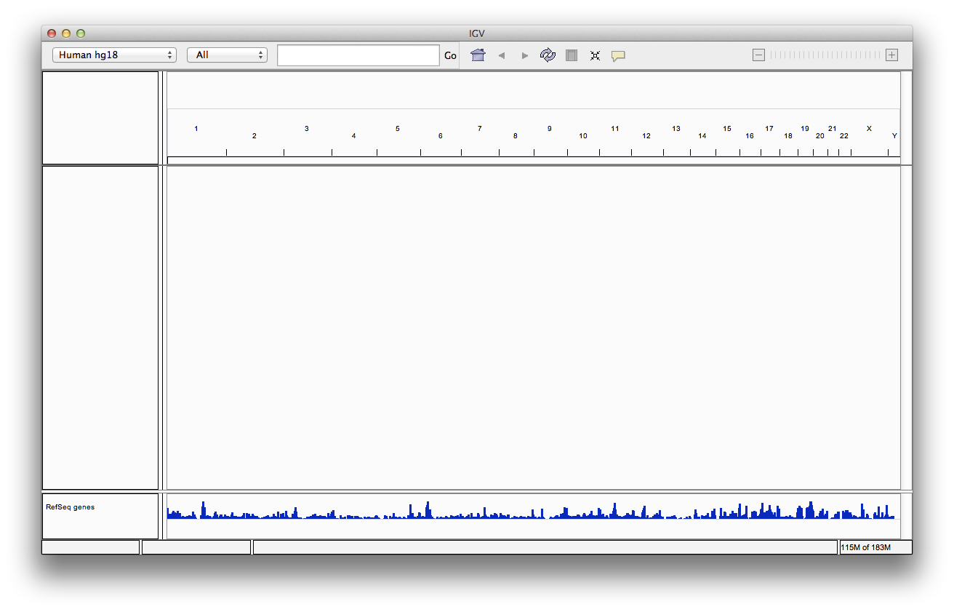
Select reference genome
1. Select genome from the drop-down menu
2. Load data
Notes:
The IGV window is divided into a number of controls and panels. At the top is a command bar with controls for selecting a reference genome, which must be selected before loading data. IGV provides dozens of hosted reference genomes to choose from, and also provides the option of importing novel references.

Slide 13
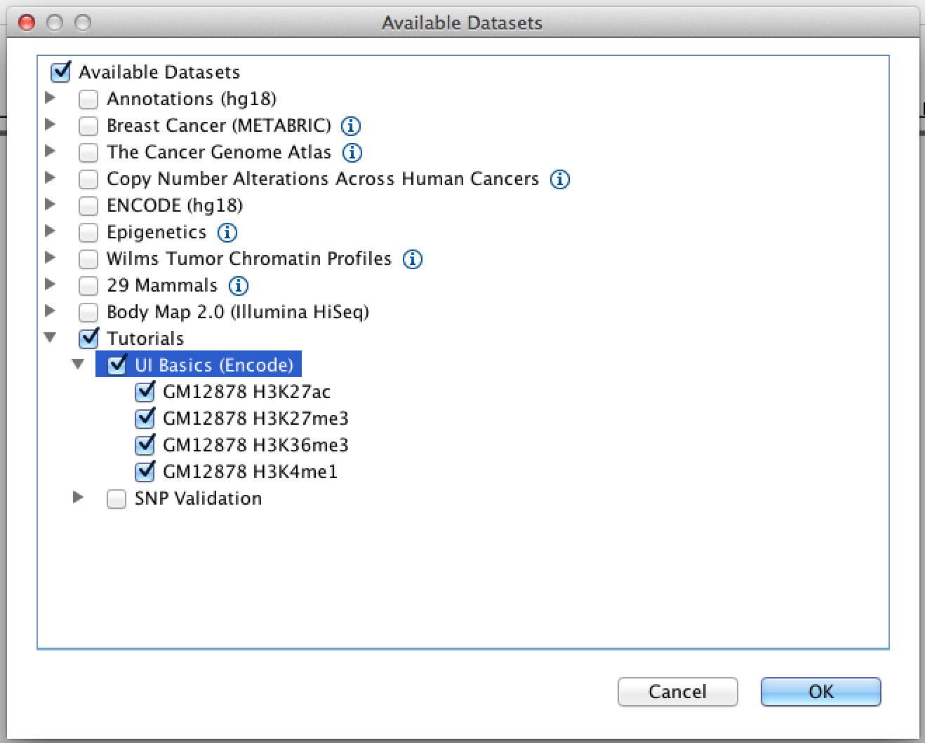
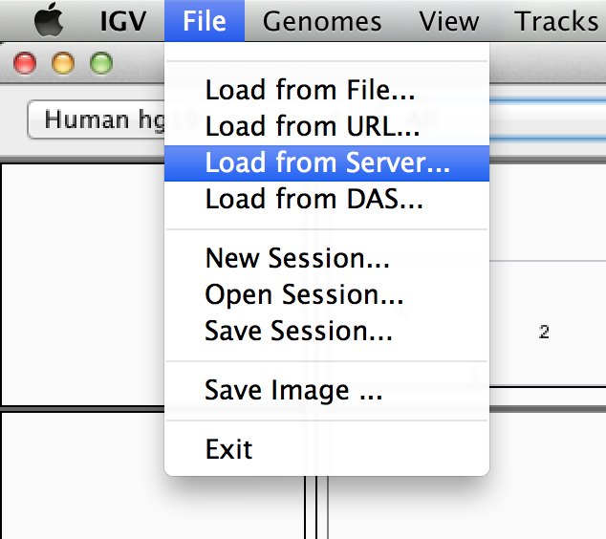
Load data
Select File > Load from Server…
Open the
Tutorials menu, select UI Basics
Notes:
Data files are loaded into IGV by:
using the built-in file browser to select a file on the local file system,
entering the URL of a file accessible over a network via HTTP or FTP,
selecting entries from the ‘File > Load from Server’ menu.
## entering the URL of a Distributed Annotation System (DAS) feature source [18] or
By default, the menu provides access to data and annotation files that are hosted at the Broad Institute for viewing in IGV. So in this example, we are loading ChIP data representing various epigenetic marks done for one individual.

Slide 14
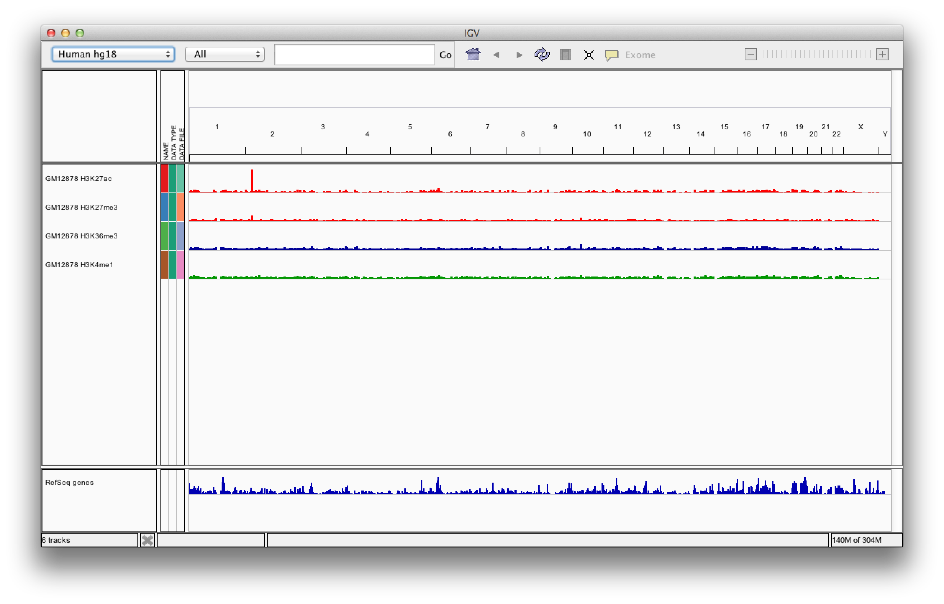
Screen layout

Slide 15

Screen layout
menus
toolbar
genome ruler
data panel
tracks
track names
genome features
Notes:
So, just below the toolbar is a header panel with an ideogram representation of the current chromosome, along with a genome coordinate ruler that indicates the size of the region in view.
The remainder of the window is divided into one or more data panels and an attribute panel. Data are mapped to the genomic coordinates of the reference genome and are displayed in the data panels as horizontal rows called ‘tracks’. Each track typically represents one sample or experiment. If any sample or track attributes have been loaded, they are displayed as a color-coded matrix in the attribute panel. These can include information like data type, or clinical details, such as age or sex of the patient, and can be sorted on.
At the bottom, we see genome features loaded by default, in this case RefSeq gene annotations.
[more on attributes/how to load attributes file: https://software.broadinstitute.org/software/igv/DisplayOptionsAttributes , https://software.broadinstitute.org/software/igv/SampleInformation ]

Slide 16
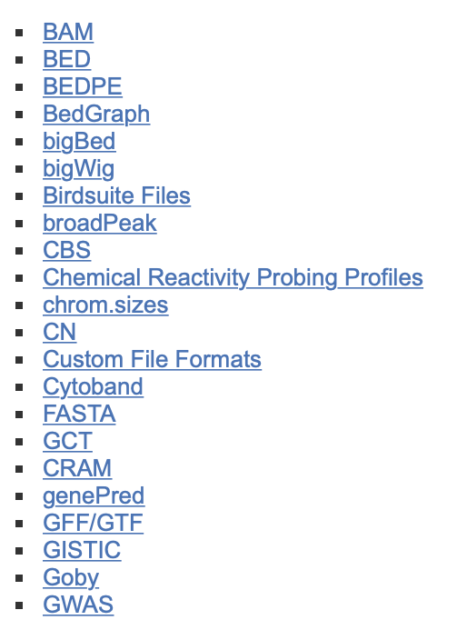
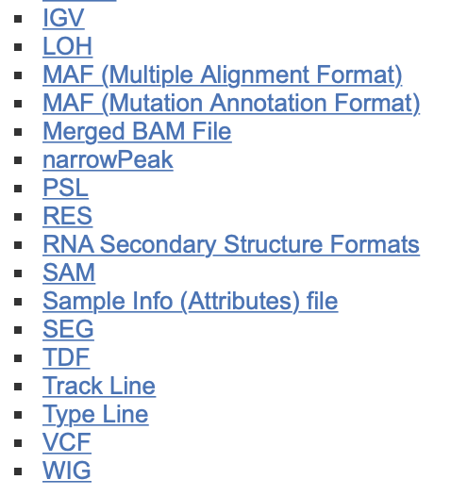
File formats and track types
The file format defines the track type.
The track type determines the display options
For current list see: https://software.broadinstitute.org/software/igv/FileFormats
Notes:
IGV currently supports more than 30 different file formats [2022: 39 formats], including many of the common formats for genome annotations, sequence alignments, variant calls and microarray data. The file format defines the track type, and the track type determines predefined display options.

Slide 17
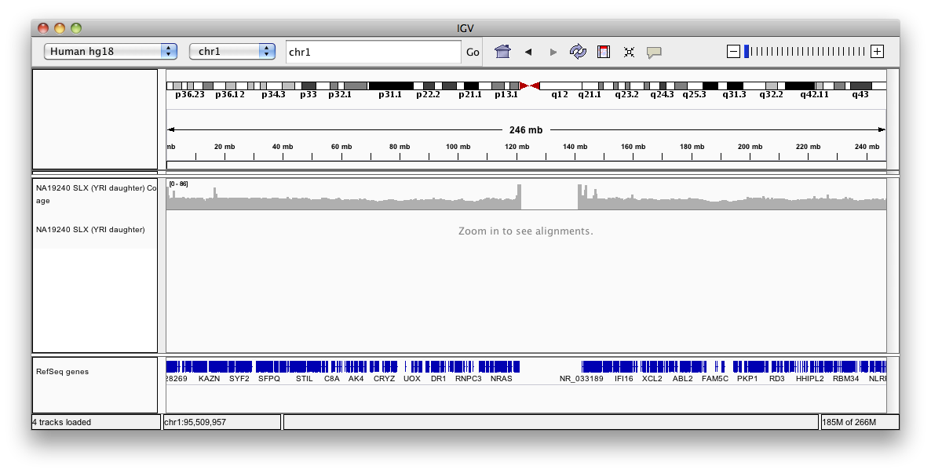
Viewing alignments
Whole chromosome view
Notes:
For NGS data, the files are in BAM format, and the track type is therefore an alignment. If we are zoomed out too far, we can’t see individual reads aligning, just a message that tells us we have to get closer. What we CAN see in this view is a bar chart of read coverage along the chromosome, with typical peaks at the centromeres, where repetitive elements are very common.

Slide 18
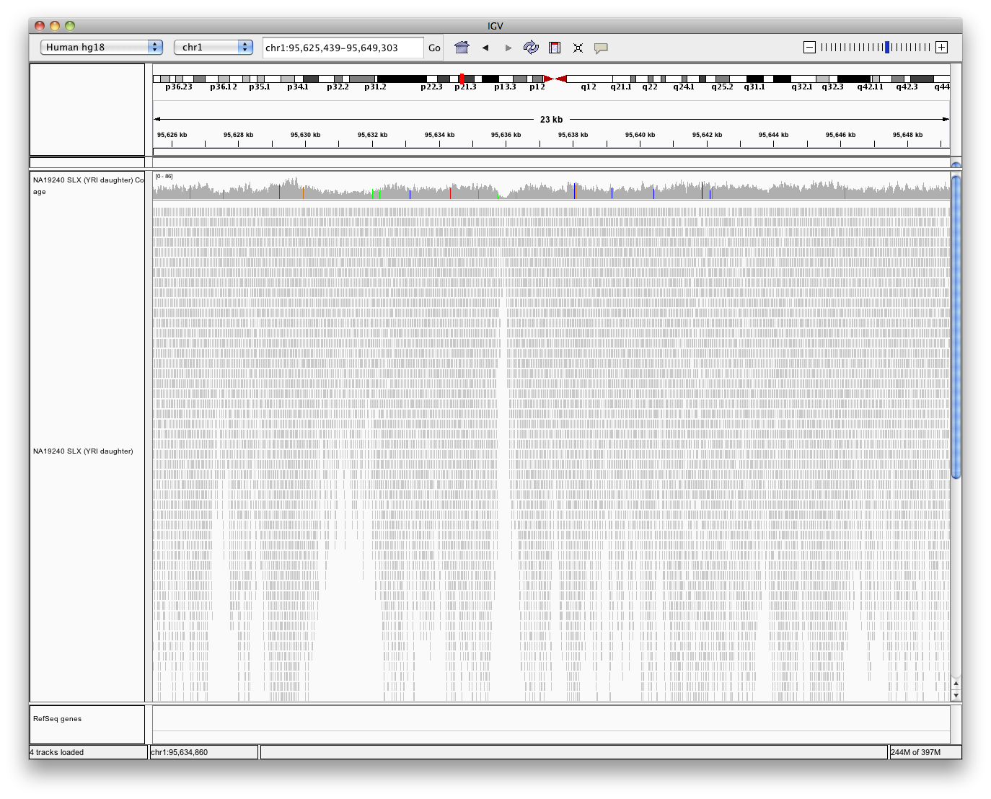
Viewing alignments – Zoom in
How far do you need to zoom in to see the alignments?
30 kb
or set a different threshold in Preferences
Higher value ➔ requires more memory
Low coverage files ➔ ok to use higher value
Very deep coverage files ➔ use lower value
Notes:
We need to zoom in to about 30kb to see alignments, although this is a threshold that can be changed depending on what your data is like, as it takes more memory to load more alignments.

Slide 19
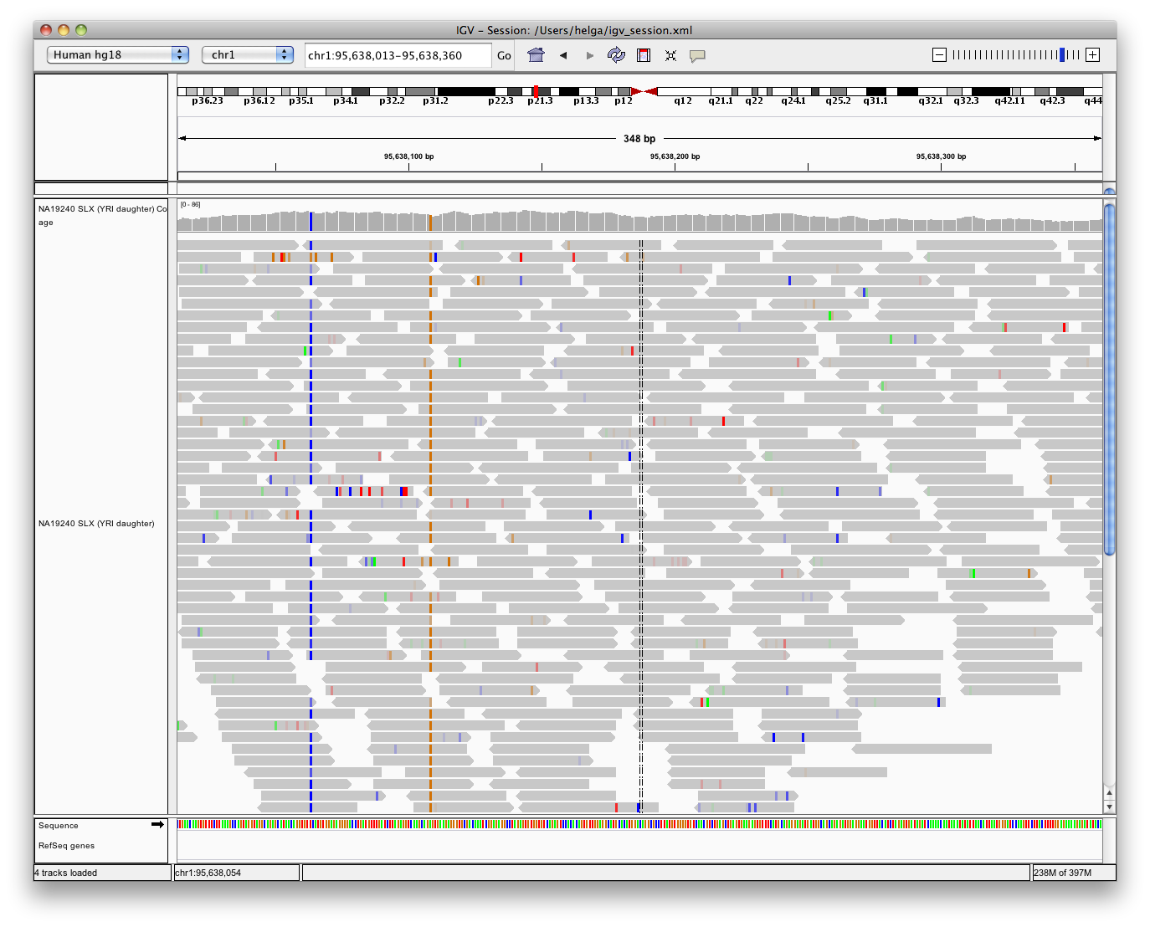
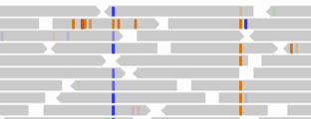
Viewing alignments – Zoom in
Bases that do not match the reference sequence are highlighted by color
Notes:
When zoomed in sufficiently, IGV uses color and transparency to highlight interesting events in the alignment data and to visually deemphasize others—in the coverage chart, at the read level and for individual bases. individual read alignments are displayed as horizontal bars. The direction of each read is denoted by the pointy-end of the bar (like an arrow pointing in the read direction), and the grey color indicates that the mapping quality is good.
Color bars in the coverage track indicate locations where a large number of read bases mismatch the reference—these are helpful in identifying putative SNPs. The relative size and color of these bars indicates the allele frequency of each base at that location. Here we see two homozygous SNPs, one that changes the reference base to a T (in blue), and one that changes it to a G.(in orange). So mismatches are color-coded by the called base and are assigned a transparency value proportional to the base call quality (phred) score. This is the default coloring scheme for read bases, and has the effect of emphasizing high-quality mismatches.

Slide 20
SNVs and Structural variations
Important metrics for evaluating the validity of SNVs:
  Coverage
  Amount of support
  Strand bias / PCR artifacts
  Mapping qualities
  Base qualities
Important metrics for evaluating SVs:
  Coverage
  Insert size
  Read pair orientation
Notes:
There are a number of metrics like this that are useful in evaluating the validity of SNVs and structural variants. For SNVs, we’re going to consider read coverage, the allelic frequency of the alternate base, strand bias, mapping quality of the reads, and the base quality at the position of interest. For SVs, we’ll take a look at coverage, and most importantly at insert size and read pair orientation.

Slide 21
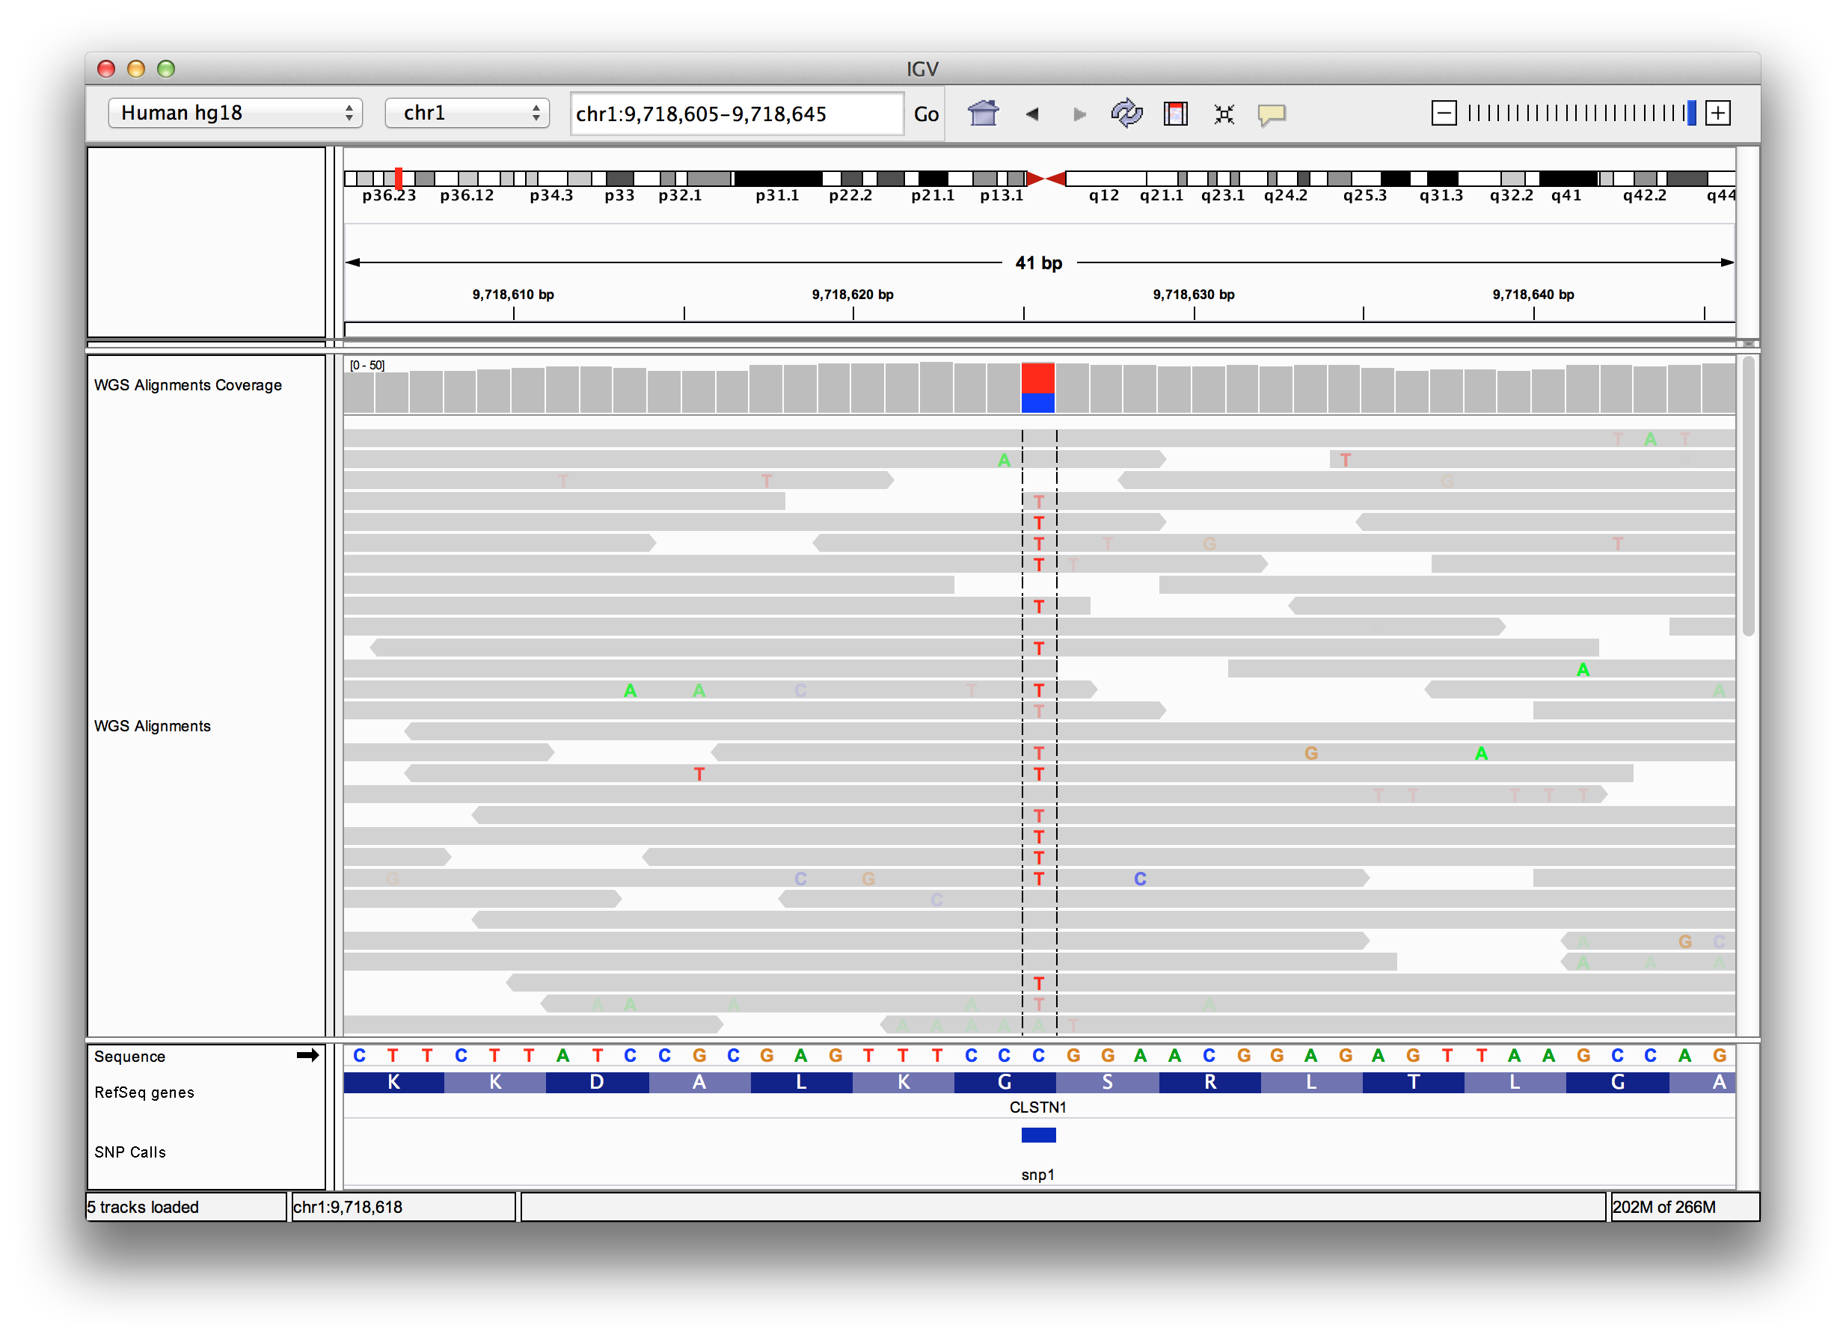
Viewing SNPs and SNVs
Notes:
The best way to consider these metrics is to look at data. In this case of an SNV, we see high read coverage (50 reads), and an allele frequency of about 60%. The color transparency corresponds to base quality, and in this case we see that not all the reads have high quality calls. So this might be a variants that we would want to investigate a bit further.

Slide 22
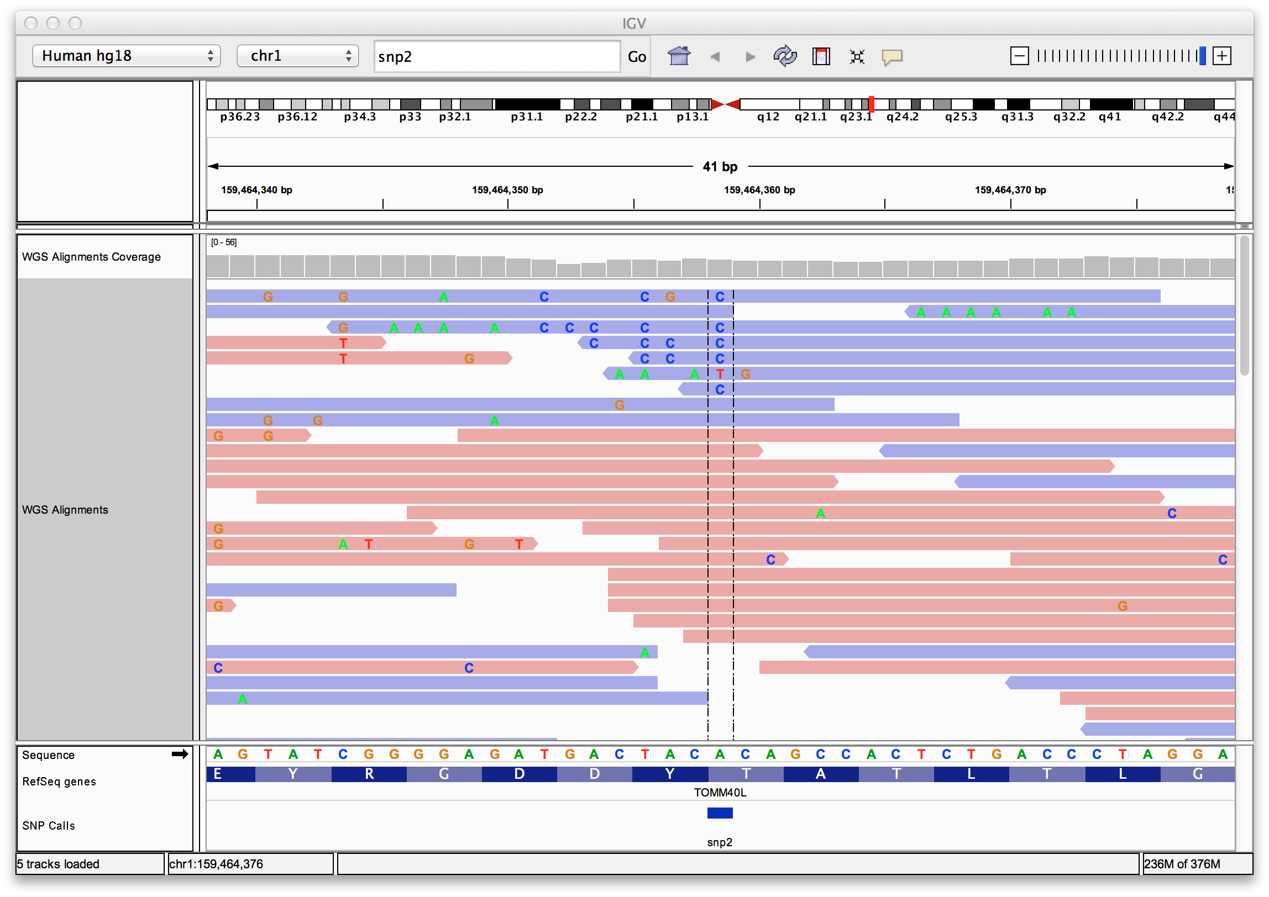
Viewing SNPs and SNVs
Notes:
In this second example, we see that the reference allele “A” is changed to a “C” in about 30% of reads, but, only in reads on the reverse strand. Here the reads on the fwd strand are colored pink, and the reads on the reverse strand are colored blue, then the alignments are sorted by base. We can also see that after the initial mismatch, these reads continue to have additional mismatches, so we would conclude that this is very likely an artifact and not a true variant.

Slide 23
Viewing Structural Events
Paired reads can yield evidence for genomic “structural events”, such as deletions, translocations, and inversions.
Alignment coloring options help highlight these events based on:
  Inferred insert size (template length)
  Pair orientation (relative strand of pair)
Notes:
Structural variants such as deletions, translocations and inversions are a bit more complicated to investigate, and we rely on two main sources of evidence in considering them: inferred insert size and pair orientation. Lets talk about why these are important by looking at how genomic sequencing data are generated.

Slide 24
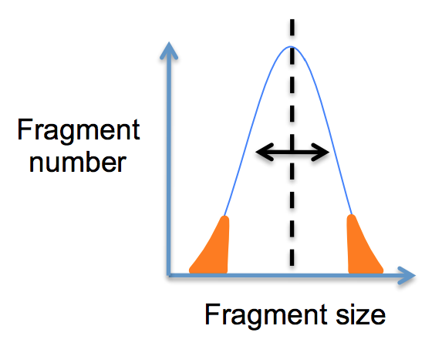
Paired-end sequencing
DNA or cDNA
Fragment and size select
Notes:
Very briefly, DNA is isolated and fragmented, and those fragments are size selected. For genomic libraries, the mean library size may be 350bp, and most fragments will fall within a tight range around that number, in a normal distribution.

Slide 25
Paired-end sequencing
DNA or cDNA
Fragment and size select
insert size
Read from each end
Notes:
Adapters are added to each end, and reads generated from each end. The insert size is the length of the DNA molecule between the two sequenced fragments.

Slide 26
Paired-end sequencing
DNA or cDNA
Fragment and size select
insert size
Read from each end
Align to Reference
inferred insert size
Notes:
These reads are then aligned to a reference genome, and at this point we can measure the inferred insert size, which is the distance between the alignments.

Slide 27
Interpreting inferred insert size
The “inferred insert size” can be used to detect structural variants including
  Deletions
  Insertions
  Inter-chromosomal rearrangements: (Undefined insert size)
Notes:
If there is a discrepancy between the library insert size and the inferred insert size, we can use that to detect deletions and insertions. Note that when read pairs map to different chromosomes the inferred insert size can not be calculated.

Slide 28
Deletion
What is the effect of a deletion on inferred insert size?
Notes:
So in the case of a deletion, how does the library insert size differ from the inferred insert size?

Slide 29
Deletion
Reference Genome
Subject
Notes:
Let’s take a look step by step: In our sequencing subject a portion of the genome is deleted.

Slide 30
Deletion
Reference Genome
Subject

Slide 31
Deletion
Reference Genome
Subject
Notes:
The subject’s DNA is then fragmented and sequenced, and the reads are aligned to the reference, which of course contains the deleted segment.

Slide 32
Deletion
Inferred insert size is > expected value
Reference Genome
inferred insert size
Subject
expected insert size
Notes:
So in the case of deletions, the inferred insert size is always larger than the expected size.

Slide 33
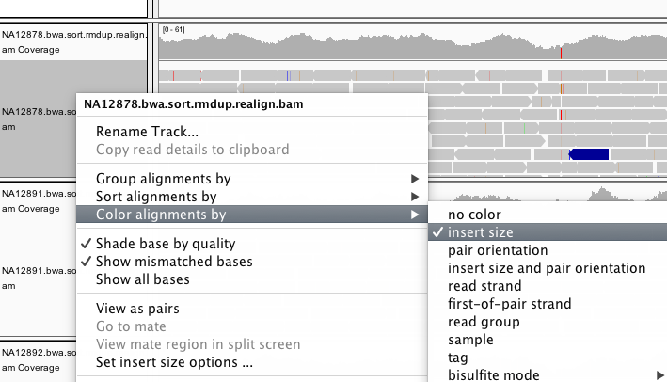
Color by insert size
Notes:
IGV has an option to color alignments by insert size in order to help us visualize them.

Slide 34
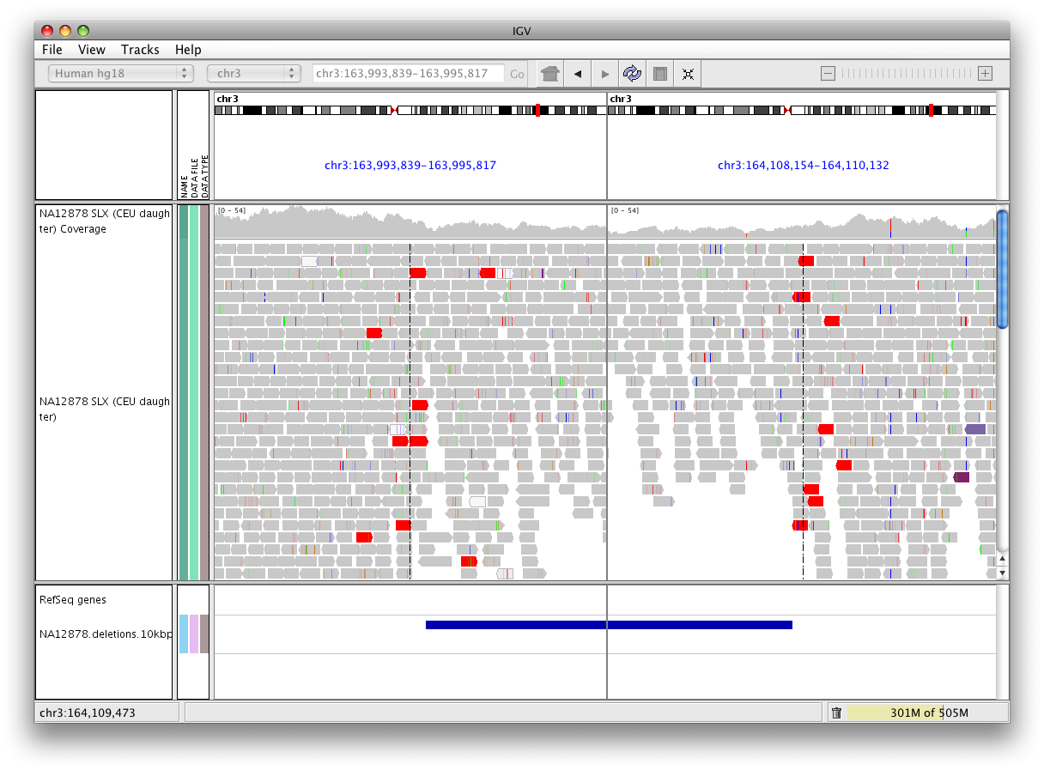
Deletion
Note drop in coverage
Pairs with larger than expected insert size are colored red.
Notes:
Here is an example of a 15 kilobase heterozygous deletion. We know it is a deletion because the read pairs have very large insert sizes and are colored red. We also see that there are still reads in the deleted region, but that the coverage in the region drops, so we can conclude that a heterozygous deletion is a likely explanation.
(Can anyone think of another possible explanation? Tumour heterogeneity scenario with a WT clone and a homozygous deletion clone)

Slide 35
Insert size color scheme
Smaller than expected insert size:
Larger than expected insert size:
Pairs on different chromosomes
Each end colored by chromosome of its mate
Notes:
Similarily, insertions are color coded by blue reads, and reads where one of the pairs maps to another chromosome are colored according to this code.

Slide 36
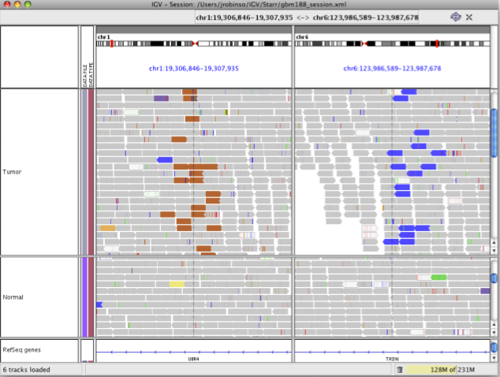
Rearrangement
CHR 1
CHR 6
TUMOR
NORMAL
Notes:
Here is an example os a translocation between chr 1 and 6.

Slide 37
Rearrangement
CHR 1
CHR 6
TUMOR
NORMAL
Color indicates mate is
on chromosome 6
Notes:
Brown is the color code for chr6 so we know the partners of these reads reside on that chromosome, and vice versa.

Slide 38
Interpreting Read-Pair Orientations
Orientation of paired reads can reveal structural events:
Inversions
Duplications
Translocations
Complex rearrangements
Orientation is defined in terms of
read strand, left vs right, and
read order, first vs second
Notes:
And finally, we can use read pair orientation to identify inversions, duplications, translocations, and even more complex rearrangements.

Slide 39
Inversion
Reference genome
Notes:
Let’s consider an inversion first.

Slide 40
Inversion
Reference genome
A
B
Notes:
The segment of interest is in its normal orientation in the reference genome (A->B)

Slide 41
Inversion
Reference Genome
A
B
Subject
B
A
Notes:
But in the sequenced subject, the inversion causes B to come before A.

Slide 42
Inversion
Reference Genome
A
B
Subject
B
A
Notes:
Now, when we generate libraries, some of our sequenced fragments will span the breakpoint.

Slide 43
Inversion
Reference Genome
A
B
Subject
B
A
Notes:
And when we align reads to the reference genome, the 1st read aligns to one side of the first breakpoint,

Slide 44
Inversion
Reference Genome
A
B
Subject
B
A
Notes:
And the second read aligns to the other side, and to the opposite strand.

Slide 45
Inversion
Reference Genome
A
B
Subject
B
A
Notes:
Similarly at the other end,

Slide 46
Inversion
Reference Genome
A
B
Subject
B
A
Notes:
One read aligns as expected past the second breakpoint,

Slide 47
Inversion
Reference Genome
A
B
Subject
B
A
Notes:
And its pair aligns on the opposite strand.

Slide 48
Inversion
Reference Genome
A
B
Notes:
So we see this pattern

Slide 49
Inversion
Reference Genome
A
B
Anomaly: expected orientation of pair is inward facing ( )
Notes:
Both breakpoints will have alignments pointing in the same direction instead of inward facing.

Slide 50
Inversion
Reference Genome
A
B
“Left” side pair
Notes:
IGVs color scheme for inversions is teal for read pair corresponding to the breakpoint on the left, and

Slide 51
Inversion
Reference Genome
A
B
“Right” side pair
Notes:
Blue for the reads corresponding to the breakpoint on the right.

Slide 52
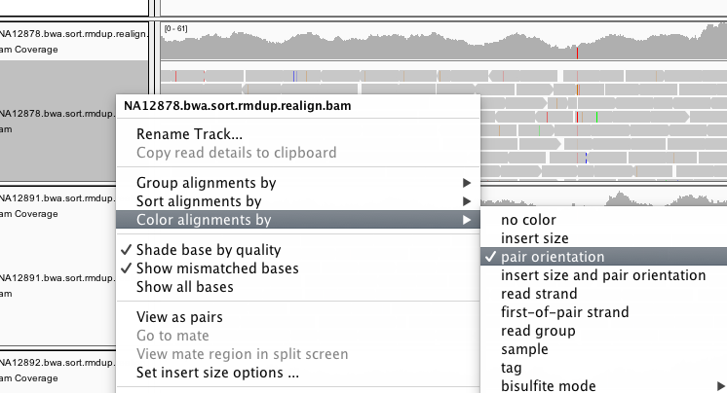
Color by pair orientation
Notes:
We can select Color by Pair orientation to make these anomalies obvious

Slide 53
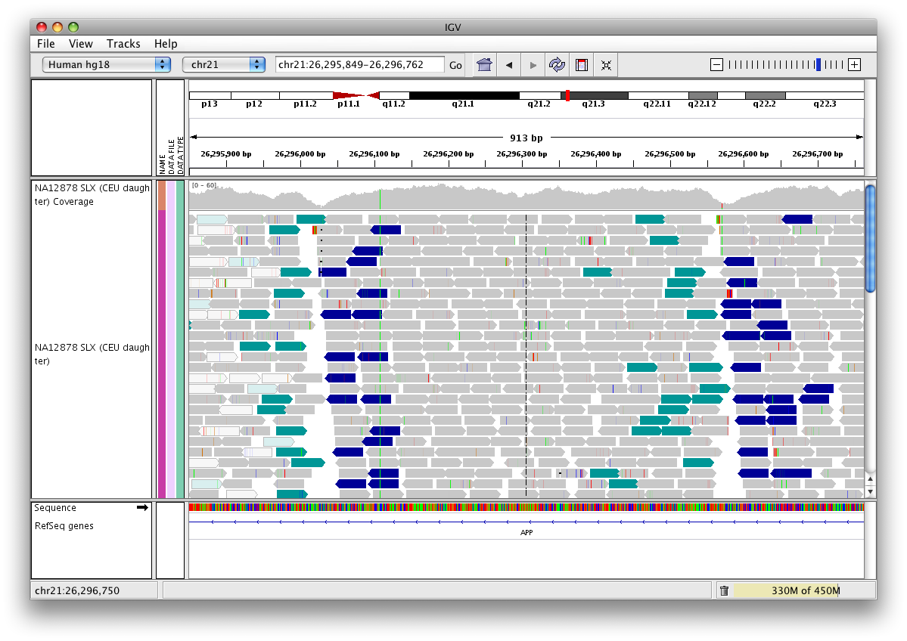
Inversion
Note drop in coverage at breakpoints
Notes:
As shown here.

Slide 54
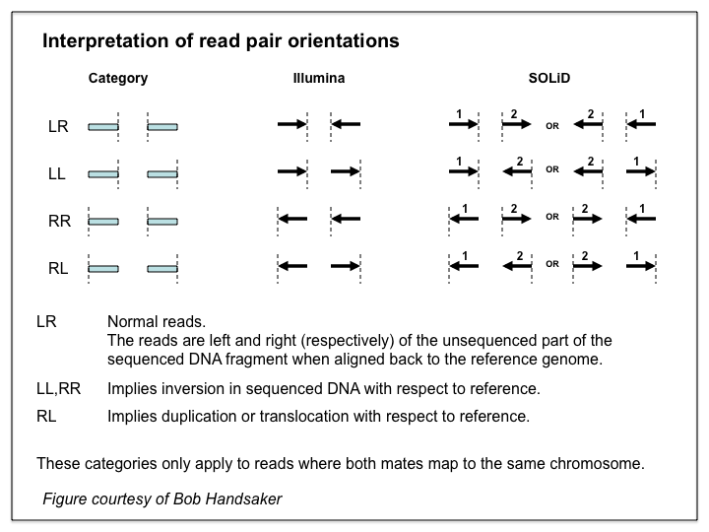
Notes:
A comprehensive chart of the color options for different kinds of mapping anomalies is on the IGV website, and always comes in useful when looking at data.

Slide 55
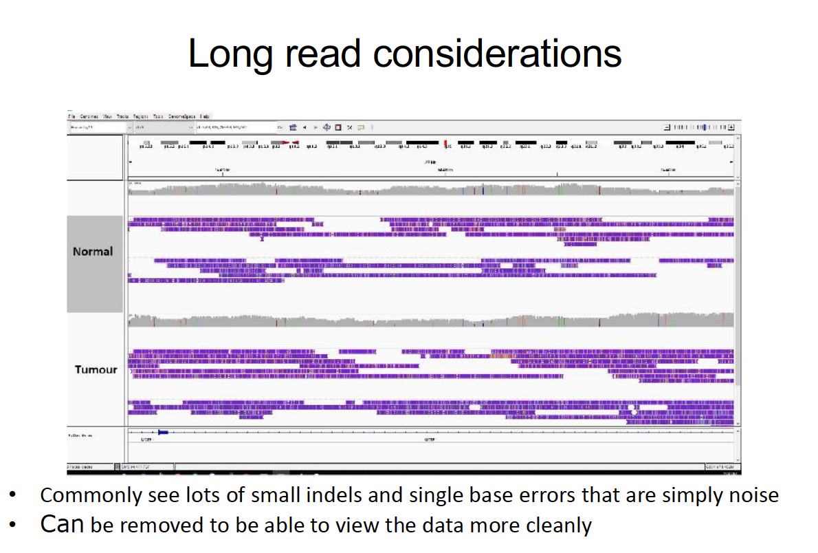

Slide 56
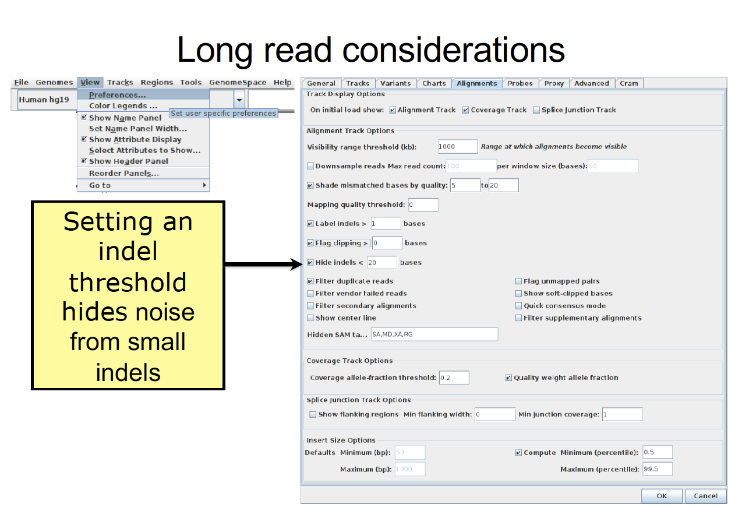

Slide 57
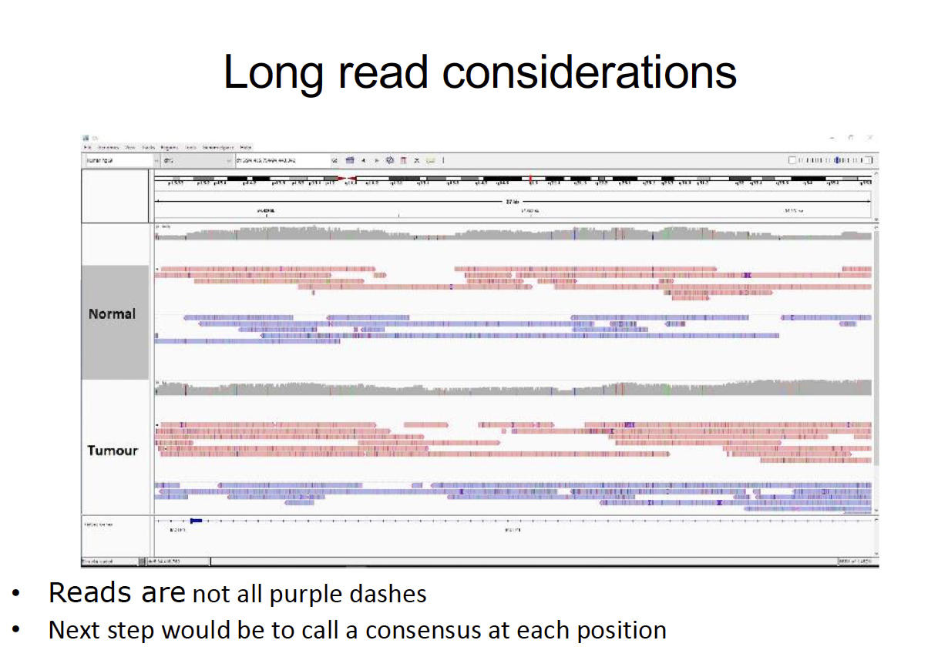

Slide 58
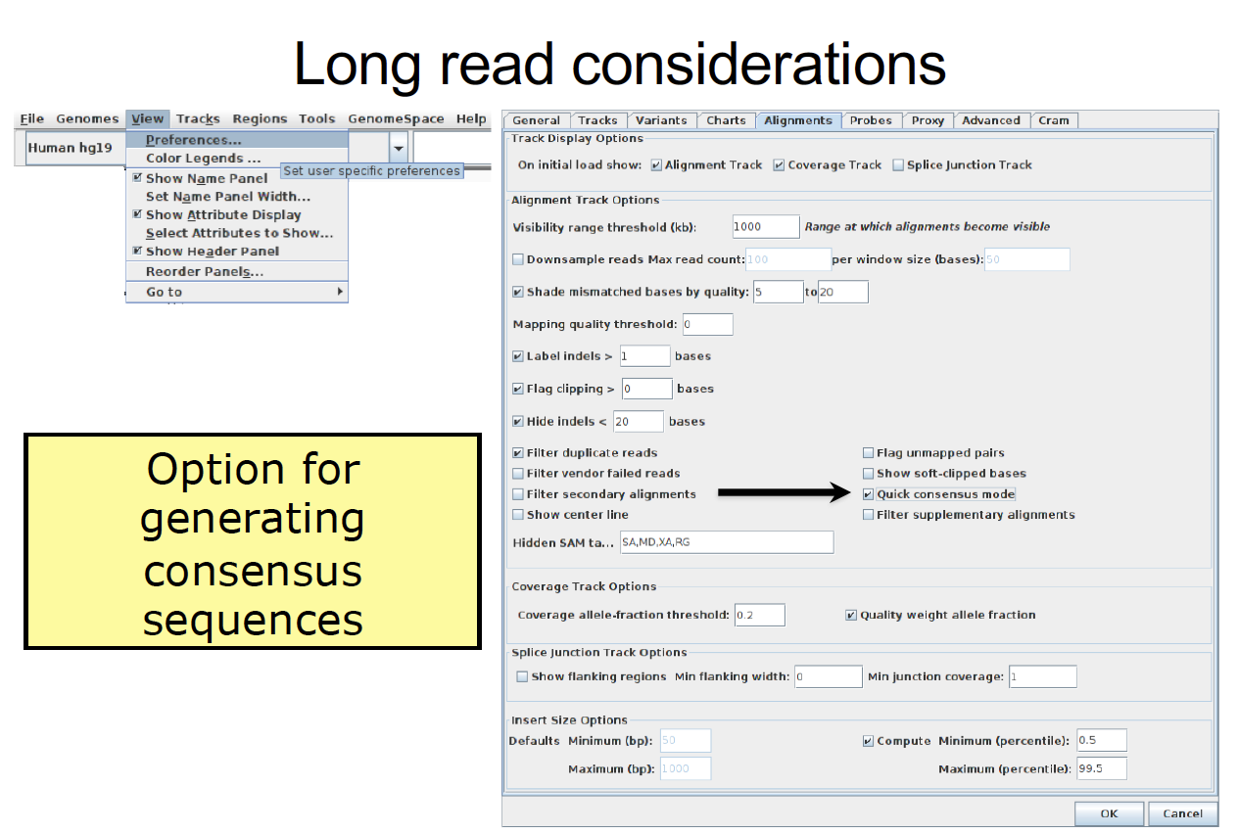

Slide 59
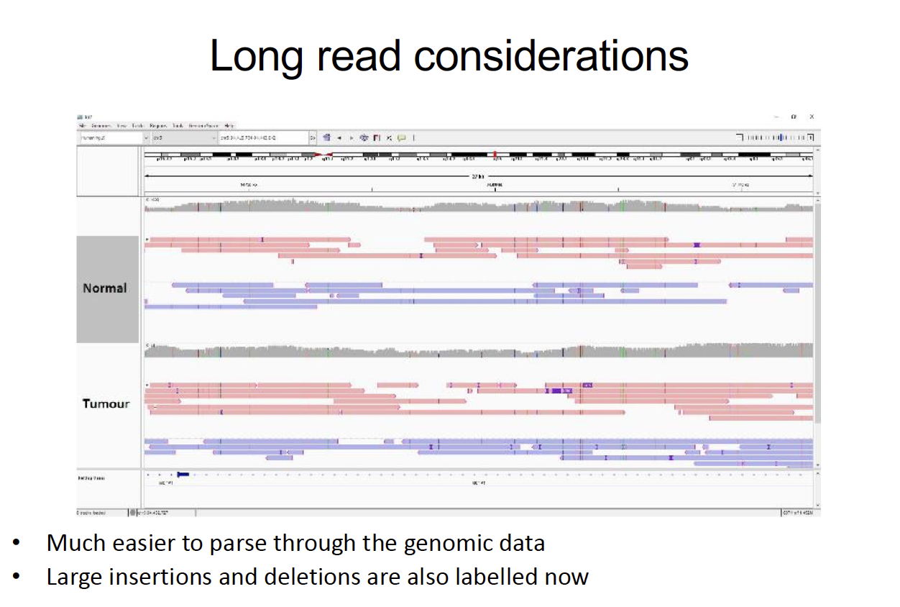

Slide 60
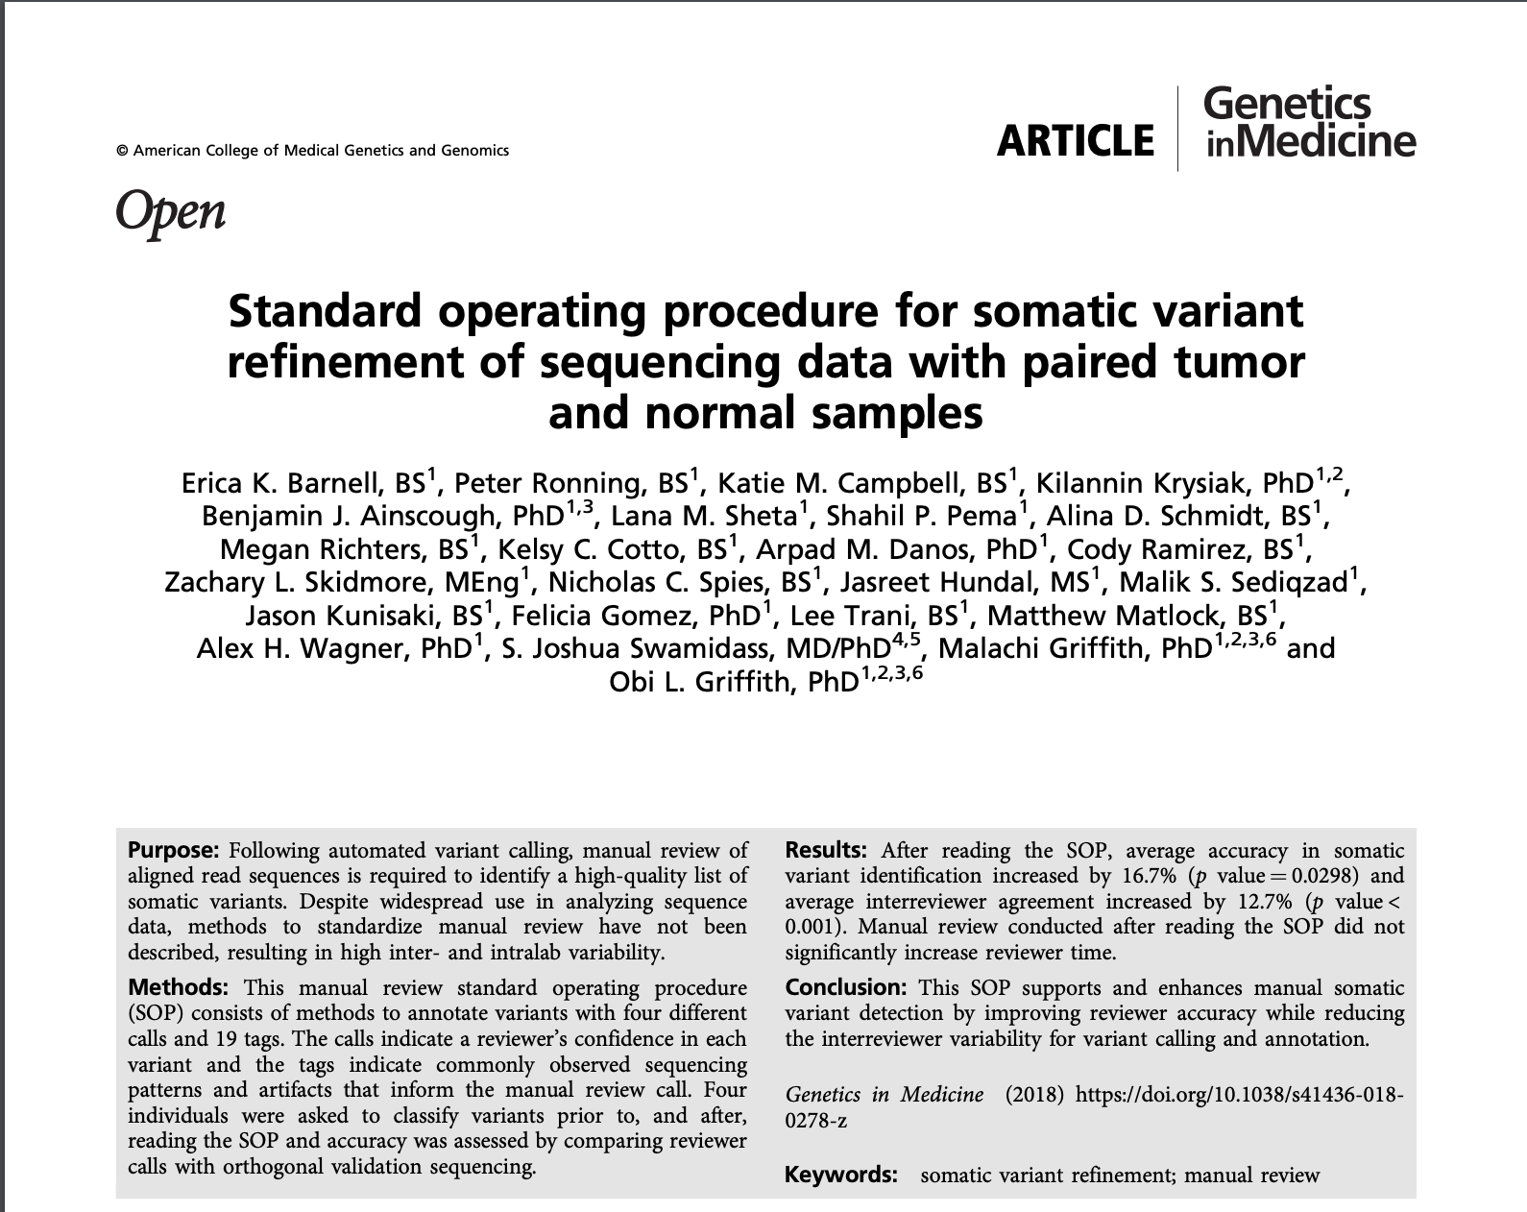
Manual Review Standard Operating Procedure (SOP) paper

Slide 61
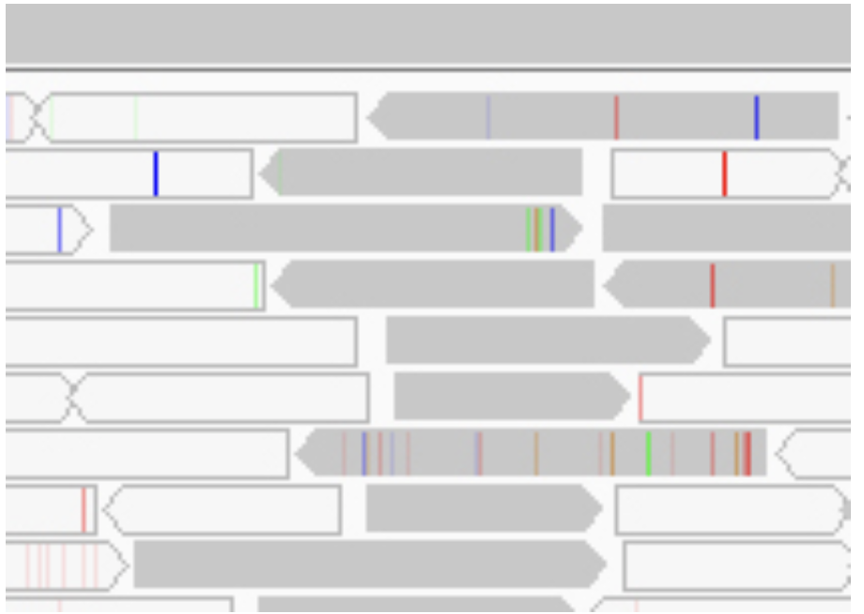
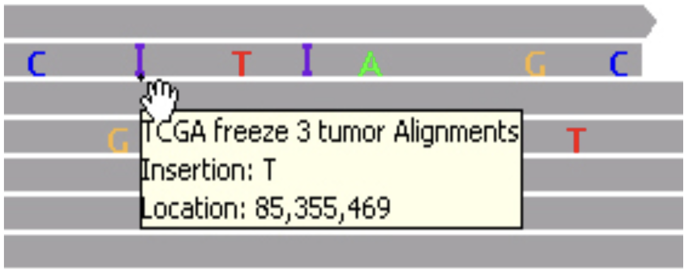
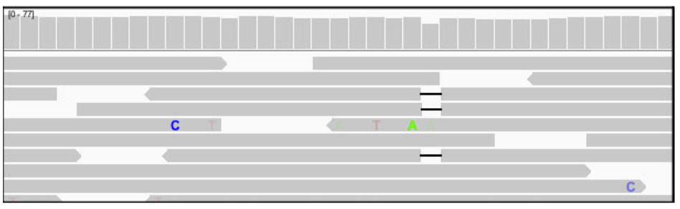
Other notes
Purple
: Insertion
Transparent (White) reads:
Low quality reads/
mapping quality equal to zero
Gapped read/black bar: Deletion
Notes:
Other helpful links for visualization with IGV:
+ https://software.broadinstitute.org/software/igv/AlignmentData
+ https://software.broadinstitute.org/software/igv/interpreting_insert_size ( for Deletion, Insertion, Inter-chromosomal Rearrangement)
+ https://software.broadinstitute.org/software/igv/interpreting_pair_orientations (for Inversion, Inverted Duplication, Tandem Duplication)

Slide 62




We are on a Coffee Break & Networking Session
Workshop Sponsors:

